Slide 1
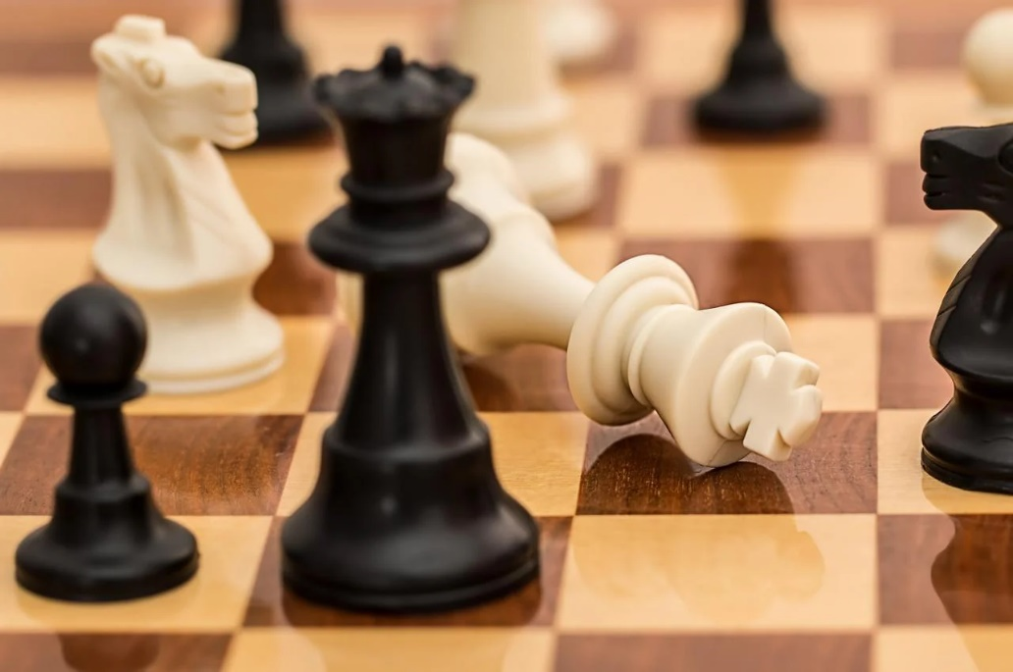
Checkmate with Prepositions
Notes:
Notes for Teacher - < Information for further reference or explanation >
Suggestions: <Ideas/ Images/ Animations / Others – To make better representation of the content >
Source of Multimedia used in this slide - <Please provide source URL where we find the image and the license agreement>
<checkmate> <https://pixabay.com/photos/checkmate-chess-board-chess-board-1511866/>

Slide 2
Puzzle
Down
1. The boy hid __ the table.
3. Nina goes to school __ her friend.
5. The dog was running __ the cat.
9. The cat jumped __ the fence.
10. The book is __ insects.
1
U
P
2
I
N
3
W
4
D
U
R
I
N
G
5
A
E
T
F
O
R
H
Across
1. It is difficult to walk ____ the hill.
2. Suma kept the pen ___ the bag.
4. We like to eat ice-cream ___ the
summer season.
6. Mother bought a new dress ___ me.
7. Where do you sit __ lunch time?
8. He went __ the road to buy fruits.
11. The farmer’s house was __ the river.
6
7
A
T
E
9
10
8
A
C
R
O
S
S
A
V
11
B
E
S
I
D
E
O
R
U
T
Notes:
Notes for Teacher - < Information for further reference or explanation >
Suggestions: <Ideas/ Images/ Animations / Others – To make better representation of the content >
Source of Multimedia used in this slide - <Please provide source URL where we find the image and the license agreement>

Slide 3
MM INDEX
Slide # | Thumbnail | Source link and Attribution
1 |  | <checkmate> <https://pixabay.com/photos/checkmate-chess-board-chess-board-1511866/>
Notes:
Notes for Teacher - < Information for further reference or explanation >
Suggestions: <Ideas/ Images/ Animations / Others – To make better representation of the content >
Source of Multimedia used in this slide - <Please provide source URL where we find the image and the license agreement>

