Slide 1
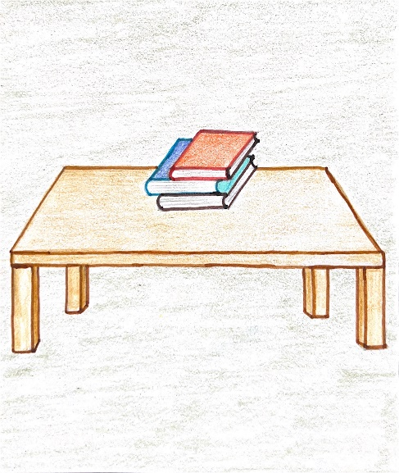
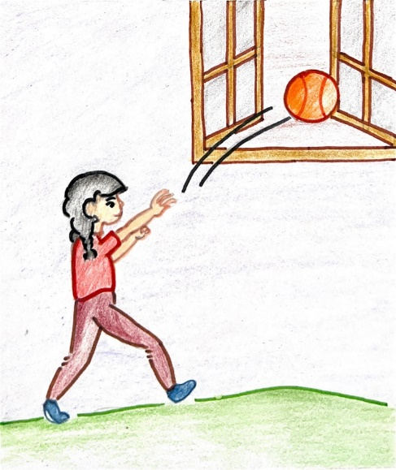
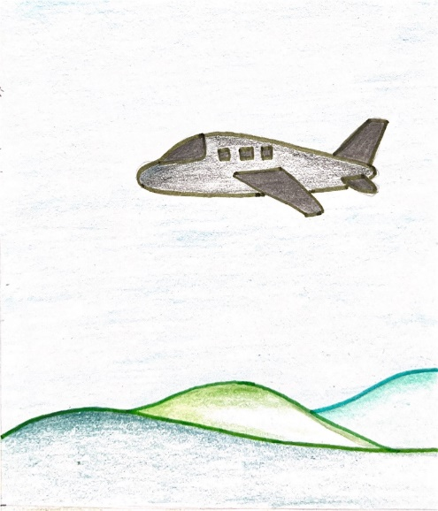
Summary Prepositions Level 2
Notes:
Notes for Teacher – N/A
Suggestions: N/A
Source of Multimedia used in this slide - <Please provide source URL where we find the image and the license agreement>
Aeroplane: https://drive.google.com/drive/folders/1ctViPTyCAuHD0QRXe3fW-WpSubI6WstH
Basketball: https://drive.google.com/drive/folders/1CWLPk-BEA4bUNAAHyiIRxjza3n-44Jo1
Books: https://drive.google.com/drive/folders/1AM_sdladRZpz6OT2xBU-HJOp9yS4qCNw

Slide 2
What is Preposition?
Preposition
A word or a group of words that shows the relationship between a noun or a pronoun with another word in the sentence
Used before a noun, pronoun or noun phrase
Used before a noun, pronoun or noun phrase.
Adds extra information to sentences such as place, time, movement
Notes:
Notes for Teacher – N/A
Suggestions: N/A
Source of Multimedia used in this slide - N/A

Slide 3
Types of Prepositions
Prepositions
Prepositions of Time
Prepositions of Place
Indicate when something happens.
Generally answer the question ‘When?’.
Generally answer the question ‘Where is?’.
Indicate position.
Prepositions of Movement
Indicate direction or destination of movement
Generally answer the question ‘Where?’.
Notes:
Notes for Teacher – N/A
Suggestions: N/A
Source of Multimedia used in this slide - N/A

Slide 4
MM INDEX
Slide # | Thumbnail | Source link and Attribution
1 |  | Aeroplane: https://drive.google.com/drive/folders/1ctViPTyCAuHD0QRXe3fW-WpSubI6WstH Basketball: https://drive.google.com/drive/folders/1CWLPk-BEA4bUNAAHyiIRxjza3n-44Jo1 Books: https://drive.google.com/drive/folders/1AM_sdladRZpz6OT2xBU-HJOp9yS4qCNw
Notes:
Notes for Teacher – N/A
Suggestions: N/A
Source of Multimedia used in this slide - N/A

