Slide 1
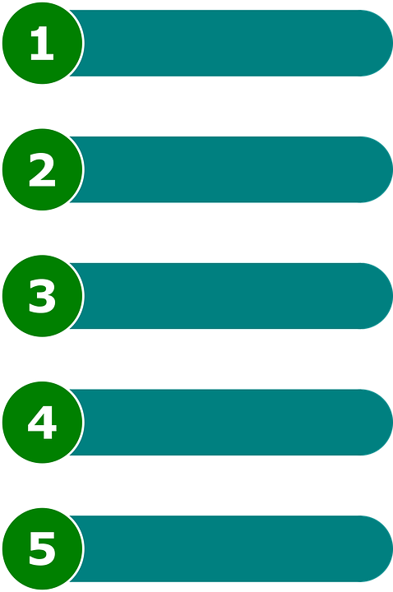
Sentences in Order
Notes:
Notes for Teacher - < Information for further reference or explanation >
Suggestions: <Ideas/ Images/ Animations / Others – To make better representation of the content >
Source of Multimedia used in this slide -
https://pixabay.com/vectors/steps-list-ordered-list-items-1496523/

Slide 2
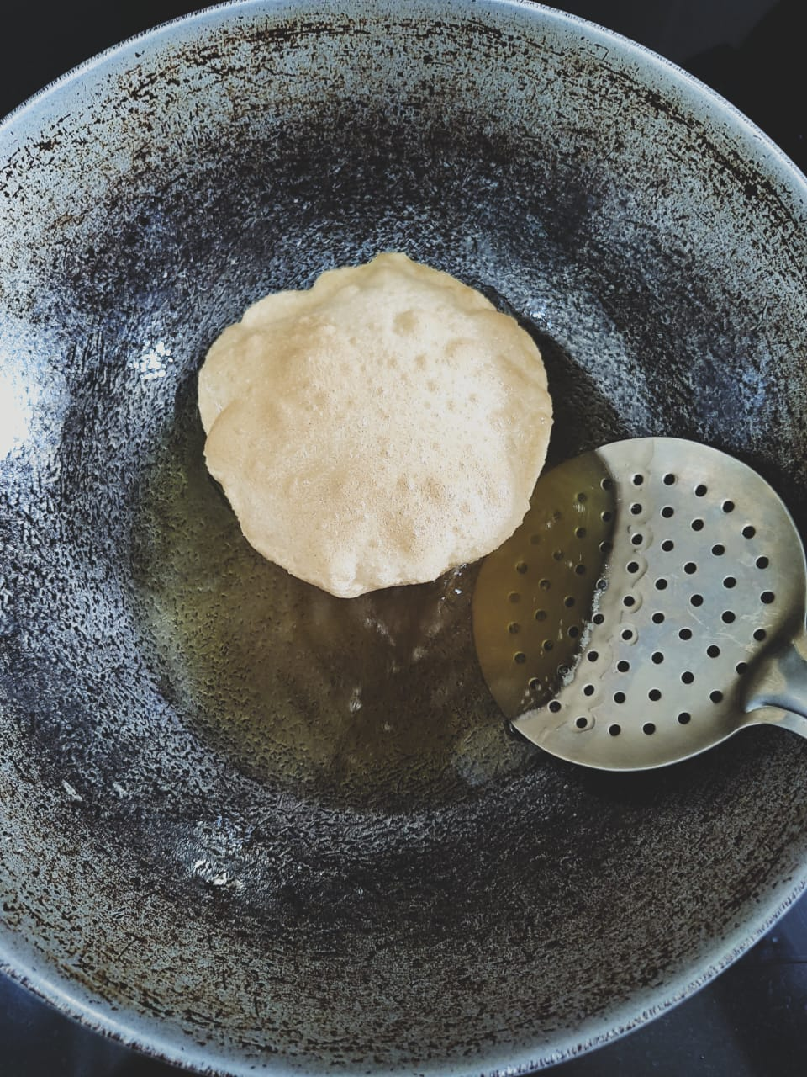
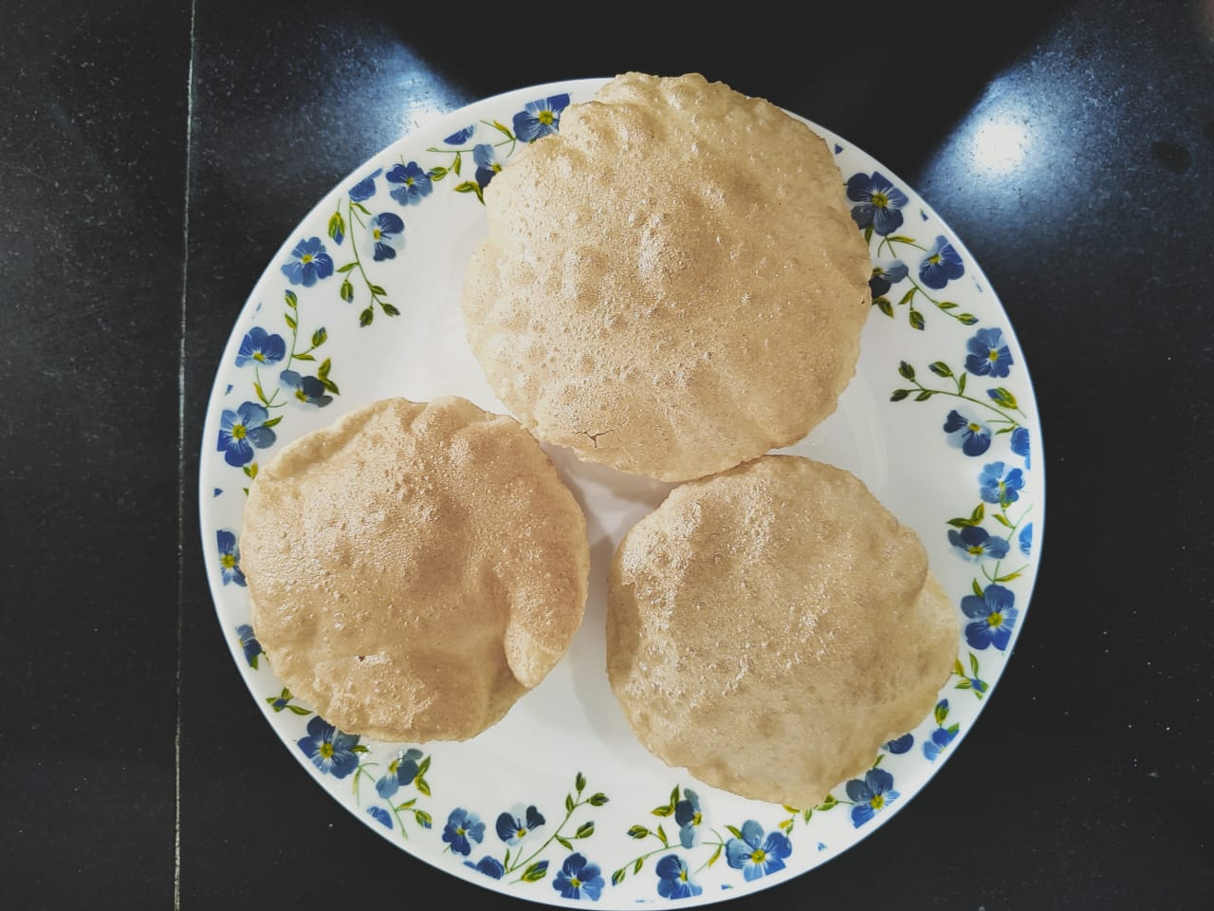
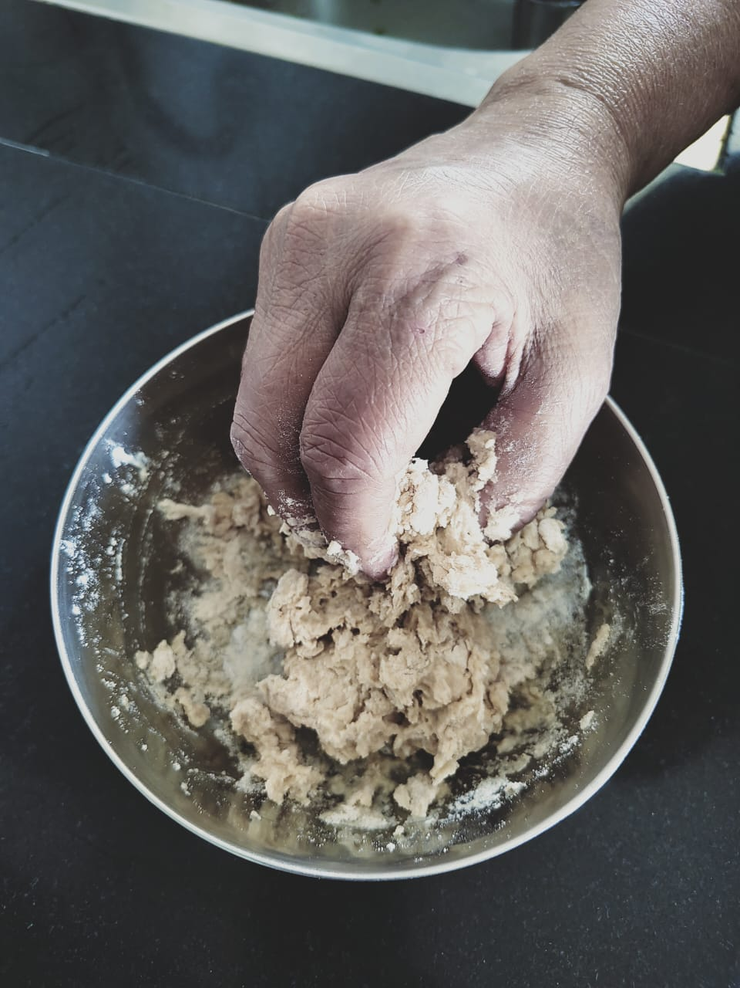
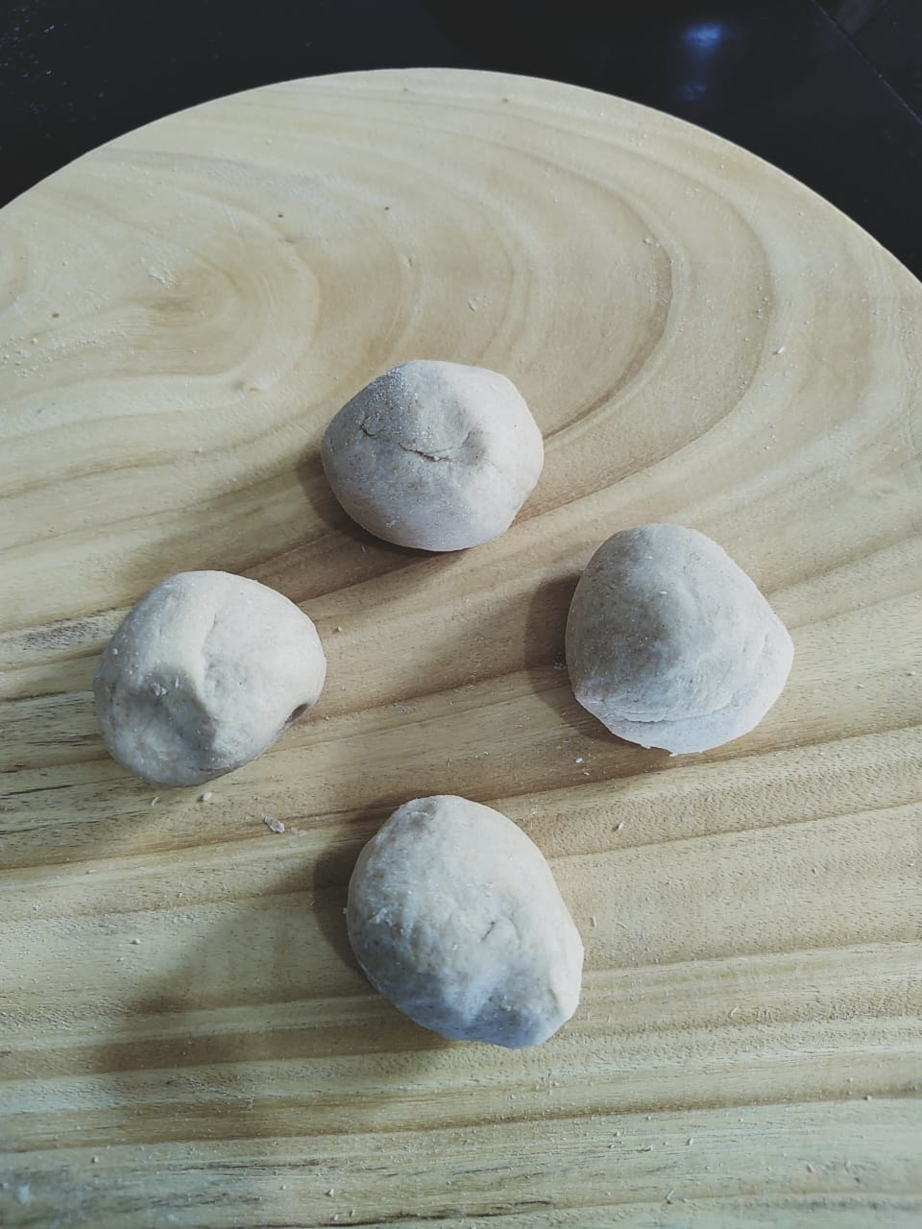
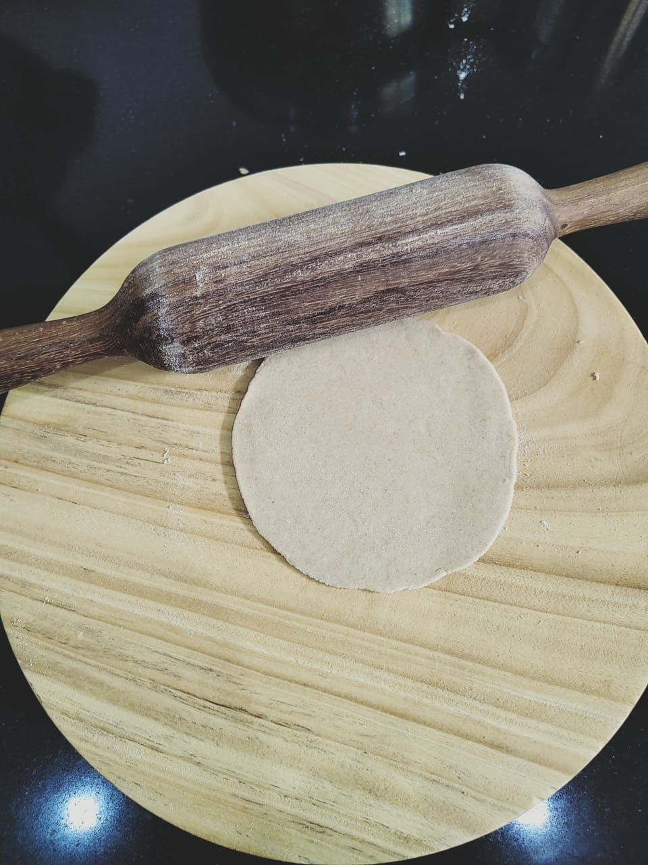
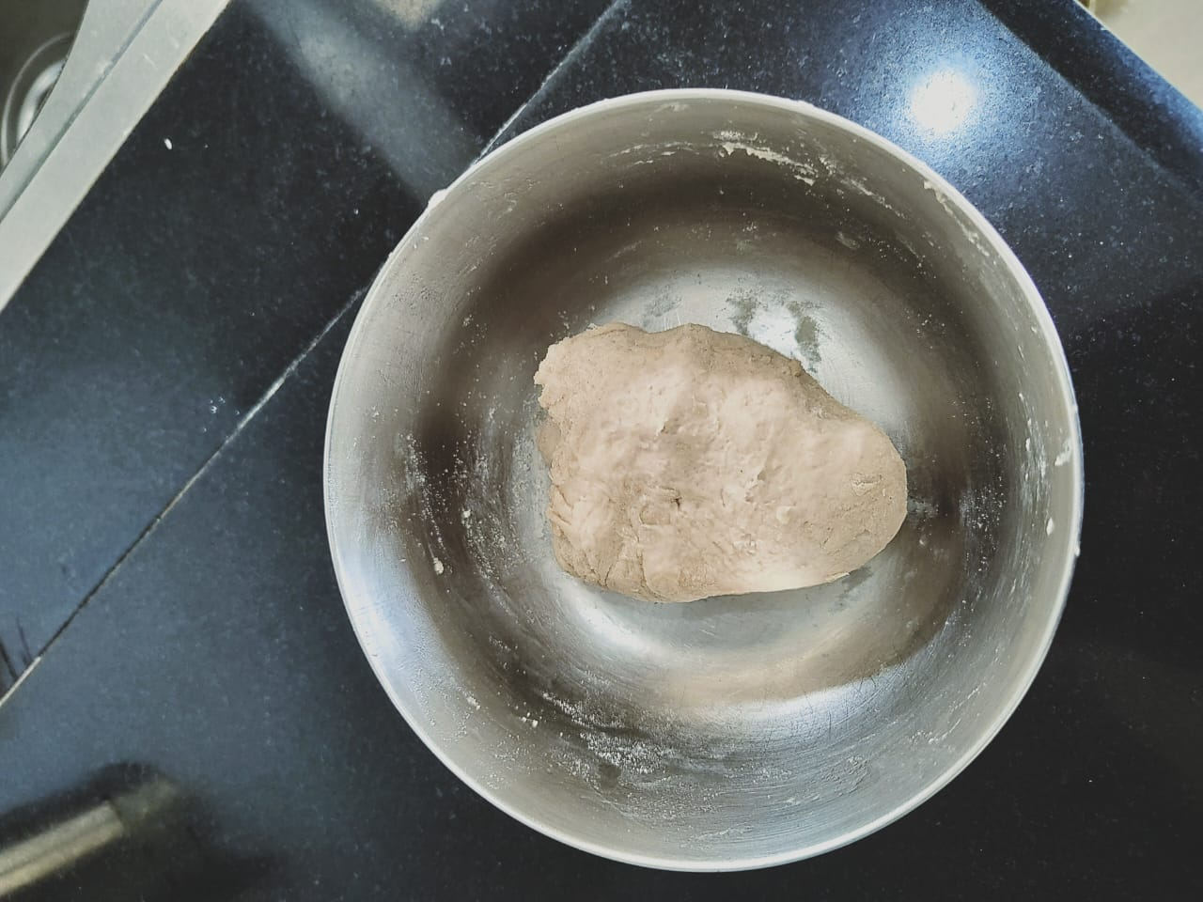
Making Of Puris
Rolled puris are fried in oil and are ready to be eaten.
It is easy to make puris.
Wheat flour is taken in a bowl.
Small balls of dough are rolled into puris.
Then it is kneaded into a soft dough with water.
Notes:
Notes for Teacher - < Information for further reference or explanation >
The teacher could write the sentences on the board /use the PPT. Allow the students to read the sentences.
Suggestions: <Ideas/ Images/ Animations / Others – To make better representation of the content >
Source of Multimedia used in this slide - <Please provide source URL where we find the image and the license agreement>
Self created – Output link - https://drive.google.com/drive/folders/1Pj2TOadf_g3vtLoxfnjmFyWXXpyKvcts
Self created – Output link - https://drive.google.com/drive/folders/1wrZuNRyTZYNb3VElDRwsWjO2p7x0bMW3

Slide 3
Let’s answer the following
1
Did you understand how puris are made?
No, we did not understand.
2
What do you think is wrong with the information?
The sentences are not in the sequence they are made.
3
What do you think we could do to make it right?
Rearrange the sentences.
Click on the questions for expected answers
Notes:
Notes for Teacher - < Information for further reference or explanation >
After the sentences are read the following questions could be posed to them. Suggestions: <Ideas/ Images/ Animations / Others – To make better representation of the content >
Source of Multimedia used in this slide - <Please provide source URL where we find the image and the license agreement>

Slide 4
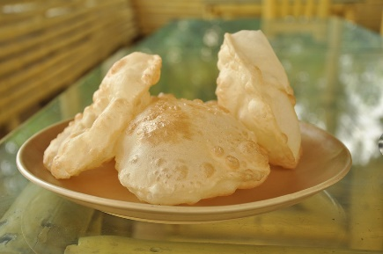
Making Of Puris
It is easy to make puris.
Wheat flour is taken in a bowl.
Then it is kneaded into a soft dough with water.
Small balls of dough are rolled into puris.
The rolled puris are fried in oil and are ready to be eaten.
Notes:
Notes for Teacher - < Information for further reference or explanation >
The teacher could write the sentences on the board /use the PPT. Allow the students to read the sentences.
Suggestions: <Ideas/ Images/ Animations / Others – To make better representation of the content >
Source of Multimedia used in this slide - <Please provide source URL where we find the image and the license agreement>
Self created – Output link - https://drive.google.com/drive/folders/1Pj2TOadf_g3vtLoxfnjmFyWXXpyKvcts
Self created – Output link - https://drive.google.com/drive/folders/1wrZuNRyTZYNb3VElDRwsWjO2p7x0bMW3
Puri - https://pixabay.com/photos/puris-indian-food-fried-390537/

Slide 5
Let’s answer the following
4
How did you now understand, how puris are made?
The sentences are in order and easy to understand.
Do you think it is important to write sentences in order to convey information effectively?
5
Yes
Click on the questions for expected answers
Notes:
Notes for Teacher - < Information for further reference or explanation >
After the sentences are read the following questions could be posed to them. Suggestions: <Ideas/ Images/ Animations / Others – To make better representation of the content >
Source of Multimedia used in this slide - <Please provide source URL where we find the image and the license agreement>

Slide 6
MM Index
Slide # | Thumbnail | Source link and Attribution
1 |  | https://pixabay.com/vectors/steps-list-ordered-list-items-1496523/
2 , 4 |  | Self created – Output link - https://drive.google.com/drive/folders/1Pj2TOadf_g3vtLoxfnjmFyWXXpyKvcts
2,4 |  | Self created – Output link - https://drive.google.com/drive/folders/1wrZuNRyTZYNb3VElDRwsWjO2p7x0bMW3
4 |  | Puri - https://pixabay.com/photos/puris-indian-food-fried-390537/
Notes:
Notes for Teacher - < Information for further reference or explanation >
Suggestions: <Ideas/ Images/ Animations / Others – To make better representation of the content >
Source of Multimedia used in this slide - <Please provide source URL where we find the image and the license agreement>

