Slide 1
Knowing Paragraph Writing
Notes:
Notes for Teacher - < Information for further reference or explanation >
Suggestions: <Ideas/ Images/ Animations / Others – To make better representation of the content >
Source of Multimedia used in this slide - <Please provide source URL where we find the image and the license agreement>

Slide 2
A Paragraph always:
Focuses on a single idea.
1.
Has a number of sentences in it.
2.
Follows a logical order.
3.
Notes:
Notes to the teacher: The teacher may use the picture clues and the help box to develop a paragraph. The paragraph may be written on the board with proper punctuation marks.
Suggestions: <Ideas/ Images/ Animations / Others – To make better representation of the content >
Source of Multimedia used in this slide - <Please provide source URL where we find the image and the license agreement>

Slide 3
Order of Paragraph Writing
Begin with a topic
Write Supporting sentences
Concluding sentence
Consistent flow
Notes:
Notes for Teacher - To help develop a paragraph in class the teacher may use the picture clues along with the help box, keeping in mind the above mentioned points.
Raju – eight years old – loves pets, especially dogs – Leo – feed – bath – play – walk – happy – good care
Suggestions: <Ideas/ Images/ Animations / Others – To make better representation of the content >
Source of Multimedia used in this slide - <Please provide source URL where we find the image and the license agreement>

Slide 4
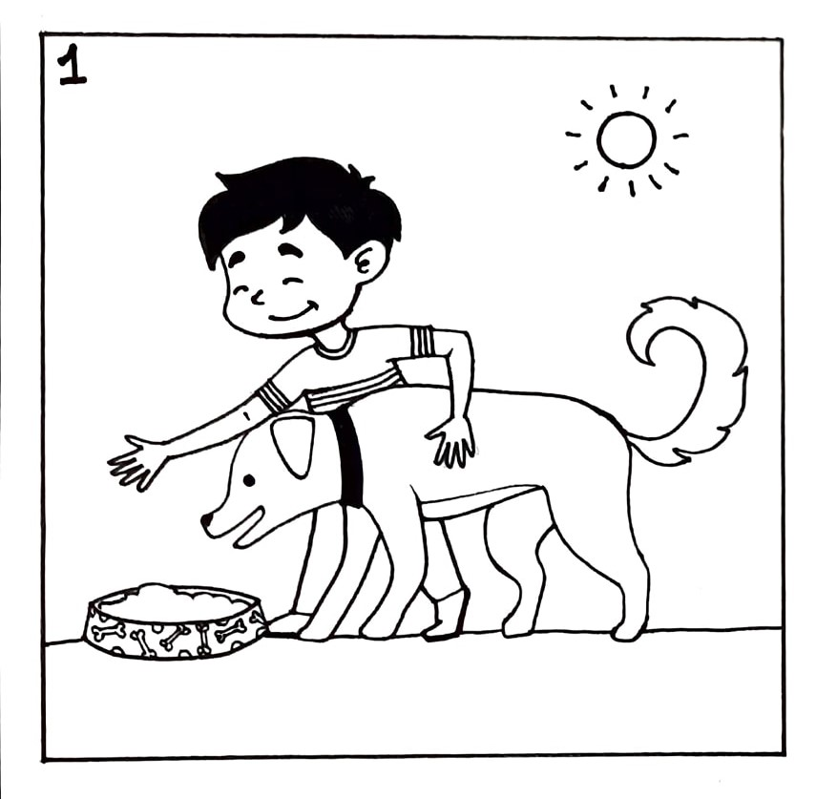
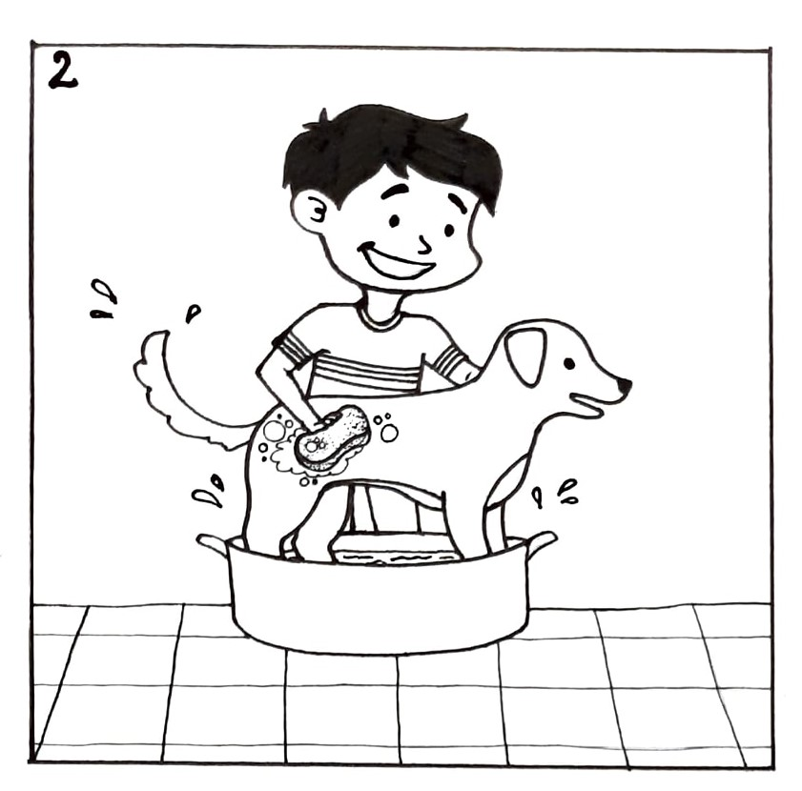
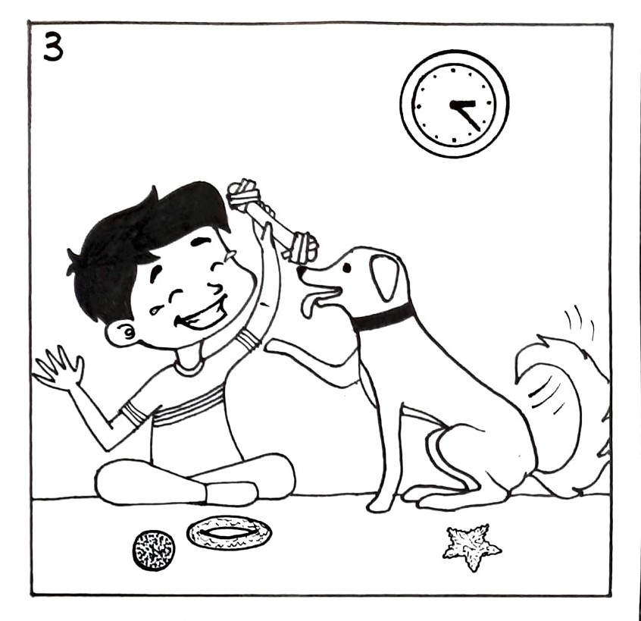
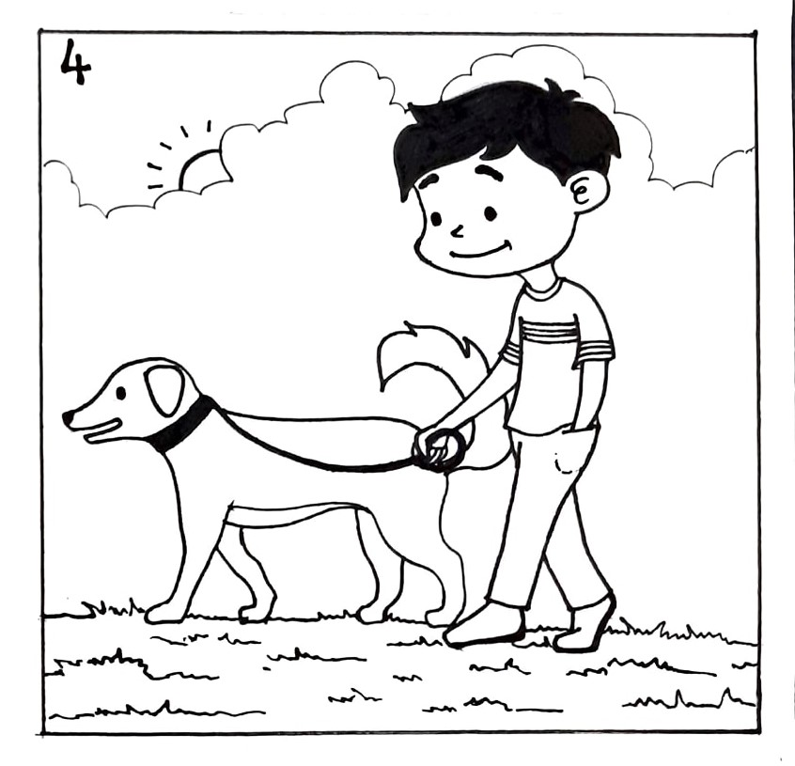
Raju and His Pet Leo
Raju – eight years old – loves pets, especially dogs – Leo – feed – bath – play – walk – happy – good care
Notes:
Notes for Teacher - To help develop a paragraph in class the teacher may use the picture clues along with the help box, keeping in mind the above mentioned points.
Raju – eight years old – loves pets, especially dogs – Leo – feed – bath – play – walk – happy – good care
Suggestions: <Ideas/ Images/ Animations / Others – To make better representation of the content >
Source of Multimedia used in this slide - <Please provide source URL where we find the image and the license agreement>
Self Created Output drive - https://drive.google.com/drive/folders/16RLzryWQoYvruPsIiYQ3hahk47CN_KPr

Slide 5
Raju and his pet Leo
Raju is eight years old. He loves pets, especially dogs. He has a pet dog named Leo. Everyday in the morning Raju feeds Leo. Once he is back from school, he gives Leo a bath to help it remain clean. Raju spends a lot of time playing with Leo. In the evenings, he takes it for a walk to make sure it gets enough exercise. He takes good care of Leo. Leo is happy too, to be a pet to such a caring boy.
A sample paragraph
Notes:
Notes for Teacher - < Information for further reference or explanation >
Suggestions: <Ideas/ Images/ Animations / Others – To make better representation of the content >
Source of Multimedia used in this slide - <Please provide source URL where we find the image and the license agreement>

Slide 6
MM INDEX
Slide # | Thumbnail | Source link and Attribution
4 |  | Self created – Output drive - https://drive.google.com/drive/folders/16RLzryWQoYvruPsIiYQ3hahk47CN_KPr
Notes:
Notes for Teacher - < Information for further reference or explanation >
Suggestions: <Ideas/ Images/ Animations / Others – To make better representation of the content >
Source of Multimedia used in this slide - <Please provide source URL where we find the image and the license agreement>

