Slide 1
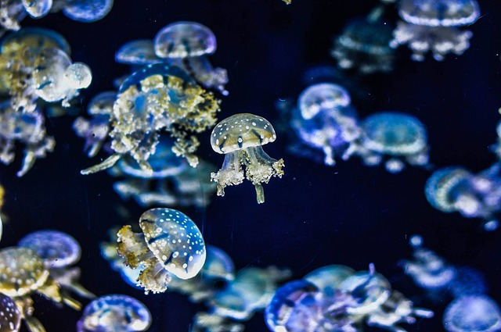
Jellyfish Facts
Notes:
Notes for Teacher - < Information for further reference or explanation >
Suggestions: <Ideas/ Images/ Animations / Others – To make better representation of the content >
Source of Multimedia used in this slide - <Please provide source URL where we find the image and the license agreement>

Slide 2
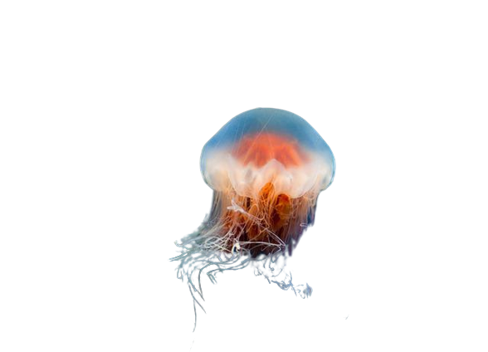
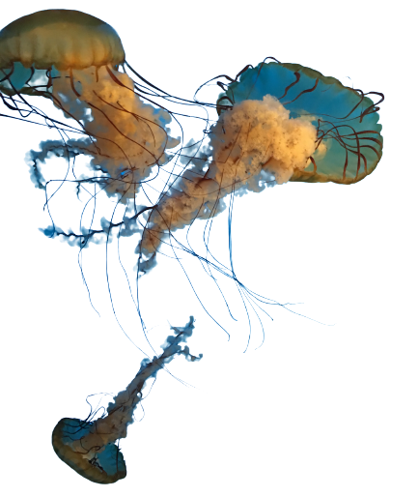
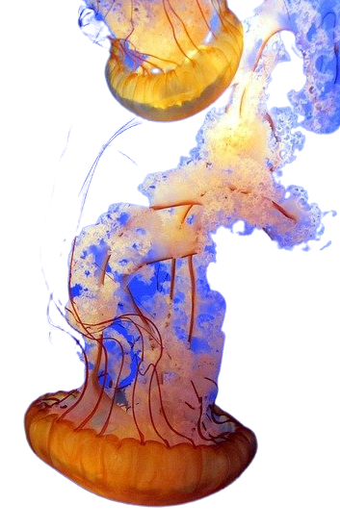
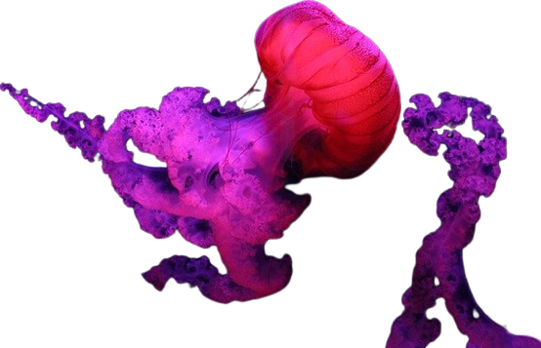
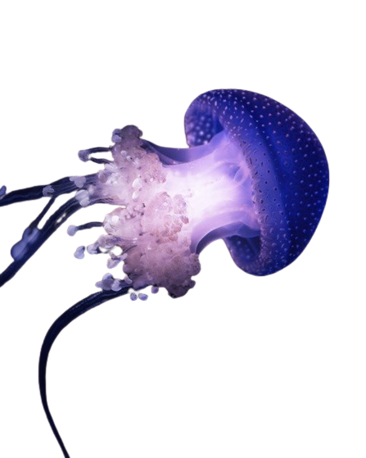
Jellyfish - Let’s Read
Jellyfish are free swimming sea animals with umbrella-shaped bells and trailing tentacles. They are found in oceans all over the world. They have no brain, heart, bones or eyes. They are made up of a smooth, bag-like body and tentacles armed with tiny, stinging cells. The jellyfish’s mouth is found in the centre of its body. On an average, jellyfish live anywhere from 1-3 years. Some jellyfish are colourless, but others are in vibrant colours of pink, yellow, blue and purple.
Notes:
Notes for Teacher - < Information for further reference or explanation >
Suggestions: <Ideas/ Images/ Animations / Others – To make better representation of the content >
Source of Multimedia used in this slide - <Please provide source URL where we find the image and the license agreement>

Slide 3
Jellyfish Facts
Let’s watch and enjoy:
https://pixabay.com/videos/jellyfish-sea-under-water-ocean-33995/
https://pixabay.com/videos/aquarium-jellyfish-underwater-fish-32138/
Notes:
Notes for Teacher - < Information for further reference or explanation >
Suggestions: <Ideas/ Images/ Animations / Others – To make better representation of the content >
Source of Multimedia used in this slide - <Please provide source URL where we find the image and the license agreement>
Camera – PPT Icon

Slide 4
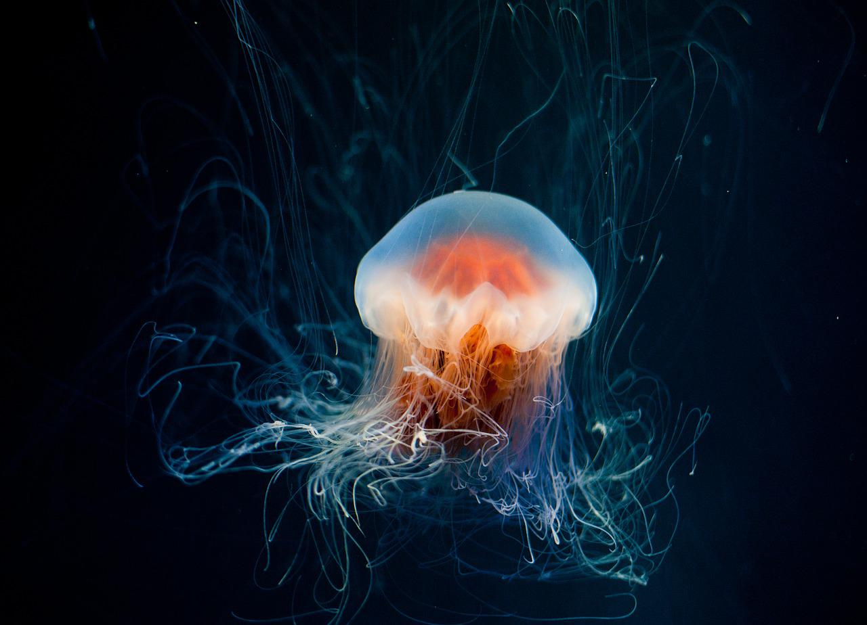
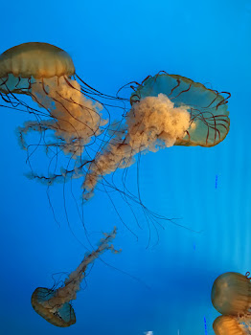
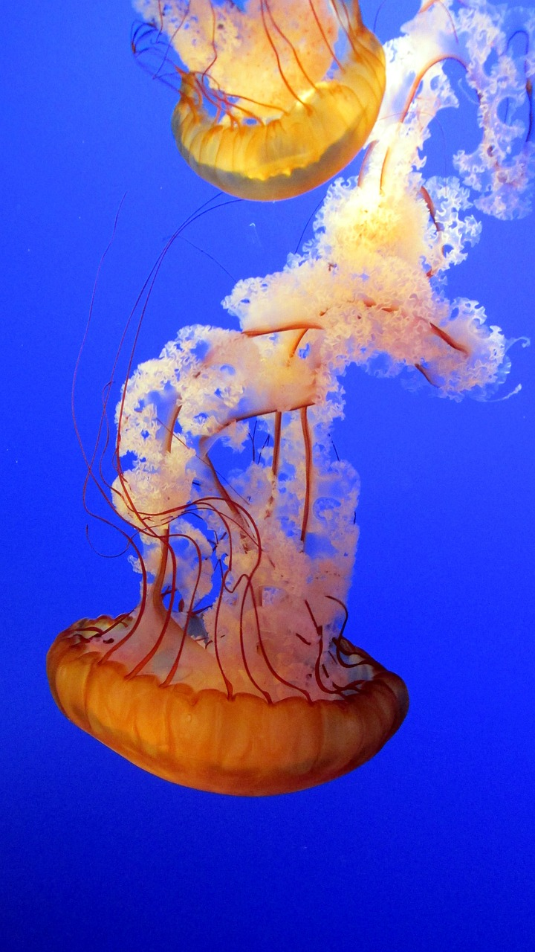
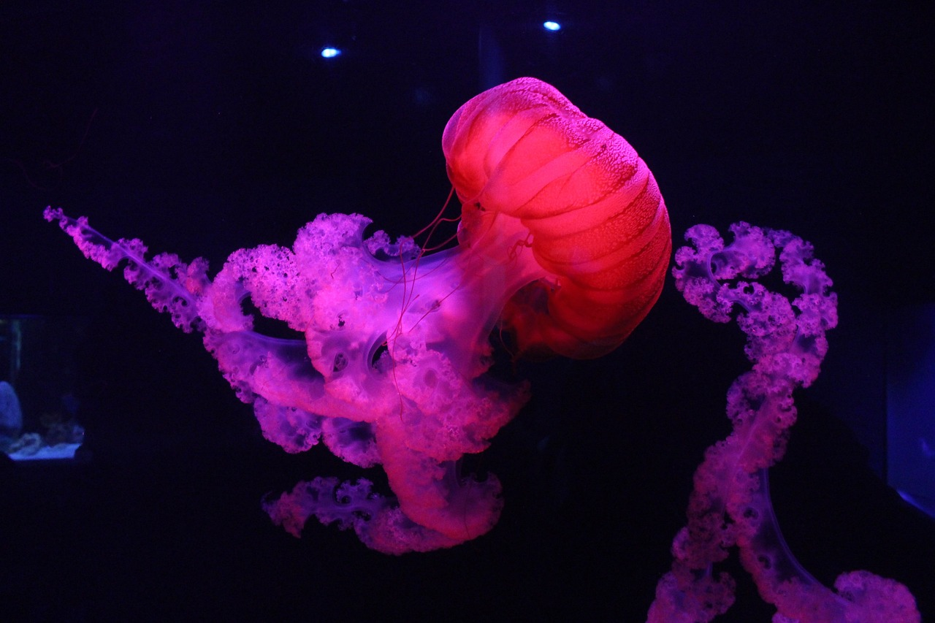
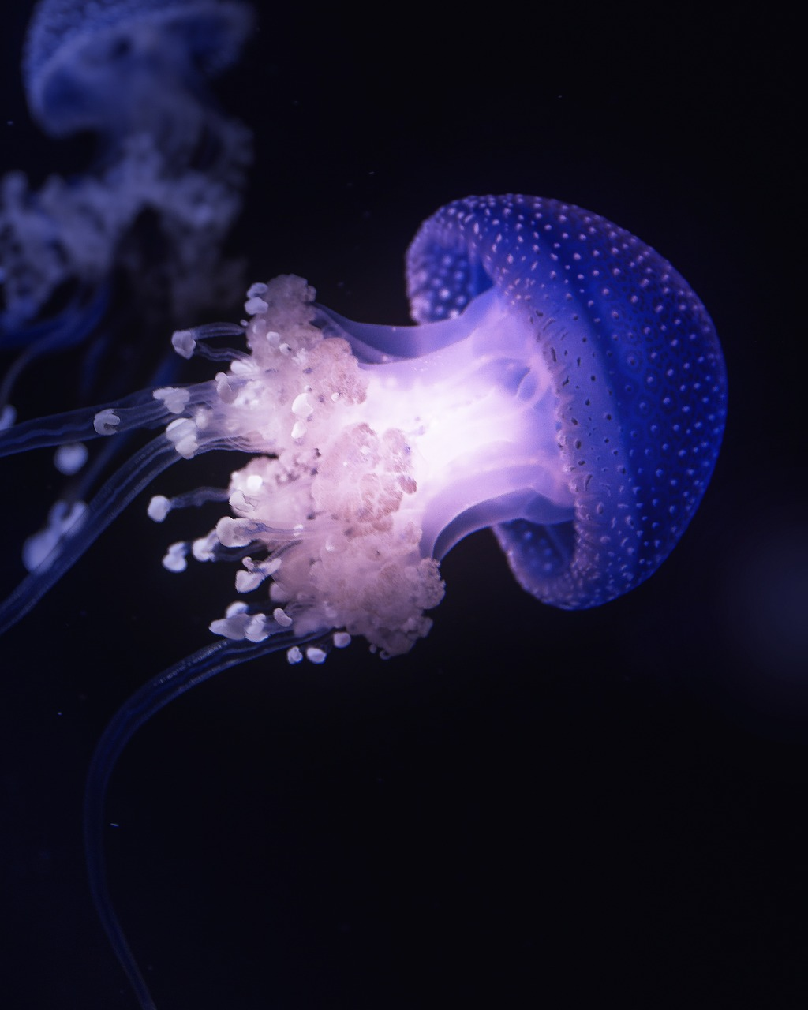
MM Index
Slide # | Thumbnail | Source link and Attribution
1 |  | https://pixabay.com/photos/jellyfish-aquarium-tropical-fish-1288749/ Attribution - Joseph82
2 |  | https://pixabay.com/photos/jellyfish-underwater-ocean-aquarium-6653502/ Attribution EddieKphoto https://pixabay.com/photos/jellyfish-animals-underwater-381659/ Attribution - Klawson SSSVV Gallery – Search word Jelly fish
3 |  | https://pixabay.com/photos/jellyfish-animal-underwater-1867355/ attribution Pexels https://pixabay.com/photos/jellyfish-tentacles-animal-6222849/ attribution - philippbrack76
3 | Video Link | https://pixabay.com/videos/jellyfish-sea-under-water-ocean-33995/ -----ikealol https://pixabay.com/videos/aquarium-jellyfish-underwater-fish-32138/ Attribution caelan
Notes:
Notes for Teacher - < Information for further reference or explanation >
Suggestions: <Ideas/ Images/ Animations / Others – To make better representation of the content >
Source of Multimedia used in this slide - <Please provide source URL where we find the image and the license agreement>

