Slide 1
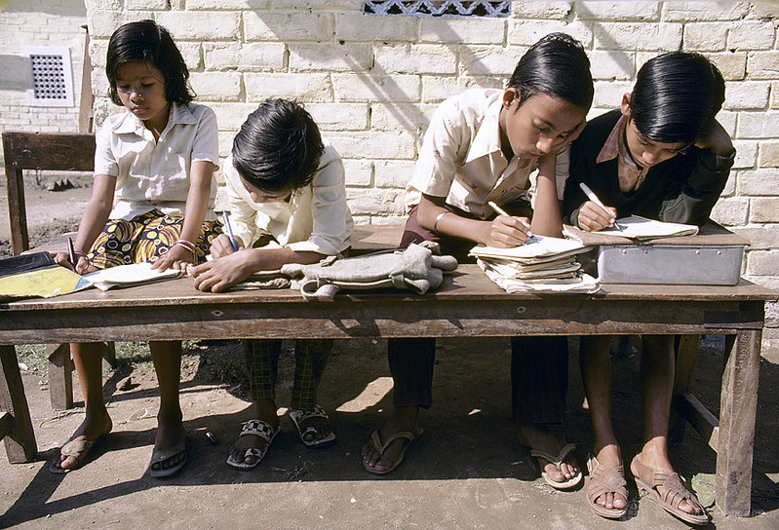
Paragraph Writing is Fun
Notes:
Notes for Teacher - < Information for further reference or explanation >
Suggestions: <Ideas/ Images/ Animations / Others – To make better representation of the content >
Source of Multimedia used in this slide -
Students: https://www.flickr.com/photos/10816734@N03/2183733660 By World Bank Photo Collection

Slide 2
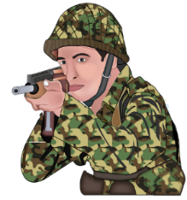
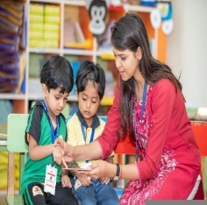
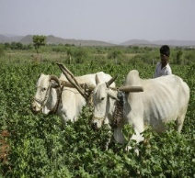
When I Grow Up I want to be ….
Nurse I love to help the sick and the old get better. | Pilot I can fly planes and help carry people from one place to another quickly. | Lawyer I can help solve people’s different problems. | Policeman I can help maintain law and order; control traffic. | Soldier I can help guard our countrymen and help during difficult times. | Teacher I can help teach children and guide them to think independently.
Farmer I can help by growing good crops for others to stay fit and healthy. | Doctor I can understand people better and treat them well. | Banker I can help make the lives of people easy and comfortable. | Engineer I can help build bridges, dams, buildings, machines for all to use. | Fireman I can be a community helper for all to be safe and happy. | Politician I love to work in such a way that others benefit and we live happily.
Sample answer in the next slide
Notes:
Notes for Teacher – <
Procedure : Divide students in 4 groups based on strength of class. Each group picks up one profession and works on it. Make use of help box to complete their ideas/reasoning. Each group comes up with a paragraph on what they want to be when they grow up and why. After 7 to 8 minutes, the paragraph is written on a sheet of paper with title. Paragraph could be read aloud and displayed in classroom/corridors (Paste the written work on chart paper)
Observation: Students can write a paragraph of about 4 to 5 sentences, describing a given picture. They will also remember to start sentences with capital letters and end with full stops. The formation of groups helps in collaborative learning. Each group expresses what they want to be when they grow up using the words in help box
Follow up activity: Remaining topics to be given as H.W. for each child to work on individually
Precautions: Discipline to be maintained, encouraging interactive discussions to build enthusiasm
Troubleshooting: If any group is not able to organise their thoughts and get started, teacher may prompt them
Instructions to the teacher:
— Explain what paragraph writing is, using the answers of the leading questions.
— Remind the students that every sentence begins with a capital letter and ends with a full stop.
— Encourage everyone to participate and help in collaborative learning.>
Source of Multimedia used in this slide - <
1.https://pixabay.com/illustrations/airline-badge-cap-captain-3021264/mohamed_hassan
2. https://pixabay.com/illustrations/indian-army-soldier-indian-army-army-7280833/Sifar_Art
3. https://pixabay.com/illustrations/judge-lawyer-attorney-barrister-3008038/mohamed_hassan
4. https://pixabay.com/photos/education-classroom-teacher-7047133/Anilsharma26
5. https://pixabay.com/vectors/doctor-man-cartoon-comic-2027768/OpenClipart-Vectors
6. https://pixabay.com/photos/farmer-bullock-cart-india-mohan-5353778/MOHANN
7. https://pixabay.com/illustrations/indian-police-police-law-uniform-4698728/shatadip7

Slide 3
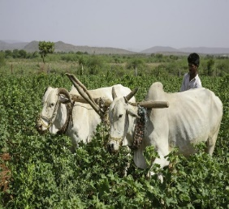
When I Grow Up I want to be a ____ because….
Pilot - I can fly planes and help carry people from one place to another quickly.
Soldier - I can help guard our countrymen and help during difficult times.
Lawyer - I can help solve people’s different problems.
Teacher - I can help teach children and guide them to think independently.
Police - I can help maintain law and order; control traffic.
Doctor - I love to help the sick and old get better.
Farmer - I can help by growing good crops for others to stay fit and healthy.
I love to work in such a way that others benefit and we live happily.
Notes:
Notes for Teacher – <
Procedure : Divide students in 4 groups based on strength of class. Each group picks up one profession and works on it. Make use of help box to complete their ideas/reasoning. Each group comes up with a paragraph on what they want to be when they grow up and why. After 7 to 8 minutes, the paragraph is written on a sheet of paper with title. Paragraph could be read aloud and displayed in classroom/corridors (Paste the written work on chart paper)
Observation: Students can write a paragraph of about 4 to 5 sentences, describing a given picture. They will also remember to start sentences with capital letters and end with full stops. The formation of groups helps in collaborative learning. Each group expresses what they want to be when they grow up using the words in help box
Follow up activity: Remaining topics to be given as H.W. for each child to work on individually
Precautions: Discipline to be maintained, encouraging interactive discussions to build enthusiasm
Troubleshooting: If any group is not able to organise their thoughts and get started, teacher may prompt them
Instructions to the teacher:
— Explain what paragraph writing is, using the answers of the leading questions.
— Remind the students that every sentence begins with a capital letter and ends with a full stop.
— Encourage everyone to participate and help in collaborative learning.>
Source of Multimedia used in this slide - <
1.https://pixabay.com/illustrations/airline-badge-cap-captain-3021264/mohamed_hassan
2. https://pixabay.com/illustrations/indian-army-soldier-indian-army-army-7280833/Sifar_Art
3. https://pixabay.com/illustrations/judge-lawyer-attorney-barrister-3008038/mohamed_hassan
4. https://pixabay.com/photos/education-classroom-teacher-7047133/Anilsharma26
5. https://pixabay.com/vectors/doctor-man-cartoon-comic-2027768/OpenClipart-Vectors
6. https://pixabay.com/photos/farmer-bullock-cart-india-mohan-5353778/MOHANN
7. https://pixabay.com/illustrations/indian-police-police-law-uniform-4698728/shatadip7

Slide 4
MM INDEX
Slide # | Thumbnail | Source link and Attribution
1 |  | Students: https://www.flickr.com/photos/10816734@N03/2183733660 By World Bank Photo Collection
2,3 |  | Pilot - https://pixabay.com/illustrations/airline-badge-cap-captain-3021264/mohamed_hassan Soldier - https://pixabay.com/illustrations/indian-army-soldier-indian-army-army-7280833/Sifar_Art Lawyerhttps://pixabay.com/illustrations/judge-lawyer-attorney-barrister-3008038/mohamed_hassan Teacher-https://pixabay.com/photos/education-classroom-teacher-7047133/Anilsharma26 Doctor-https://pixabay.com/vectors/doctor-man-cartoon-comic-2027768/OpenClipart-Vectors Farmer-. https://pixabay.com/photos/farmer-bullock-cart-india-mohan-5353778/MOHANN Police-https://pixabay.com/illustrations/indian-police-police-law-uniform-4698728/shatadip7
Notes:
Notes for Teacher - < Information for further reference or explanation >
Suggestions: <Ideas/ Images/ Animations / Others – To make better representation of the content >
Source of Multimedia used in this slide - <Please provide source URL where we find the image and the license agreement>

