Slide 1
Teamwork Works
Notes:
Notes for Teacher - < Information for further reference or explanation >
Suggestions: <Ideas/ Images/ Animations / Others – To make better representation of the content >
Source of Multimedia used in this slide - <Please provide source URL where we find the image and the license agreement>

Slide 2
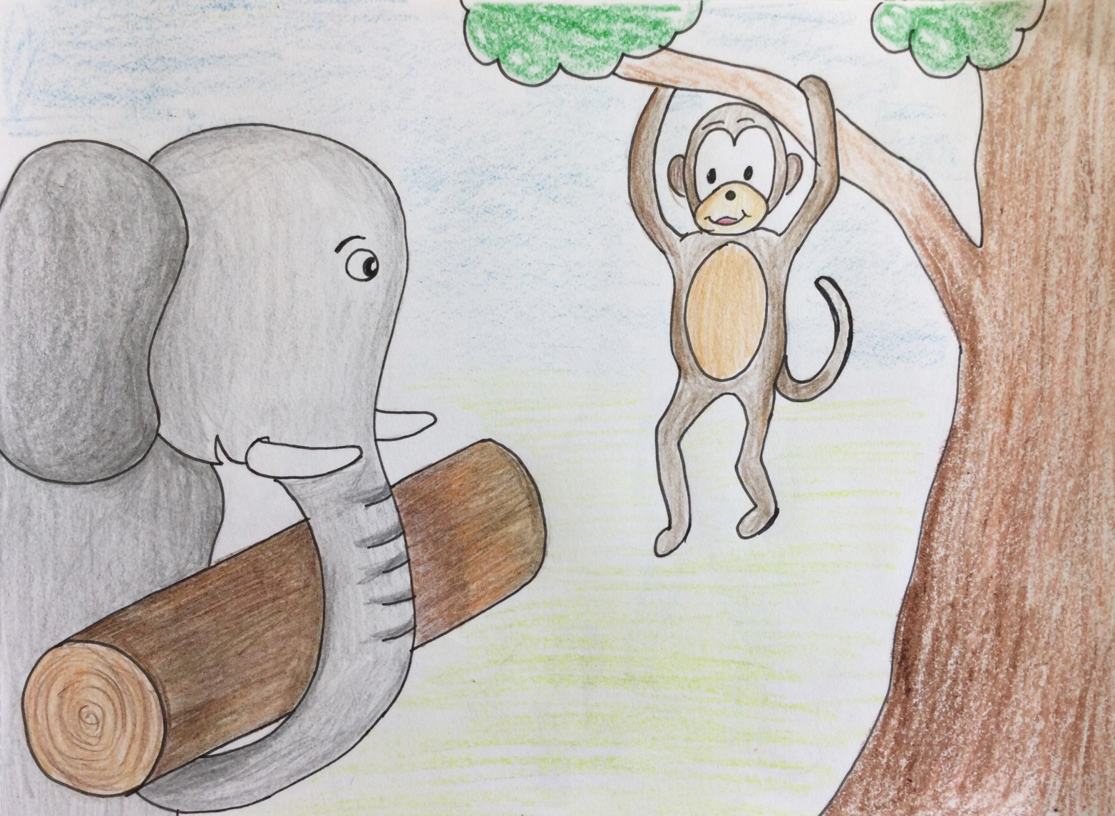
The Elephant and The Monkey
I am better I am fast and agile
I am better
I am strong
Notes:
Notes for Teacher - < Information for further reference or explanation >
Suggestions: <Ideas/ Images/ Animations / Others – To make better representation of the content >
Source of Multimedia used in this slide - <Please provide source URL where we find the image and the license agreement>
Self created – Output link - https://drive.google.com/drive/folders/1X7DuOSOchpdZkwAo7KMnF8fGPXJoxh1f
Self created – Output link- https://drive.google.com/drive/folders/1q5eJdbKkigQfYAj0avOb-VHwAQnXuUqz

Slide 3
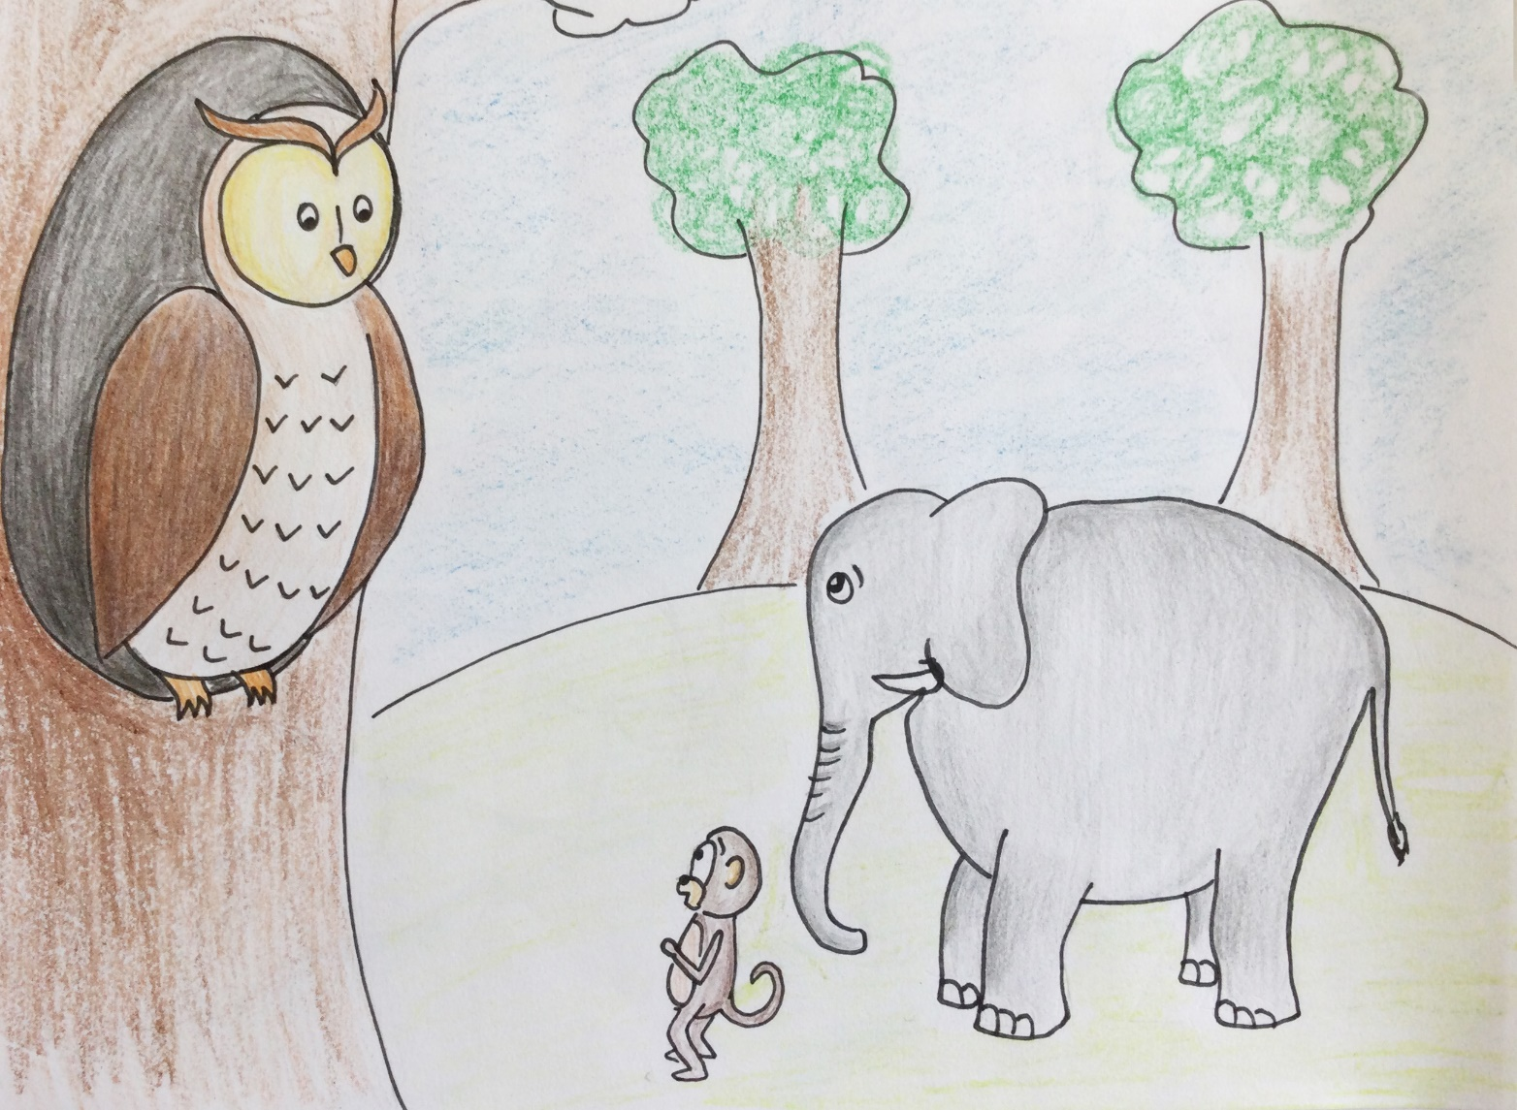
The Elephant and The Monkey
Bring me the golden mango fruit across the river
Which one of us is better?
Notes:
Notes for Teacher - < Information for further reference or explanation >
Suggestions: <Ideas/ Images/ Animations / Others – To make better representation of the content >
Source of Multimedia used in this slide - <Please provide source URL where we find the image and the license agreement>
Self created – Output link - https://drive.google.com/drive/folders/1X7DuOSOchpdZkwAo7KMnF8fGPXJoxh1f
Self created – Output link- https://drive.google.com/drive/folders/1q5eJdbKkigQfYAj0avOb-VHwAQnXuUqz

Slide 4
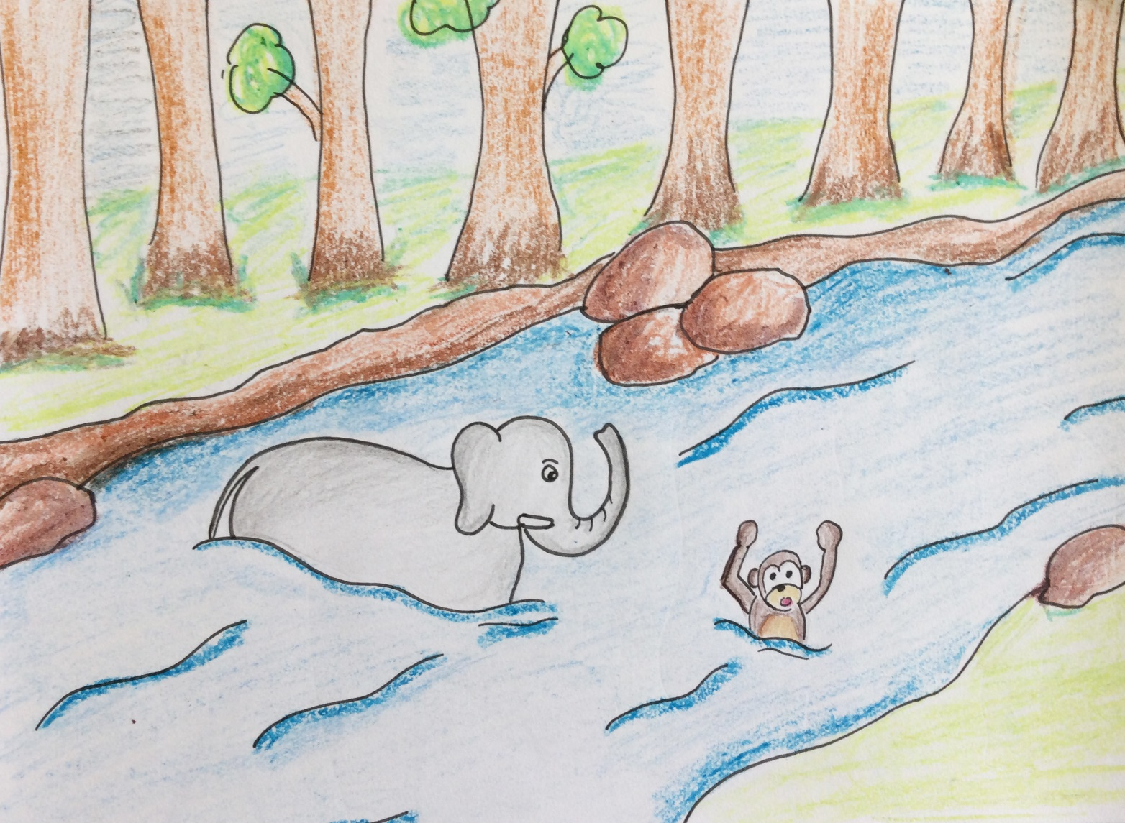
The Elephant and The Monkey
Help !! I am drowning
Notes:
Notes for Teacher - < Information for further reference or explanation >
Suggestions: <Ideas/ Images/ Animations / Others – To make better representation of the content >
Source of Multimedia used in this slide - <Please provide source URL where we find the image and the license agreement>
Self created – Output link - https://drive.google.com/drive/folders/1X7DuOSOchpdZkwAo7KMnF8fGPXJoxh1f
Self created – Output link- https://drive.google.com/drive/folders/1q5eJdbKkigQfYAj0avOb-VHwAQnXuUqz

Slide 5
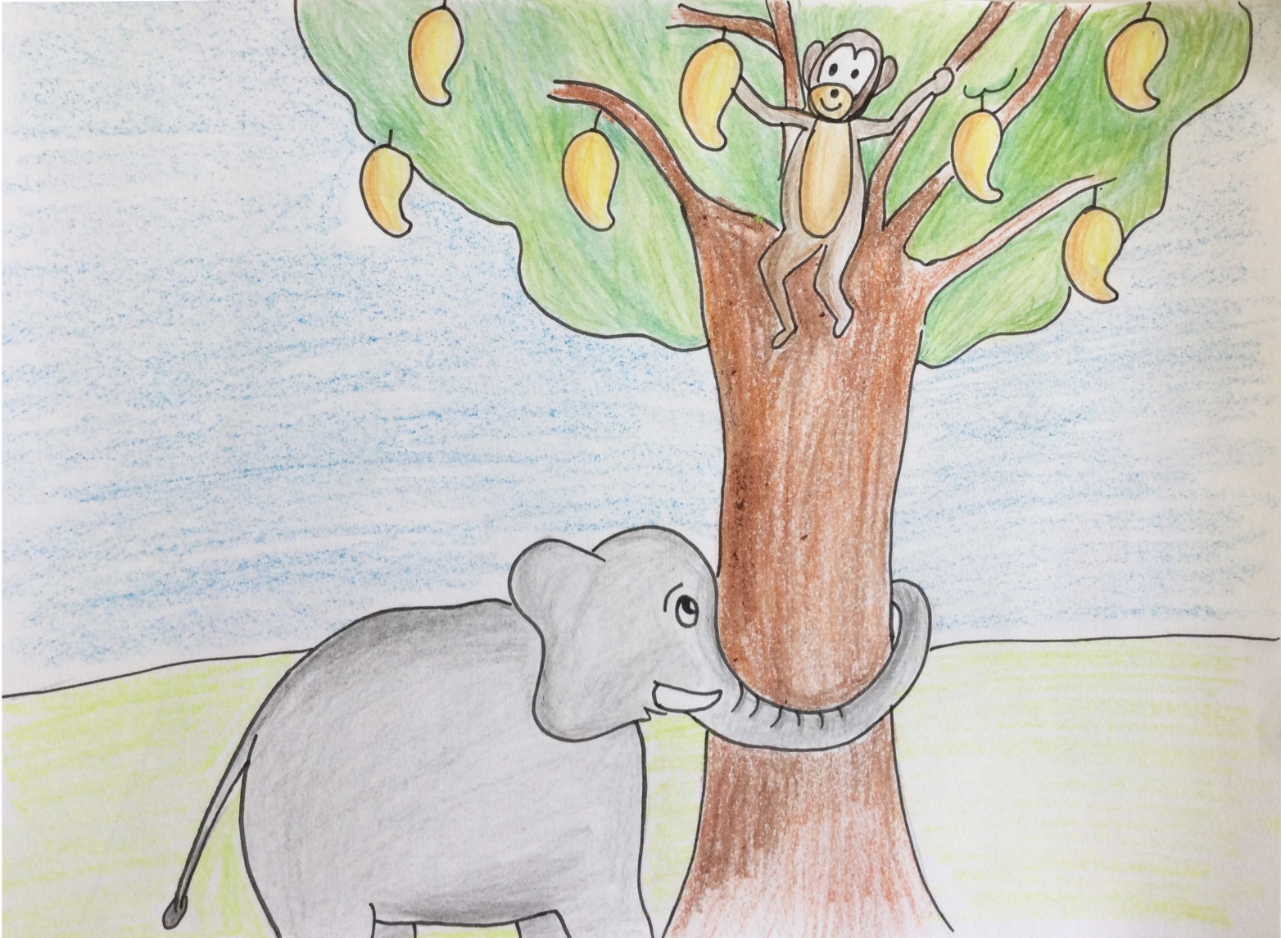
The Elephant and The Monkey
The fruit is
not falling
I can climb up and reach the fruit
Notes:
Notes for Teacher - < Information for further reference or explanation >
Suggestions: <Ideas/ Images/ Animations / Others – To make better representation of the content >
Source of Multimedia used in this slide - <Please provide source URL where we find the image and the license agreement>
Self created – Output link - https://drive.google.com/drive/folders/1X7DuOSOchpdZkwAo7KMnF8fGPXJoxh1f
Self created – Output link- https://drive.google.com/drive/folders/1q5eJdbKkigQfYAj0avOb-VHwAQnXuUqz

Slide 6
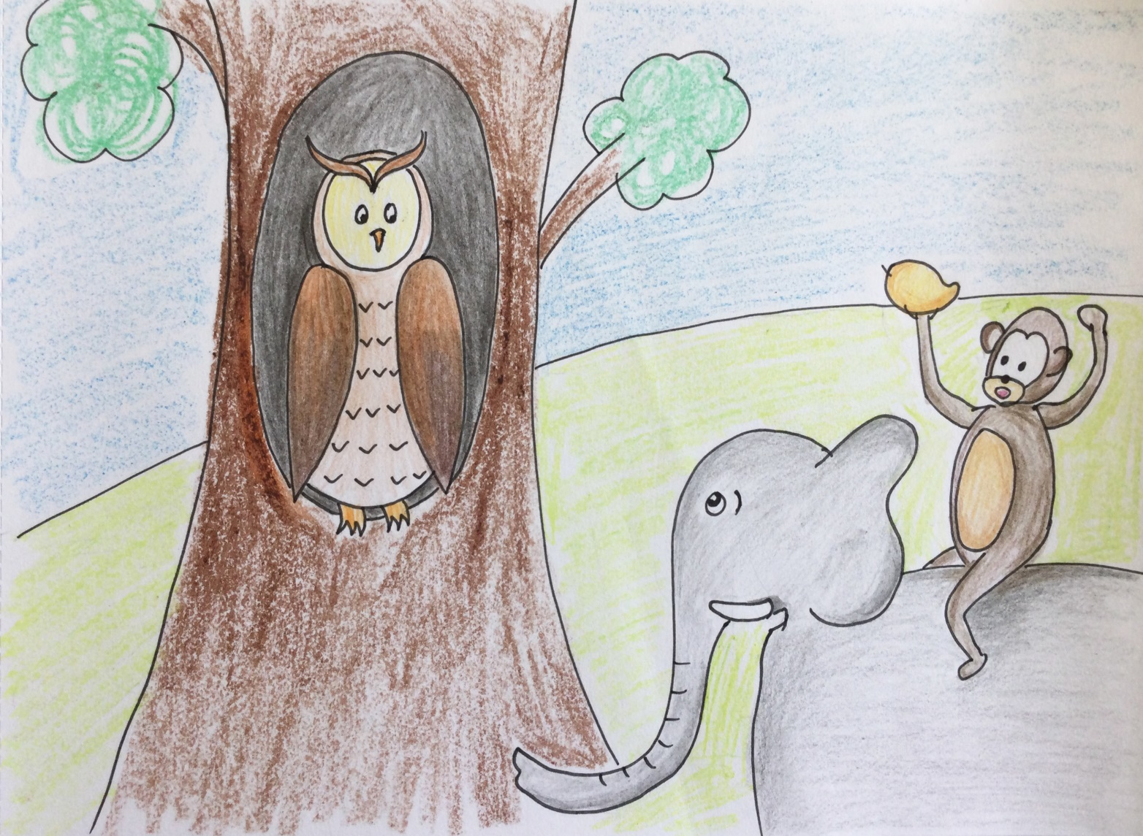
The Elephant and The Monkey
Who amongst you both has brought me the fruit
Notes:
Notes for Teacher - < Information for further reference or explanation >
Suggestions: <Ideas/ Images/ Animations / Others – To make better representation of the content >
Source of Multimedia used in this slide - <Please provide source URL where we find the image and the license agreement>
Self created – Output link - https://drive.google.com/drive/folders/1X7DuOSOchpdZkwAo7KMnF8fGPXJoxh1f
Self created – Output link- https://drive.google.com/drive/folders/1q5eJdbKkigQfYAj0avOb-VHwAQnXuUqz

Slide 7
Points to reflect:
Appreciate others abilities and strengths
Strength is in working together
Everything becomes possible being united
TEAM -Together everyone achieves more
Notes:
Notes for Teacher - < Information for further reference or explanation >
Suggestions: <Ideas/ Images/ Animations / Others – To make better representation of the content >
Source of Multimedia used in this slide - <Please provide source URL where we find the image and the license agreement>

Slide 8
MM INDEX
Slide # | Thumbnail | Source link and Attribution
1 |  | https://freesvg.org/black-elephant-silhouette https://pixabay.com/vectors/monkey-animal-silhouette-tree-32427/
2,4,5 |  | Self created – Output link - https://drive.google.com/drive/folders/1X7DuOSOchpdZkwAo7KMnF8fGPXJoxh1f
3,6 |  | Self created – Output link- https://drive.google.com/drive/folders/1q5eJdbKkigQfYAj0avOb-VHwAQnXuUqz
Notes:
Notes for Teacher - < Information for further reference or explanation >
Suggestions: <Ideas/ Images/ Animations / Others – To make better representation of the content >
Source of Multimedia used in this slide - <Please provide source URL where we find the image and the license agreement>

