Slide 1
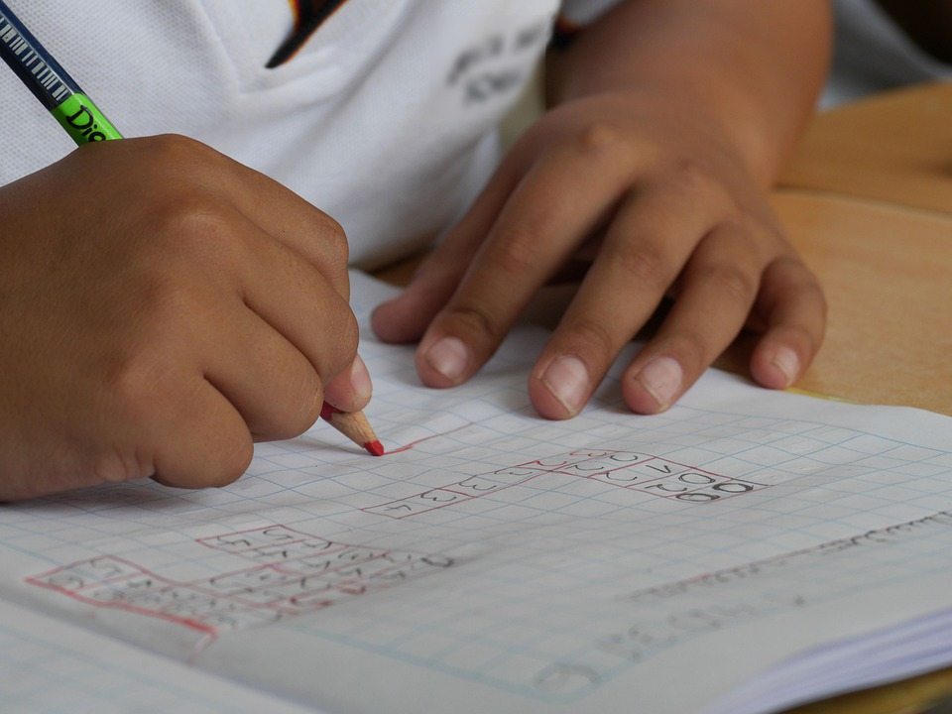
Writing About Myself
Notes:
Notes for Teacher - < Information for further reference or explanation >
Suggestions: <Ideas/ Images/ Animations / Others – To make better representation of the content >
Source of Multimedia used in this slide -
<Please provide source URL where we find the image and the license agreement>
https://pixabay.com/photos/study-learning-school-1412778/

Slide 2
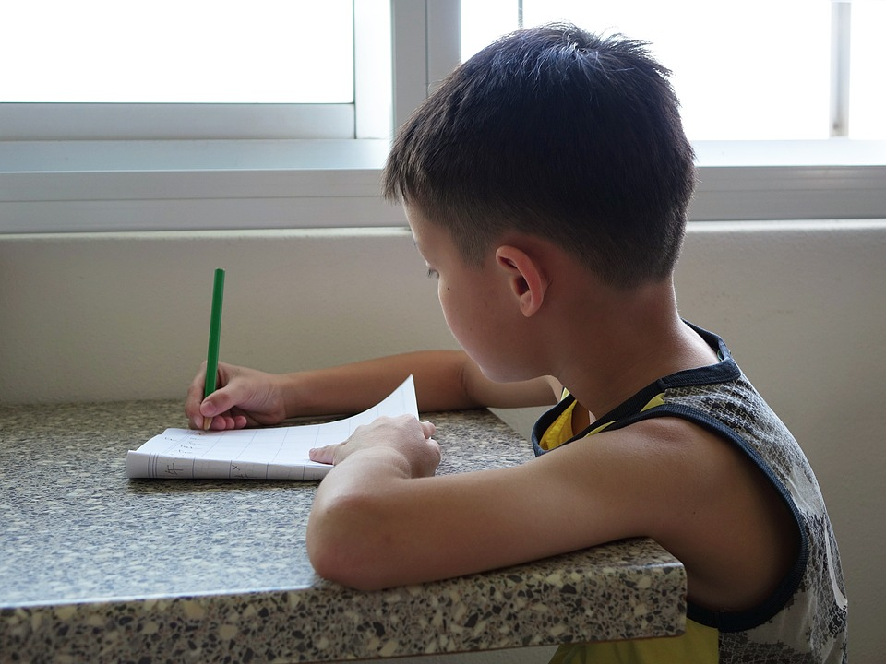
Worksheet
Draw a portrait of yourself and write about yourself
Notes:
Notes for Teacher - The teacher may use the information to assess the students’ understanding of a paragraph writing. The teacher may use the worksheet or write the leading questions on the board. The students with the help of leading questions will be able to write 7 to 8 about themselves.
< Information for further reference or explanation >
Suggestions: <Ideas/ Images/ Animations / Others – To make better representation of the content >
Source of Multimedia used in this slide -
Pencil: https://pxhere.com/en/photo/821894
writing> <https://pixabay.com/photos/writing-boy-child-student-kid-711286/

Slide 3
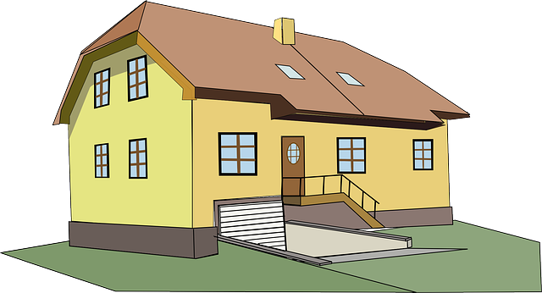
Helpful Questions
What is your name?
How old are you?
Where do you live?
Notes:
Notes for Teacher - The teacher may use the information to assess the students’ understanding of a paragraph writing. The teacher may use the worksheet or write the leading questions on the board. The students with the help of leading questions will be able to write 7 to 8 about themselves.
< Information for further reference or explanation >
Suggestions: <Ideas/ Images/ Animations / Others – To make better representation of the content >
Source of Multimedia used in this slide -
Pencil: https://pxhere.com/en/photo/821894
writing> <https://pixabay.com/photos/writing-boy-child-student-kid-711286/

Slide 4
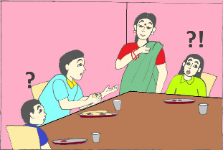
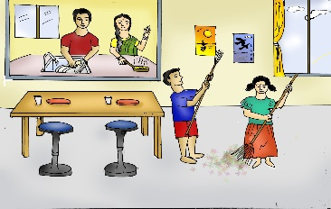
Helpful Questions
Who do you live with?
Do you have any pets?
Do you help your parents at home?
Notes:
Notes for Teacher - The teacher may use the information to assess the students’ understanding of a paragraph writing. The teacher may use the worksheet or write the leading questions on the board. The students with the help of leading questions will be able to write 7 to 8 about themselves.
< Information for further reference or explanation >
Suggestions: <Ideas/ Images/ Animations / Others – To make better representation of the content >
Source of Multimedia used in this slide -
Pencil: https://pxhere.com/en/photo/821894
writing> <https://pixabay.com/photos/writing-boy-child-student-kid-711286/

Slide 5
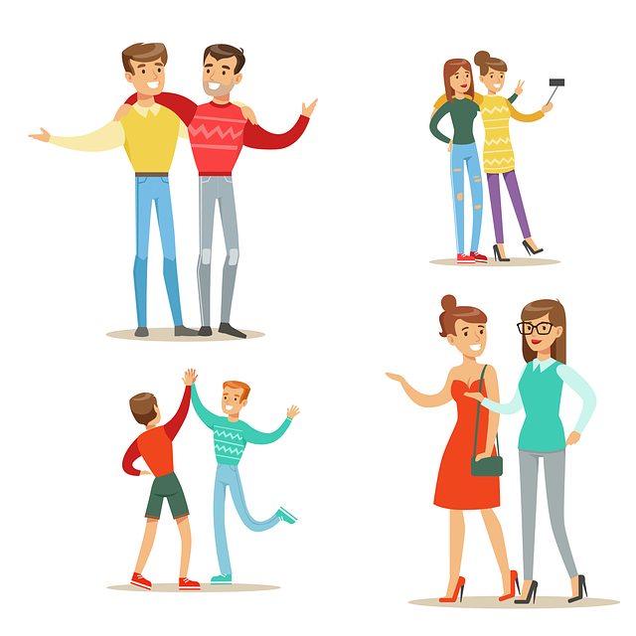
Helpful Questions
What do you like to do most?
What do you do in the evenings and before going to bed?
What are you good at?
Notes:
Notes for Teacher - The teacher may use the information to assess the students’ understanding of a paragraph writing. The teacher may use the worksheet or write the leading questions on the board. The students with the help of leading questions will be able to write 7 to 8 about themselves.
< Information for further reference or explanation >
Suggestions: <Ideas/ Images/ Animations / Others – To make better representation of the content >
Source of Multimedia used in this slide -
Pencil: https://pxhere.com/en/photo/821894
writing> <https://pixabay.com/photos/writing-boy-child-student-kid-711286/

Slide 6
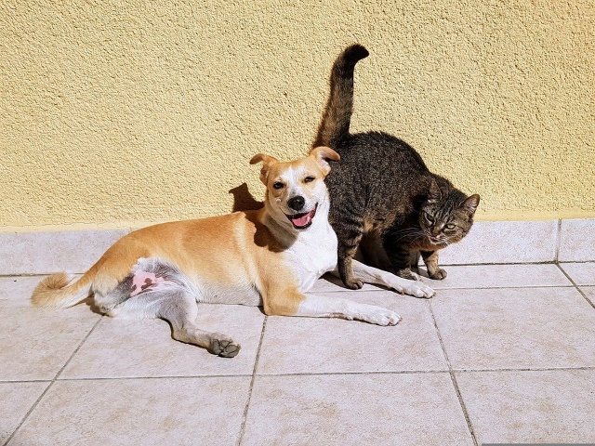
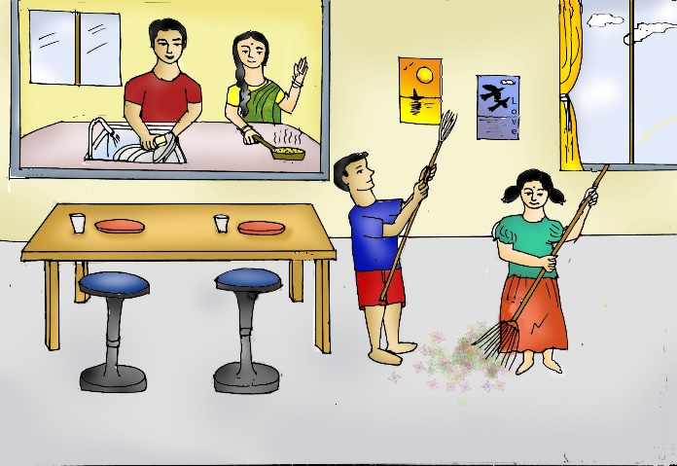
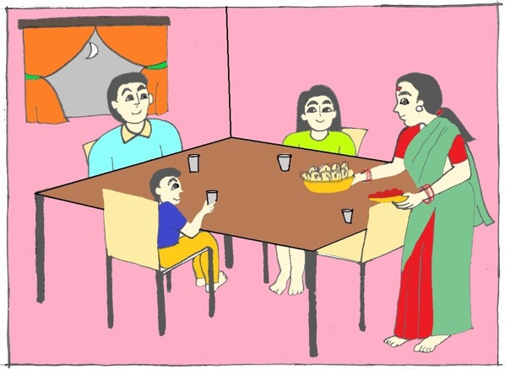
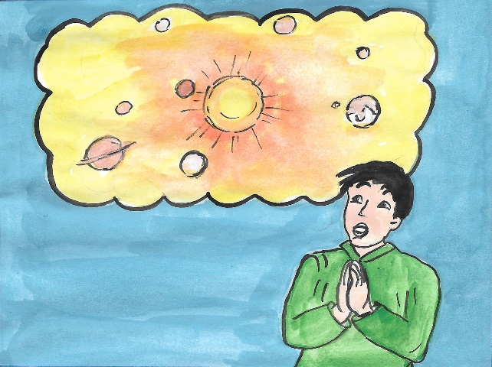
Sample Paragraph
Start—> I am ____ . I am ___ years old. __________________
My name is Saanvi. I am eight years old. I live in a small town named Ramanagar, near Bengaluru. My family is big. I live with my grandparents, uncle, aunt, my parents and my brother. We have two pets, a dog and a cat. All of us help in taking care of them. My brother and I help at home by doing small chores. In the evenings, we study and also practice singing as we both love to sing. Dinner is the best time of the day as we all get together and eat and talk about our day. We clean up after that, offer our prayers to God and go to sleep.
Notes:
Notes for Teacher - < Information for further reference or explanation >
Suggestions: <Ideas/ Images/ Animations / Others – To make better representation of the content >
Source of Multimedia used in this slide - cat & dog: https://pixabay.com/photos/pets-cat-dog-friendship-animals-2283305/<Please provide source URL where we find the image and the license agreement>

Slide 7
MM INDEX
Slide # | Thumbnail | Source link and Attribution
1 |  | https://pixabay.com/photos/study-learning-school-1412778/
2 |  | https://pxhere.com/en/photo/821894 https://pixabay.com/photos/writing-boy-child-student-kid-711286/
3 |  | https://pixabay.com/illustrations/meal-emotions-cakes-date-of-birth-2205842/ https://pixabay.com/vectors/name-name-tag-sign-id-press-label-1714231/ <big house> https://pixabay.com/vectors/house-home-2-story-yellow-big-304341/
4 |  | Family: SSSVV Gallery keyword children Helping parents: SSSVV Gallery key word: children <cat> https://pixabay.com/vectors/kitten-cute-cat-animals-furry-4794761/
5 |  | <book> https://pixabay.com/illustrations/book-reading-read-coffee-knowledge-4155805/ <family> https://pixabay.com/vectors/friends-people-friendship-family-4187953/ <girl on bike> https://pixabay.com/vectors/girl-cycle-helmet-sport-fast-tour-311181/
6 |  | https://pixabay.com/photos/pets-cat-dog-friendship-animals-2283305/< SSSVV Gallery; search word Children SSSVV Gallery: Search word - family,children SSSVV Gallery: Search word :pray
Notes:
Notes for Teacher - < Information for further reference or explanation >
Suggestions: <Ideas/ Images/ Animations / Others – To make better representation of the content >
Source of Multimedia used in this slide - <Please provide source URL where we find the image and the license agreement>

