Slide 1
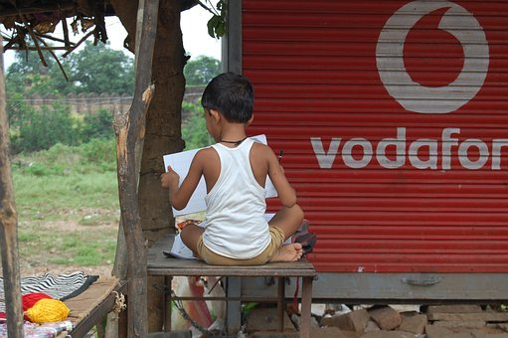
Importance of Reading
Notes:
Notes for Teacher - < Information for further reference or explanation >
Suggestions: <Ideas/ Images/ Animations / Others – To make better representation of the content >
Source of Multimedia used in this slide -
1. https://pixabay.com/photos/child-reading-homework-education-3785922/

Slide 2
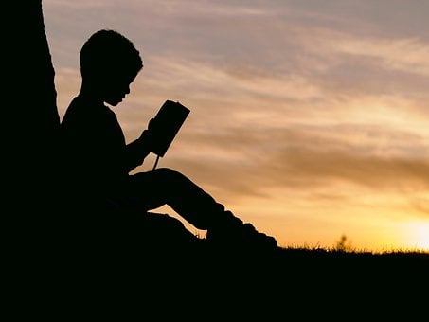
Why do we read?
Do you all like to read?
What kind of books do you like to read?
Notes:
Notes for Teacher - < Information for further reference or explanation >
Suggestions: <Ideas/ Images/ Animations / Others – To make better representation of the content >
Source of Multimedia used in this slide -
Silhoutte: https://pixabay.com/photos/people-man-kid-boy-child-read-2572105/
Children: https://youtu.be/jalmmKpx1kk?t=117 (Attribution: AKSHAR MANTRA)

Slide 3
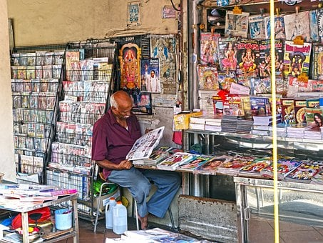
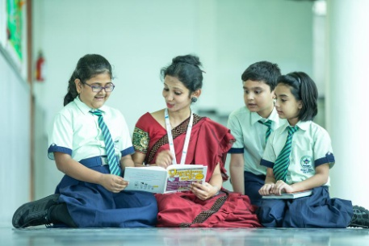
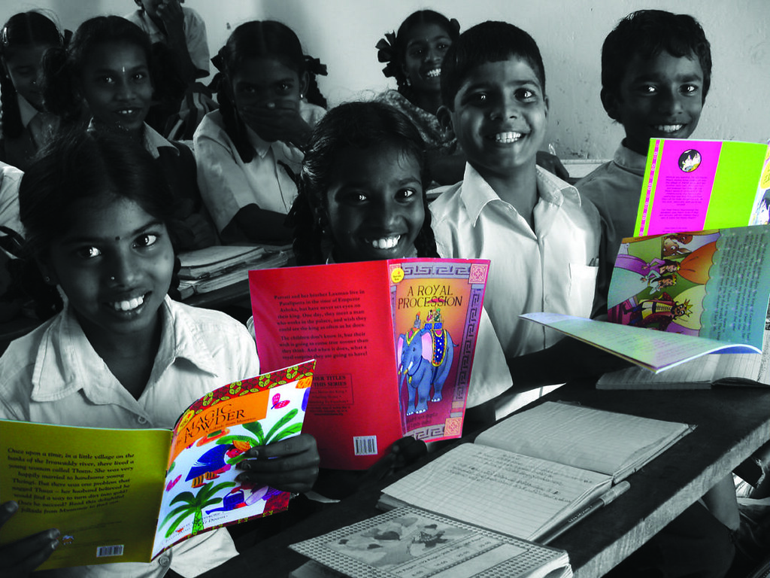
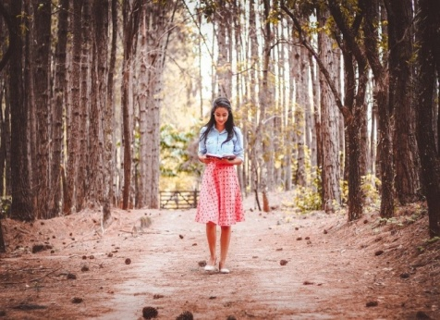
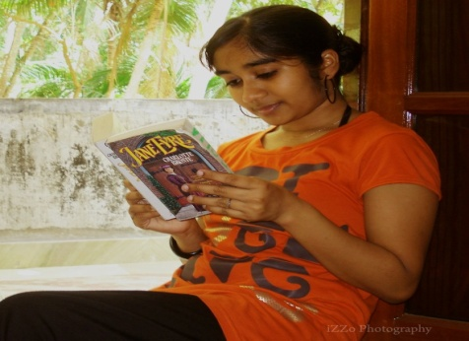
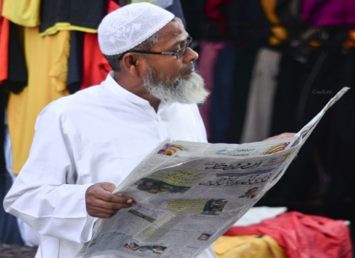
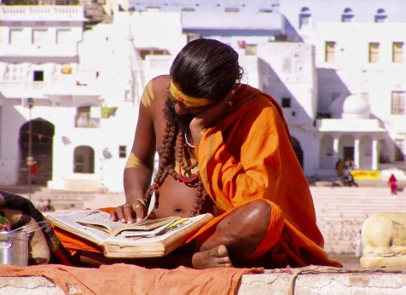
Reading
Where can you read ?
Notes:
Notes for Teacher - < Information for further reference or explanation >
Suggestions: <Ideas/ Images/ Animations / Others – To make better representation of the content >
Source of Multimedia used in this slide -
Magazine: https://pixabay.com/photos/shop-vendor-magazine-man-singapore-805536/
Teacher: https://pixabay.com/photos/school-classroom-teacher-7047287/
Window girl: https://www.flickr.com/photos/29695407@N00/3337615282 (attribution: Easa Shamih)
Man: https://commons.wikimedia.org/w/index.php?curid=71350426 (Attribution: Selvin)
Children: https://www.flickr.com/photos/35026043@N03/3292581996 (Attribution: Pratham Books)
Sanyasi: https://pixabay.com/photos/hindu-read-cross-legged-a-book-4695995/
Girl walking: https://pixabay.com/photos/woman-trees-book-open-book-walk-1868725/

Slide 4
Reading Comprehension
Why do you think we should read?
For fun
For knowledge
Learn new words
For stories
Colourful pictures
Is it necessary that we have to understand what we read?
The joy is in understanding what we read.
Notes:
Notes for Teacher – After getting answers from the children, the teacher display the ppt answers too.
Suggestions: <Ideas/ Images/ Animations / Others – To make better representation of the content >
Source of Multimedia used in this slide - <Please provide source URL where we find the image and the license agreement>

Slide 5
MM Index
1 |  | 1. https://pixabay.com/photos/child-reading-homework-education-3785922/
2 |  | Silhoutte: https://pixabay.com/photos/people-man-kid-boy-child-read-2572105/ Children: https://youtu.be/jalmmKpx1kk?t=117 (Attribution: AKSHAR MANTRA
3 |  | Magazine: https://pixabay.com/photos/shop-vendor-magazine-man-singapore-805536/ Teacher: https://pixabay.com/photos/school-classroom-teacher-7047287/ Window girl: https://www.flickr.com/photos/29695407@N00/3337615282 (attribution: Easa Shamih) Man: https://commons.wikimedia.org/w/index.php?curid=71350426 (Attribution: Selvin) Children: https://www.flickr.com/photos/35026043@N03/3292581996 (Attribution: Pratham Books) Sanyasi: https://pixabay.com/photos/hindu-read-cross-legged-a-book-4695995/ Girl walking: https://pixabay.com/photos/woman-trees-book-open-book-walk-1868725/
Notes:
Notes for Teacher - < Information for further reference or explanation >
Suggestions: <Ideas/ Images/ Animations / Others – To make better representation of the content >
Source of Multimedia used in this slide - <Please provide source URL where we find the image and the license agreement>

