Slide 1
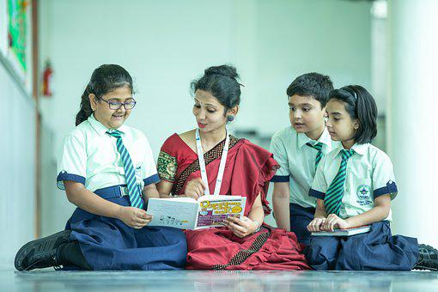
Reading Comprehension
Notes:
Notes for Teacher - < Information for further reference or explanation >
Suggestions: <Ideas/ Images/ Animations / Others – To make better representation of the content >
Source of Multimedia used in this slide -
1. https://pixabay.com/photos/school-classroom-teacher-7047287/

Slide 2
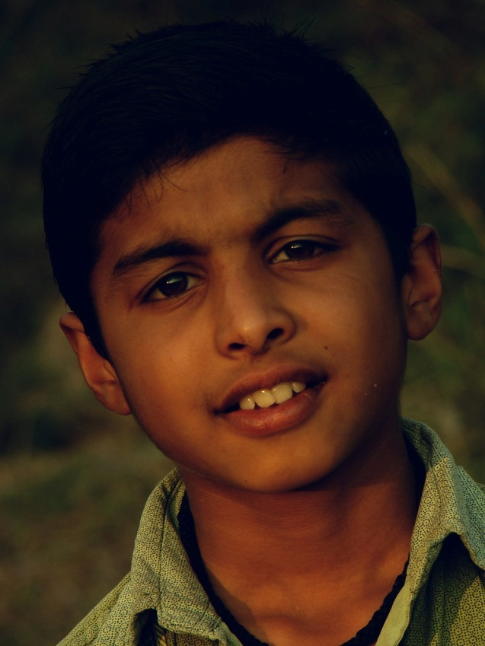
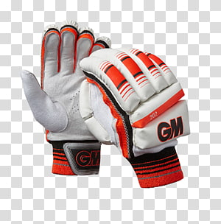
A Budding Cricketer
Ajay is 12 years old. He lives with his parents and younger sister in Chennai. He loves studying and always comes first in class. He also loves indoor games like chess.
Ajay is sure that one day he will be famous like Virat Kohli.
His parents always encourage him. They even bought him a pair of new gloves, a bat and a ball when he started playing cricket. He plans to join the school cricket team for juniors next year.
His favourite outdoor game is
cricket. There is a playground
near his house where all the
older children play cricket. Ajay
always watches them play
every Sunday morning.
Notes:
Notes for Teacher
< Information for further reference or explanation >
Suggestions: <Ideas/ Images/ Animations / Others – To make better representation of the content >
Source of Multimedia used in this slide -
Boy: https://www.flickr.com/photos/32012820@N06/8492210374 (Attribution: aphotoshooter)
Cricket bat, ball: https://www.hiclipart.com/free-transparent-background-png-clipart-ijdbb
Gloves: https://www.hiclipart.com/free-transparent-background-png-clipart-fyaum

Slide 3
Question Time
Q1. What is the name of the main person in the text?
Ajay
Q2. What is the name of the indoor sport that is
mentioned in the text?
Chess
Fill in the blanks
younger
Chennai
1. Ajay lives with his parents and _______ sister in ________.
school
2. Ajay plans to join the ______ cricket team for juniors next year.
Notes:
Notes for Teacher - < Information for further reference or explanation >
Suggestions: <Ideas/ Images/ Animations / Others – To make better representation of the content >
Source of Multimedia used in this slide –
<Please provide source URL where we find the image and the license agreement>

Slide 4
Question Time
Choose the correct answer
1. Ajay’s favourite outdoor game is
a. Chess b. Football c. Cricket
c. Cricket
2. Ajay’s parents bought him
a. A pair of new gloves, a bat and a ball b. A pair of gloves and a bat c. A pair of gloves and a ball
a. A pair of new gloves, a bat
and a ball
Notes:
Notes for Teacher - < Information for further reference or explanation >
Suggestions: <Ideas/ Images/ Animations / Others – To make better representation of the content >
Source of Multimedia used in this slide - <Please provide source URL where we find the image and the license agreement>

Slide 5
MM INDEX
Slide # | Thumbnail | Source link and Attribution
1 |  | 1. https://pixabay.com/photos/school-classroom-teacher-7047287/
2 |  | Boy: https://www.flickr.com/photos/32012820@N06/8492210374 (Attribution: aphotoshooter) Cricket bat, ball: https://www.hiclipart.com/free-transparent-background-png-clipart-ijdbb Gloves: https://www.hiclipart.com/free-transparent-background-png-clipart-fyaum
Notes:
Notes for Teacher - < Information for further reference or explanation >
Suggestions: <Ideas/ Images/ Animations / Others – To make better representation of the content >
Source of Multimedia used in this slide - <Please provide source URL where we find the image and the license agreement>

