Slide 1
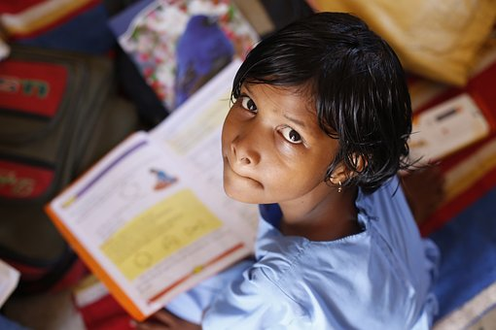
Reading in daily life
Notes:
Notes for Teacher - < Information for further reference or explanation >
Suggestions: <Ideas/ Images/ Animations / Others – To make better representation of the content >
Source of Multimedia used in this slide -
1. https://pixabay.com/photos/children-infant-girl-school-306607/

Slide 2
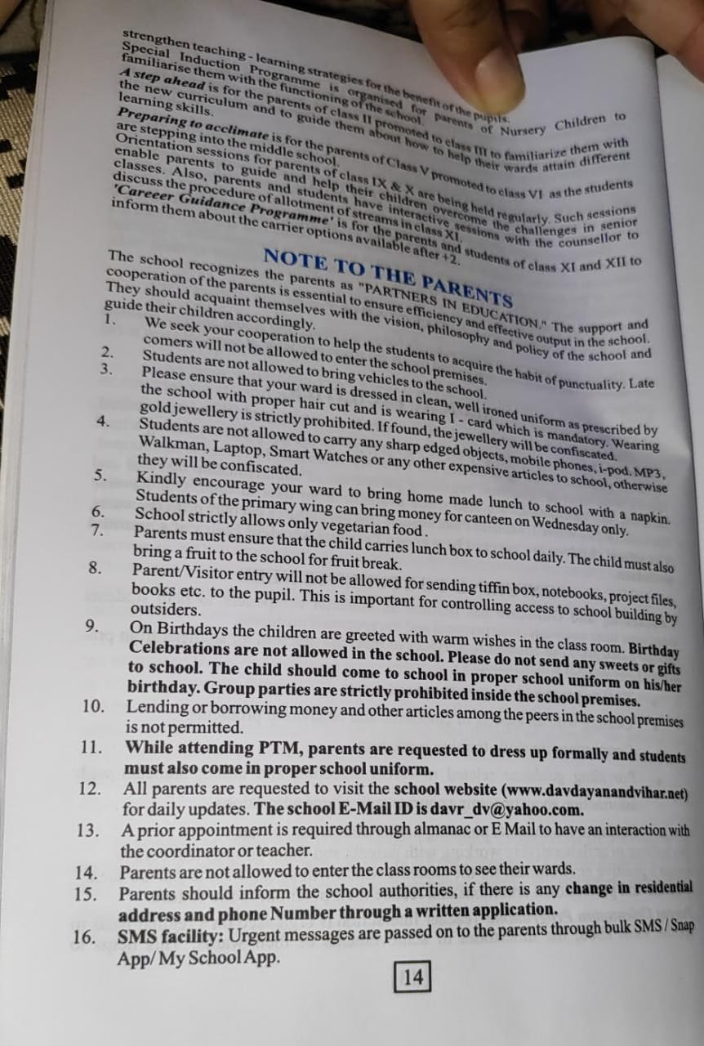
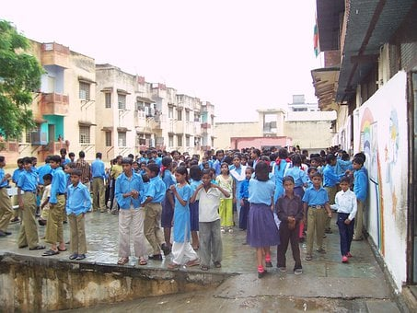
At School-School Diary
Notes:
Notes for Teacher - < Information for further reference or explanation >
Suggestions: <Ideas/ Images/ Animations / Others – To make better representation of the content >
Source of Multimedia used in this slide -
1. https://pixabay.com/photos/students-school-children-young-572289/

Slide 3
Employment Contract
Notes:
Notes for Teacher - < Information for further reference or explanation >
Suggestions: <Ideas/ Images/ Animations / Others – To make better representation of the content >
Source of Multimedia used in this slide -
1. https://pixabay.com/photos/ladies-poor-wrinkles-lady-woman-5166427/

Slide 4
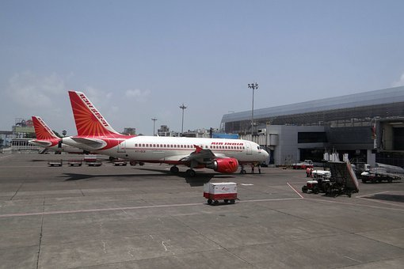
Airline Terms and Conditions
Notes:
Notes for Teacher - < Information for further reference or explanation >
Suggestions: <Ideas/ Images/ Animations / Others – To make better representation of the content >
Source of Multimedia used in this slide -
1. https://pixabay.com/photos/airport-mumbai-aircraft-air-india-385293/

Slide 5
MM Index
Slide # | Thumbnail | Source link and Attribution
1 |  | 1. https://pixabay.com/photos/children-infant-girl-school-306607/
2 |  | 1. https://pixabay.com/photos/students-school-children-young-572289/
3 |  | 1. https://pixabay.com/photos/ladies-poor-wrinkles-lady-woman-5166427/
4 |  | 1. https://pixabay.com/photos/airport-mumbai-aircraft-air-india-385293/
Notes:
Notes for Teacher - < Information for further reference or explanation >
Suggestions: <Ideas/ Images/ Animations / Others – To make better representation of the content >
Source of Multimedia used in this slide - <Please provide source URL where we find the image and the license agreement>

