Slide 1
DO NOT ACT HASTILY
Notes:
Notes for Teacher - < Information for further reference or explanation >
Suggestions: <Ideas/ Images/ Animations / Others – To make better representation of the content >
Source of Multimedia used in this slide - <Please provide source URL where we find the image and the license agreement>

Slide 2
Do Not Act Hastily
Comprehension is the understanding and interpretation of what is read. It involves reading, thinking, and reasoning.
1
Likewise in life, when we have to make decisions or act in a situation, we need to reason well before we do so.
2
Notes:
Notes for Teacher - < Information for further reference or explanation >
Suggestions: <Ideas/ Images/ Animations / Others – To make better representation of the content >
Source of Multimedia used in this slide - <Please provide source URL where we find the image and the license agreement>
Boy meditating : https://pixabay.com/da/vectors/mand-soldat-ex-soldat-meditere-2967813/

Slide 3
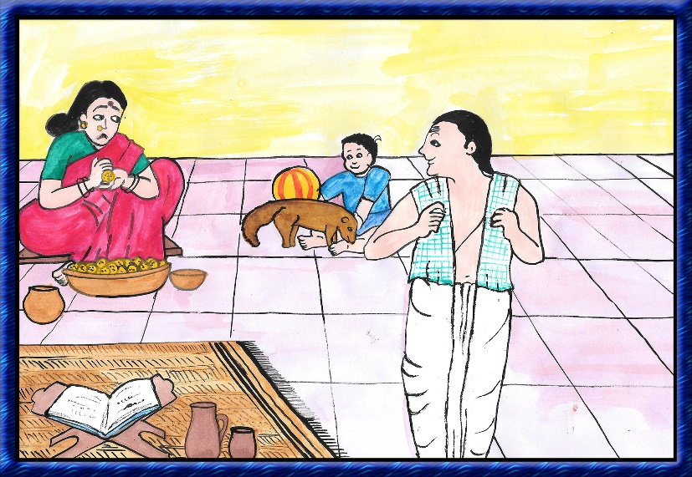
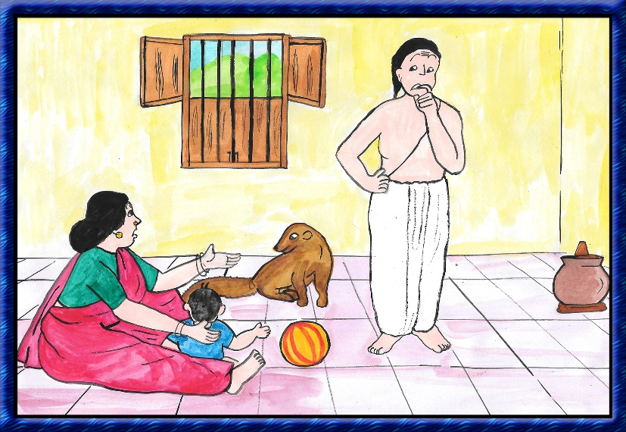
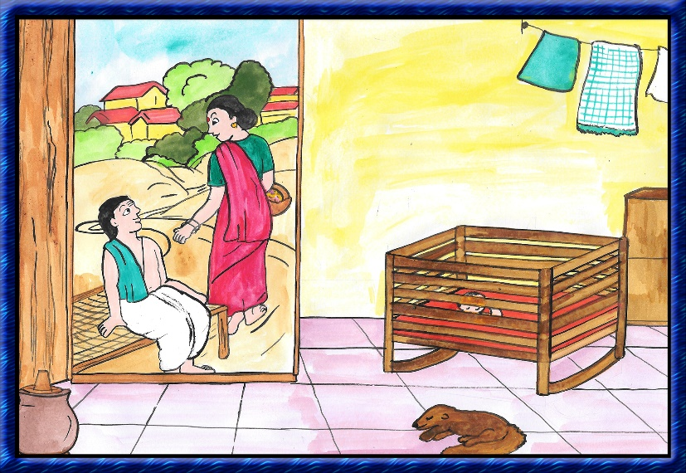
Do Not Act Hastily : Story
Farmer brought the mangoose home
The farmer’s wife was scared about letting the mongoose near her child
One day the farmer’s wife had to go to the market
Notes:
Notes for Teacher –
Suggestions: <Ideas/ Images/ Animations / Others – To make better representation of the content >
Source of Multimedia used in this slide - <Please provide source URL where we find the image and the license agreement>
Story : SSSVV Gallery: Search Keyword “mongoose“

Slide 4
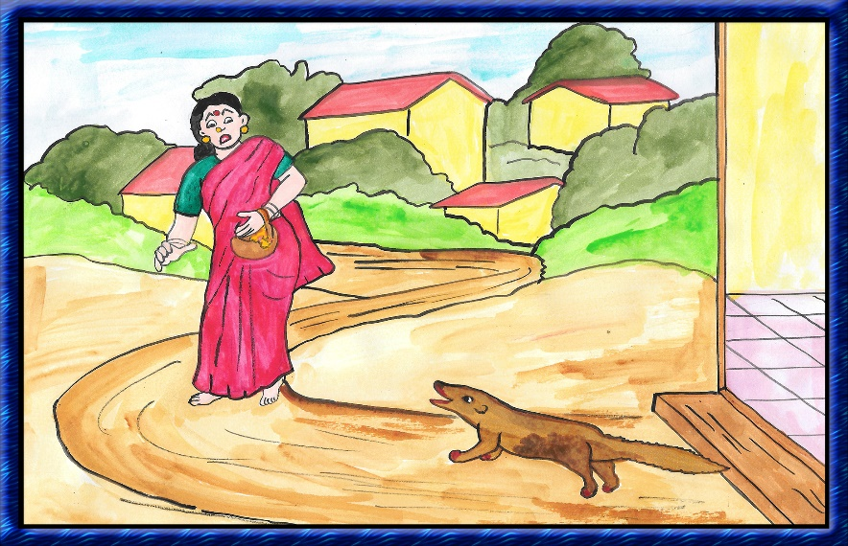
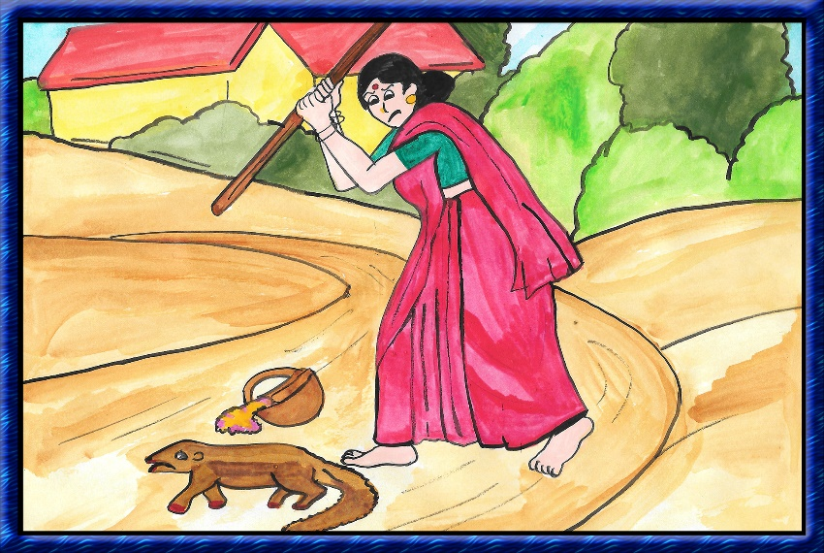
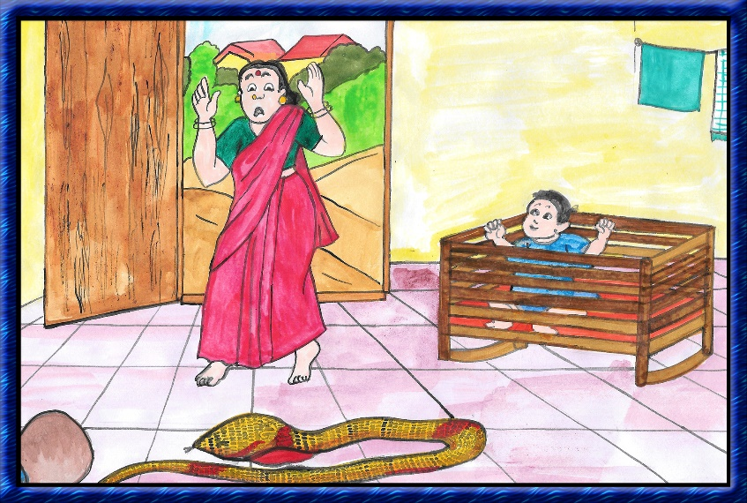
Do Not Act Hastily : Story
She saw the mongoose covered with blood in in its mouth
Out of anger, she hit the mongoose on its head
She found her child sleeping in the cradle. But on the floor was a poisonous dead snake
Notes:
Notes for Teacher –
Suggestions: <Ideas/ Images/ Animations / Others – To make better representation of the content >
Source of Multimedia used in this slide - <Please provide source URL where we find the image and the license agreement>
Story : SSSVV Gallery: Search Keyword “mongoose“

Slide 5
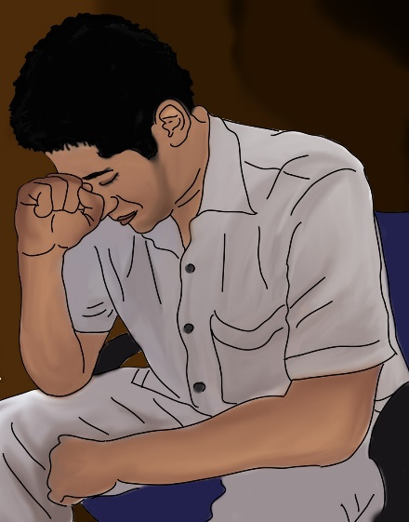
Do Not Act Hastily
Acting without thinking can be painful and dangerous.
There is no point repenting once the action is done.
Do not act hastily. Think before you act.
Notes:
Notes for Teacher - < Information for further reference or explanation >
Suggestions: <Ideas/ Images/ Animations / Others – To make better representation of the content >
Source of Multimedia used in this slide - <Please provide source URL where we find the image and the license agreement>
Argue : https://pixabay.com/vectors/arguing-female-male-man-shouting-1296392/ By OpenClipart-Vectors
Repent : https://archive.sssmediacentre.org/www/imagedownloads/SMN_20140529.jpg (From Radio Sai)
Thinking : https://pixabay.com/vectors/thinker-thinking-person-idea-28741/ By Clker-Free-Vector-Images

Slide 6
MM INDEX
Slide # | Thumbnail | Source link and Attribution
2 |  | https://pixabay.com/da/vectors/mand-soldat-ex-soldat-meditere-2967813/
4 |  | Argue : https://pixabay.com/vectors/arguing-female-male-man-shouting-1296392/ By OpenClipart-Vectors Thinking : https://pixabay.com/vectors/thinker-thinking-person-idea-28741/ By Clker-Free-Vector-Images
Notes:
Notes for Teacher - < Information for further reference or explanation >
Suggestions: <Ideas/ Images/ Animations / Others – To make better representation of the content >
Source of Multimedia used in this slide - <Please provide source URL where we find the image and the license agreement>

