Slide 1
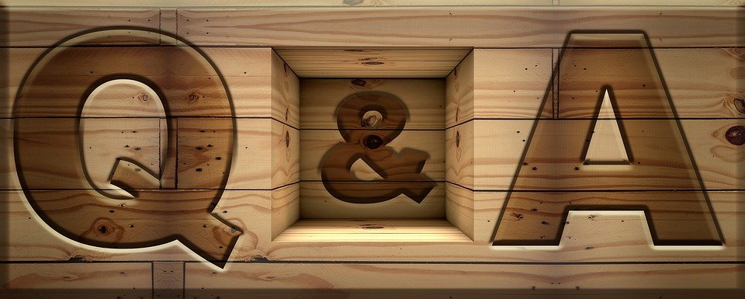
Testing Time
Notes:
Notes for Teacher - < Information for further reference or explanation >
Suggestions: <Ideas/ Images/ Animations / Others – To make better representation of the content >
Source of Multimedia used in this slide -
1. https://pixabay.com/illustrations/q-and-a-question-answer-q-sign-2453376/

Slide 2
The Library
There is a big library in Rahul’s school. The librarian who helps us find the books we need is Miss Kala. The library is open from 8 a.m. to 4 p.m.
This library has books about everything. There are adventure books, fantasy books, mystery books, encyclopedias, science fiction books and many more. If you wish to read an interesting cartoon book, you can always ask Miss Kala to help you find one.
Our library has a big notice that says, ’Silence is Golden’. We all have to read in the mind. There are many tables and chairs for everyone to do their homework or project. If you require information from magazines, newspaper articles for your project, the librarian is always ready to help.
Don’t forget to visit the library and remember to thank the librarian for the help provided.
Notes:
Notes for Teacher - < Information for further reference or explanation >
Suggestions: <Ideas/ Images/ Animations / Others – To make better representation of the content >
Source of Multimedia used in this slide - <Please provide source URL where we find the image and the license agreement>

Slide 3
Testing Time
1. Fill in the blanks
a. What is the name of the librarian?
Miss Kala
b. What time does the library close?
4 p.m.
c. Where is the library?
In Rahul’s school
2. Choose the correct answer
a. The notice in the library says
1. Silence is good
2. Silence is golden
2. Silence is Golden
3. Silence is perfect
Notes:
Notes for Teacher - < Information for further reference or explanation >
Suggestions: <Ideas/ Images/ Animations / Others – To make better representation of the content >
Source of Multimedia used in this slide -
1. https://pixabay.com/photos/school-student-teacher-education-7047300/

Slide 4
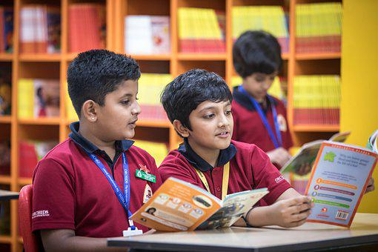
Testing Time
3. True or False
a. There are few tables and chairs in the library.
False-has many
b. The library has adventure and mystery books also.
True
Notes:
Notes for Teacher - < Information for further reference or explanation >
Suggestions: <Ideas/ Images/ Animations / Others – To make better representation of the content >
Source of Multimedia used in this slide -
1. https://pixabay.com/photos/children-classroom-grade-school-7047132/

Slide 5
MM INDEX
Slide # | Thumbnail | Source link and Attribution
1 |  | 1. https://pixabay.com/illustrations/q-and-a-question-answer-q-sign-2453376/
3 |  | 1. https://pixabay.com/photos/school-student-teacher-education-7047300/
4 |  | 1. https://pixabay.com/photos/children-classroom-grade-school-7047132/
Notes:
Notes for Teacher - < Information for further reference or explanation >
Suggestions: <Ideas/ Images/ Animations / Others – To make better representation of the content >
Source of Multimedia used in this slide - <Please provide source URL where we find the image and the license agreement>

