Slide 1
Words vs Sentence
Sun
Shine
The Sun shines brightly.
Brightly
Notes:
Notes for Teacher - < Information for further reference or explanation >
Suggestions: <Ideas/ Images/ Animations / Others – To make better representation of the content >
Source of Multimedia used in this slide -
1. Sun: https://www.hiclipart.com/free-transparent-background-png-clipart-iwmxa

Slide 2
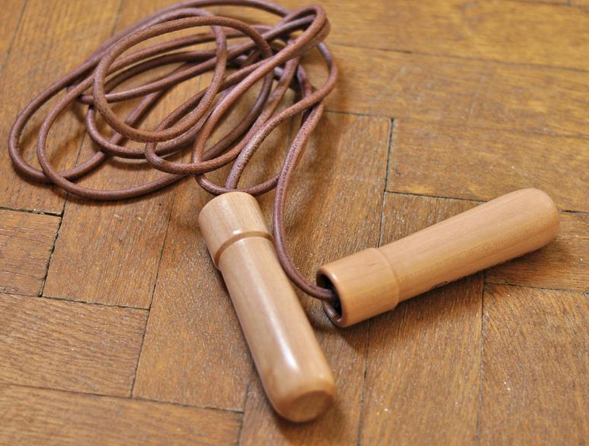
See and answer
Who is in this picture?
Can you name this?
What is the girl doing?
Girl
Skipping rope
The girl is skipping.
Notes:
Notes for Teacher - The teacher elicits information from the students by showing a PPT and asking questions.
Teacher: Children, you have given three answers to three different pictures shown to you:
‘Girl’, ‘Skipping rope’ and ‘The girl is skipping’.
What is the difference in the answers you have given?
Notes to the Teacher: The teacher continues to ask questions till she gets the following answer from the students:
Students: ‘Girl’ and ‘skipping rope’ are words and ‘The girl is skipping’ is a sentence.
Suggestions: <Ideas/ Images/ Animations / Others – To make better representation of the content >
Source of Multimedia used in this slide –
Girl: https://pixabay.com/photos/children-portrait-artistic-girl-1706121/
Skipping rope: https://pixabay.com/photos/skipping-rope-sports-game-tool-1443645/
3. Girl Skipping: https://pixabay.com/vectors/girl-jumping-rope-silhouette-child-5767956/

Slide 3
Words vs Sentence
A word has single letters or alphabets whereas a
sentence is made up of words
A word is a single unit of language which has a meaning. A sentence is a set of words which expresses a statement, question or an order. A sentence begins with a capital letter and ends with a full stop.
Girl
Skipping rope
The girl is skipping.
Word
Word
Sentence
Notes:
Notes for Teacher - < Information for further reference or explanation >
Suggestions: <Ideas/ Images/ Animations / Others – To make better representation of the content >
Source of Multimedia used in this slide - <Please provide source URL where we find the image and the license agreement>

Slide 4
MM Index
1 |  | Sun: https://www.hiclipart.com/free-transparent-background-png-clipart-iwmxa
2 |  | 1.Girl: https://pixabay.com/photos/children-portrait-artistic-girl-1706121/ 2.Skipping rope: https://pixabay.com/photos/skipping-rope-sports-game-tool-1443645/ 3.Girl Skipping: https://pixabay.com/vectors/girl-jumping-rope-silhouette-child-5767956/
Notes:
Notes for Teacher - < Information for further reference or explanation >
Suggestions: <Ideas/ Images/ Animations / Others – To make better representation of the content >
Source of Multimedia used in this slide - <Please provide source URL where we find the image and the license agreement>

