Slide 1
Spot Subject Predicate
Notes:
Notes for Teacher: Objective: Students will be able to identify Subject and Predicate in simple sentences.
The teacher will show this PPT to the students again to elicit required information from the students.
Suggestions: N/A
Source of Multimedia used in this slide -
Piles of books - https://www.rawpixel.com/image/6584277/vector-background-design-book

Slide 2
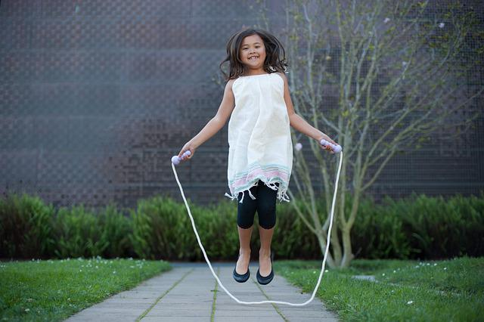
Subject and Predicate
Gita
is skipping.
Subject
Predicate
Notes:
Notes for Teacher - After the teacher asks the question, students give a variety of answers.
Suggestions: N/A
Source of Multimedia used in this slide -
Girl skipping - https://pixabay.com/photos/jump-rope-girl-jump-jumping-5746626/
Blackboard - https://publicdomainvectors.org/en/free-clipart/Vector-illustration-of-blackboard/7534.html

Slide 3
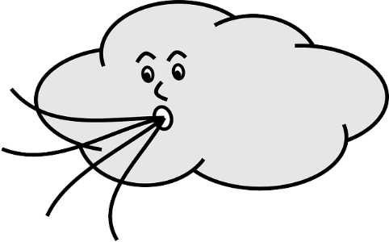
Practice
The wind is blowing.
The leaves are falling.
The Sun is shining.
Subject
Predicate
Subject
Predicate
Subject
Predicate
Notes:
Notes for Teacher - Board a few student’s responses to confirm their understanding of the concept. Correct them if necessary.
Write some more example sentences on the blackboard with things as Subjects and ask them to identify Subject and Predicate.
Suggestions: N/A
Source of Multimedia used in this slide -
Wind blowing -https://pixabay.com/vectors/wind-blowing-cloud-face-weather-149701/
Leaves falling - https://pixabay.com/illustrations/autumn-isolated-blade-branch-5483537/
Sun shining -https://pixabay.com/vectors/blazing-face-shining-sun-symbol-2024298/

Slide 4
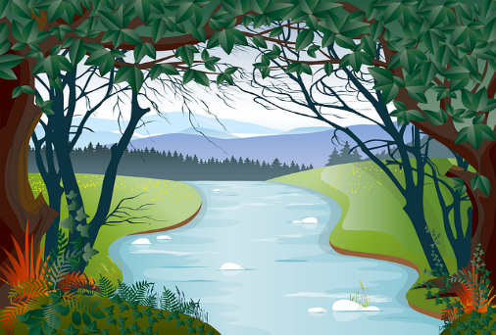
Practice
The water is boiling.
The river is flowing.
The birds are flying.
Subject
Predicate
Subject
Predicate
Subject
Predicate
Notes:
Notes for Teacher – N/A
Suggestions: N/A
Source of Multimedia used in this slide -
Water boiling -https://publicdomainvectors.org/en/free-clipart/Boiling-water-in-a-pot/83439.html
River flowing -https://pixabay.com/vectors/river-trees-field-brook-creek-6208962/
Birds flying - https://freesvg.org/colibri-birds

Slide 5
MM INDEX
Slide # | Thumbnail | Source link and Attribution
1 |  | Piles of books - https://www.rawpixel.com/image/6584277/vector-background-design-book
2,.3 |  | Girl skipping - https://pixabay.com/photos/jump-rope-girl-jump-jumping-5746626/
3 |  | Wind blowing -https://pixabay.com/vectors/wind-blowing-cloud-face-weather-149701/ Leaves falling - https://pixabay.com/illustrations/autumn-isolated-blade-branch-5483537/ Sun shining -https://pixabay.com/vectors/blazing-face-shining-sun-symbol-2024298/ Water boiling -https://publicdomainvectors.org/en/free-clipart/Boiling-water-in-a-pot/83439.html River flowing -https://pixabay.com/vectors/river-trees-field-brook-creek-6208962/ https://freesvg.org/colibri-birds
Notes:
Notes for Teacher – N/A
Suggestions: N/A
Source of Multimedia used in this slide: N/A

