Slide 1
Subject or Predicate
Notes:
Notes for Teacher - < Information for further reference or explanation >
Suggestions: <Ideas/ Images/ Animations / Others – To make better representation of the content >
Source of Multimedia used in this slide - <Please provide source URL where we find the image and the license agreement>

Slide 2
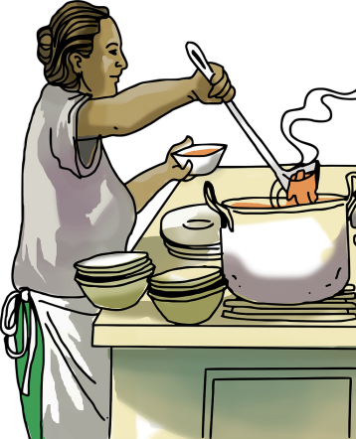
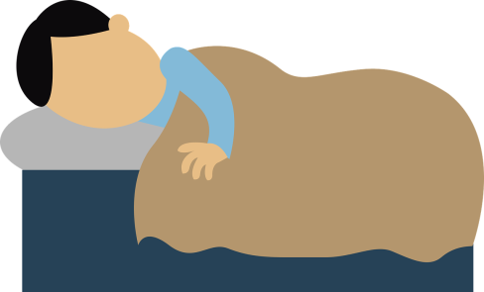
Subject or Predicate
My mother is cooking.
Predicate
Her brother was sleeping.
Subject
The school bell has rung.
Predicate
Notes:
Notes for Teacher - < Information for further reference or explanation >
Suggestions: <Ideas/ Images/ Animations / Others – To make better representation of the content >
Source of Multimedia used in this slide - <Please provide source URL where we find the image and the license agreement>
<cooking> <https://pixabay.com/illustrations/kitchen-cooking-woman-chef-6585871/>
<boy sleeping> <https://pixabay.com/vectors/sleep-sleeping-asleep-1389978/>
<school bell> <SSSVV - School Bell>

Slide 3
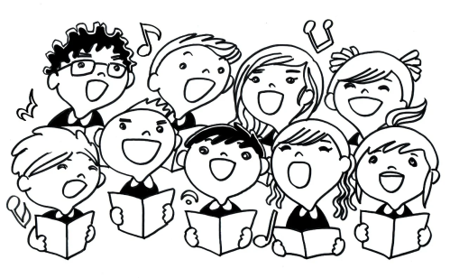
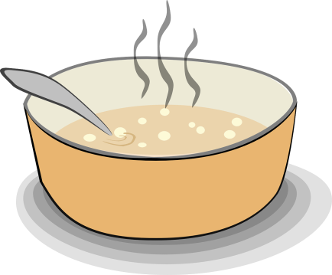
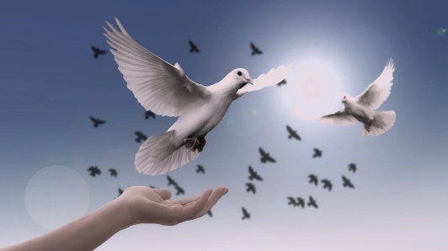
Subject or Predicate
All the children are singing.
Predicate
The soup is boiling.
Subject
The pigeons have flown away.
Predicate
Notes:
Notes for Teacher - < Information for further reference or explanation >
Suggestions: <Ideas/ Images/ Animations / Others – To make better representation of the content >
Source of Multimedia used in this slide - <Please provide source URL where we find the image and the license agreement>
<singing> <https://pixabay.com/illustrations/singing-children-song-sing-child-18382/>
<soup> <https://pixabay.com/vectors/soup-stew-steaming-bowl-food-hot-23469/>
<dove> <https://pixabay.com/photos/dove-peace-freedom-birds-faith-3426187/>

Slide 4
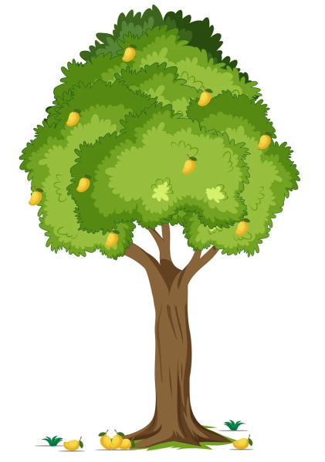
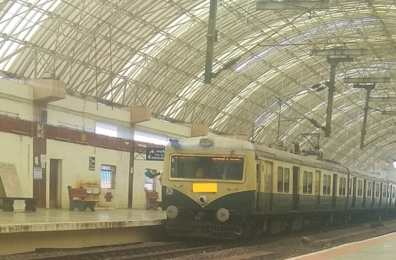
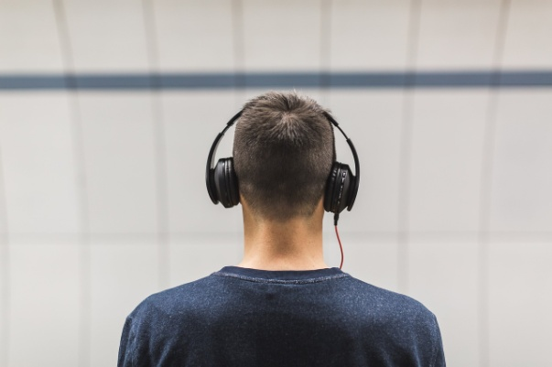
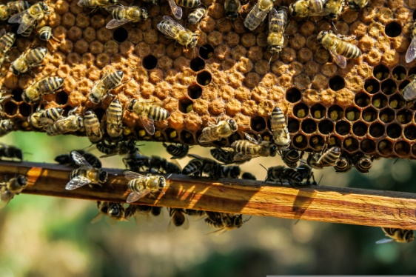
Subject or Predicate
Some mangoes have fallen down.
Subject
The train has arrived.
Predicate
My father is listening quietly.
Subject
The bees are buzzing.
Predicate
Notes:
Notes for Teacher - < Information for further reference or explanation >
Suggestions: <Ideas/ Images/ Animations / Others – To make better representation of the content >
Source of Multimedia used in this slide - <Please provide source URL where we find the image and the license agreement>
<mango tree> <https://pixabay.com/illustrations/mango-mango-tree-fruit-tree-6875556/>
<train> <SSSVV - Electric train electric-train-6992 Electric train>
<man with headphones> <https://pixabay.com/photos/people-man-headphones-music-sound-2572971/>
<bees> <https://pixabay.com/photos/apiary-bees-insects-macro-1867537/>

Slide 5
MM INDEX
Slide # | Thumbnail | Source link and Attribution
2 |  | <cooking> <SSSVV-sketch, story, hand drawn, mother, daughter, mother and daughter, cooking, LPG stove, LPG burner, window, boiling, food> <boy sleeping> <SSSVV - boy, sleeping, caring, father, > <school bell> <SSSVV - School Bell>
3 |  | <singing> <https://pixabay.com/illustrations/singing-children-song-sing-child-18382/> <soup> <https://pixabay.com/vectors/soup-stew-steaming-bowl-food-hot-23469/> <dove> <https://pixabay.com/photos/dove-peace-freedom-birds-faith-3426187/>
4 |  | <mango tree> <https://pixabay.com/illustrations/mango-mango-tree-fruit-tree-6875556/> <train> <SSSVV - Electric train electric-train-6992 Electric train> <man with headphones> <https://pixabay.com/photos/people-man-headphones-music-sound-2572971/> <bees> <https://pixabay.com/photos/apiary-bees-insects-macro-1867537/>
Notes:
Notes for Teacher - < Information for further reference or explanation >
Suggestions: <Ideas/ Images/ Animations / Others – To make better representation of the content >
Source of Multimedia used in this slide - <Please provide source URL where we find the image and the license agreement>

