Slide 1
Object - Let us identify
Notes:
Notes for Teacher – N/A
Suggestions: N/A
Source of Multimedia used in this slide - N/A

Slide 2
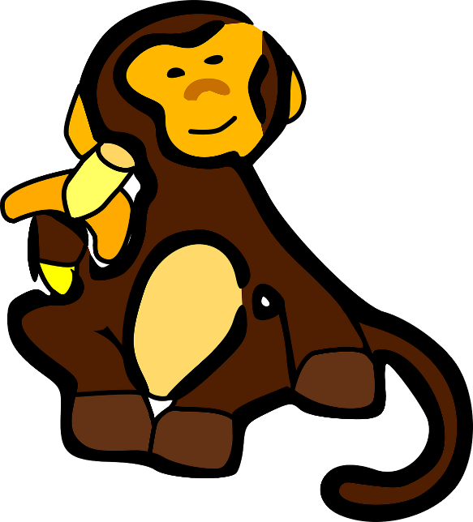
What do you see?
What do you see?
A monkey.
What is it doing?
Eating a banana.
Sentence – The monkey is eating a banana.
Subject -performing an action
Verb - the action
Object - receives the action
Notes:
Notes for Teacher – N/A
Suggestions: N/A
Source of Multimedia used in this slide -
<monkey> <https://pixabay.com/vectors/monkey-animal-cartoon-banana-zoo-30516/>

Slide 3
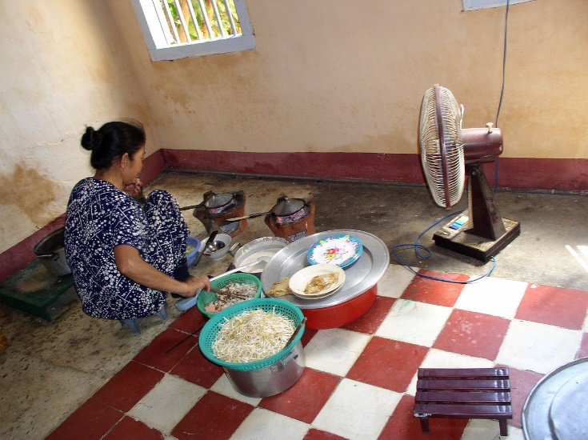
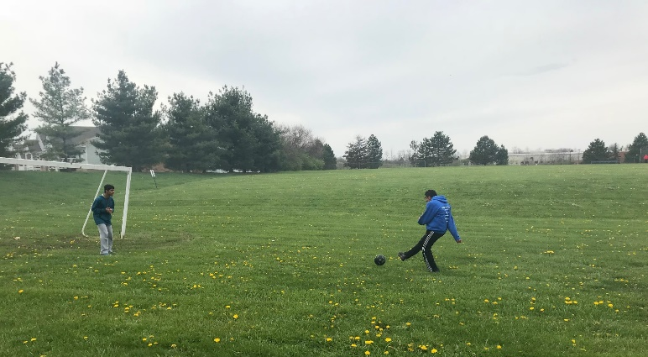
Identify the Object
The boys are playing football.
Mother is cooking vegetables.
Notes:
Notes for Teacher – N/A
Suggestions: N/A
Source of Multimedia used in this slide -
<football> <SSSVV Image Gallery: Search Keyword “Football”>
<woman cooking> <https://pixabay.com/photos/woman-poor-cooking-kitchen-hot-441497/>

Slide 4
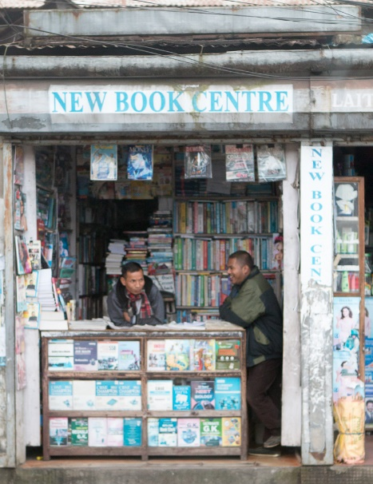
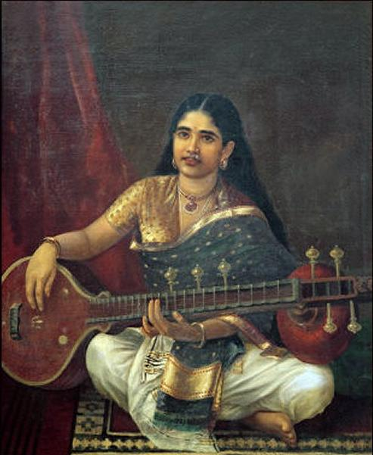
Identify the Object
My sister is playing the veena.
The shopkeeper is selling books.
Notes:
Notes for Teacher – N/A
Suggestions: N/A
Source of Multimedia used in this slide -
<veena> <https://commons.wikimedia.org/wiki/File:Woman_with_veena_by_Raja_Ravi_Varma.jpg By Raja Ravi Varma>
<bookstore> <https://www.flickr.com/photos/77334245@N00/49794838056 By Carsten ten Brink>

Slide 5
MM INDEX
Slide # | Thumbnail | Source link and Attribution
2 |  | <monkey> <https://pixabay.com/vectors/monkey-animal-cartoon-banana-zoo-30516/>
3 |  | <woman cooking> <https://pixabay.com/photos/woman-poor-cooking-kitchen-hot-441497/>
4 |  | <veena> <https://commons.wikimedia.org/wiki/File:Woman_with_veena_by_Raja_Ravi_Varma.jpg By Raja Ravi Varma> <bookstore> <https://www.flickr.com/photos/77334245@N00/49794838056 By Carsten ten Brink>
Notes:
Notes for Teacher – N/A
Suggestions: N/A
Source of Multimedia used in this slide - N/A

