Slide 1
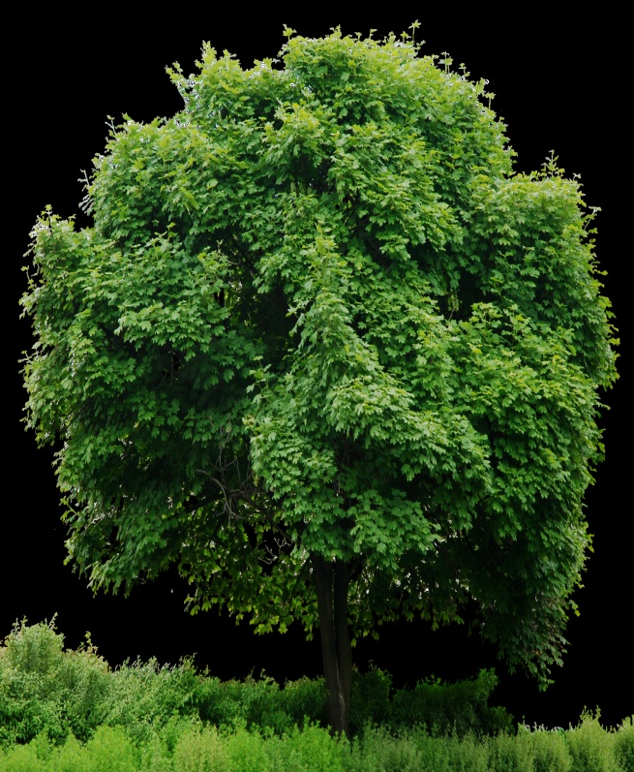
Importance of Trees
Notes:
Notes for Teacher - < Information for further reference or explanation >
Suggestions: <Ideas/ Images/ Animations / Others – To make better representation of the content >
Source of Multimedia used in this slide -
1. 1. Tree: https://www.hiclipart.com/free-transparent-background-png-clipart-ithyb/downloa

Slide 2
Importance of Trees
Trees help life on Earth. They shelter animals, birds and insects. Trees give fruits and flowers. They provide firewood, medicines and paper. Trees release oxygen and cool breeze. They bring clouds and rainfall. Trees hold soil and prevent floods. They absorb harmful gases and control pollution. So, we must respect trees.
Notes:
Notes for Teacher - < Information for further reference or explanation >
Teacher will show the PPT on the Importance of Trees to the students.
She will ask them to read the paragraph and identify Subject, Predicate and Object in each sentence.
This will be the paragraph that will be shown:
Green - Subject
Blue – Verb
Orange - Object
Suggestions: <Ideas/ Images/ Animations / Others – To make better representation of the content >
Source of Multimedia used in this slide -
Tree: https://www.hiclipart.com/free-transparent-background-png-clipart-ithyb/download

Slide 3
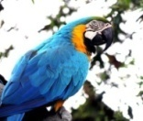
Importance of Trees
Trees help life on Earth.
They shelter animals, birds and insects.
Notes:
Notes for Teacher – < Information for further reference or explanation >
Green - Subject
Blue – Verb
Orange - Object Suggestions: <Ideas/ Images/ Animations / Others – To make better representation of the content >
Source of Multimedia used in this slide -
Tree: https://www.hiclipart.com/free-transparent-background-png-clipart-ithyb/download
Tiger: https://pixabay.com/photos/tiger-feline-stripes-big-cat-1868911/
Bird: https://pixabay.com/photos/macaw-bird-animal-parrot-410144/
Ladybird: https://pixabay.com/vectors/ladybug-beetle-insect-156624/
Butterfly: https://pixabay.com/vectors/animal-butterfly-chromatic-flying-2027356/
Butterfly Blue: https://pixabay.com/vectors/animal-butterfly-chromatic-colorful-1769728/

Slide 4
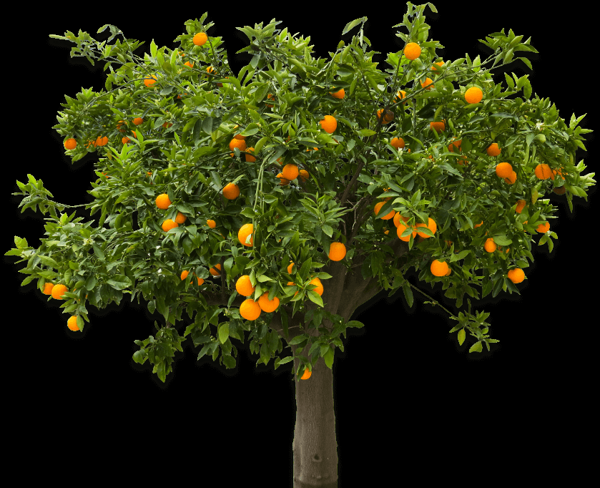
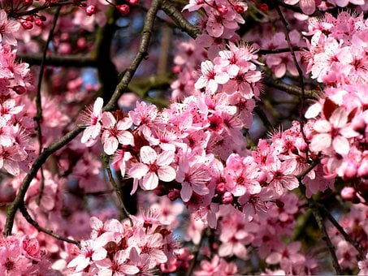
Importance of Trees
Trees give fruits and flowers.
Notes:
Notes for Teacher –
Green - Subject
Blue – Verb
Orange - Object
Suggestions: <Ideas/ Images/ Animations / Others – To make better representation of the content >
Source of Multimedia used in this slide -
Flowers: https://pixabay.com/photos/almond-tree-blossoms-almond-blossom-1982539/
Tree: https://www.hiclipart.com/free-transparent-background-png-clipart-jrlxq/download

Slide 5
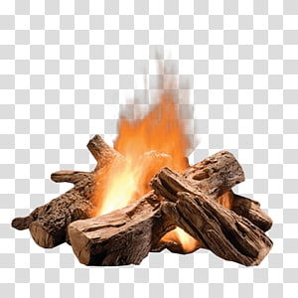
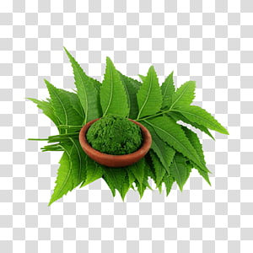
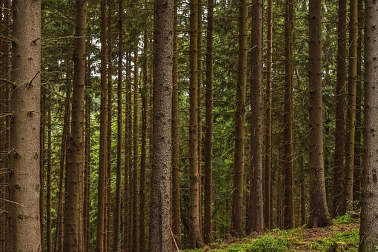
Importance of Trees
They provide firewood, medicines and paper.
Notes:
Notes for Teacher –
Green - Subject
Blue – Verb
Orange - Object
Suggestions: <Ideas/ Images/ Animations / Others – To make better representation of the content >
Source of Multimedia used in this slide -
Firewood: https://www.hiclipart.com/free-transparent-background-png-clipart-irovi
Medicines: https://www.hiclipart.com/free-transparent-background-png-clipart-nctsh
Paper: https://pixabay.com/photos/forest-trees-pine-nature-landscape-4335520/

Slide 6
Importance of Trees
Trees release oxygen and cool breeze.
They bring clouds and rainfall.
Notes:
Notes for Teacher –
Green - Subject
Blue – Verb
Orange - Object Suggestions: <Ideas/ Images/ Animations / Others – To make better representation of the content >
Source of Multimedia used in this slide -
Tree: https://www.hiclipart.com/free-transparent-background-png-clipart-ithyb/download
Cloud: https://www.hiclipart.com/free-transparent-background-png-clipart-mzluh/download

Slide 7
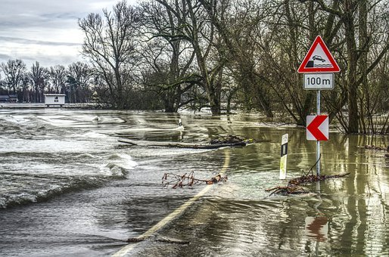
Importance of Trees
Trees hold soil and prevent floods.
Notes:
Notes for Teacher –
Green - Subject
Blue – Verb
Orange - Object Suggestions: <Ideas/ Images/ Animations / Others – To make better representation of the content >
Source of Multimedia used in this slide -
Tree floods: https://pixabay.com/photos/flood-flooded-floods-underwater-3067060/

Slide 8
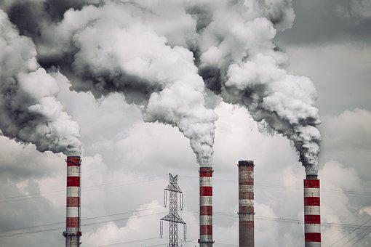
Importance of Trees
They absorb harmful gases and control pollution.
So, we must respect trees.
Notes:
Notes for Teacher –
Green - Subject
Blue – Verb
Orange - Object Suggestions: <Ideas/ Images/ Animations / Others – To make better representation of the content >
Source of Multimedia used in this slide -
Tree: https://www.hiclipart.com/free-transparent-background-png-clipart-ithyb/download
Smoke: https://pixabay.com/photos/power-station-chimneys-factory-smog-6579092/

Slide 9
MM Index
Slide # | Thumbnail | Source link and Attribution
1,2 |  | 1. Tree: https://www.hiclipart.com/free-transparent-background-png-clipart-ithyb
3 |  | Tree: https://www.hiclipart.com/free-transparent-background-png-clipart-ithyb Tiger: https://pixabay.com/photos/tiger-feline-stripes-big-cat-1868911/ Bird: https://pixabay.com/photos/macaw-bird-animal-parrot-410144/ Ladybird: https://pixabay.com/vectors/ladybug-beetle-insect-156624/ Butterfly: https://pixabay.com/vectors/animal-butterfly-chromatic-flying-2027356/ Butterfly Blue: https://pixabay.com/vectors/animal-butterfly-chromatic-colorful-1769728/
4 |  | Flowers: https://pixabay.com/photos/almond-tree-blossoms-almond-blossom-1982539/ Tree: https://www.hiclipart.com/free-transparent-background-png-clipart-jrlxq
5 |  | Firewood: https://www.hiclipart.com/free-transparent-background-png-clipart-irovi Medicines: https://www.hiclipart.com/free-transparent-background-png-clipart-nctsh Paper: https://pixabay.com/photos/forest-trees-pine-nature-landscape-4335520/
6 |  | Tree: https://www.hiclipart.com/free-transparent-background-png-clipart-ithyb Cloud: https://www.hiclipart.com/free-transparent-background-png-clipart-mzluh
7 |  | 1. Tree floods: https://pixabay.com/photos/flood-flooded-floods-underwater-3067060/
8 |  | Tree: https://www.hiclipart.com/free-transparent-background-png-clipart-ithyb Smoke: https://pixabay.com/photos/power-station-chimneys-factory-smog-6579092/
Notes:
Notes for Teacher - < Information for further reference or explanation >
Suggestions: <Ideas/ Images/ Animations / Others – To make better representation of the content >
Source of Multimedia used in this slide - <Please provide source URL where we find the image and the license agreement>

