Slide 1
Types of Objects
Direct/Indirect objects
Direct object answers the question ‘what’
Indirect object answers the question ‘to whom’
Notes:
Notes for Teacher - < Information for further reference or explanation >
Suggestions: <Ideas/ Images/ Animations / Others – To make better representation of the content >
Source of Multimedia used in this slide - <Please provide source URL where we find the image and the license agreement>

Slide 2
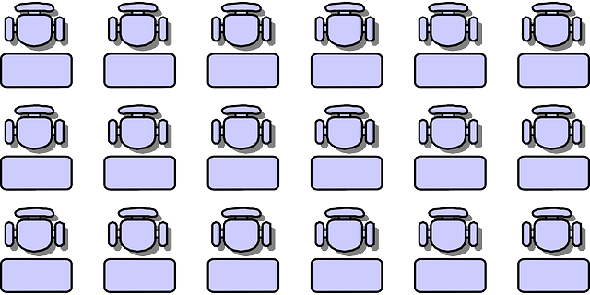
Subject
What is the Subject in this sentence?
Mother
gave me an apple.
Mother
Notes:
Notes for Teacher - < Information for further reference or explanation >
Suggestions: <Ideas/ Images/ Animations / Others – To make better representation of the content >
Source of Multimedia used in this slide - <Please provide source URL where we find the image and the license agreement>

Slide 3
Verb
What is the Verb?
Mother
gave
me an apple.
gave
Notes:
Notes for Teacher - < Information for further reference or explanation >
Suggestions: <Ideas/ Images/ Animations / Others – To make better representation of the content >
Source of Multimedia used in this slide - <Please provide source URL where we find the image and the license agreement>

Slide 4
Object
And the Object?
Mother gave
me
an apple.
me
an apple
Notes:
Notes for Teacher - < Information for further reference or explanation >
Suggestions: <Ideas/ Images/ Animations / Others – To make better representation of the content >
Source of Multimedia used in this slide - <Please provide source URL where we find the image and the license agreement>

Slide 5
How many objects are there in the sentence?
Do you agree that there are two Objects here?
Mother gave me an apple.
Yes teacher
Notes:
Notes for Teacher - < Information for further reference or explanation >
Suggestions: <Ideas/ Images/ Animations / Others – To make better representation of the content >
Source of Multimedia used in this slide - <Please provide source URL where we find the image and the license agreement>

Slide 6
Explaining the 2 objects
What did the mother give?
Mother gave me
an apple.
An apple
Notes:
Notes for Teacher - < Information for further reference or explanation >
Suggestions: <Ideas/ Images/ Animations / Others – To make better representation of the content >
Source of Multimedia used in this slide - <Please provide source URL where we find the image and the license agreement>

Slide 7
Direct Object
answers the question ‘what’
Right! An apple answers the question ‘what’ and is therefore called the direct object.
Mother gave me an apple.
Direct Object
Notes:
Notes for Teacher - < Information for further reference or explanation >
Suggestions: <Ideas/ Images/ Animations / Others – To make better representation of the content >
Source of Multimedia used in this slide - <Please provide source URL where we find the image and the license agreement>

Slide 8
Explaining the second object
To whom did the mother give an apple?
Mother gave
me
an apple.
To ‘me’
Notes:
Notes for Teacher - < Information for further reference or explanation >
Suggestions: <Ideas/ Images/ Animations / Others – To make better representation of the content >
Source of Multimedia used in this slide - <Please provide source URL where we find the image and the license agreement>

Slide 9
Indirect Object
answers the question ‘to whom’
Good! ‘me’ here is the indirect object because it answers the question ‘to whom’.
Mother gave me an apple.
Indirect Object
Notes:
Notes for Teacher - < Information for further reference or explanation >
Suggestions: <Ideas/ Images/ Animations / Others – To make better representation of the content >
Source of Multimedia used in this slide - <Please provide source URL where we find the image and the license agreement>

Slide 10
Summarizing
Mother gave me an apple.
↓ ↓ ↓ ↓
Subject Verb Indirect Object Direct Object
Notes:
Notes for Teacher - < Information for further reference or explanation >
Suggestions: <Ideas/ Images/ Animations / Others – To make better representation of the content >
Source of Multimedia used in this slide - <Please provide source URL where we find the image and the license agreement>

Slide 11
MM Index
Slide # | Thumbnail | Source link and Attribution
1 |  | https://pixabay.com/vectors/teacher-students-schoolboys-pupils-158711/ https://pixabay.com/illustrations/teacher-school-university-board-1015630/
2,3,4,5,6,7,8,9 |  | https://pixabay.com/vectors/teacher-silhouette-black-isolated-309533/ https://pixabay.com/illustrations/board-school-blackboard-empty-114656/ https://pixabay.com/vectors/classroom-students-sitting-three-36509/
Notes:
Notes for Teacher - < Information for further reference or explanation >
Suggestions: <Ideas/ Images/ Animations / Others – To make better representation of the content >
Source of Multimedia used in this slide - <Please provide source URL where we find the image and the license agreement>

