Slide 1
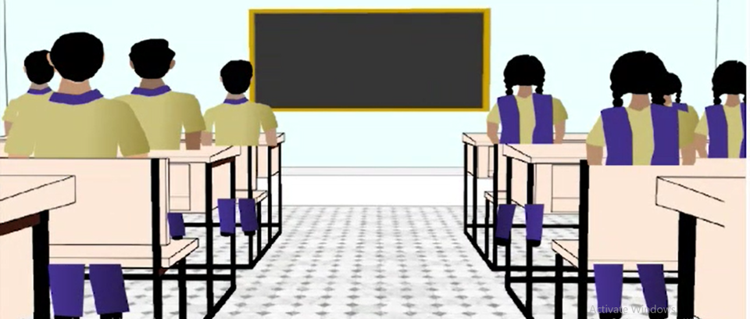
Discipline for Happy Living
Notes:
Notes for Teacher - < Information for further reference or explanation >
Suggestions: <Ideas/ Images/ Animations / Others – To make better representation of the content >
Source of Multimedia used in this slide - <Please provide source URL where we find the image and the license agreement>
<Classroom discipline> <SSSVV-Classroom Classroom Class, classmates, school, classroom>

Slide 2
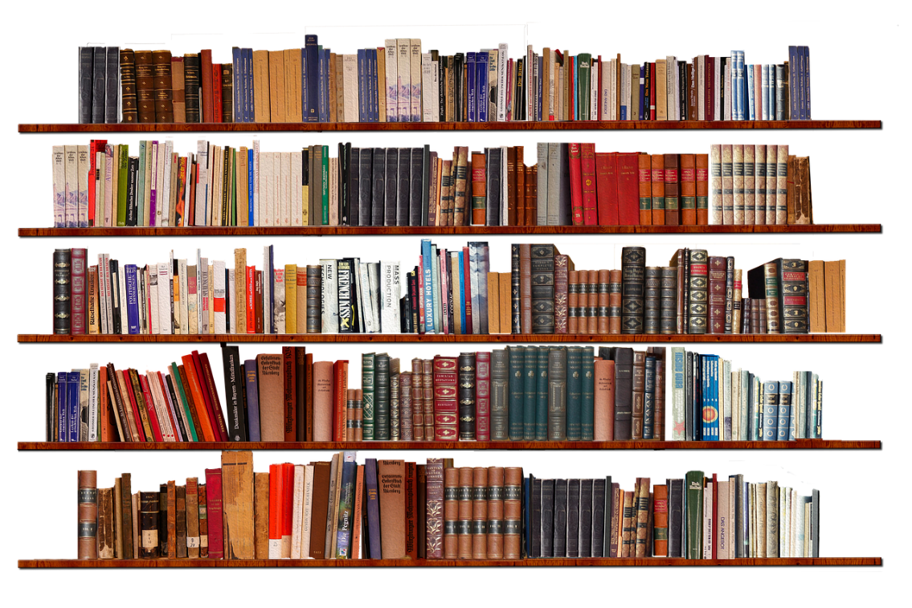
Sentence formation
A sentence will be meaningful only when the words are placed in an orderly and disciplined manner.
So too, our lives become meaningful only when we follow certain disciplines.
Notes:
Notes for Teacher - < Information for further reference or explanation >
Suggestions: <Ideas/ Images/ Animations / Others – To make better representation of the content >
Source of Multimedia used in this slide - <Please provide source URL where we find the image and the license agreement>
<book shelf> <https://pixabay.com/photos/books-shelves-library-bookshelf-3981515/>

Slide 3
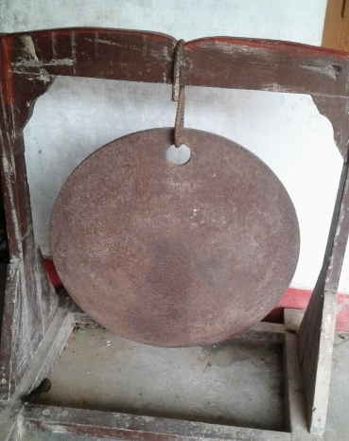
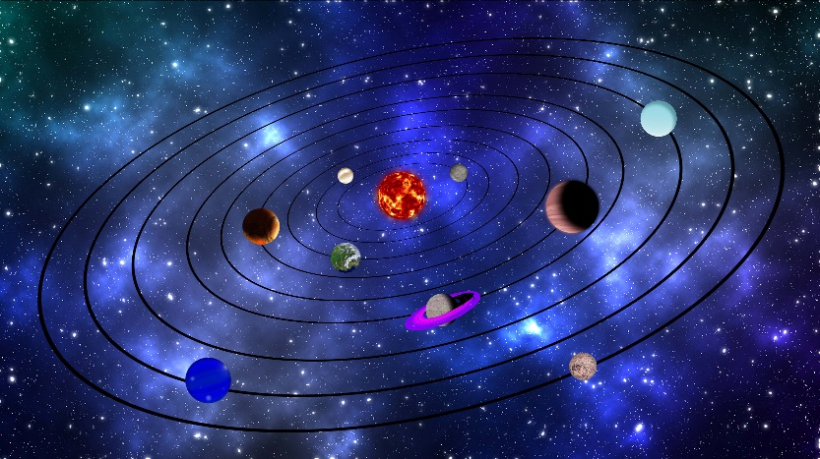
Discipline
Imagine what would happen:
If the school bell rang early on some days and late on some other days.
If the planets don’t revolve around their orbits.
If the Sun refused to shine .
Notes:
Notes for Teacher - < Information for further reference or explanation >
Suggestions: <Ideas/ Images/ Animations / Others – To make better representation of the content >
Source of Multimedia used in this slide - <Please provide source URL where we find the image and the license agreement>
<solar system> <SSSVV - Galaxy, Formation of Solar System, Solar System, Planets galaxy-formation-of-solar-system-solar-system-planets-5720 Galaxy, Formation of Solar System, Solar System, Planets>
<sun shine> <SSSVV - Sun, Sun Smiling sun-sun-smiling-5585 Sun, Sun Smiling>
<bell> <School Bell , bell school-bell-bell-7177 School Bell , bell>

Slide 4
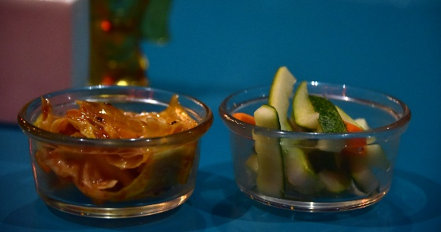
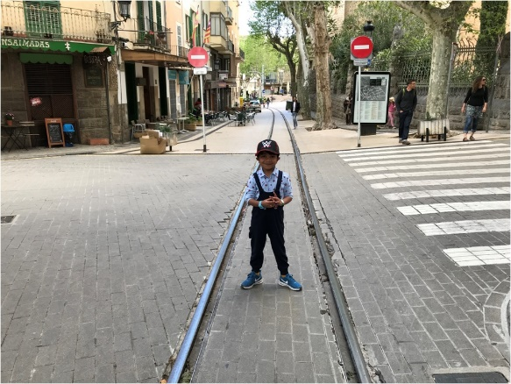
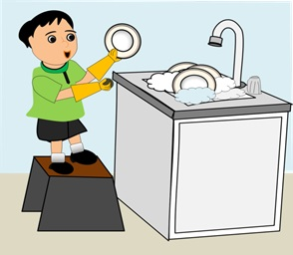
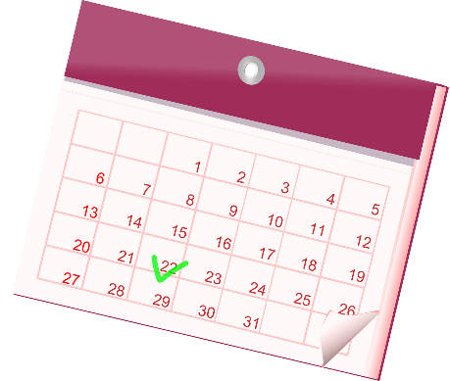
Discipline at home, school and community
Wake up on time.
Eat healthy.
Exercise daily.
Be neat and tidy.
Be punctual.
Adhere to laws, rules and disciplines.
Plan and be organized.
Notes:
Notes for Teacher - < Information for further reference or explanation >
Suggestions: <Ideas/ Images/ Animations / Others – To make better representation of the content >
Source of Multimedia used in this slide - <Please provide source URL where we find the image and the license agreement>
<alarm clock> <SSSVV - clocks clocks-7668 time piece, wrist watch>
<Salad> <SSSVV - Salad salad-7231 Vegetables, Healthy Diet, Food>
<yoga> <https://pixabay.com/vectors/yoga-exercise-female-fitness-girl-3432693/>
<neat and tidy> <SSSVV - Conservation of resources conservation-of-resources-6496 Water conservation, cleaning vessels, helping mom in kitchen, using less water to clean vessels, using less water to brush teeth, brushing teeth, using less water in toilets>
<law, rule, discipline> <SSSVV - Road road-6398 Signal, Zebra crossing>
<organised> <https://pixabay.com/vectors/calendar-month-year-date-datetime-159098/>
<punctual> <SSSVV - clocks clocks-7669 time piece, wrist watch>

Slide 5
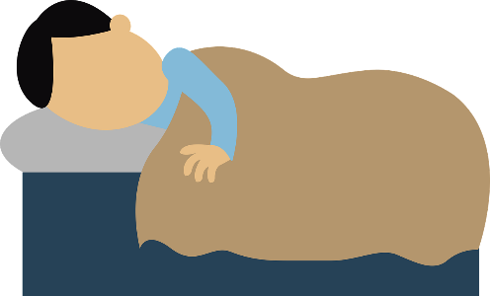
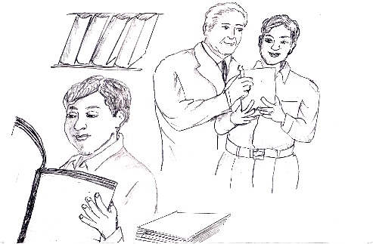
Activity
Early/wakes/Rama/up
Follows/traffic/the/rules/Seema
Rama wakes up early.
Seema follows the traffic rules.
Well/Mohan/studies
Room/Suman/cleans/her
Fruits/Raju/and/nuts/eats
Raju eats fruits and nuts.
Mohan studies well.
Suman cleans her room.
Notes:
Notes for Teacher - < Information for further reference or explanation >
Suggestions: <Ideas/ Images/ Animations / Others – To make better representation of the content >
Source of Multimedia used in this slide - <Please provide source URL where we find the image and the license agreement>
<sleeping> <https://pixabay.com/vectors/sleep-sleeping-asleep-1389978/>
<girl on bike> <https://pixabay.com/vectors/girl-cycle-helmet-sport-fast-tour-311181/>
<fruit basket> <https://pixabay.com/vectors/fruits-basket-fruits-basket-apple-5429751/>
<Boy studying> <SSSVV - Sketches sketches-5322 story, sketch, hand sketch, books, reading, library, book shelf, study room, boy, man, >
<girl cleaning> <https://pixabay.com/vectors/cleaning-silhouette-maid-duster-5196528/>

Slide 6
MM INDEX
Slide # | Thumbnail | Source link and Attribution
1 |  | <Classroom discipline> <SSSVV-Classroom Classroom Class, classmates, school, classroom>
2 |  | <book shelf> <https://pixabay.com/photos/books-shelves-library-bookshelf-3981515/>
3 |  | <solar system> <SSSVV - Galaxy, Formation of Solar System, Solar System, Planets galaxy-formation-of-solar-system-solar-system-planets-5720 Galaxy, Formation of Solar System, Solar System, Planets> <sun shine> <SSSVV - Sun, Sun Smiling sun-sun-smiling-5585 Sun, Sun Smiling> <bell> <School Bell , bell school-bell-bell-7177 School Bell , bell>
4 |  | <alarm clock> <SSSVV - clocks clocks-7668 time piece, wrist watch> <Salad> <SSSVV - Salad salad-7231 Vegetables, Healthy Diet, Food> <yoga> <https://pixabay.com/vectors/yoga-exercise-female-fitness-girl-3432693/> <neat and tidy> <SSSVV - Conservation of resources conservation-of-resources-6496 Water conservation, cleaning vessels, helping mom in kitchen, using less water to clean vessels, using less water to brush teeth, brushing teeth, using less water in toilets> <law, rule, discipline> <SSSVV - Road road-6398 Signal, Zebra crossing> <organised> <https://pixabay.com/vectors/calendar-month-year-date-datetime-159098/> <punctual> <SSSVV - clocks clocks-7669 time piece, wrist watch>
5 |  | <sleeping> <https://pixabay.com/vectors/sleep-sleeping-asleep-1389978/> <girl on bike> <https://pixabay.com/vectors/girl-cycle-helmet-sport-fast-tour-311181/> <fruit basket> <https://pixabay.com/vectors/fruits-basket-fruits-basket-apple-5429751/> <Boy studying> <SSSVV - Sketches sketches-5322 story, sketch, hand sketch, books, reading, library, book shelf, study room, boy, man, > <girl cleaning> <https://pixabay.com/vectors/cleaning-silhouette-maid-duster-5196528/>
Notes:
Notes for Teacher - < Information for further reference or explanation >
Suggestions: <Ideas/ Images/ Animations / Others – To make better representation of the content >
Source of Multimedia used in this slide - <Please provide source URL where we find the image and the license agreement>

