Slide 1
Quiz Time
Notes:
Notes for Teacher – N/A
Suggestions: N/A
Source of Multimedia used in this slide - N/A

Slide 2
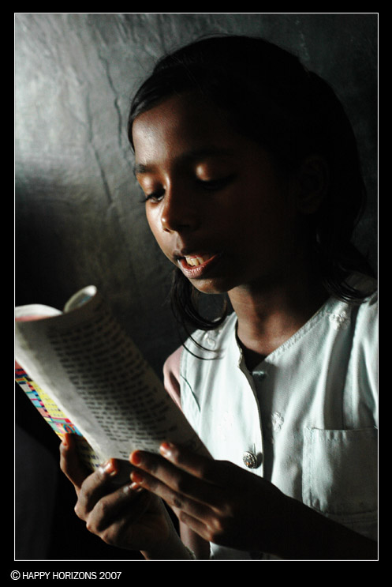
Quiz time
What is Dipti doing?
Click here
Dipti is reading a book.
Notes:
Notes for Teacher – N/A
Suggestions: N/A
Source of Multimedia used in this slide -
Girl - https://www.flickr.com/photos/72215997@N00/1273151126 By HappyHorizons

Slide 3
Quiz time
What is Vighnesh doing?
Click here
Vighnesh is riding a bicycle.
Notes:
Notes for Teacher – N/A
Suggestions: N/A
Source of Multimedia used in this slide -
Boy riding - https://www.flickr.com/photos/15694753@N00/4586402595 By Anoop Kumar

Slide 4
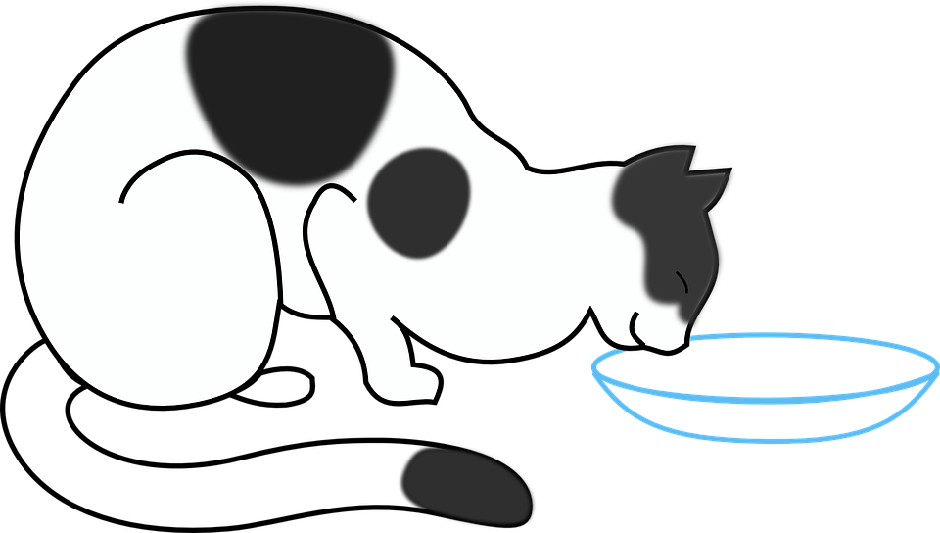
Quiz time
What is the cat doing?
Click here
The cat is drinking milk.
Notes:
Notes for Teacher – N/A
Suggestions: N/A
Source of Multimedia used in this slide -
Cat - https://pixabay.com/vectors/cat-drinking-milk-kitten-33595/

Slide 5
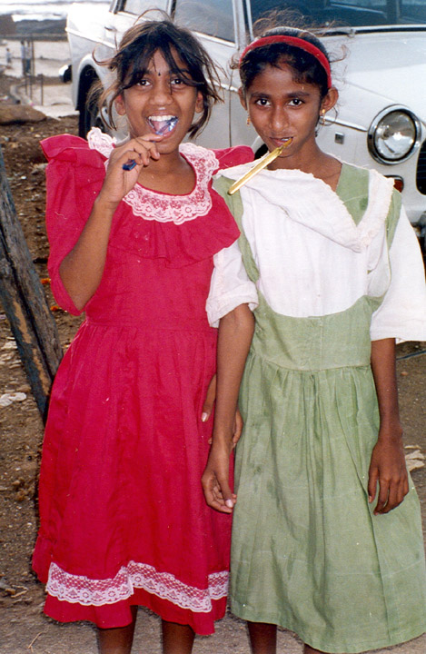
Quiz time
What is Roja doing?
Click here
Roja is brushing her teeth.
Notes:
Notes for Teacher – N/A
Suggestions: N/A
Source of Multimedia used in this slide - N/A
Brushing -https://www.flickr.com/photos/79139412@N00/95582273 By Bob Marquart

Slide 6
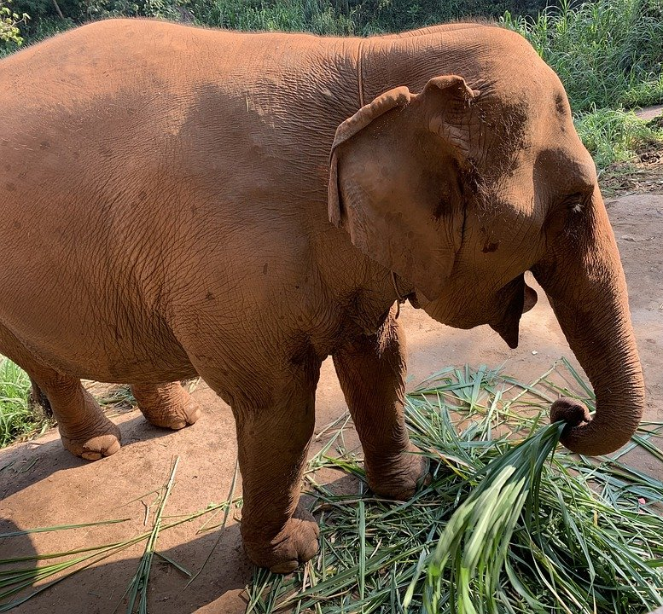
Quiz time
5. What is the elephant doing?
Click here
The elephant is eating grass.
Notes:
Notes for Teacher – N/A
Suggestions: N/A
Source of Multimedia used in this slide -
Elephant - https://pixabay.com/photos/elephant-thailand-eat-grass-4168443/

Slide 7
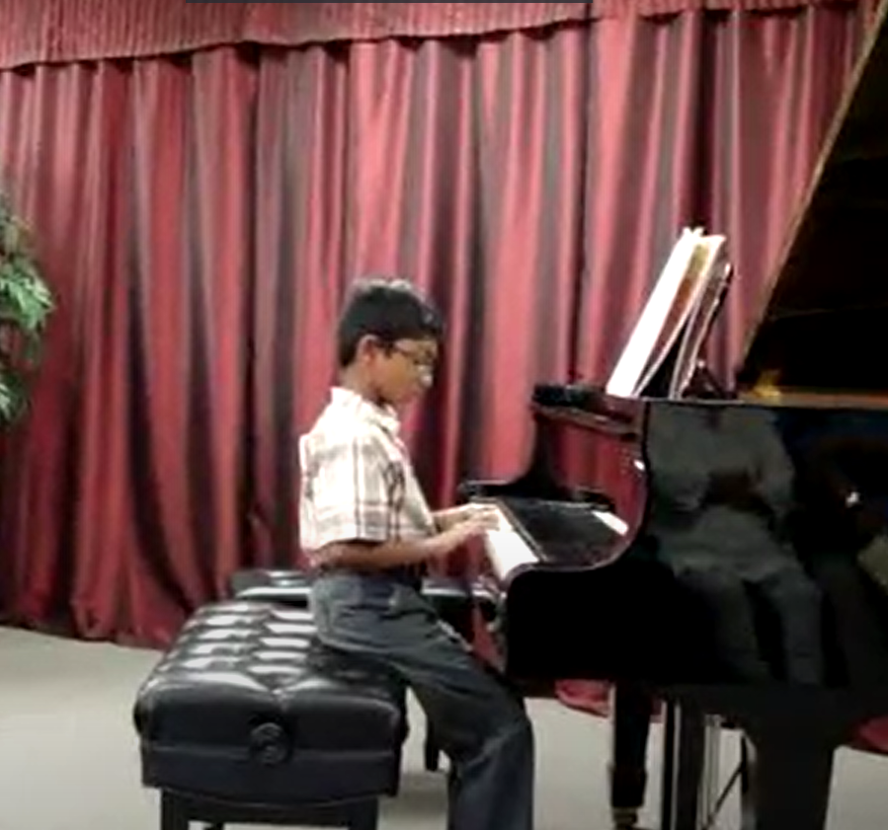
Quiz time
6. What is Mahesh doing?
Click here
Mahesh is playing the piano.
Notes:
Notes for Teacher – N/A
Suggestions: N/A
Source of Multimedia used in this slide -
Piano boy - https://drive.google.com/drive/folders/1yx6nTDlYUOHz-hFokN5aTp7hF_hJT2oi

Slide 8
MM INDEX
Slide # | Thumbnail | Source link and Attribution
2 |  | https://www.flickr.com/photos/72215997@N00/1273151126 By HappyHorizons
3 |  | https://www.flickr.com/photos/15694753@N00/4586402595 By Anoop Kumar
4 |  | https://pixabay.com/vectors/cat-drinking-milk-kitten-33595/
5 |  | https://www.flickr.com/photos/79139412@N00/95582273 By Bob Marquart
6 |  | https://pixabay.com/photos/elephant-thailand-eat-grass-4168443/
7 |  | https://drive.google.com/drive/folders/1yx6nTDlYUOHz-hFokN5aTp7hF_hJT2oi
Notes:
Notes for Teacher – N/A
Suggestions: N/A
Source of Multimedia used in this slide - N/A

