Slide 1
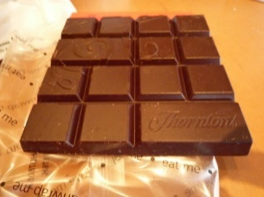
Summary Sentence Formation
He gave her a chocolate
Subject
Verb
Indirect Object
Direct Object
Notes:
Notes for Teacher - < Information for further reference or explanation >
Suggestions: <Ideas/ Images/ Animations / Others – To make better representation of the content >
Source of Multimedia used in this slide - <Please provide source URL where we find the image and the license agreement>

Slide 2
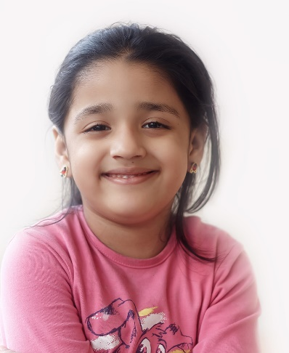
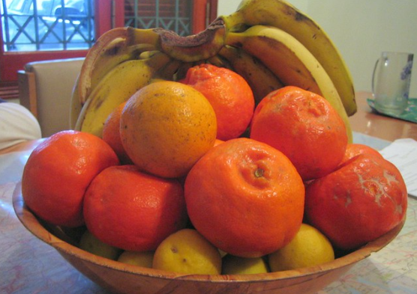
Common Way of Forming Sentence
SUBJECT
PREDICATE / VERB
OBJECT
The person or thing that performs the action
Expresses the action done by the subject
Receives the action of the verb
She likes fruits
Notes:
Notes for Teacher - < Information for further reference or explanation >
Suggestions: <Ideas/ Images/ Animations / Others – To make better representation of the content >
Source of Multimedia used in this slide - <Please provide source URL where we find the image and the license agreement>
Portrait of a Smiling Little Indian Girl - https://www.flickr.com/photos/47850033@N08/24849131082 – Attribute to Nithi Anand
Fruit Basket - https://www.flickr.com/photos/69903173@N00/1198031704 – Attribute to Jason Jacobs

Slide 3
Sentence Formation
Objects are of two types:
The Subject-Verb-Object word order should be maintained to make the sentence meaningful.
Direct
Indirect
Answers the question
‘what’
Answers the question
‘to whom’
The Predicate contains the Verb and may also have some other modifying words.
Notes:
Notes for Teacher - < Information for further reference or explanation >
Suggestions: <Ideas/ Images/ Animations / Others – To make better representation of the content >
Source of Multimedia used in this slide - <Please provide source URL where we find the image and the license agreement>
chilli chocolate bar - https://www.flickr.com/photos/16036153@N04/3915624132 – Attribute to Ambernectar 13
Cute happy smiling child - https://www.freepik.com/free-vector/cute-happy-smiling-child-isolated-white_5135263.htm – Attribute to brgfx
Girl - https://www.freepik.com/free-vector/indian-school-girl-happy-elementary-school-pupil-back-school_16495316.htm - Attribute to nizovatina

Slide 4
MM INDEX
Slide # | Thumbnail | Source link and Attribution
1 |  | Chilli chocolate bar - https://www.flickr.com/photos/16036153@N04/3915624132 – Attribute to Ambernectar 13 Cute happy smiling child - https://www.freepik.com/free-vector/cute-happy-smiling-child-isolated-white_5135263.htm – Attribute to brgfx Girl - https://www.freepik.com/free-vector/indian-school-girl-happy-elementary-school-pupil-back-school_16495316.htm - Attribute to nizovatina
2 |  | Portrait of a Smiling Little Indian Girl - https://www.flickr.com/photos/47850033@N08/24849131082 – Attribute to Nithi Anand Fruit Basket - https://www.flickr.com/photos/69903173@N00/1198031704 – Attribute to Jason Jacobs
Notes:
Notes for Teacher - < Information for further reference or explanation >
Suggestions: <Ideas/ Images/ Animations / Others – To make better representation of the content >
Source of Multimedia used in this slide - <Please provide source URL where we find the image and the license agreement>

