Slide 1
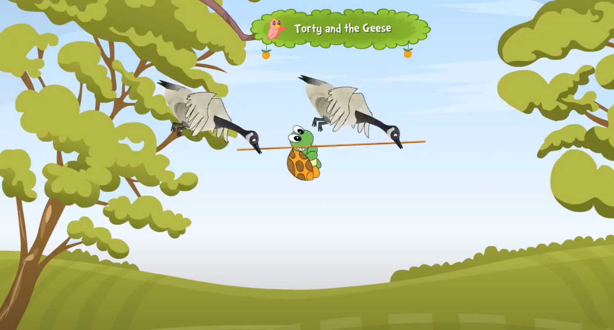
The Tortoise and the Geese
Notes:
Notes for Teacher - < Information for further reference or explanation >
Suggestions: <Ideas/ Images/ Animations / Others – To make better representation of the content >
Source of Multimedia used in this slide - <Please provide source URL where we find the image and the license agreement>
<opens mouth> https://youtu.be/VG5zvDuLVCs?t=210 < Anaika Educators>

Slide 2
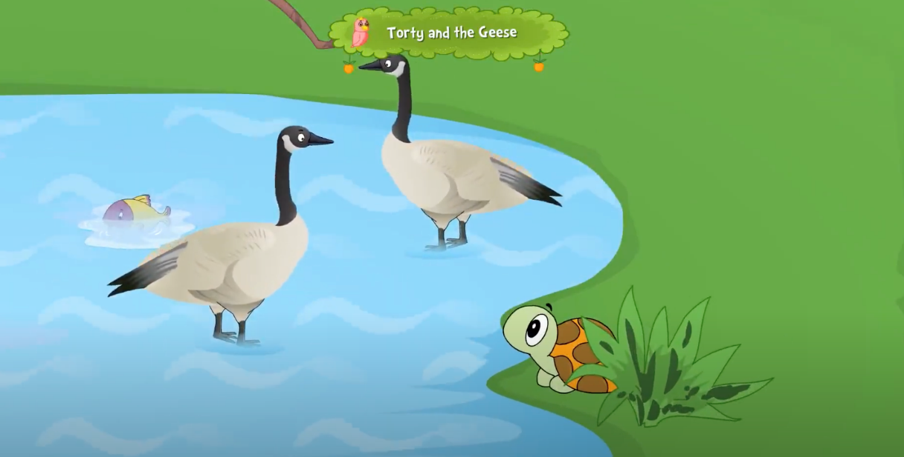
Tortoise and the Geese
1. Once upon a time, a tortoise lived near a lake.
2. Its friends were two geese that also lived in the same lake.
Notes:
Notes for Teacher - < Information for further reference or explanation >
Suggestions: <Ideas/ Images/ Animations / Others – To make better representation of the content >
Source of Multimedia used in this slide - <Please provide source URL where we find the image and the license agreement>
Tortoise talking - https://youtu.be/VG5zvDuLVCs?t=19 < Anaika Educators>

Slide 3
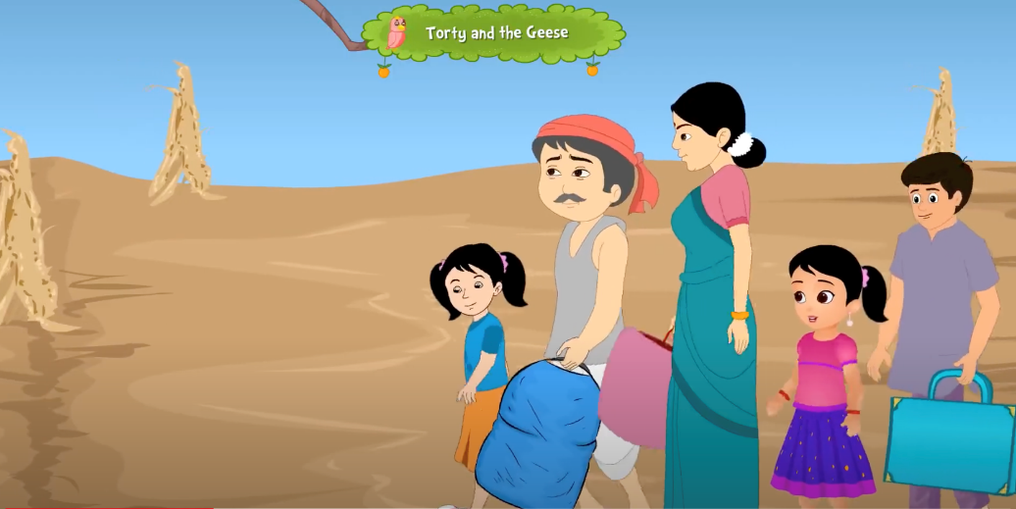
Lake Drying
3. One summer, the lake began to dry up, and there was little water for the animals.
4. The geese told the tortoise that there was another lake in another forest, where they should go to survive.
Notes:
Notes for Teacher - < Information for further reference or explanation >
Suggestions: <Ideas/ Images/ Animations / Others – To make better representation of the content >
Source of Multimedia used in this slide - <Please provide source URL where we find the image and the license agreement>
<no water> < https://youtu.be/VG5zvDuLVCs?t=51> Anaika Educators

Slide 4
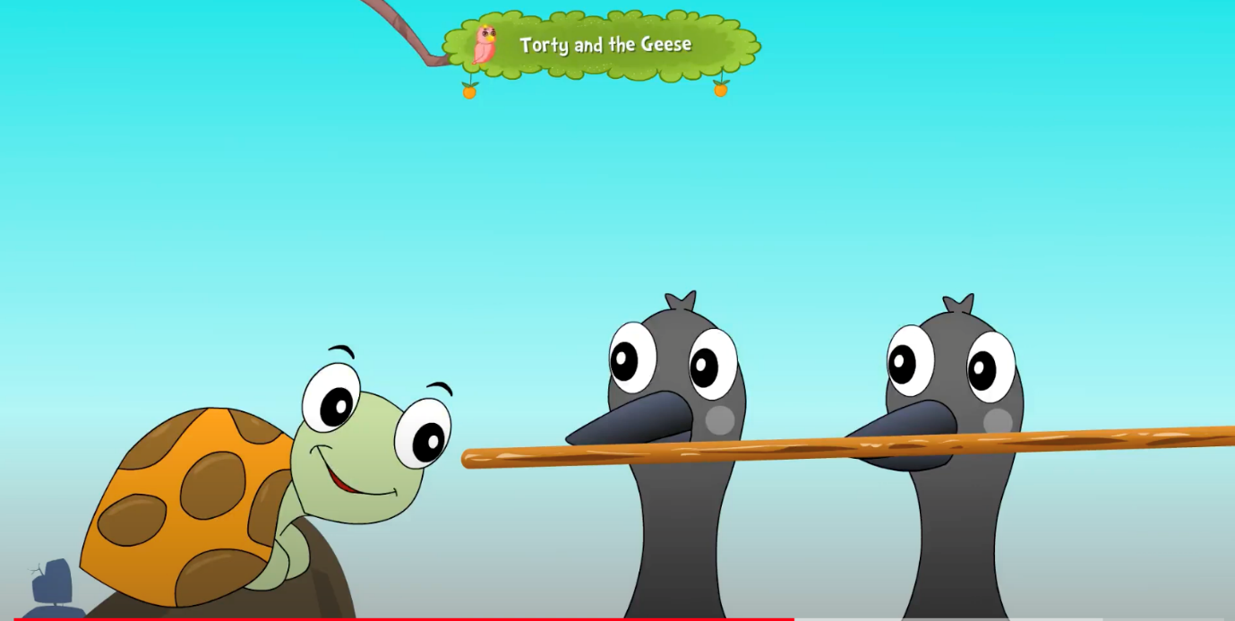
Plan
5. They came up with a plan to take the tortoise along with them.
6. They made the tortoise bite the centre of a stick and told it not to open its mouth, no matter what.
Notes:
Notes for Teacher - < Information for further reference or explanation >
Suggestions: <Ideas/ Images/ Animations / Others – To make better representation of the content >
Source of Multimedia used in this slide - <Please provide source URL where we find the image and the license agreement>
<tortoise with stick> https://youtu.be/VG5zvDuLVCs?t=160 < Anaika Educators>

Slide 5
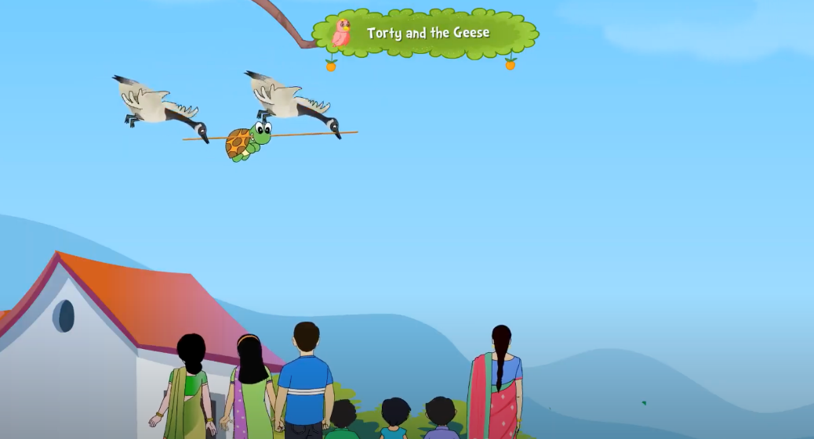
The Journey
7. The geese then held each end of the stick and flew with the tortoise in between.
8. People in the villages saw a tortoise flying and were awestruck.
9. In spite of warnings from the geese, the tortoise _______
Notes:
Notes for Teacher - < Information for further reference or explanation >
Suggestions: <Ideas/ Images/ Animations / Others – To make better representation of the content >
Source of Multimedia used in this slide - <Please provide source URL where we find the image and the license agreement>
<Flying and villagers watching> https://youtu.be/VG5zvDuLVCs?t=169 < Anaika Educators>
<flying> https://youtu.be/VG5zvDuLVCs?t=200 < Anaika Educators>

Slide 6
MM Index
Slide # | Thumbnail | Source link and Attribution
1 |  | <opens mouth> https://youtu.be/VG5zvDuLVCs?t=210 < Anaika Educators>
2 |  | Tortoise talking - https://youtu.be/VG5zvDuLVCs?t=19 < Anaika Educators>
3 |  | <no water> < https://youtu.be/VG5zvDuLVCs?t=51> Anaika Educators
4 |  | <tortoise with stick> https://youtu.be/VG5zvDuLVCs?t=160 < Anaika Educators>
5 |  | <Flying and villagers watching> https://youtu.be/VG5zvDuLVCs?t=169 < Anaika Educators> <flying> https://youtu.be/VG5zvDuLVCs?t=200 < Anaika Educators>
Notes:
Notes for Teacher - < Information for further reference or explanation >
Suggestions: <Ideas/ Images/ Animations / Others – To make better representation of the content >
Source of Multimedia used in this slide - <Please provide source URL where we find the image and the license agreement>

