Slide 1
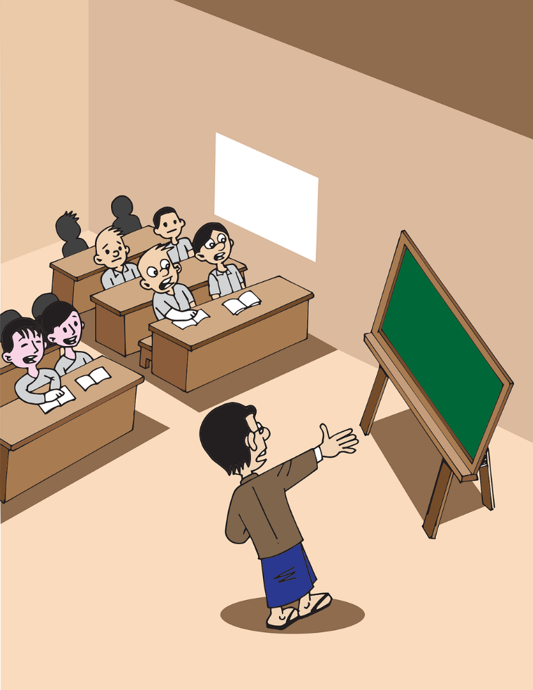
Some Interesting Facts
Notes:
Notes for Teacher - < Information for further reference or explanation >
Suggestions: <Ideas/ Images/ Animations / Others – To make better representation of the content >
Source of Multimedia used in this slide - <Please provide source URL where we find the image and the license agreement>
<classroom> <https://pixabay.com/vectors/myanmar-burma-school-classroom-5221135/>

Slide 2
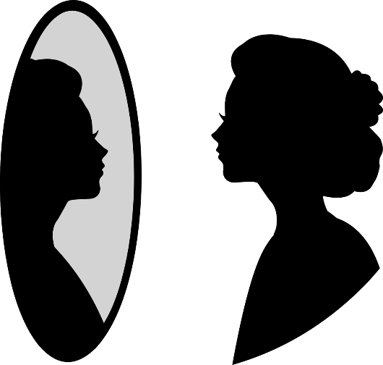
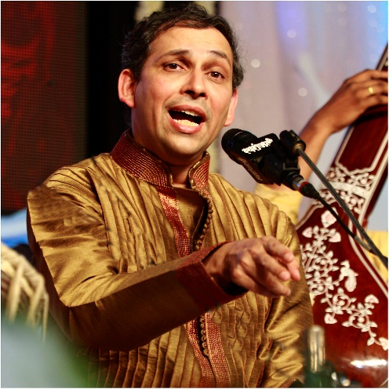
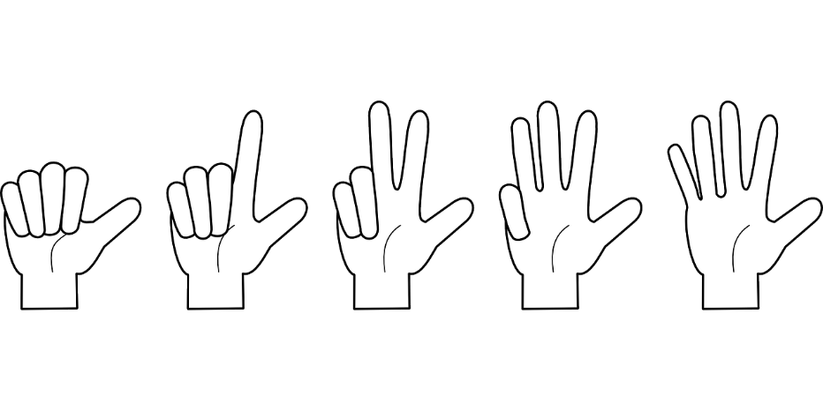
Interesting facts
You can’t count your hair.
The most used adjective in the English language is ‘good’.
You cannot see your ears without a mirror.
Notes:
Notes for Teacher - < Information for further reference or explanation >
Suggestions: <Ideas/ Images/ Animations / Others – To make better representation of the content >
Source of Multimedia used in this slide - <Please provide source URL where we find the image and the license agreement> <reflections> <https://pixabay.com/vectors/mirror-woman-silhouette-looking-4758692/>
<counting> <https://pixabay.com/vectors/hand-counting-fingers-one-two-162127/>
<singer> <https://www.flickr.com/photos/31341155@N07/8318216657 By Ramnath Bhat>

Slide 3
Interesting facts
The word Goodbye originally comes from an old English phrase meaning ‘God be with you’.
The two most common words in English are ‘I’ and ‘you’.
“Go!” is the shortest grammatically correct sentence in English.
GO
Notes:
Notes for Teacher - < Information for further reference or explanation >
Suggestions: <Ideas/ Images/ Animations / Others – To make better representation of the content >
Source of Multimedia used in this slide - <Please provide source URL where we find the image and the license agreement>
<English> <https://pixabay.com/vectors/dictionary-english-textbook-school-5094403/>
<praying> <https://pixabay.com/vectors/praying-kneeling-pray-people-man-294149/>

Slide 4
MM Index
Slide # | Thumbnail | Source link and Attribution
1 |  | https://pixabay.com/vectors/myanmar-burma-school-classroom-5221135/
2 |  | <reflections> <https://pixabay.com/vectors/mirror-woman-silhouette-looking-4758692/> <counting> <https://pixabay.com/vectors/hand-counting-fingers-one-two-162127/> <singer> <https://www.flickr.com/photos/31341155@N07/8318216657 By Ramnath Bhat>
3 |  | <English> <https://pixabay.com/vectors/dictionary-english-textbook-school-5094403/> <praying> <https://pixabay.com/vectors/praying-kneeling-pray-people-man-294149/>
Notes:
Notes for Teacher - < Information for further reference or explanation >
Suggestions: <Ideas/ Images/ Animations / Others – To make better representation of the content >
Source of Multimedia used in this slide - <Please provide source URL where we find the image and the license agreement>

