Slide 1
Household Chores
Notes:
Notes for Teacher - < Information for further reference or explanation >
Suggestions: <Ideas/ Images/ Animations / Others – To make better representation of the content >
Source of Multimedia used in this slide - <Please provide source URL where we find the image and the license agreement>
<chores> <SSSVV-Household chores household chores1 Housework, help, children, family, chores, share, together, dust, broom, vessels >

Slide 2
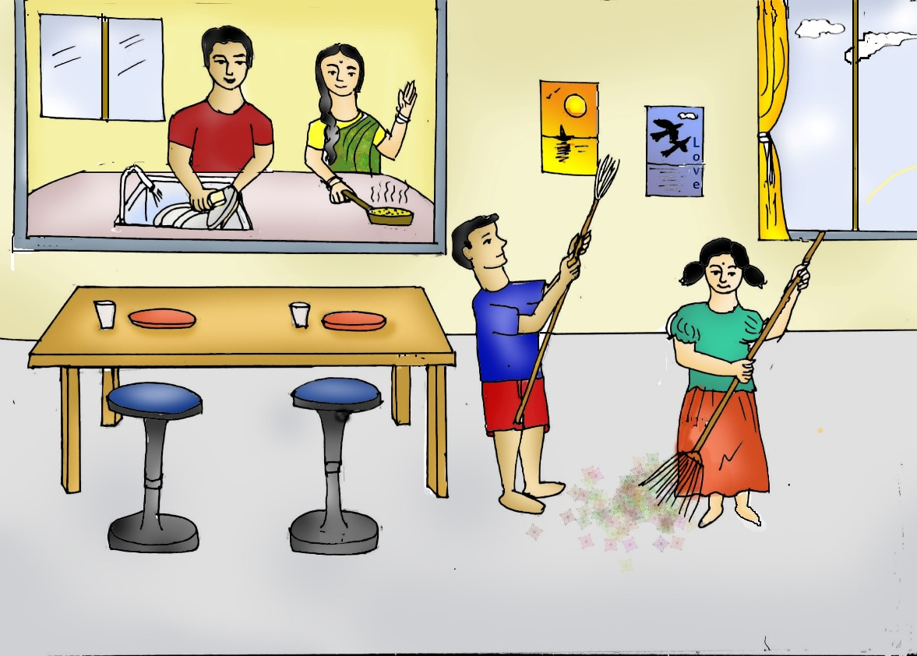
Choose the most appropriate verb
We ____ (is, are) three children in our family. My sister, my brother and I. We do some regular household chores. On Thursdays I ______ (clean, dirty) my room, help my mother in ________ (folding, fold) the clothes.
are
clean
folding
Notes:
Notes for Teacher - < Information for further reference or explanation >
Suggestions: <Ideas/ Images/ Animations / Others – To make better representation of the content >
Source of Multimedia used in this slide - <Please provide source URL where we find the image and the license agreement>
<chores> <SSSVV Image Gallery-Search Keyword “chore”>

Slide 3
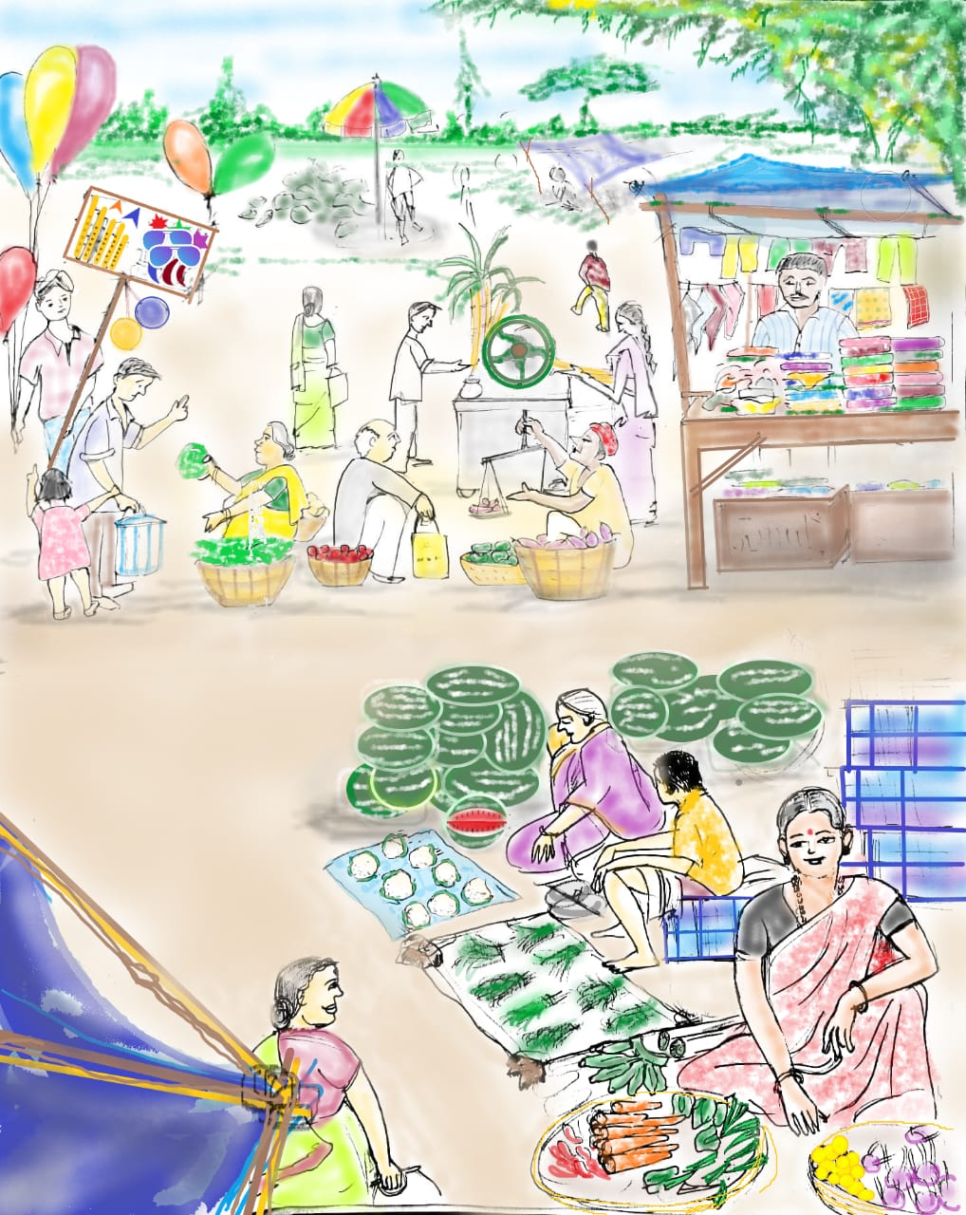
Choose the most appropriate verb
My brother _____(goes, go)to the market on Saturdays and _______(buys, buying) fruits and vegetables. My sister ______(does, do) a lot of work for my mother. She ________(makes, make) tea and coffee for all of us.
goes
buys
does
makes
Notes:
Notes for Teacher - < Information for further reference or explanation >
Suggestions: <Ideas/ Images/ Animations / Others – To make better representation of the content >
Source of Multimedia used in this slide - <Please provide source URL where we find the image and the license agreement>
<market> <SSSVV - Rural market, vegetable market, market at the village>

Slide 4
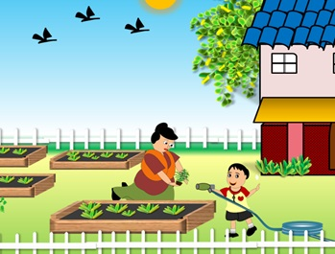
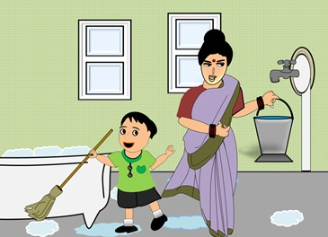
Choose the most appropriate verb
Last Sunday three of us ________ (scrubbed, scrubs) the floor and ________ (watered, watering) the plants in the garden. My mother felt so happy that she _________ (prepared , preparing) our favourite dishes for lunch and ________(thanked, thanks) us for helping her.
scrubbed
watered
prepared
thanked
Notes:
Notes for Teacher - < Information for further reference or explanation >
Suggestions: <Ideas/ Images/ Animations / Others – To make better representation of the content >
Source of Multimedia used in this slide - <Please provide source URL where we find the image and the license agreement>
<water garden> <SSSVV Image Gallery-Search Keyword “chore”>
<scrub floor> <SSSVV Image Gallery-Search Keyword “chore”>

Slide 5
MM Index
Slide # | Thumbnail | Source link and Attribution
2 |  | <chores> <SSSVV Image Gallery-Search Keyword “chore”>
3 |  | <market> <SSSVV Image Galery - Rural market, vegetable market, market at the village>
4 |  | <water garden> <SSSVV Image Gallery-Search Keyword “chore”> <scrub floor> <SSSVV Image Gallery-Search Keyword “chore”>
Notes:
Notes for Teacher - < Information for further reference or explanation >
Suggestions: <Ideas/ Images/ Animations / Others – To make better representation of the content >
Source of Multimedia used in this slide - <Please provide source URL where we find the image and the license agreement>

