Slide 1
Studying more about Verbs
Notes:
Notes for Teacher –N/A
Suggestions: N/A
Source of Multimedia used in this slide - N/A

Slide 2
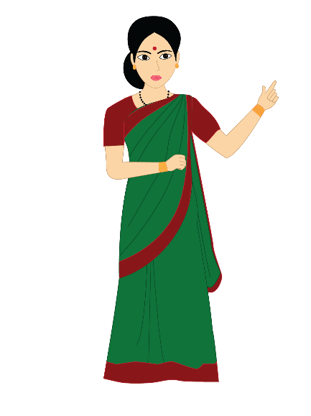
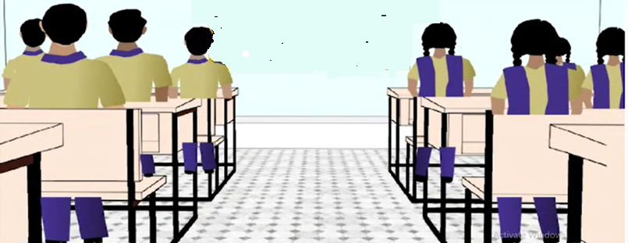
Guided Discovery Method
Base verb | Past Tense | Present/Past Participle
like | liked | liked
look | looked | looked
fry | fried | fried
take | took | taken
Do you observe any difference in the past tense form of the base verbs?
Answer
Some words ended in ‘d’, ‘ed’, ‘ied’
Some words have changed completely from the base verb – took, ate, flew.
Notes:
Notes for Teacher –N/A
Suggestions: N/A
Source of Multimedia used in this slide
Classroom: SSSVV Gallery
Teacher: SSSVV Gallery
Click: https://pixabay.com/vectors/hand-click-click-here-finger-touch-1367746/

Slide 3
Regular verbs
Follow the normal pattern when changing the base verb to Past and Past Participle forms.
i.
Add ‘ed’ and only ‘d’ if the verb already ends in an ‘e’
ii.
If the verb ends in a ‘y’, we change the last letter to an ‘i’ and then add the ‘ed’, ‘ied’. For example: ‘Marry – Married’
iii.
The Past tense of the base verbs remains the same in the Participle form. Example: ‘call – called’, ‘wait – waited’
Verb | Past Tense | Past Participle
Bake | baked | I had baked
Notes:
Notes for Teacher –The teacher then introduces the terms ‘Regular and Irregular Verbs to the students, defines and explains the differences with suitable examples
Suggestions: N/A
Source of Multimedia used in this slide - N/A

Slide 4
Regular verbs
Present/
Past Participle
Base Form
Past Tense
add
added
added
bake
baked
baked
cheer
cheered
cheered
enjoy
enjoyed
enjoyed
Notes:
Notes for Teacher –N/A
Suggestions: N/A
Source of Multimedia used in this slide - N/A

Slide 5
Irregular verbs
i.
Do not follow the normal pattern when being changed from base verbs by adding ‘d’, ‘ed’, or ‘ied’
ii.
They form completely new words in their Past tense and Past Participle form.
iii.
They can also be called rule breakers
Example:
Verb | Past Tense | Past Participle
Eat | I ate | I had eaten
Notes:
Notes for Teacher –N/A
Suggestions: N/A
Source of Multimedia used in this slide - N/A

Slide 6
Irregular verbs
Present/
Past Participle
Base Form
Past Tense
be
was/were
been
drive
drove
driven
know
knew
known
hide
hid
hidden
Notes:
Notes for Teacher –N/A
Suggestions: N/A
Source of Multimedia used in this slide - N/A

Slide 7
Irregular verbs
Present/
Past Participle
Base Form
Past Tense
speak
spoke
spoken
take
took
taken
begin
began
begun
do
did
done
Notes:
Notes for Teacher –N/A
Suggestions: N/A
Source of Multimedia used in this slide - N/A

Slide 8
MM INDEX
Slide # | Thumbnail | Source link and Attribution
2 |  | Click: https://pixabay.com/vectors/hand-click-click-here-finger-touch-1367746/
Notes:
Notes for Teacher –N/A
Suggestions: N/A
Source of Multimedia used in this slide

