Slide 1
Assessment Time
Notes:
Notes for Teacher - The teacher may present the questions and allow the students to write down the answers or speak up the answers before revealing them.
Suggestions: N/A
Source of Multimedia used in this slide -
https://pixabay.com/illustrations/quick-quiz-quiz-puzzle-questions-6701919/

Slide 2
Exercise 1
Indicate whether the verb is regular or irregular and write the Past tense and Past Participle.
Two Verbs have been worked out as examples.
Verb | Regular or Irregular | Past Tense | Past Participle
SHOP
BLOW
FALL
STAND
CARRY
Click for Answer
R
SHOPPED
SHOPPED
IR
BLEW
BLOWN
IR
FELL
FALLEN
IR
STOOD
STOOD
R
CARRIED
CARRIED
Notes:
Notes for Teacher - No clicks needed for this slide. Click the Show Answers button to view the answers.
Suggestions: N/A
Source of Multimedia used in this slide -
https://pixabay.com/vectors/question-mark-thinking-question-5656992/

Slide 3
Exercise 1 – Contd.
Verb | Regular or Irregular | Past Tense | Past Participle
AGREE
PLAY
CLEAN
SING
COOK
SWIM
DRIVE
R
AGREED
AGREED
PLAYED
Click for Answer
R
PLAYED
R
CLEANED
CLEANED
IR
SANG
SUNG
R
COOKED
COOKED
IR
SWAM
SWUM
IR
DROVE
DRIVEN
Notes:
Notes for Teacher - No clicks needed for this slide. Click the Show Answers button to view the answers.
Suggestions: N/A
Source of Multimedia used in this slide -
https://pixabay.com/vectors/question-mark-thinking-question-5656992/

Slide 4
Exercise 2
Select any five words from table in Exercise 1 and make sentences of your own with the words in the Past tense or Past Participle form.
Examples
AGREED
The teacher agreed to teach him how to be a good painter.
The storm has blown two little birds out of the nest.
BLOWN
Notes:
Notes for Teacher – N/A
Suggestions: N/A
Source of Multimedia used in this slide -
https://pixabay.com/vectors/question-mark-thinking-question-5656992/

Slide 5
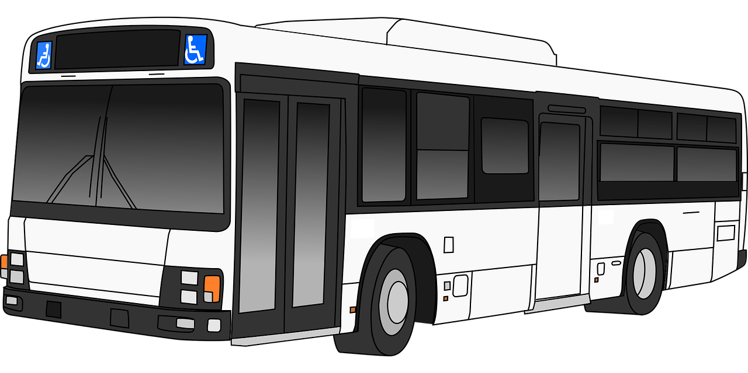
Exercise 3
Fill in the blanks with the appropriate form of the verbs given in brackets.
1. My wife _____ to work by bus yesterday (go)
Click for Answer
went
2. He was big and strong and soon ________ (become) a sailor.
became
Notes:
Notes for Teacher - No clicks needed for this slide. Click the Show Answers button to view the answers.
Suggestions: N/A
Source of Multimedia used in this slide -
https://pixabay.com/vectors/question-mark-thinking-question-5656992/
https://pixabay.com/vectors/bus-vehicle-travel-transportation-1297050/
https://pixabay.com/vectors/sailor-man-boat-smiling-cadet-1424820/

Slide 6
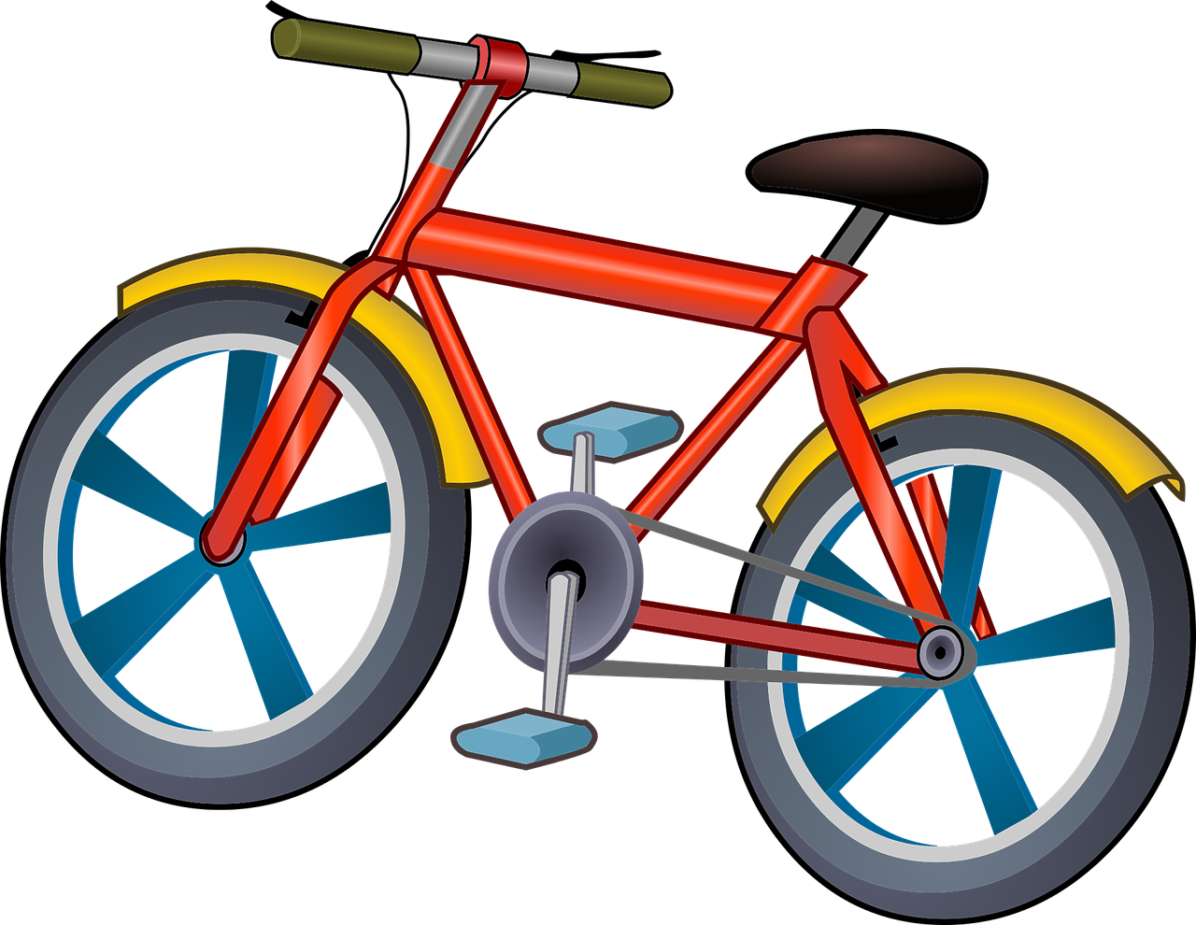
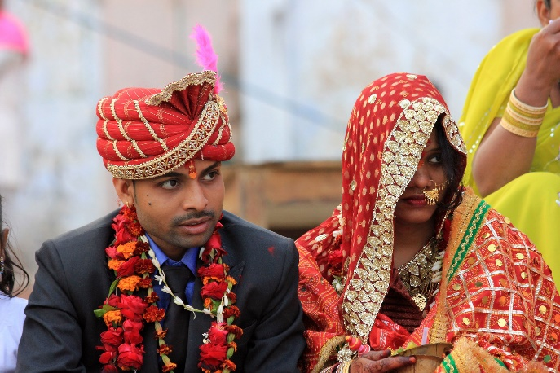
Exercise 3 – Contd.
3. The little boy _____ (break) his friend’s bicycle last week.
Click for Answer
broke
4. They got _______ last month (to marry).
married
Notes:
Notes for Teacher - No clicks needed for this slide. Click the Show Answers button to view the answers.
Suggestions: N/A
Source of Multimedia used in this slide -
https://pixabay.com/vectors/question-mark-thinking-question-5656992/
https://pixabay.com/vectors/bicycle-small-vehicle-bike-cycle-1456759/
https://pixabay.com/photos/india-wedding-color-woman-man-4870379/

Slide 7
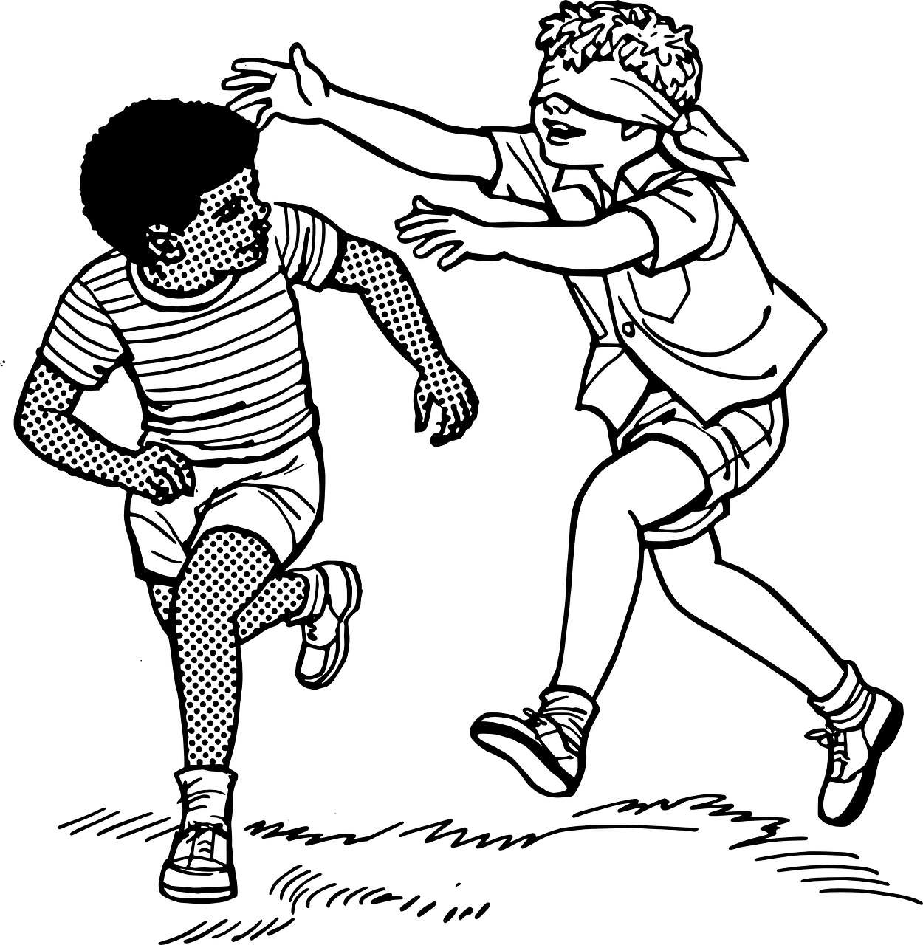
Exercise 3 – Contd.
5. We _____ (take) a taxi to reach home yesterday.
took
Click for Answer
6. My friends _______ (play) hide and seek with me this morning.
played
Notes:
Notes for Teacher - No clicks needed for this slide. Click the Show Answers button to view the answers.
Suggestions: N/A
Source of Multimedia used in this slide -
https://pixabay.com/vectors/question-mark-thinking-question-5656992/
https://pixabay.com/vectors/taxi-passenger-transportation-5693219
https://pixabay.com/vectors/blindfolded-chase-game-search-kids-37705/

Slide 8
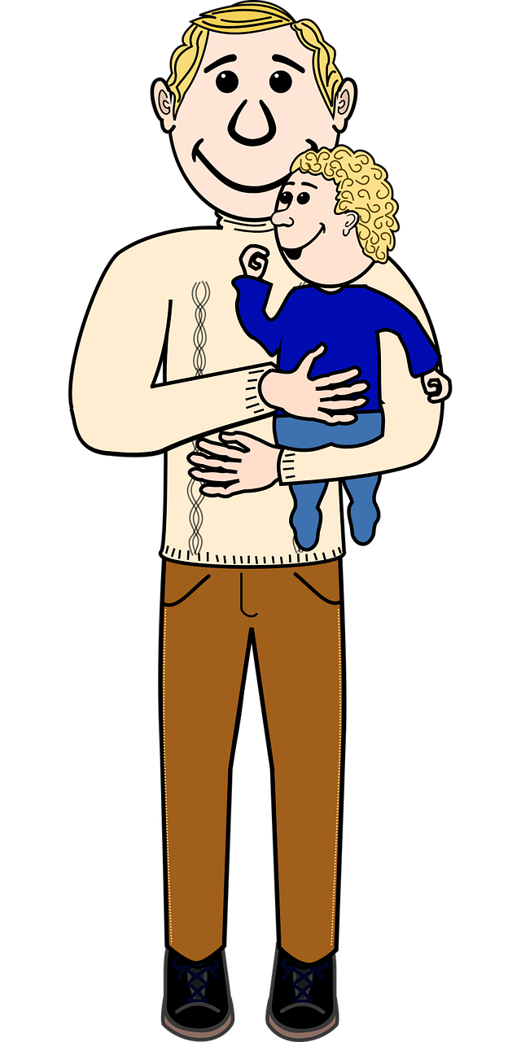
Exercise 3 – Contd.
7. The little girl _____ (hear) a strange voice near her house last night.
Click for Answer
heard
8. My father ______ (live) in Benaras for ten years.
lived
Notes:
Notes for Teacher - No clicks needed for this slide. Click the Show Answers button to view the answers.
Suggestions: N/A
Source of Multimedia used in this slide -
https://pixabay.com/vectors/question-mark-thinking-question-5656992/
https://pixabay.com/vectors/architecture-building-home-house-1299093/
https://pixabay.com/vectors/arm-baby-child-comic-dad-daddy-1294906/

Slide 9
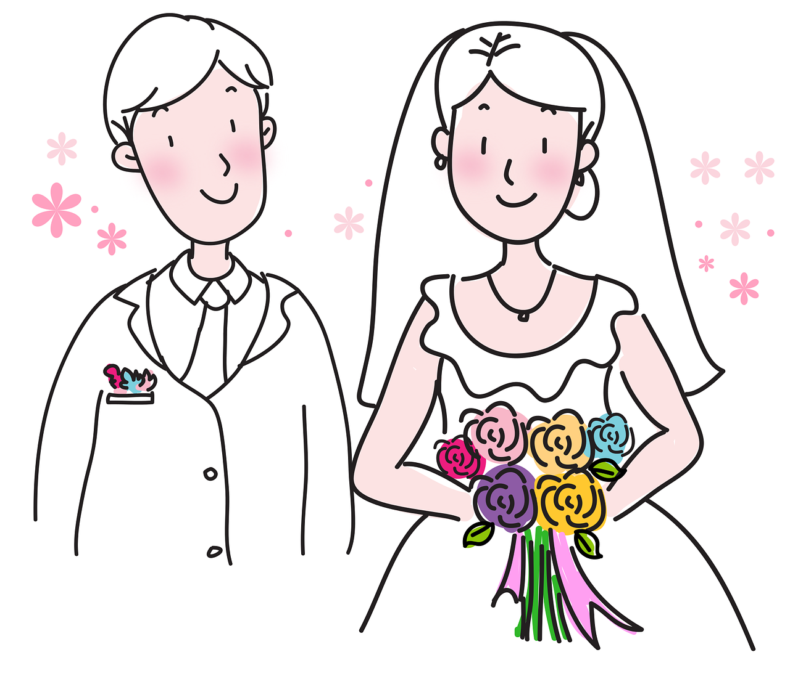
MM INDEX
Slide # | Thumbnail | Source link and Attribution
1 |  | Source Link: https://pixabay.com/illustrations/quick-quiz-quiz-puzzle-questions-6701919/
2 |  | Source Link: https://pixabay.com/vectors/bus-vehicle-travel-transportation-1297050/ Source Link: https://pixabay.com/vectors/sailor-man-boat-smiling-cadet-1424820/
3 |  | Source Link: https://pixabay.com/vectors/bicycle-small-vehicle-bike-cycle-1456759/ Source Link: https://pixabay.com/vectors/groom-bride-marriage-wedding-2145374/
4 |  | Source Link: https://pixabay.com/vectors/taxi-passenger-transportation-5693219/ Source Link: https://pixabay.com/vectors/blindfolded-chase-game-search-kids-37705/
5 |  | Source Link: https://pixabay.com/vectors/architecture-building-home-house-1299093/ Source Link: https://pixabay.com/vectors/arm-baby-child-comic-dad-daddy-1294906/
2 – 8 |  | Source Link: https://pixabay.com/vectors/question-mark-thinking-question-5656992/
Notes:
Notes for Teacher – N/A
Suggestions: N/A
Source of Multimedia used in this slide - N/A

