Slide 1
Think before you act
Notes:
Notes for Teacher - < Information for further reference or explanation >
Suggestions: <Ideas/ Images/ Animations / Others – To make better representation of the content >
Source of Multimedia used in this slide - https://www.freepik.com/free-vector/kid-doing-homework-with-speech-bubble-library_25539657.htm:By brgfx

Slide 2
Concept
Regular verbs follow normal rules or typical patterns of changing verbs into past and past participle forms
Irregular verbs can take up different forms in past and past participle tense or they can remain the same
Notes:
Notes for Teacher - < Information for further reference or explanation >
Suggestions: <Ideas/ Images/ Animations / Others – To make better representation of the content >
Source of Multimedia used in this slide

Slide 3
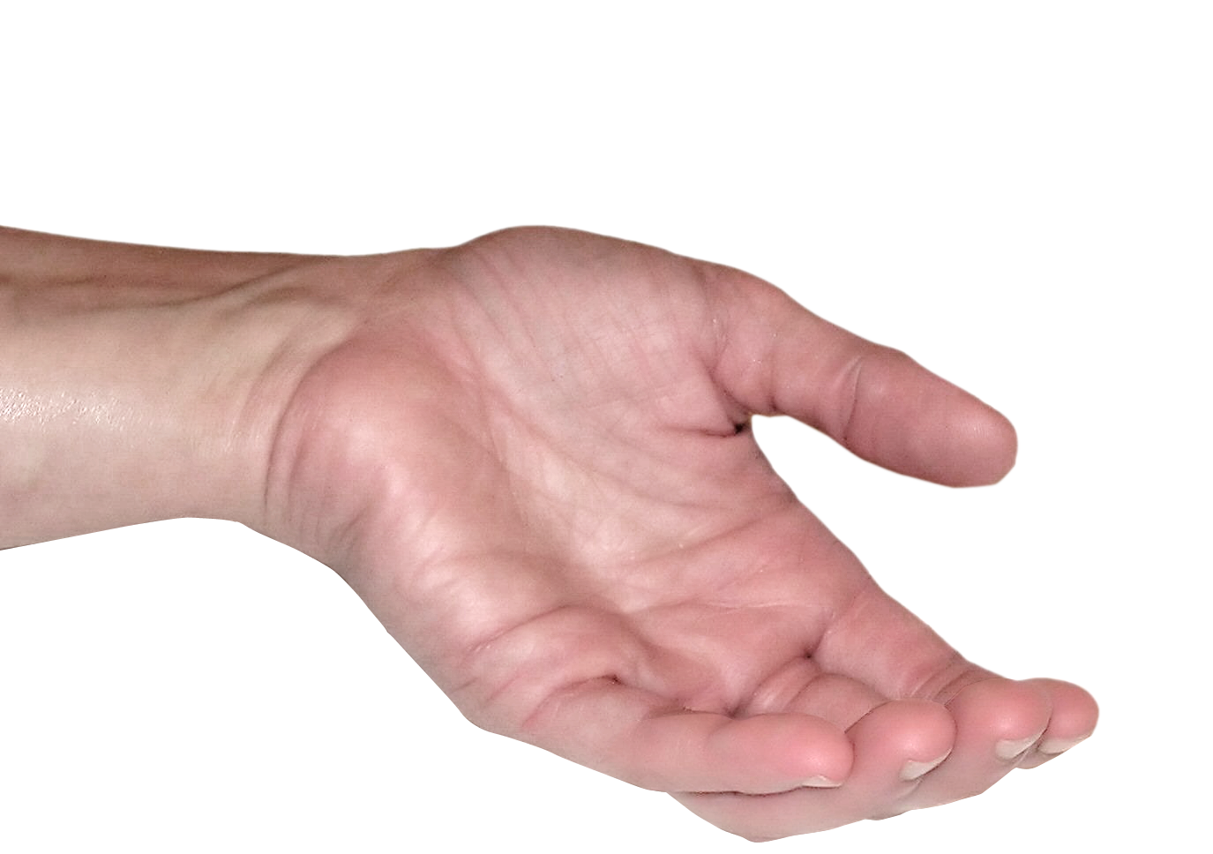
Concept-Value connection
Likewise in life, there are situations where obeying rules is compulsory and situations where obeying rules is not mandatory. We need to think clearly and act wisely depending on the situation.
Notes:
Notes for Teacher - < Information for further reference or explanation >
Suggestions: <Ideas/ Images/ Animations / Others – To make better representation of the content >
Source of Multimedia used in this slide

Slide 4
Activity
Given below are a few pictures with description. Go through each situation carefully and select one of the two options
I need to follow the Rules
I am free to choose
Notes:
Notes for Teacher - < Information for further reference or explanation >
Suggestions: <Ideas/ Images/ Animations / Others – To make better representation of the content >
Source of Multimedia used in this slide - https://www.freepik.com/free-vector/choice-concept-illustration_13662969.htm;By storyset

Slide 5
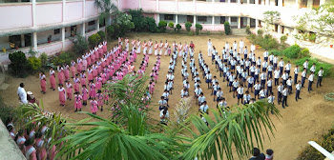
Standing in line for the School Assembly.
I need to follow the Rules
I am free to choose
Click on the Oval Buttons to answer
Notes:
Notes for Teacher - < Information for further reference or explanation >
Suggestions: <Ideas/ Images/ Animations / Others – To make better representation of the content >
Source of Multimedia used in this slide - SSSVV Image Gallery: Search Keyword “school assembly”
Yes: https://pixabay.com/vectors/check-mark-tick-mark-check-correct-1292787/ By OpenClipart-Vectors
No: https://pixabay.com/vectors/cross-mark-red-sign-icon-mark-304374/ By Clker-Free-Vector-Images

Slide 6
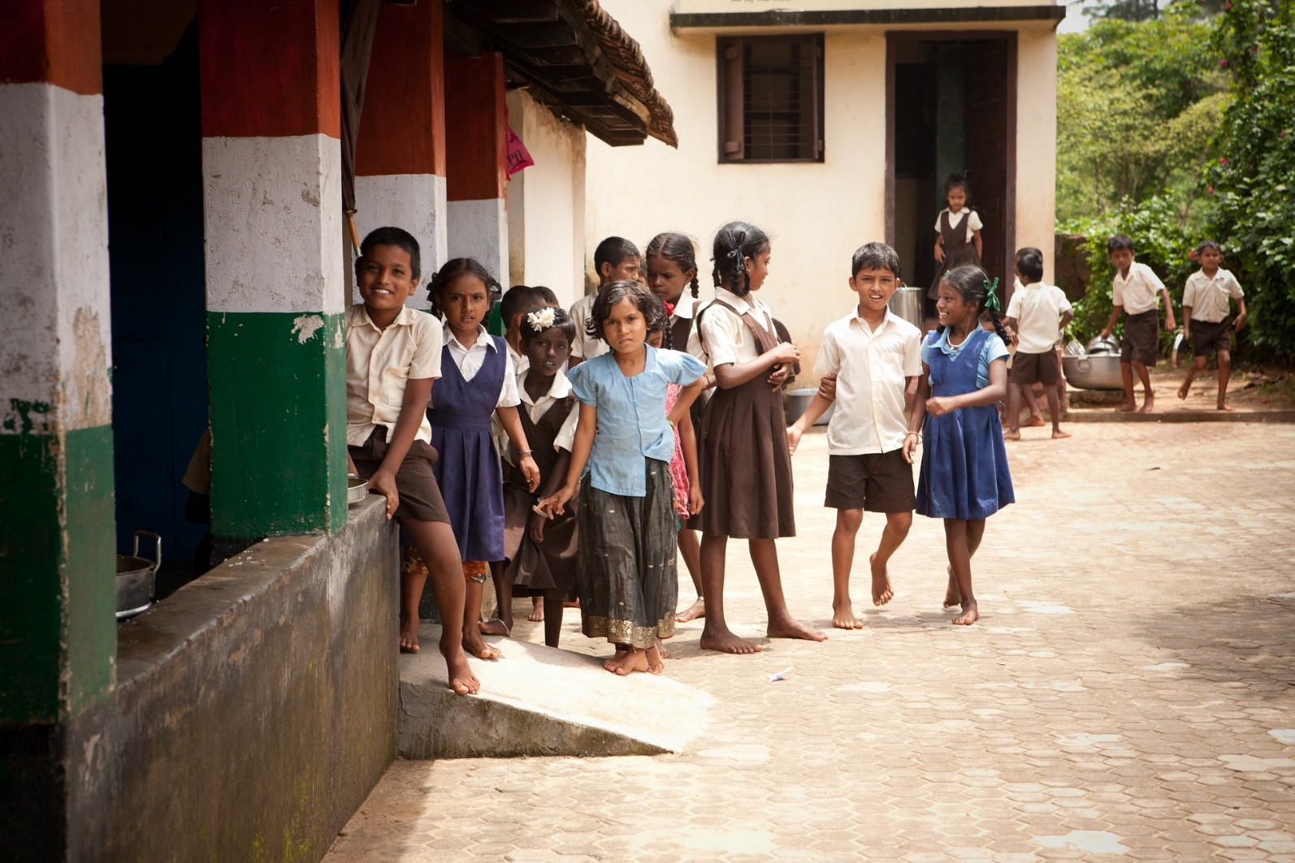
Standing in line during interval break.
I need to follow the Rules
I am free to choose
Click on the Oval Buttons to answer
Notes:
Notes for Teacher - < Information for further reference or explanation >
Suggestions: <Ideas/ Images/ Animations / Others – To make better representation of the content >
Source of Multimedia used in this slide - https://pixabay.com/photos/school-nursery-children-india-298681/

Slide 7
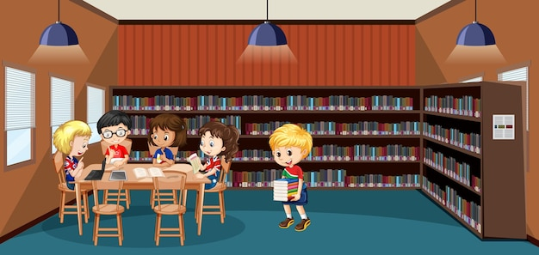
Maintaining silence in the library.
I need to follow the Rules
I am free to choose
Click on the Oval Buttons to answer
Notes:
Notes for Teacher - < Information for further reference or explanation >
Suggestions: <Ideas/ Images/ Animations / Others – To make better representation of the content >
Source of Multimedia used in this slide - https://www.freepik.com/free-vector/school-library-interior-with-children-group_19774008.htm;By brgfx
https://openclipart.org/detail/275518/signal-of-silence-yellow by DG-RA

Slide 8
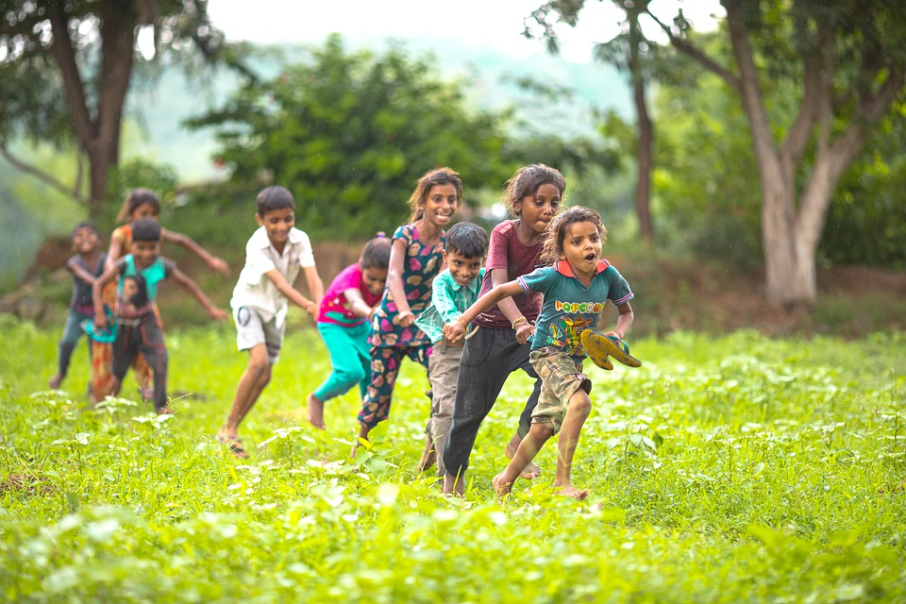
Maintaining silence during play time.
I need to follow the Rules
I am free to choose
Click on the Oval Buttons to answer
Notes:
Notes for Teacher - < Information for further reference or explanation >
Suggestions: <Ideas/ Images/ Animations / Others – To make better representation of the content >
Source of Multimedia used in this slide - https://pixabay.com/photos/children-kids-playing-rajasthan-7186580/

Slide 9
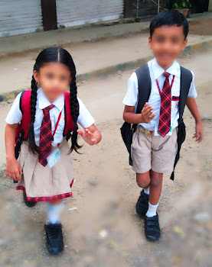
Dress code for school.
I need to follow the Rules
I am free to choose
Click on the Oval Buttons to answer
Notes:
Notes for Teacher - < Information for further reference or explanation >
Suggestions: <Ideas/ Images/ Animations / Others – To make better representation of the content >
Source of Multimedia used in this slide - SSSVV Image Gallery: Search Keyword “school children”

Slide 10
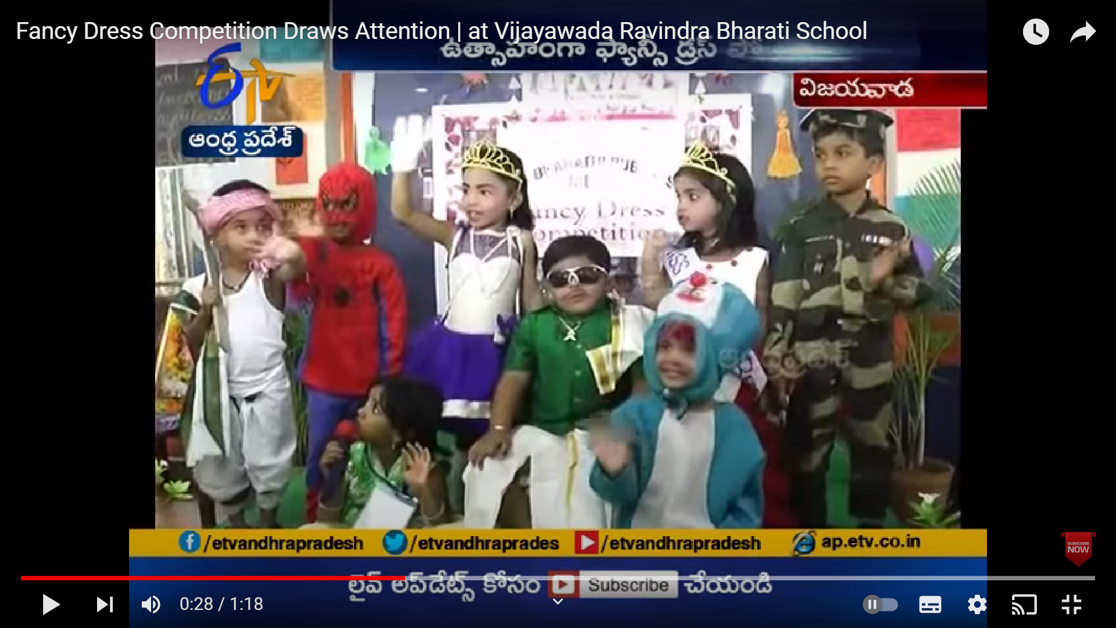
Dressing up for a festival.
I need to follow the Rules
I am free to choose
Click on the Oval Buttons to answer
Notes:
Notes for Teacher - < Information for further reference or explanation >
Suggestions: <Ideas/ Images/ Animations / Others – To make better representation of the content >
Source of Multimedia used in this slide - https://youtu.be/bXKPp_IGjDo?t=28;Attribution credit : ETV Andra Pradesh

Slide 11
Follow up on the Activity
1.
2.
3.
4.
Rules create orderliness and help us avoid chaos.
Be familiar with the rules to be followed at home, school, and public places.
Freedom is the ability to do what one wants by respecting the rules and laws.
It helps us to make better choices.
Notes:
Notes for Teacher - < Information for further reference or explanation >
Suggestions: <Ideas/ Images/ Animations / Others – To make better representation of the content >
Source of Multimedia used in this slide - <Please provide source URL where we find the image and the license agreement>

Slide 12
Points to ponder
Rules and Freedom are a natural part of life.
Both are needed for responsible behavior.
Be aware of the dos and don’ts in different situations.
Think clearly! Act wisely!
Notes:
Notes for Teacher - < Information for further reference or explanation >
Suggestions: <Ideas/ Images/ Animations / Others – To make better representation of the content >
Source of Multimedia used in this slide

Slide 13
MM INDEX
Slide # | Thumbnail | Source link and Attribution
1. |  | https://www.freepik.com/free-vector/kid-doing-homework-with-speech-bubble-library_25539657.htm:By brgfx
4. |  | https://www.freepik.com/free-vector/choice-concept-illustration_13662969.htm;By storyset
5. |  | SSSVV Image Gallery: Search Keyword “school assembly”
6. |  | https://pixabay.com/photos/school-nursery-children-india-298681/
7. |  | https://www.freepik.com/free-vector/school-library-interior-with-children-group_19774008.htm;By brgfx https://openclipart.org/detail/275518/signal-of-silence-yellow
8. |  | https://pixabay.com/photos/children-kids-playing-rajasthan-7186580/
9. |  | SSSVV Image Gallery: Search Keyword “school children”
10. |  | https://youtu.be/bXKPp_IGjDo?t=28;Attribution credit : ETV Andra Pradesh
5,6,7,8,9,10 |  | Yes: https://pixabay.com/vectors/check-mark-tick-mark-check-correct-1292787 By OpenClipart-Vectors No: https://pixabay.com/vectors/cross-mark-red-sign-icon-mark-304374 By Clker-Free-Vector-Images
Notes:
Notes for Teacher - < Information for further reference or explanation >
Suggestions: <Ideas/ Images/ Animations / Others – To make better representation of the content >
Source of Multimedia used in this slide - <Please provide source URL where we find the image and the license agreement>

