Slide 1
Summary Verbs
Notes:
Notes for Teacher - The teacher could draw the mind map or write the main points of the summary on the blackboard.
Teacher can introduce the asset by saying, "Let us summarise what we have learnt from this topic”.
Suggestions: N/A
Source of Multimedia used in this slide -
Alphabets- https://pixabay.com/illustrations/alphabet-abc-letter-to-learn-read-1219546/

Slide 2
Summary of Verbs
Verbs form an integral part of a sentence and no sentence is complete without a verb
There are Two types of Verbs; Regular and Irregular Verbs.
Regular Verbs follow a normal pattern. In the Past and Past Participle forms
‘d’, ‘ed’ or ‘ied’ are added to the base verb.
Irregular verbs do not follow a normal pattern In the Past and Past Participle forms they form completely new words. They can also be called rule breakers
Notes:
Notes for Teacher – N/A
Suggestions: N/A
Source of Multimedia used in this slide -
Numbers- https://pixabay.com/illustrations/mathematics-pay-digits-number-four-1660859/
Numbers- https://pixabay.com/illustrations/mathematics-pay-digits-number-four-1660868/

Slide 3
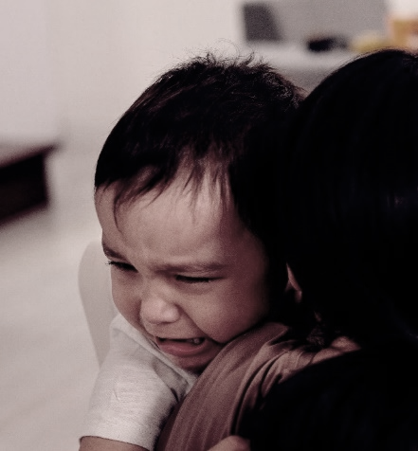
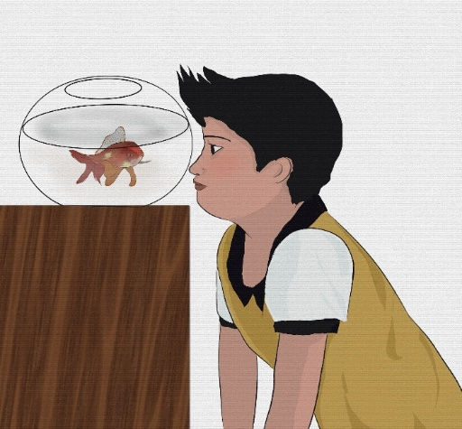
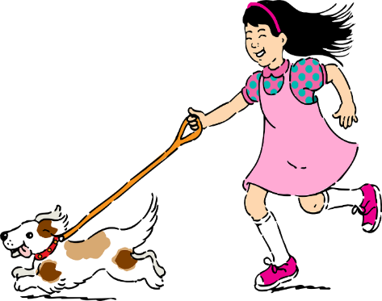
Examples
Regular Verbs
Irregular Verbs
cry
cried
sing
sang
look
looked
like
liked
run
ran
Notes:
Notes for Teacher – N/A
Suggestions: N/A
Source of Multimedia used in this slide -
Like-https://pixabay.com/illustrations/kids-text-font-type-typography-2113965/
Numbers- https://pixabay.com/illustrations/mathematics-pay-digits-number-four-1660859/
Numbers- https://pixabay.com/illustrations/mathematics-pay-digits-number-four-1660868/
Child crying-https://www.pexels.com/photo/boy-hugging-a-woman-while-crying-6222771/
Run- https://pixabay.com/vectors/pet-pets-girl-dog-puppy-running-312041/
Sing- https://pixabay.com/vectors/vector-file-man-song-singing-man-1527609/
Look- https://pixabay.com/illustrations/goldfish-watch-pets-boy-lonely-7327337/

Slide 4
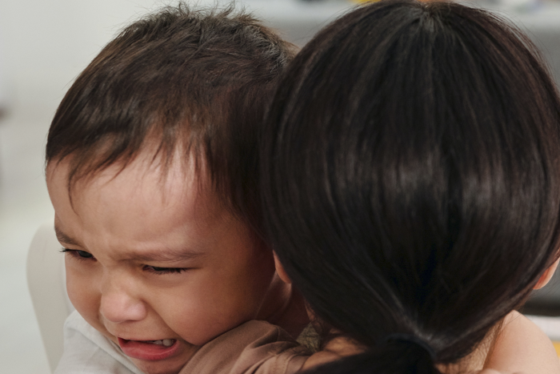
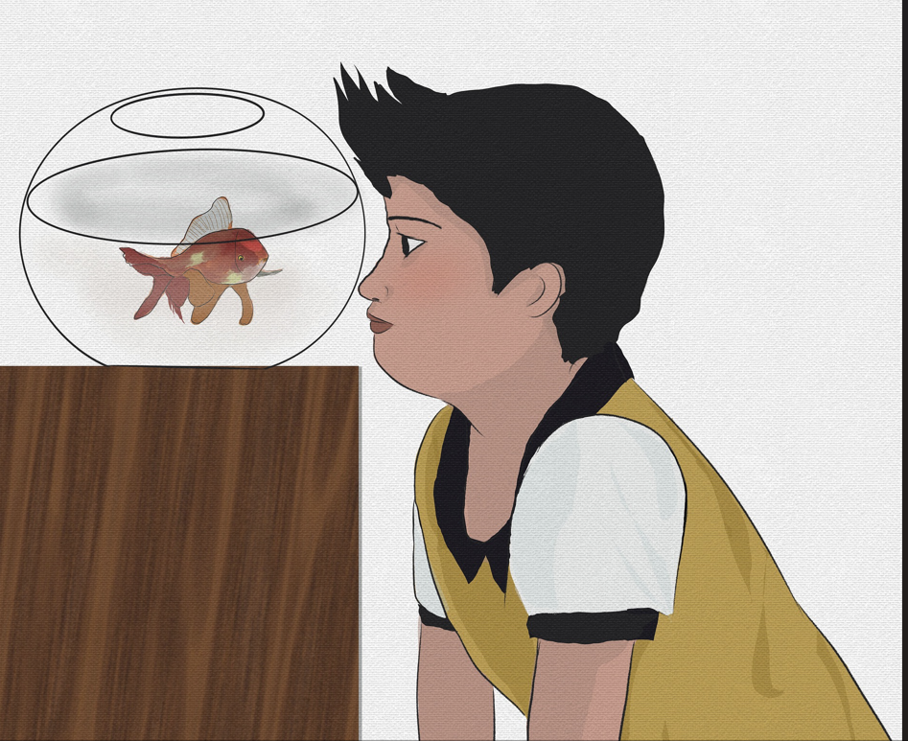
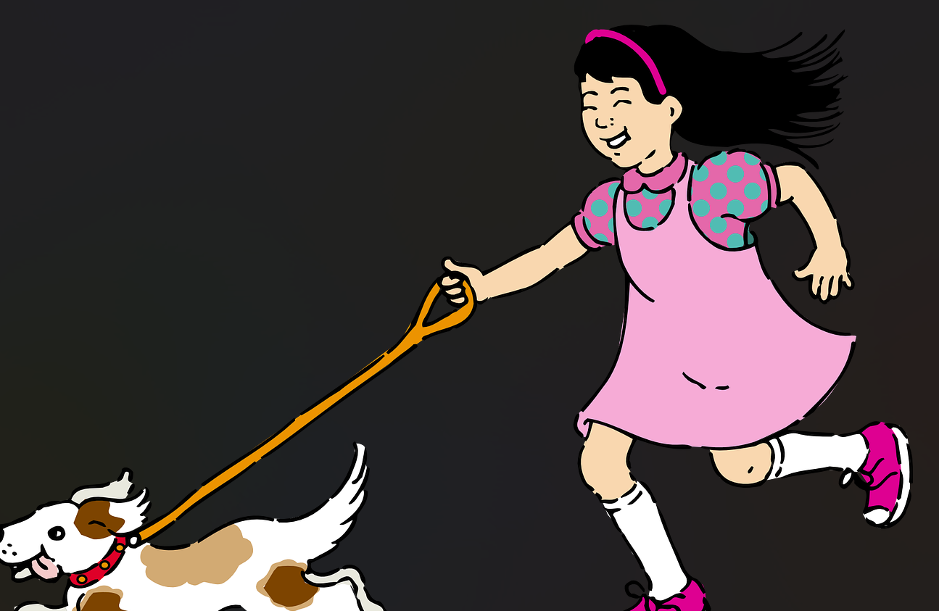
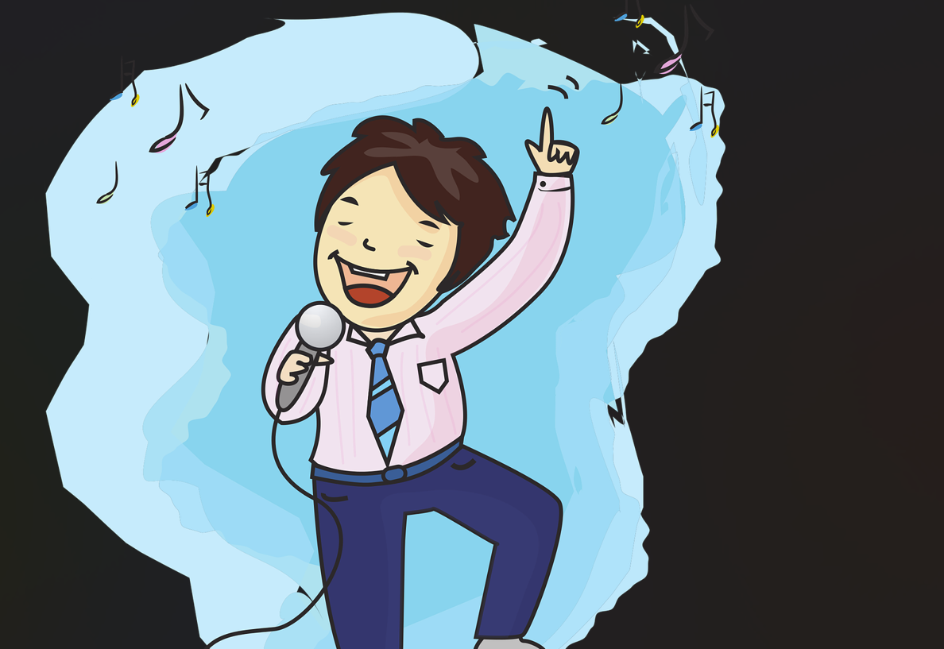
MM INDEX
Slide # | Thumbnail | Source link and Attribution
1 |  | Alphabets- https://pixabay.com/illustrations/alphabet-abc-letter-to-learn-read-1219546/
3 |  | Numbers- https://pixabay.com/illustrations/mathematics-pay-digits-number-four-1660859/
3 |  | Numbers- https://pixabay.com/illustrations/mathematics-pay-digits-number-four-1660868/
3 |  | Like-https://pixabay.com/illustrations/kids-text-font-type-typography-2113965/
3 |  | Child crying-https://www.pexels.com/photo/boy-hugging-a-woman-while-crying-6222771/
3 |  | Look- https://pixabay.com/illustrations/goldfish-watch-pets-boy-lonely-7327337/
3 |  | Run- https://pixabay.com/vectors/pet-pets-girl-dog-puppy-running-312041/
3 |  | Sing- https://pixabay.com/vectors/vector-file-man-song-singing-man-1527609/
Notes:
Notes for Teacher – N/A
Suggestions: N/A
Source of Multimedia used in this slide - N/A

