Slide 1
Adverbs of Time
Notes:
Notes for Teacher - < Information for further reference or explanation >
Suggestions: <Ideas/ Images/ Animations / Others – To make better representation of the content >
Source of Multimedia used in this slide -
1. Clock: https://pixabay.com/vectors/clock-analog-time-watch-147257/ (https://pixabay.com/users/openclipart-vectors-30363/)

Slide 2
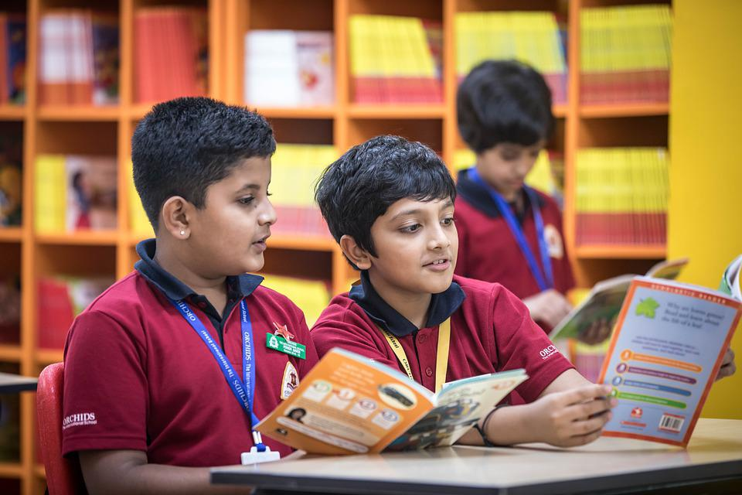
Inquisitive questions
Maya, when is your English test?
Sita, you always talk very loud.
It is tomorrow.
I am sorry teacher.
We are reading a story book now.
What are you boys doing?
Notes:
Notes for Teacher –
Q1: What do the underlined words mean?
A: They all tell us when the action happened or is happening (now), will/may happen (tomorrow) and how often it happens (always).
Q2: Can anyone tell what they are called?
A: They are called ‘Adverbs of Time’.
Suggestions: <Ideas/ Images/ Animations / Others – To make better representation of the content >
Source of Multimedia used in this slide -
1. Girl: girl: https://www.freepik.com/free-vector/set-happy-children-different-
actions_5874504.htm (Attribution: brgfx)
2. Mother: SSSVV gallery (Keyword-teacher, mother)
3. Girl: https://www.hiclipart.com/free-transparent-background-png-clipart-labdq (Attribution: brgfx)
4. Boys: https://pixabay.com/photos/children-classroom-grade-school-7047132/ ( Attribution: Anisharma26)

Slide 3
Adverbs of Time
Adverbs tell us more about verbs. Adverbs of time tell us when an action happened, is happening, will/may happen or even how often it is happening.
Points of Time
Relationships
In Time
Adverbs of Frequency
Notes:
Notes for Teacher - < Information for further reference or explanation >
Suggestions: <Ideas/ Images/ Animations / Others – To make better representation of the content >
Source of Multimedia used in this slide - <Please provide source URL where we find the image and the license agreement>

Slide 4
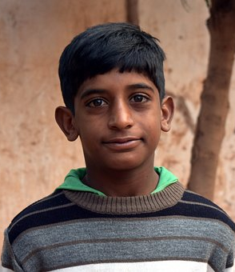
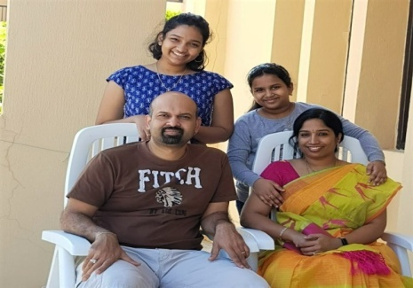
Points of Time
This group of adverbs gives specific information about when an action is happening.
List of adverbs: Tomorrow, tonight, yesterday, now, then, today, daily, weekly, immediately, etc
I will go to school tomorrow.
Ramu is going to study tonight.
We saw a movie yesterday.
Notes:
Notes for Teacher – The underlined adverbs usually appear after the main verb.
Suggestions: <Ideas/ Images/ Animations / Others – To make better representation of the content >
Source of Multimedia used in this slide -
School: https://pixabay.com/vectors/school-building-education-property-295210/(https://pixabay.com/users/clker-free-vector-images-3736/)
Ramu: https://pixabay.com/photos/people-portrait-a-village-boy-child-3125603/ (Attribution: SandeepHanda)
Family: SSSVV gallery( family)

Slide 5
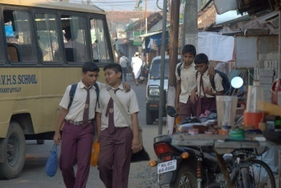
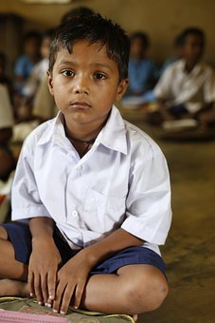
Relationships in Time
This group of adverbs tells you the duration of time when something happened.
List of adverbs: Already, last, just, before, later, next, soon, earlier, since, recently, still, etc
The school bell just rang.
Veena finished her homework before dinner.
I haven’t eaten anything since morning.
Notes:
Notes for Teacher - < Information for further reference or explanation >
Suggestions: <Ideas/ Images/ Animations / Others – To make better representation of the content >
Source of Multimedia used in this slide -
Girl: https://www.flickr.com/photos/13657368@N00/3335503224 (Attribution: Simple CVR)
Boys: https://www.flickr.com/photos/18735074@N00/3230398214 (Attribution: David Arpi)
Little boy: https://pixabay.com/photos/children-infant-boy-india-poor-306602/

Slide 6
Adverbs of Frequency
This group of adverbs describes how frequently an activity is done.
List of adverbs: always, usually, normally/generally, often/frequently,
Sometimes, occasionally, seldom, rarely/hardly, never.
Notes:
Notes for Teacher - Position of adverb of frequency is always before the main verb.
Suggestions: <Ideas/ Images/ Animations / Others – To make better representation of the content >
Source of Multimedia used in this slide - <Please provide source URL where we find the image and the license agreement>

Slide 7
Adverbs of Frequency
Frequency
Adverb of frequency
Example sentence
100%
always
I always go to bed at 9 p.m.
90%
usually
I usually have bread for breakfast.
80%
normally/generally
Ram normally plays football after school.
70%
often/frequently
Geetha often has an apple after lunch.
50%
sometimes
I sometimes travel by train.
30%
occasionally
I occasionally eat pizza.
10%
seldom
I seldom read a story book.
5%
rarely/hardly
We rarely go to the theatre.
0%
never
I never drink coffee at night.
Notes:
Notes for Teacher - Position of adverb of frequency is always before the main verb. Suggestions: <Ideas/ Images/ Animations / Others – To make better representation of the content >
Source of Multimedia used in this slide - <Please provide source URL where we find the image and the license agreement>

Slide 8
Attribution / Citation
Slide # | Thumbnail | Source link | Author
1,4,5,6 |  | 1. Clock: https://pixabay.com/vectors/clock-analog-time-watch-147257/ | https://pixabay.com/users/openclipart-vectors-30363/
2 |  | 1. Girl: girl: https://www.freepik.com/free-vector/set-happy-children-different actions_5874504.htm (Attribution: brgfx) 2. Girl: https://www.hiclipart.com/free-transparent-background-png-clipart-labdq (Attribution: brgfx) 3. Boys: https://pixabay.com/photos/children-classroom-grade-school-7047132/ | Brgfx Anisharma26 brgfx
4 |  | School: https://pixabay.com/vectors/school-building-education-property-295210/ Ramu: https://pixabay.com/photos/people-portrait-a-village-boy-child-3125603/ | https://pixabay.com/users/clker-free-vector-images-3736/ SandeepHanda
5 |  | Girl: https://www.flickr.com/photos/13657368@N00/3335503224 (Attribution: Simple CVR) Boys: https://www.flickr.com/photos/18735074@N00/3230398214 (Attribution: David Arpi) Little boy: https://pixabay.com/photos/children-infant-boy-india-poor-306602/ | Simple CVR David Arpi akshayapatra
Notes:
Notes for Teacher - < Information for further reference or explanation >
Suggestions: <Ideas/ Images/ Animations / Others – To make better representation of the content >
Source of Multimedia used in this slide - <Please provide source URL where we find the image and the license agreement>

