Slide 1
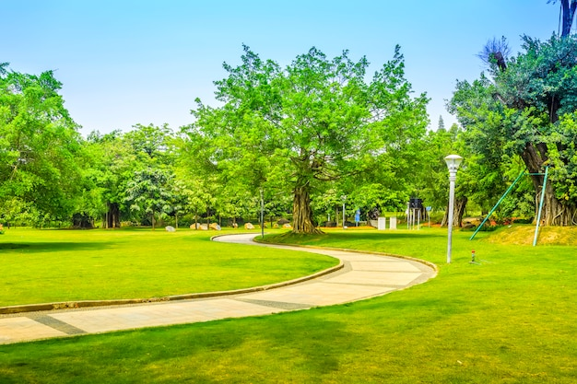
Adverbs of Place
Notes:
Notes for Teacher - < Information for further reference or explanation >
Suggestions: <Ideas/ Images/ Animations / Others – To make better representation of the content >
Source of Multimedia used in this slide -
1. Garden: https://www.freepik.com/free-photo/beautiful-park_1278124.htm#query=garden&position=36&from_view=search&track=sph (attribution: 4045)

Slide 2
Adverbs in our daily life
Mother, I cannot find
my English textbook.
I have searched
everywhere.
Did you check in your bedroom upstairs?
Yes, Mother, I know I kept in my room somewhere.
I will search for it.
You please come
here and have your
breakfast.
Sure Banu!
If you find the book, could you come to the school and give it to me as it is nearby?
Notes:
Notes for Teacher - Questions:
1. What do you understand from the conversation?
Banu has lost her English textbook.
2. What do the words in bold mean?
They are all talking about ‘place’.
The teacher can conclude by saying that, all these words answer the question ‘where’ and are hence called ‘Adverbs of Place’. Suggestions: <Ideas/ Images/ Animations / Others – To make better representation of the content >
Source of Multimedia used in this slide -
Girl: https://www.freepik.com/free-vector/sticker-template-with-student-girl-school-uniform_17677340.htm#query=children%20girl%20school&position=29&from_view=search&track=ais#position=29&query=children%20girl%20school (attribution: brgfx)
Mother: SSSVV gallery (mother, woman)

Slide 3
Adverbs of Place - TYPES
Show direction
Show
distance
Show
location
Show
movement
General
1
2
3
4
5
north, south,
east, west, left,
right, straight
etc.
far, faraway,
near, nearby,
behind, ahead etc.
outside, back,
around, inside,
abroad, away
etc.
upwards,
downwards,
southwards,
northwards etc.
anywhere,
somewhere,
everywhere,
nowhere etc.
Notes:
Notes for Teacher - < Information for further reference or explanation >
Suggestions: <Ideas/ Images/ Animations / Others – To make better representation of the content >
Source of Multimedia used in this slide - <Please provide source URL where we find the image and the license agreement>

Slide 4
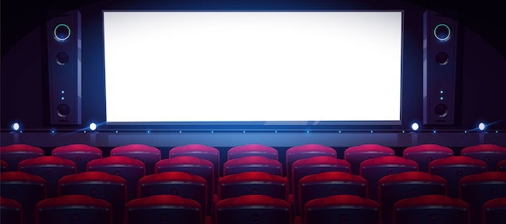
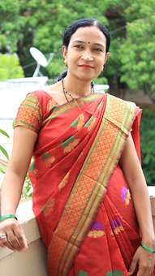
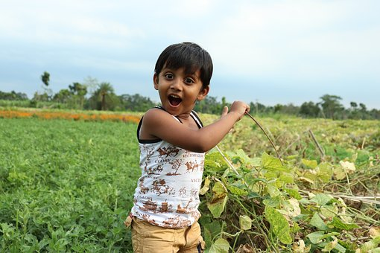
Make sentences using the images
S.no
Adverb
Example
1
behind
My parents went to a movie leaving me behind.
MOVIE
2
anywhere
Ram, don’t go anywhere without telling me.
Ram
Notes:
Notes for Teacher –The teacher can show the ppt. Show the 1st word ‘behind’ and the image and ask for a sentence from the children. Then the teacher can click on the slide for the sentence given. Similarly, sentences for all the adverbs can be given by the children before revealing the sentence in the ppt.
Suggestions: <Ideas/ Images/ Animations / Others – To make better representation of the content >
Source of Multimedia used in this slide -
Boy: https://www.freepik.com/free-vector/set-happy-children-different-actions_5874504.htm (attribution: brgfx)
Parents: https://www.freepik.com/free-vector/indian-group-india-cartoon_4887735.htm#page=3&query=Parents&position=42&from_view=search&track=sph (attribution: jemastock)
Movie: https://www.freepik.com/free-vector/movie-theater_10385652.htm#query=movie%20theatre&position=16&from_view=search&track=ais (attribution: upklyak)
Boy: https://pixabay.com/photos/cute-kids-happy-child-childhood-3415367/ (attribution: rabackpro)
Mother: https://pixabay.com/photos/women-indian-female-mother-woman-4419742/ (attribution: sonamabcd)

Slide 5
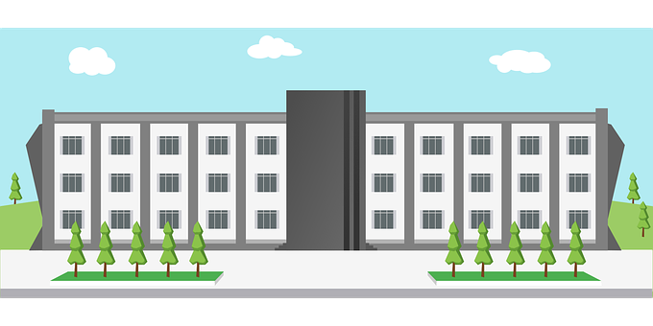
Make sentences using the images
My home
School
3
far
My school is not far from my home.
4
Upstairs
The children are playing upstairs.
Notes:
Notes for Teacher –The teacher can show the ppt. Show the 1st word ‘behind’ and ask for a sentence from the children. Then the teacher can click on the slide for the sentence given. Similarly, sentences for all the adverbs can be given by the children before revealing the sentence in the ppt.
Suggestions: <Ideas/ Images/ Animations / Others – To make better representation of the content >
Source of Multimedia used in this slide -
School: https://pixabay.com/vectors/school-design-building-learning-1727586/ (attribution: 200degrees)
Home: https://www.freepik.com/free-vector/beautiful-home_4979878.htm#page=2&query=home%20india&position=46&from_view=search&track=ais (attribution: studiogstock)
Children: https://www.freepik.com/free-vector/many-children-with-happy-face-sitting-log_7029941.htm#query=children&position=47&from_view=search&track=sph (attribution: brgfx)

Slide 6
Make sentences using the images
5
nearby
My cousins live nearby.
Cousins
Arjun
6
down
Arjun fell down and broke his hand.
Notes:
Notes for Teacher –The teacher can show the ppt. Show the 1st word ‘behind’ and ask for a sentence from the children. Then the teacher can click on the slide for the sentence given. Similarly, sentences for all the adverbs can be given by the children before revealing the sentence in the ppt.
Suggestions: <Ideas/ Images/ Animations / Others – To make better representation of the content >
Source of Multimedia used in this slide -
Boy: https://www.freepik.com/free-vector/set-happy-children-different-actions_5874504.htm (attribution: brgfx)
Cousins: https://www.freepik.com/free-vector/many-children-with-happy-face-sitting-log_7029941.htm#query=children&position=47&from_view=search&track=sph (attribution: brgfx)
Arjun: https://www.freepik.com/free-vector/children-with-wounds-from-accident_1046913.htm#query=boy%20hand%20broken&position=2&from_view=search&track=ais (attribution: brgfx)

Slide 7
Make sentences using the images
7
upwards
The hot air balloon went upwards.
8
away
Throw away the spoilt bread.
Notes:
Notes for Teacher –The teacher can show the ppt. Show the 1st word ‘behind’ and ask for a sentence from the children. Then the teacher can click on the slide for the sentence given. Similarly, sentences for all the adverbs can be given by the children before revealing the sentence in the ppt.
Suggestions: <Ideas/ Images/ Animations / Others – To make better representation of the content >
Source of Multimedia used in this slide -
Hot air balloon: https://www.freepik.com/free-vector/hot-air-balloon-background-with-sky-hand-drawn-style_2279850.htm#page=4&query=hot%20air%20balloon&position=49&from_view=search&track=ais (attribution: freepik)
Bread: https://www.freepik.com/free-vector/inedible-bread-with-mould_32266822.htm#query=old%20bread&position=28&from_view=search&track=ais (attribution: brgfx)

Slide 8
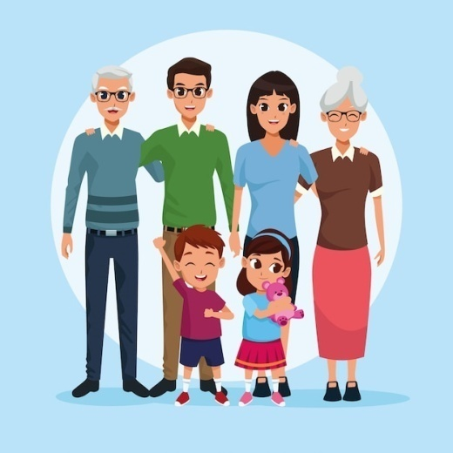
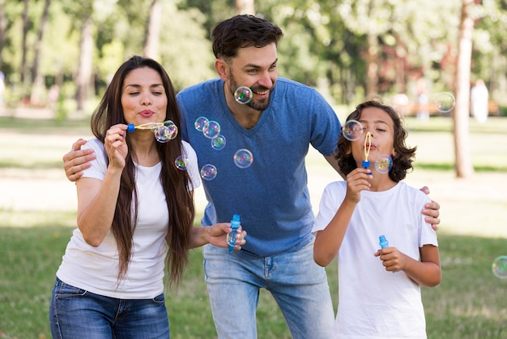
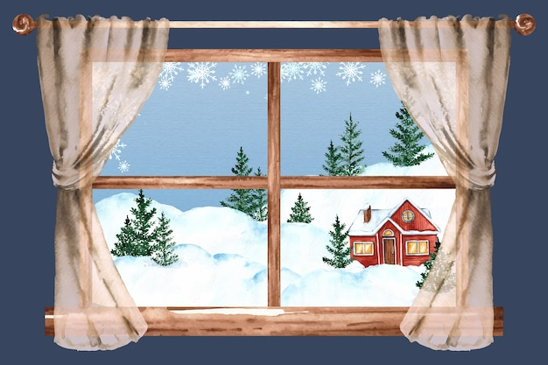
Make sentences using the images
Australia
America
9
abroad
Many of my relatives live abroad.
10
indoors
We stay indoors when it snows.
Notes:
Notes for Teacher –The teacher can show the ppt. Show the 1st word ‘behind’ and ask for a sentence from the children. Then the teacher can click on the slide for the sentence given. Similarly, sentences for all the adverbs can be given by the children before revealing the sentence in the ppt.
Suggestions: <Ideas/ Images/ Animations / Others – To make better representation of the content >
Source of Multimedia used in this slide -
Relatives: https://www.freepik.com/free-vector/family-grandparents-parents-kids-cartoons_4889872.htm#query=family&position=8&from_view=search&track=sph (attribution: jemastock)
Relatives: https://www.freepik.com/free-photo/parents-boy-having-great-time-blowing-bubbles-park_9860993.htm#page=2&query=family&position=3&from_view=search&track=sph (attribution: freepik)
Children: https://www.freepik.com/free-vector/many-children-with-happy-face-sitting-log_7029941.htm#query=children&position=47&from_view=search&track=sph (attribution: brgfx)
Snow: https://www.freepik.com/free-vector/watercolor-winter-window-illustration_33745219.htm#query=snow%20house%20indoors&position=13&from_view=search&track=ais#position=13&query=snow%20house%20indoors (attribution: freepik)

Slide 9
Attribution / Citation
Slide # | Thumbnail | Source link | Author
1 |  | 1. Garden: https://www.freepik.com/free-photo/beautiful-park_1278124.htm#query=garden&position=36&from_view=search&track=sph (attribution: 4045) | 4045
2 |  | 1. Girl: https://www.freepik.com/free-vector/sticker-template-with-student-girl-school-uniform_17677340.htm#query=children%20girl%20school&position=29&from_view=search&track=ais#position=29&query=children%20girl%20school (attribution: brgfx) | brgfx
4,6 |  | Boy: https://www.freepik.com/free-vector/set-happy-children-different-actions_5874504.htm (attribution: brgfx) Parents: https://www.freepik.com/free-vector/indian-group-india-cartoon_4887735.htm#page=3&query=Parents&position=42&from_view=search&track=sph (attribution: jemastock) Movie: https://www.freepik.com/free-vector/movie-theater_10385652.htm#query=movie%20theatre&position=16&from_view=search&track=ais (attribution: upklyak) Boy: https://pixabay.com/photos/cute-kids-happy-child-childhood-3415367/ (attribution: rabackpro) Mother: https://pixabay.com/photos/women-indian-female-mother-woman-4419742/ (attribution: sonamabcd) | Brgfx Jemastock Upklyak Rabackpro sonamabcd
5,6,8 |  | School: https://pixabay.com/vectors/school-design-building-learning-1727586/ (attribution: 200degrees) Home: https://www.freepik.com/free-vector/beautiful-home_4979878.htm#page=2&query=home%20india&position=46&from_view=search&track=ais (attribution: studiogstock) Children: https://www.freepik.com/free-vector/many-children-with-happy-face-sitting-log_7029941.htm#query=children&position=47&from_view=search&track=sph (attribution: brgfx) | 200degrees Studiogstock brgfx
6 |  | 1. Arjun: https://www.freepik.com/free-vector/children-with-wounds-from- accident_1046913.htm#query=boy%20hand%20broken&position=2&from_view=search&track=ais (attribution: brgfx) | brgfx
7 |  | Hot air balloon: https://www.freepik.com/free-vector/hot-air-balloon-background-with-sky-hand-drawn-style_2279850.htm#page=4&query=hot%20air%20balloon&position=49&from_view=search&track=ais (attribution: freepik) Bread: https://www.freepik.com/free-vector/inedible-bread-with-mould_32266822.htm#query=old%20bread&position=28&from_view=search&track=ais (attribution: brgfx) | Freepik brgfx
8 |  | Relatives: https://www.freepik.com/free-vector/family-grandparents-parents-kids-cartoons_4889872.htm#query=family&position=8&from_view=search&track=sph (attribution: jemastock) Relatives: https://www.freepik.com/free-photo/parents-boy-having-great-time-blowing-bubbles-park_9860993.htm#page=2&query=family&position=3&from_view=search&track=sph (attribution: freepik) Snow: https://www.freepik.com/free-vector/watercolor-winter-window-illustration_33745219.htm#query=snow%20house%20indoors&position=13&from_view=search&track=ais#position=13&query=snow%20house%20indoors (attribution: freepik) | Jemastock Freepik freepik
Notes:
Notes for Teacher - < Information for further reference or explanation >
Suggestions: <Ideas/ Images/ Animations / Others – To make better representation of the content >
Source of Multimedia used in this slide - <Please provide source URL where we find the image and the license agreement>

