Slide 1
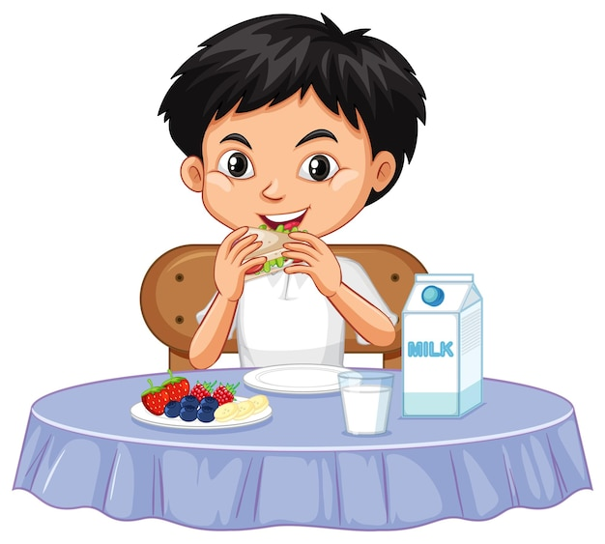
You Are What You Eat
Notes:
Notes for Teacher - < Information for further reference or explanation >
Suggestions: <Ideas/ Images/ Animations / Others – To make better representation of the content >
Source of Multimedia used in this slide - <Please provide source URL where we find the image and the license agreement>
Boy : https://www.freepik.com/free-vector/one-happy-boy-eating-table_18973385.htm#query=kids%20eat&position=5&from_view=search&track=ais (brgfx)

Slide 2
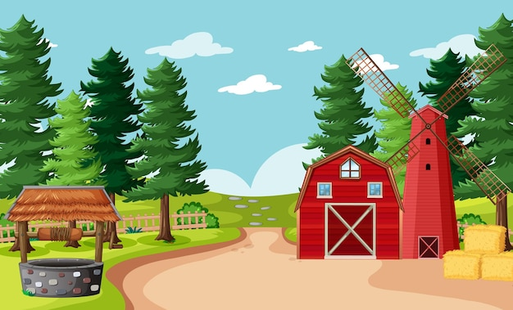
Role Play
Grandfather
Ramu
Grandmother
Ramu’s grandparents lived in a small village, far away from the pollution and noise of the city.
Ramu is excited to spend his summer holidays with his grandparents and they are happy to see Ramu.
Notes:
Notes for Teacher - Narrator: The school has closed for the summer vacations and Ramu is excited to spend his summer holidays with his grandparents who live in a small village, far away from the pollution and noise of the city. His grandparents are happy to see Ramu. The next morning, Ramu finds his grandfather practicing yoga outdoors.
Ramu: Good morning, Grandpa! You are so active even at this age and you rarely look tired. You also look young for your age (smiles). What is the secret of your wwonderful energy level?
Grandfather: Good morning, Ramu! Hope you slept well last night. The secret of my energy level comes from the food I eat.
Ramu: Is it so? I also eat a lot but always feel tired and sleepy. I want to be active like you and Grandma and also wish to perform better in studies and sports. How can I do so?
Grandmother: Ramu, all you need to do is change your eating habits. Try to eat nutritious food as much as possible.
Grandfather: Also try to cut down on junk foods and start eating food made at home.
Grandmother: Since you will be here for a few more weeks, I will see to it that you start enjoying homemade healthy foods. You will definitely feel the difference yourself.
(After two weeks)
Ramu: Grandpa! Grandma! I am surprised at my high energy level. I never felt tired during the last two weeks. In fact, I find myself running better and am also able to focus more on my studies. I now understand how healthy foods can add value to my body.
Grandfather: Yes Ramu, Remember! You are what you eat! Eat healthy to stay healthy!
Suggestions: N/A
Source of Multimedia used in this slide - <Please provide source URL where we find the image and the license agreement>
Grand father : https://www.freepik.com/free-vector/grandchildren-grandfather-hand_5056244.htm (jemastock)
House : https://www.freepik.com/free-vector/blank-farm-scene-cartoon-style_11862406.htm (brgfx)
Grandmother : https://www.freepik.com/free-vector/indian-family-people-hindu-national-clothes-cartoon-indian-characters_2703434.htm (vectorpouch)
Boy : https://www.freepik.com/free-vector/asian-boy-cartoon-character-sticker_21848968.htm (brgfx)

Slide 3
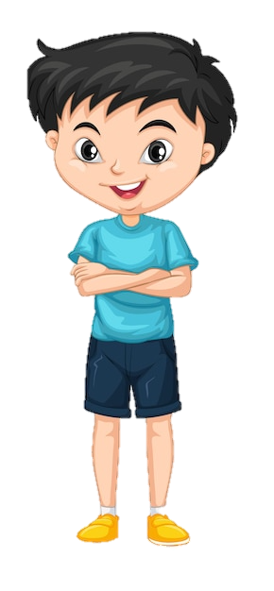
Role Play
Good morning, Grandpa! You look young for your age, What is the secret of your wonderful energy level?
The next morning, Ramu finds his grandfather practicing yoga outdoors.
Notes:
Notes for Teacher - < Information for further reference or explanation >
Suggestions: <Ideas/ Images/ Animations / Others – To make better representation of the content >
Source of Multimedia used in this slide - <Please provide source URL where we find the image and the license agreement>
Yoga : https://www.freepik.com/free-vector/active-elderly-people-illustration_9396741.htm#query=elderly%20exercise&position=17&from_view=search&track=ais (freepik)
Ramu : https://www.freepik.com/free-vector/boy-blue-shirt-isolated_7281242.htm (brgfx)

Slide 4
Role Play
Good morning, Ramu! The secret of my energy comes from the food I eat.
Notes:
Notes for Teacher - < Information for further reference or explanation >
Suggestions: <Ideas/ Images/ Animations / Others – To make better representation of the content >
Source of Multimedia used in this slide - <Please provide source URL where we find the image and the license agreement>
Yoga : https://www.freepik.com/free-vector/active-elderly-people-illustration_9396741.htm (freepik)
Ramu : https://www.freepik.com/free-vector/boy-blue-shirt-isolated_7281242.htm (brgfx)

Slide 5
Role Play
Is it so? I also eat a lot, but always feel tired and sleepy. I want to be active like you and Grandma.
Ramu, all you need to do, is change your eating habits.
Notes:
Notes for Teacher - < Information for further reference or explanation >
Suggestions: <Ideas/ Images/ Animations / Others – To make better representation of the content >
Source of Multimedia used in this slide - <Please provide source URL where we find the image and the license agreement>
Yoga : https://www.freepik.com/free-vector/active-elderly-people-illustration_9396741.htm#query=elderly%20exercise&position=17&from_view=search&track=ais (freepik)
Ramu : https://www.freepik.com/free-vector/boy-blue-shirt-isolated_7281242.htm (brgfx)

Slide 6
Role Play
Ramu, try to cut down on junk foods and start eating food made at home.
Since you will be here for a few more weeks, I will see to it that you start enjoying homemade healthy foods.
Ok Grandma.
Notes:
Notes for Teacher - < Information for further reference or explanation >
Suggestions: <Ideas/ Images/ Animations / Others – To make better representation of the content >
Source of Multimedia used in this slide - <Please provide source URL where we find the image and the license agreement>

Slide 7
Role Play
After two weeks
Grandpa! Grandma! I am surprised at my high energy level.
I now understand how healthy foods can add value to my body.
Yes Ramu, Remember!
You are what you eat! Eat healthy to stay healthy!
Notes:
Notes for Teacher - < Information for further reference or explanation >
Suggestions: <Ideas/ Images/ Animations / Others – To make better representation of the content >
Source of Multimedia used in this slide - <Please provide source URL where we find the image and the license agreement>
Calender : https://pixabay.com/vectors/calendar-month-year-date-datetime-97868/ (openicons)
Boy : https://www.freepik.com/free-vector/cute-happy-smiling-child-isolated-white-background_5597171.htm#query=happy%20boy%20cartoon&position=29&from_view=search&track=ais (brgfx)

Slide 8
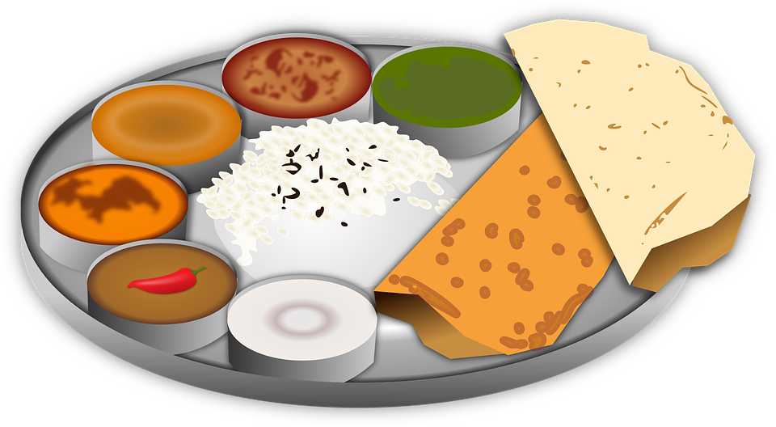
Points to ponder
Good food choices are good investments.
Eating healthy is all about a well-balanced diet.
Moderation in eating is the key to maintaining good health.
Take care of your body through healthy food habits.
Notes:
Notes for Teacher - < Information for further reference or explanation >
Suggestions: <Ideas/ Images/ Animations / Others – To make better representation of the content >
Source of Multimedia used in this slide - <Please provide source URL where we find the image and the license agreement>
Food : https://pixabay.com/vectors/bread-cultural-culture-curry-food-1296280/ (OpenClipart-Vectors)

Slide 9
Attribution / Citation
Slide # | Thumbnail | Source link | Author
1 |  | https://www.freepik.com/free-vector/one-happy-boy-eating-table_18973385.htm | brgfx
2, 5, 6, 7 |  | Grandpa : https://www.freepik.com/free-vector/grandchildren-grandfather-hand_5056244.htm House : https://www.freepik.com/free-vector/blank-farm-scene-cartoon-style_11862406.htm Grandmother : https://www.freepik.com/free-vector/indian-family-people-hindu-national-clothes-cartoon-indian-characters_2703434.htm Boy : https://www.freepik.com/free-vector/asian-boy-cartoon-character-sticker_21848968.htm | jemastock brgfx vectorpouch brgfx
3, 4 |  | Yoga : https://www.freepik.com/free-vector/active-elderly-people-illustration_9396741.htm Ramu : https://www.freepik.com/free-vector/boy-blue-shirt-isolated_7281242.htm | freepik brgfx
7 |  | Calendar : https://pixabay.com/vectors/calendar-month-year-date-datetime-97868 Boy : https://www.freepik.com/free-vector/cute-happy-smiling-child-isolated-white-background_5597171.htm | openicons brgfx
8 |  | Food : https://pixabay.com/vectors/bread-cultural-culture-curry-food-1296280/ | OpenClipart-Vectors)
Notes:
Notes for Teacher - < Information for further reference or explanation >
Suggestions: <Ideas/ Images/ Animations / Others – To make better representation of the content >
Source of Multimedia used in this slide - <Please provide source URL where we find the image and the license agreement>

