Slide 1
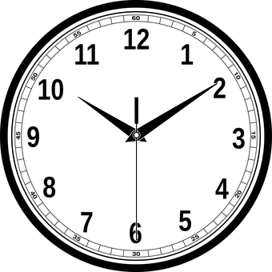
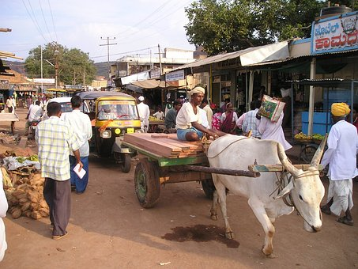
Summary Adverbs of Time and Place
Notes:
Notes for Teacher - < Information for further reference or explanation >
Suggestions: <Ideas/ Images/ Animations / Others – To make better representation of the content >
Source of Multimedia used in this slide -
Clock: https://pixabay.com/vectors/clock-time-hour-watch-countdown-1300646/ (Attribution: Open Clipart-Vectors)
Place: https://pixabay.com/photos/india-ox-cart-team-of-oxen-dealer-310/ ( Attribution: Simon)

Slide 2
SUMMARY
Adverbs of Time
Adverbs of time tell us when an action happened, is happening, will/may happen or even how often it is happening.
Tomorrow, tonight, yesterday, now, then, today, daily, weekly, immediately, already, last, just, before, later, next, soon, earlier, since, recently, still, always, usually, often, frequently, occasionally, rarely, never etc.
Adverbs of Place
Adverbs of place tell us where something happens.
North, south, east, west, left, right, straight far, faraway, near, nearby, behind, ahead, outside, behind, back, around, inside, abroad, away, upwards, downwards, southwards, anywhere, nowhere, somewhere, everywhere etc.
Notes:
Notes for Teacher - < Information for further reference or explanation >
Suggestions: <Ideas/ Images/ Animations / Others – To make better representation of the content >
Source of Multimedia used in this slide - <Please provide source URL where we find the image and the license agreement>

Slide 3
Attribution / Citation
Slide # | Thumbnail | Source link | Author
1 |  | Clock: https://pixabay.com/vectors/clock-time-hour-watch-countdown-1300646/ (Attribution: Open Clipart-Vectors) Place: https://pixabay.com/photos/india-ox-cart-team-of-oxen-dealer-310/ ( Attribution: Simon) | Open clipart vectors Simon
Notes:
Notes for Teacher - < Information for further reference or explanation >
Suggestions: <Ideas/ Images/ Animations / Others – To make better representation of the content >
Source of Multimedia used in this slide - <Please provide source URL where we find the image and the license agreement>

