Slide 1
Understanding Conjunctions
Notes:
Brief Description: Students will be able to infer the use of different conjunctions in different situations.
Teaching Aids: GO, PPT
TLM: Placards with pictures of means of transport (bus, train, aeroplane, boat). To be prepared by the teacher, ahead of the class, using pictures stuck to chart paper.
Notes To The Teacher: This asset starts with IQ and seamlessly flows into the MS.
The teacher may begin the class by drawing the attention of the students to the various means of transport that act as connectors between places, each one used to suit different situations- The bus, train, aeroplane, boat. (Interdisciplinary learning is used here) The GO and PPT may be used for clarity. Alternatively, the teacher may choose to prepare placards as given in the TLM.
Source of Multimedia used in this slide - <Please provide source URL where we find the image and the license agreement>

Slide 2
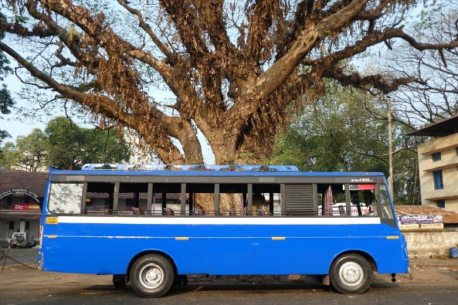
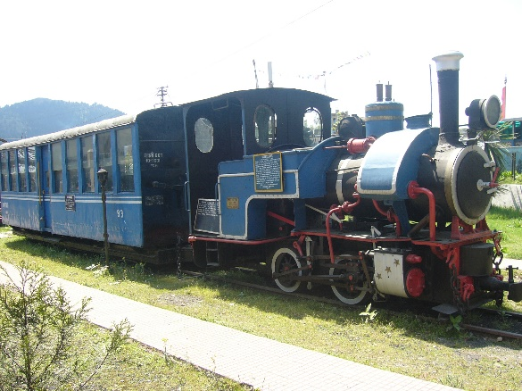
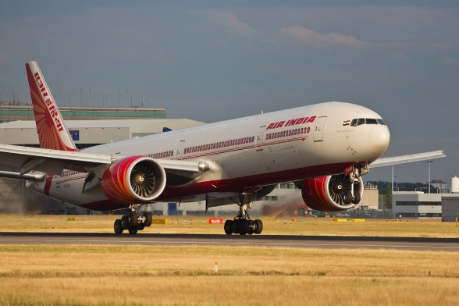
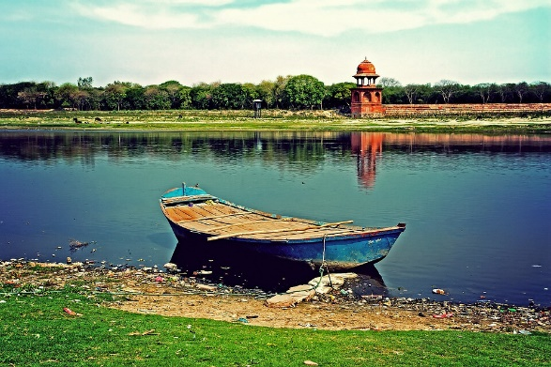
Connectors
The various means of transport act as connectors between places. Each one is designed differently to be used under different situations.
Bus – when two locations are connected by roads and are not too far apart.
1
Trains – connect locations that are a bit apart from one another where rails have been laid.
2
Aeroplanes – allows people to travel quickly to distant locations.
3
4
A boat - connects places across smaller waterways.
Notes:
Notes for Teacher – NA
Suggestions: NA
Source of Multimedia used in this slide -
https://www.flickr.com/photos/26445715@N00/39499730375
https://commons.wikimedia.org/w/index.php?curid=9658091
https://www.flickr.com/photos/27118242@N04/9633873002
https://www.flickr.com/photos/181992057@N05/48107548061

Slide 3
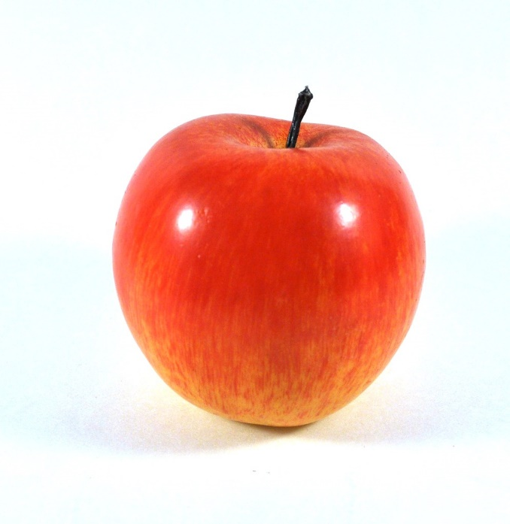
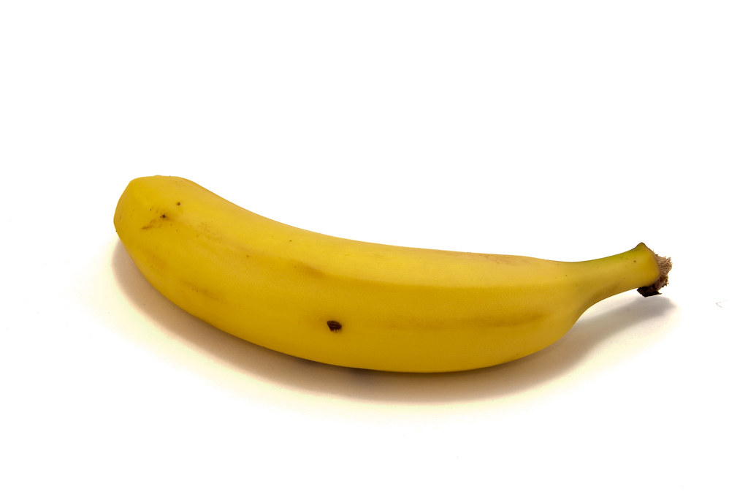
Conjunctions
Conjunctions are words that are used to join two ideas to make a sentence.
Different conjunctions are used in different situations.
AND: is used to connect two similar ideas.
Example-
I like apples. I like bananas.
I like apples and bananas.
Notes:
Notes for Teacher – The teacher may use more examples and encourage students to find the suitable conjunction according to the situation.
Suggestions: NA
Source of Multimedia used in this slide - https://www.flickr.com/photos/28446991@N00/4573302424
https://www.flickr.com/photos/53507547@N06/5129712590

Slide 4
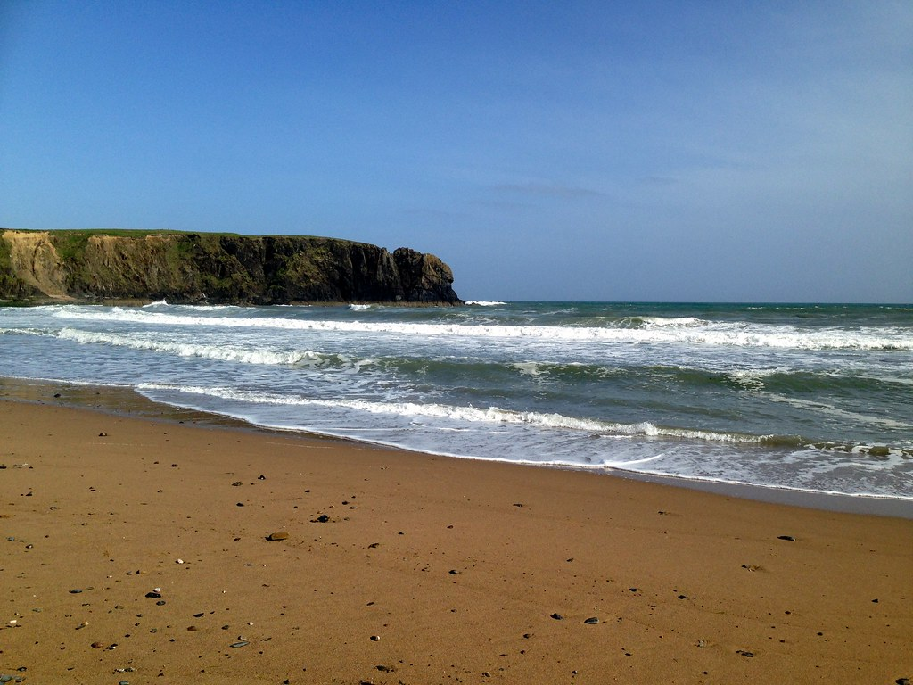
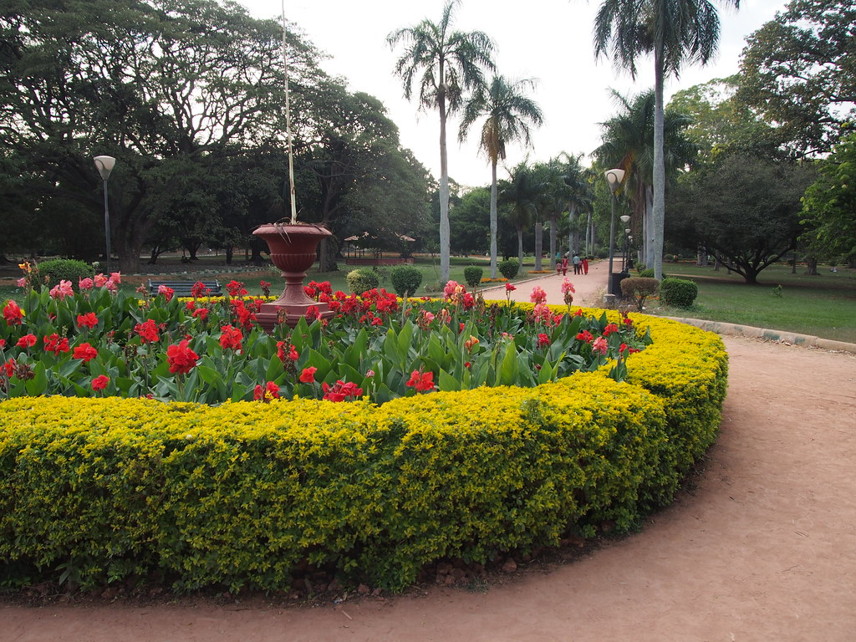
Conjunctions
OR: is used to express a choice between two ideas.
Example-
We may go to the beach. We may go to the park.
We may go to the beach or the park.
Notes:
Notes for Teacher – The teacher may use more examples and encourage students to find the suitable conjunction according to the situation.
Suggestions: NA
Source of Multimedia used in this slide -
https://www.flickr.com/photos/18090920@N07/14372113941
https://www.flickr.com/photos/22446827@N02/16587602856

Slide 5
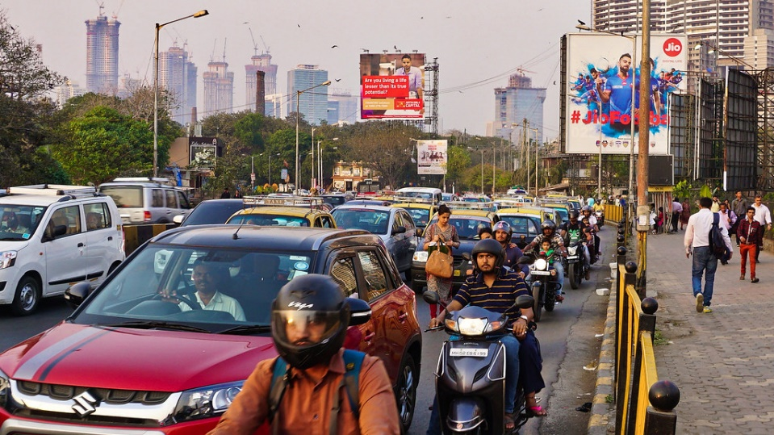
Conjunctions
BECAUSE: is used when one idea gives the reason for the other.
Example-
I was late for work. I was stuck in traffic.
I was late for work because I was stuck in traffic.
Notes:
Notes for Teacher – The teacher may use more examples and encourage students to find the suitable conjunction according to the situation.
Suggestions: NA
Source of Multimedia used in this slide - https://vectorportal.com/vector/programmer-working-vector-clip-art/27424
https://www.flickr.com/photos/185536361@N03/49544275088

Slide 6
Conjunctions
BUT: is used when one idea contrasts the other.
Example:
I want to come for the picnic. I have exams tomorrow.
I want to come for the picnic but I have exams tomorrow.
Notes:
Notes for Teacher – The teacher may use more examples and encourage students to find the suitable conjunction according to the situation.
Suggestions: NA
Source of Multimedia used in this slide - https://www.pexels.com/photo/family-having-a-picnic-5119595/
https://www.freepik.com/free-photo/exam-check-quiz-knowledge-lesson-test-concept_18091946.htm#page=5&query=exam&position=25&from_view=search&track=sph

Slide 7
Attribution / Citation
Slide # | Thumbnail | Source link | Author
2 |  | https://www.flickr.com/photos/26445715@N00/39499730375 https://commons.wikimedia.org/w/index.php?curid=9658091 https://www.flickr.com/photos/27118242@N04/9633873002 https://www.flickr.com/photos/181992057@N05/48107548061 | Mike Finn Shahnoor Habib Munmun Michael Garnett Abhiman Singh
3 |  | https://www.flickr.com/photos/28446991@N00/4573302424 https://www.flickr.com/photos/53507547@N06/5129712590 | Joe King robin_24
4 |  | https://www.flickr.com/photos/18090920@N07/14372113941 https://www.flickr.com/photos/22446827@N02/16587602856 | Sean MacEntee Heather Cowper
5 |  | https://vectorportal.com/vector/programmer-working-vector-clip-art/27424 https://www.flickr.com/photos/185536361@N03/49544275088 | Vectorportal.com Cyprien Hauser
6 |  | https://www.pexels.com/photo/family-having-a-picnic-5119595/ https://www.freepik.com/free-photo/exam-check-quiz-knowledge-lesson-test-concept_18091946.htm | Anna Tarazevich Rawpixel.com
Notes:
Notes for Teacher - NA Suggestions: NA
Source of Multimedia used in this slide - NA

