Slide 1
Choosing Conjunctions
Notes:
Notes for Teacher - This asset highlights the use of different conjunctions according to the situation and alongside helps students notice the use of conjunctions in daily conversations (SA and DD).
AIM: To help students recognize the use of different conjunctions according to the situation and relate to their use in daily conversations.
RESOURCES REQUIRED: A bowl with a few chits (depending upon the number of groups made in the class) with situations mentioned in them. Example: with the vegetable vendor, at the library, among friends, during a train journey, in the school bus (the teacher may innovate ideas based on the requirement)
TYPE OF ACTIVITY: Indoor / group. Role play.
PREPARATION OF ACTIVITY:
The class to be divided into groups of 4 or 5 students.
Teacher to ensure a mix of active and passive students in each group.
The teacher could demonstrate or explain the activity using the ppt.
PROCEDURE:
The bowl of chits to be sent around for every group to pick one.
Based on the situation mentioned in the chit, students of the group prepare a role play. Every student in the group should present at least one dialogue wherein suitable conjunctions have been used.
After the given time, the teacher could call out the groups to perform.
OBSERVATION: Students are able to converse using appropriate conjunctions.
FOLLOW UP ACTIVITY:
The teacher may let the students explain why certain conjunctions were used to test their understanding.
Further, the teacher could probe the students to notice the use of conjunctions in everyday conversations.
The teacher could also assign a task of writing two sentences with conjunctions that the students notice during their casual conversations through the day.
TROUBLESHOOTING: In case of an unhealthy conversation cropping up, the teacher should be quick to notice and nip it in the bud. If a passive student is found fumbling during the act, the teacher should prompt and help.
CONCLUSION: The class could be concluded with a quick synopsis of the use of suitable conjunctions and their use in daily conversations.
Suggestions: Not applicable
Source of Multimedia used in this slide - https://freesvg.org/chain-link

Slide 2
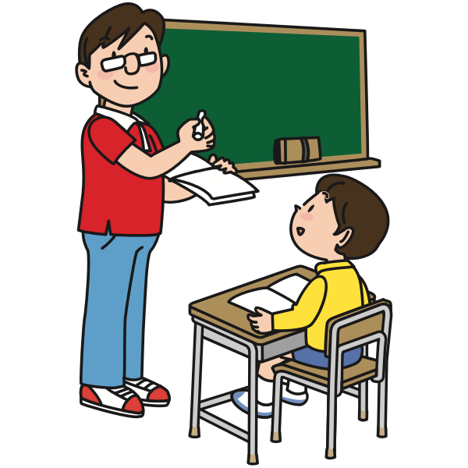
In the Classroom
Mohan and Kumar, your notebooks are yet to be corrected. Please submit them today.
I finished my work sir but I forgot to bring my notebook. Sorry sir. Kumar is absent today because he has an appointment with the dentist.
Okay, submit your work tomorrow and remind Kumar too.
Notes:
Notes for Teacher – Not applicable
Suggestions: Not applicable
Source of Multimedia used in this slide - https://freesvg.org/male-teacher-and-student

Slide 3
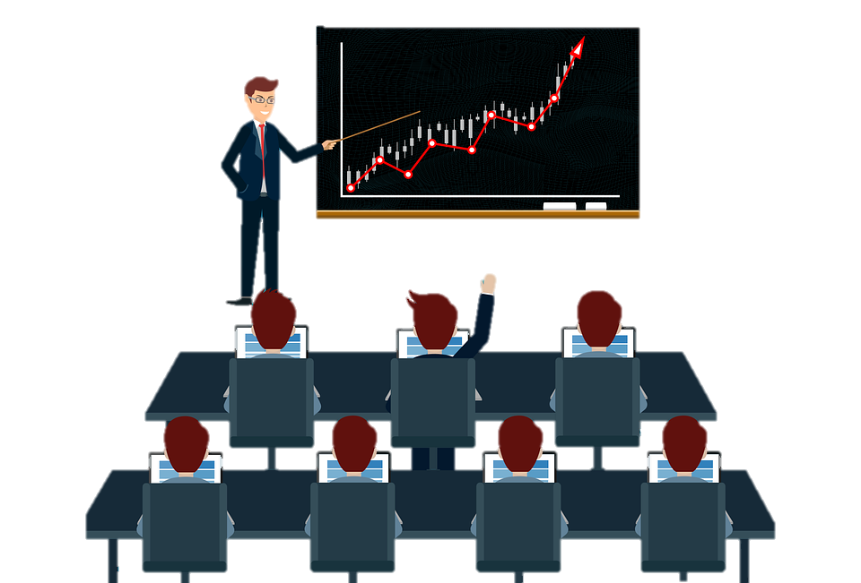
In the Classroom
Oh yes! We are planning to go to the museum or the planetarium. You may check with your parents and give your names by Friday.
Sir, my friends are poking me with their pencils because they want me to ask you about our excursion.
There will be no class but learning will go on. After the trip I will be asking you all to write an essay or present a speech on the trip.
That will be great fun because we won’t have to bring our bags!
Notes:
Notes for Teacher - Not applicable
Suggestions: Not applicable
Source of Multimedia used in this slide - https://pixabay.com/vectors/man-teacher-training-business-6107457/

Slide 4
Attribution / Citation
Slide # | Thumbnail | Source link | Author
1 |  | https://freesvg.org/chain-link | OpenClipart
2 |  | https://freesvg.org/male-teacher-and-student | OpenClipart
3 |  | https://pixabay.com/vectors/man-teacher-training-business-6107457/ | merhanhaval22 / Merhan Saeed
Notes:
Notes for Teacher – Not applicable
Suggestions: Not applicable
Source of Multimedia used in this slide - Not applicable

