Slide 1
Use Demonstrative Pronouns
This
These
That
Those
Notes:
Notes for Teacher – This asset starts with IQ and seamlessly flows into the MS. The teacher could start the class by asking the students to give a few sentences about their friends using pronouns. She/he could then write down the sentences spoken by the students. She/he may then underline the Pronouns in those sentences and ask the students the kind of pronouns used. She/he can recap the pronouns already learnt (he, she, it, we, my, her, his, we, they etc.) and start the MS. The PPT may be used for clarity. Alternatively, the teacher may choose to prepare placards as given in the TLM.
Suggestions: Not applicable
Source of Multimedia used in this slide - Not applicable

Slide 2
Introduction
Identify the pronouns given in the sentence.
Answers
1. This book is mine.
mine (possessive)
2. She is running fast.
she (personal)
3. We are going to the park.
we (personal)
4. His bag is heavy.
his (possessive)
that (demonstrative),
his (possessive)
5. That is his bottle.
Notes:
Notes for Teacher – The teacher can ask the students the meaning and usage of THAT in the 5th sentence and what it stands for. Then the teacher introduces them to Demonstrative Pronouns.
Suggestions: Not applicable
Source of Multimedia used in this slide - PPT icons

Slide 3
Demonstrative Pronouns
A Demonstrative Pronoun is a pronoun used to point to something specific within a sentence.
These pronouns can indicate items in space or time and be singular or plural.
When used to represent a thing or things, they can be used for either near or far in distance or time.
Example: this, that, these and those.
Notes:
Notes for Teacher - Not applicable
Suggestions: Not applicable
Source of Multimedia used in this slide - Not applicable

Slide 4
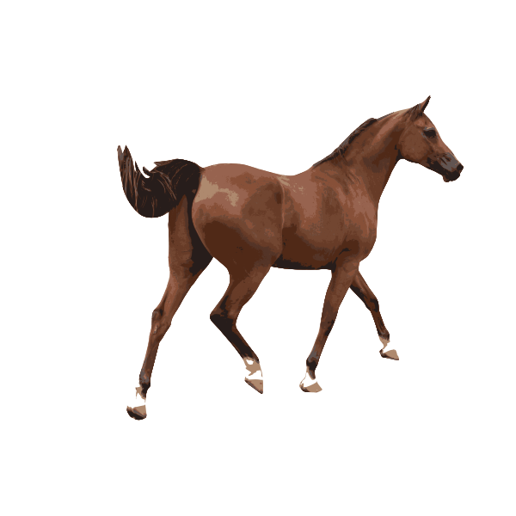
Demonstrative Pronouns
Demonstrative Pronouns
Near
Near in time or distance
This is used to refer to a singular noun that is near the speaker.
These is used to refer to a plural noun that is near to the speaker.
This always comes with the word ‘is’.
These always comes with the word ‘are’.
This is a horse.
These are colour pencils.
Notes:
Notes for Teacher - Not applicable
Suggestions: Not applicable
Source of Multimedia used in this slide -
1. Horse - https://freesvg.org/colored-vector-illustration-of-a-male-horse
2. Colour pencils - https://freesvg.org/colored-pencils-vector-image

Slide 5
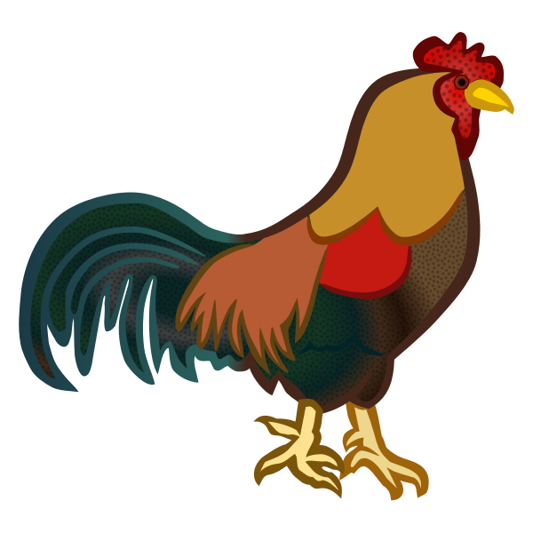
Demonstrative Pronouns
Demonstrative Pronouns
Far
Far in time or distance
That is used to refer to a singular noun that is far from the speaker.
Those is used to refer to a plural noun that is far from the speaker.
That always comes with the word ‘is’.
Those always comes with the word ‘are’.
That is a hen.
Those are books.
Notes:
Notes for Teacher - Not applicable
Suggestions: Not applicable
Source of Multimedia used in this slide -
1. Hen - https://freesvg.org/colored-male-chicken
2. Books - https://freesvg.org/stack-of-books-vector-clip-art

Slide 6
More examples of ‘This’
1. This is my grandparents’ house.
2. This is a present from my friend.
3. This is my friend’s glass.
4. This is the bottle I got as a gift.
5. This is my mother’s purse.
Notes:
Notes for Teacher – Not applicable
Suggestions: Not applicable
Source of Multimedia used in this slide -
1. House - https://pixabay.com/illustrations/house-boy-drawing-trees-path-6001425/
2. Boy with gift - https://pixabay.com/vectors/open-clipart-traced-present-child-7260700/

Slide 7
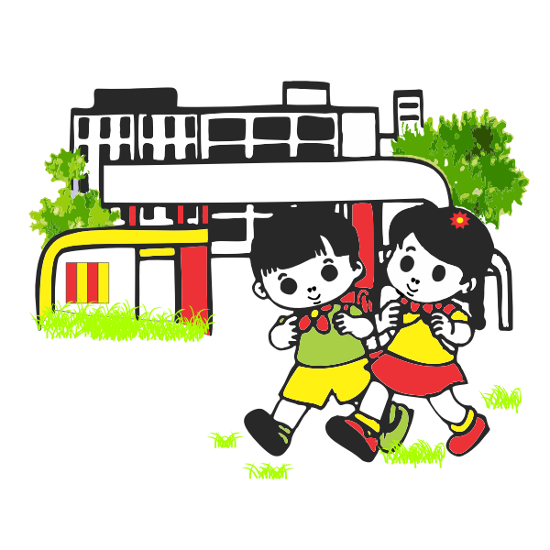
More examples of ‘That’
1. That is an aeroplane.
2. That is the best thing to do.
SCHOOL
3. That is the flower I love.
4. That is our school.
5. That is an elephant.
Notes:
Notes for Teacher – Not applicable
Suggestions: Not applicable
Source of Multimedia used in this slide -
1. Aeroplane - https://pixabay.com/vectors/aeroplane-plane-flying-airplane-311402/
2. Children and school - https://freesvg.org/school-kids-vector-image

Slide 8
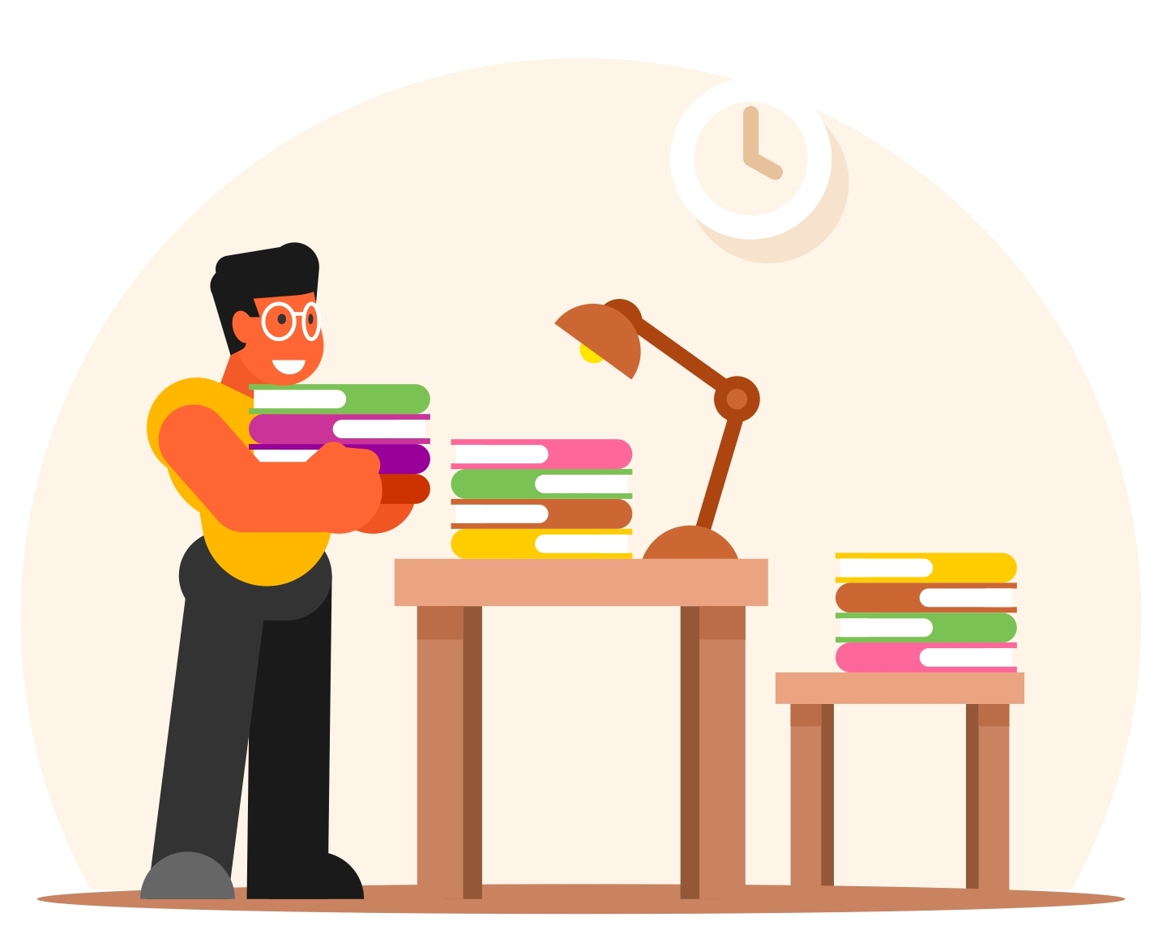
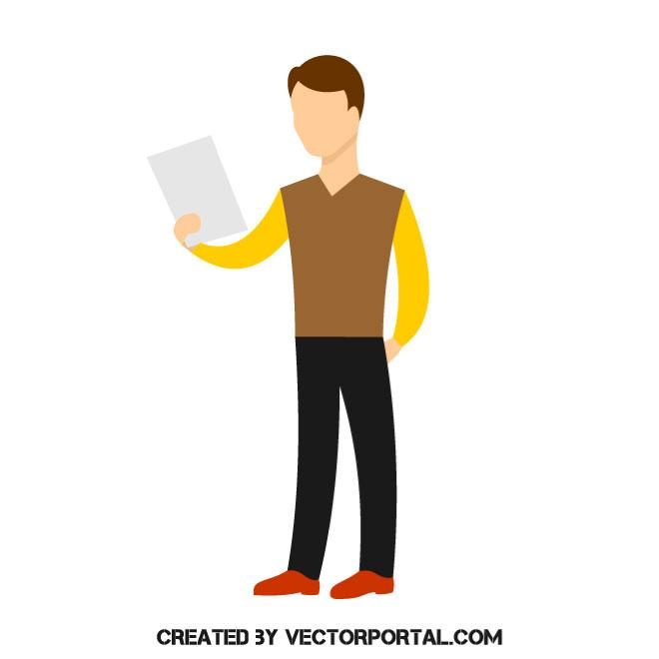
More examples of ‘These’
1. These are my cupcakes.
2. These papers belong to me.
3. These are my friend’s books.
4. Are these your guests?
5. These are the dresses my mother made.
Notes:
Notes for Teacher – Not applicable
Suggestions: Not applicable
Source of Multimedia used in this slide -
1. Person with paper - https://vectorportal.com/vector/man-reading-something/15979
2. Person with books - https://free-vectors.net/education/librarian-vector

Slide 9
More examples of ‘Those’
1. Those are my neighbour’s dogs.
2. These are cakes, and those are pastries.
3. Are those your classmates?
4. Those were beautiful flowers.
5. Those boys gave me chocolate.
Notes:
Notes for Teacher – One should distinguish demonstrative adjectives from demonstrative pronouns. The words are identical, but demonstrative adjectives qualify as nouns, whereas demonstrative pronouns stand alone.
Suggestions: Not applicable
Source of Multimedia used in this slide -
1. Person with dog - https://freesvg.org/publicdomainq-0011533jjmpbf
2. Flowers - https://pixabay.com/vectors/flowers-roses-bouquet-bunch-5826201/

Slide 10
Attribution / Citation
Slide # | Thumbnail | Source link | Author
4 |  | 1. Horse - https://freesvg.org/colored-vector-illustration-of-a-male-horse 2. Colour pencils - https://freesvg.org/colored-pencils-vector-image | 1. OpenClipart 2. OpenClipart
5 |  | 1. Hen - https://freesvg.org/colored-male-chicken 2. Books - https://freesvg.org/stack-of-books-vector-clip-art | 1. OpenClipart 2. OpenClipart
6 |  | 1. House - https://pixabay.com/illustrations/house-boy-drawing-trees-path-6001425/ 2. Boy with gift - https://pixabay.com/vectors/open-clipart-traced-present-child-7260700/ | 1. buket6923 2. samuelharvey479
7 |  | 1. Aeroplane - https://pixabay.com/vectors/aeroplane-plane-flying-airplane-311402/ 2. Children and school - https://freesvg.org/school-kids-vector-image | 1. Clker-Free-Vector-Images 2. OpenClipart
8 |  | 1. Person with paper - https://vectorportal.com/vector/man-reading-something/15979 2. Person with books - https://free-vectors.net/education/librarian-vector | 1. Vectorportal.com 2. FREE-VECTORS.NET
9 |  | 1. Person with dog - https://freesvg.org/publicdomainq-0011533jjmpbf 2. Flowers - https://pixabay.com/vectors/flowers-roses-bouquet-bunch-5826201/ | 1. OpenClipart 2. moizgraphics
COPYRIGHT Cum DISCLAIMER NOTICE
Content owned by Sri Sathya Sai Central Trust, Prashanthi Nilayam, Puttaparthi, Sathya Sai District, Andhra Pradesh, India.
Strictly not for Commercial Use, excluding content that falls in Public Domain or common knowledge facts.
Content can be downloaded and used for personal, educational, informational and other non-commercial purposes, subject to attribution in the name of ‘Sri Sathya Sai Central Trust, Prashanthi Nilayam, Puttaparthi’ only. Any attempt to remove, alter, circumvent, or distort the data that is accessed is illegal and strictly prohibited.
Some of the content is owned by Third Parties and are used in compliance with their licensing conditions. Anyone infringing the Copyright of such Third Parties will be doing so at their own risks and costs.
Notes:
Notes for Teacher - Not applicable
Suggestions: Not applicable
Source of Multimedia used in this slide - Not applicable

