Slide 1
Foolish Dumdum
Notes:
Notes for Teacher - < Information for further reference or explanation >
Suggestions: <Ideas/ Images/ Animations / Others – To make better representation of the content >
Source of Multimedia used in this slide - <Please provide source URL where we find the image and the license agreement>

Slide 2
Foolish Dumdum
Once upon a time, a salt seller lived in a village with his donkey named Dumdum. They both were good friends. The merchant used to carry the salt bag on his Dumdum daily to the market. The donkey started becoming lazy, and he felt that he shouldn’t be carrying these salt bags. On their way, they both had to cross a stream. One day the donkey suddenly fell into the stream, and the salt bag fell into the water. The salt completely dissolved in that water, so the bag became very light to carry. The donkey was very happy because he didn’t have to carry the salt bags which his master had been loading him with. Then the donkey started to play that same trick every day. The salt merchant came to understand the trick and decided to teach a lesson to his Dumdum. The next day he loaded a cotton bag on the donkey. Again it played the same trick hoping that the cotton bag would still become lighter.
But the wet cotton became heavy, and the donkey suffered. It learnt a lesson and didn’t play the trick after that day, and the seller was happy.
Notes:
Notes for Teacher -. The teacher may begin the class by reading the anecdote to the students and children will enjoy listening /viewing it. The students can be asked to identify the highlighted pronouns in different colours. She/he could interestingly differentiate between the personal, possessive and demonstrative pronouns to bring clarity to the students about the usage of Demonstrative Pronouns. To set the mood, the teacher could ask them what they learned from this anecdote and how it has helped them.
Suggestions: <Ideas/ Images/ Animations / Others – To make better representation of the content >
Source of Multimedia used in this slide - <Please provide source URL where we find the image and the license agreement>
Image : https://youtu.be/G3LZNjeURC4?t=17 (Smart kids Learning & playing)
Image : https://youtu.be/G3LZNjeURC4?t=27

Slide 3
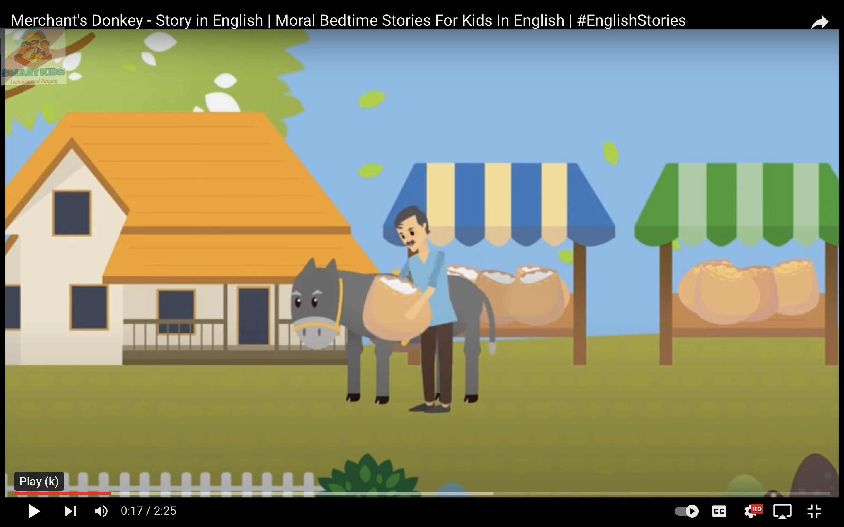
Foolish Dumdum
Once upon a time, a salt seller lived in a village with his donkey named Dumdum. They both were good friends. The merchant used to carry the salt bag on his Dumdum daily to the market
The donkey started becoming lazy, and he felt that he shouldn’t be carrying these salt bags
Notes:
Notes for Teacher -. The teacher may begin the class by reading the anecdote to the students and children will enjoy listening /viewing it. The students can be asked to identify the highlighted pronouns in different colours. She/he could interestingly differentiate between the personal, possessive and demonstrative pronouns to bring clarity to the students about the usage of Demonstrative Pronouns. To set the mood, the teacher could ask them what they learned from this anecdote and how it has helped them.
Suggestions: <Ideas/ Images/ Animations / Others – To make better representation of the content >
Source of Multimedia used in this slide - <Please provide source URL where we find the image and the license agreement>
Image : https://youtu.be/G3LZNjeURC4?t=17 (Smart kids Learning & playing)
Image : https://youtu.be/G3LZNjeURC4?t=27

Slide 4
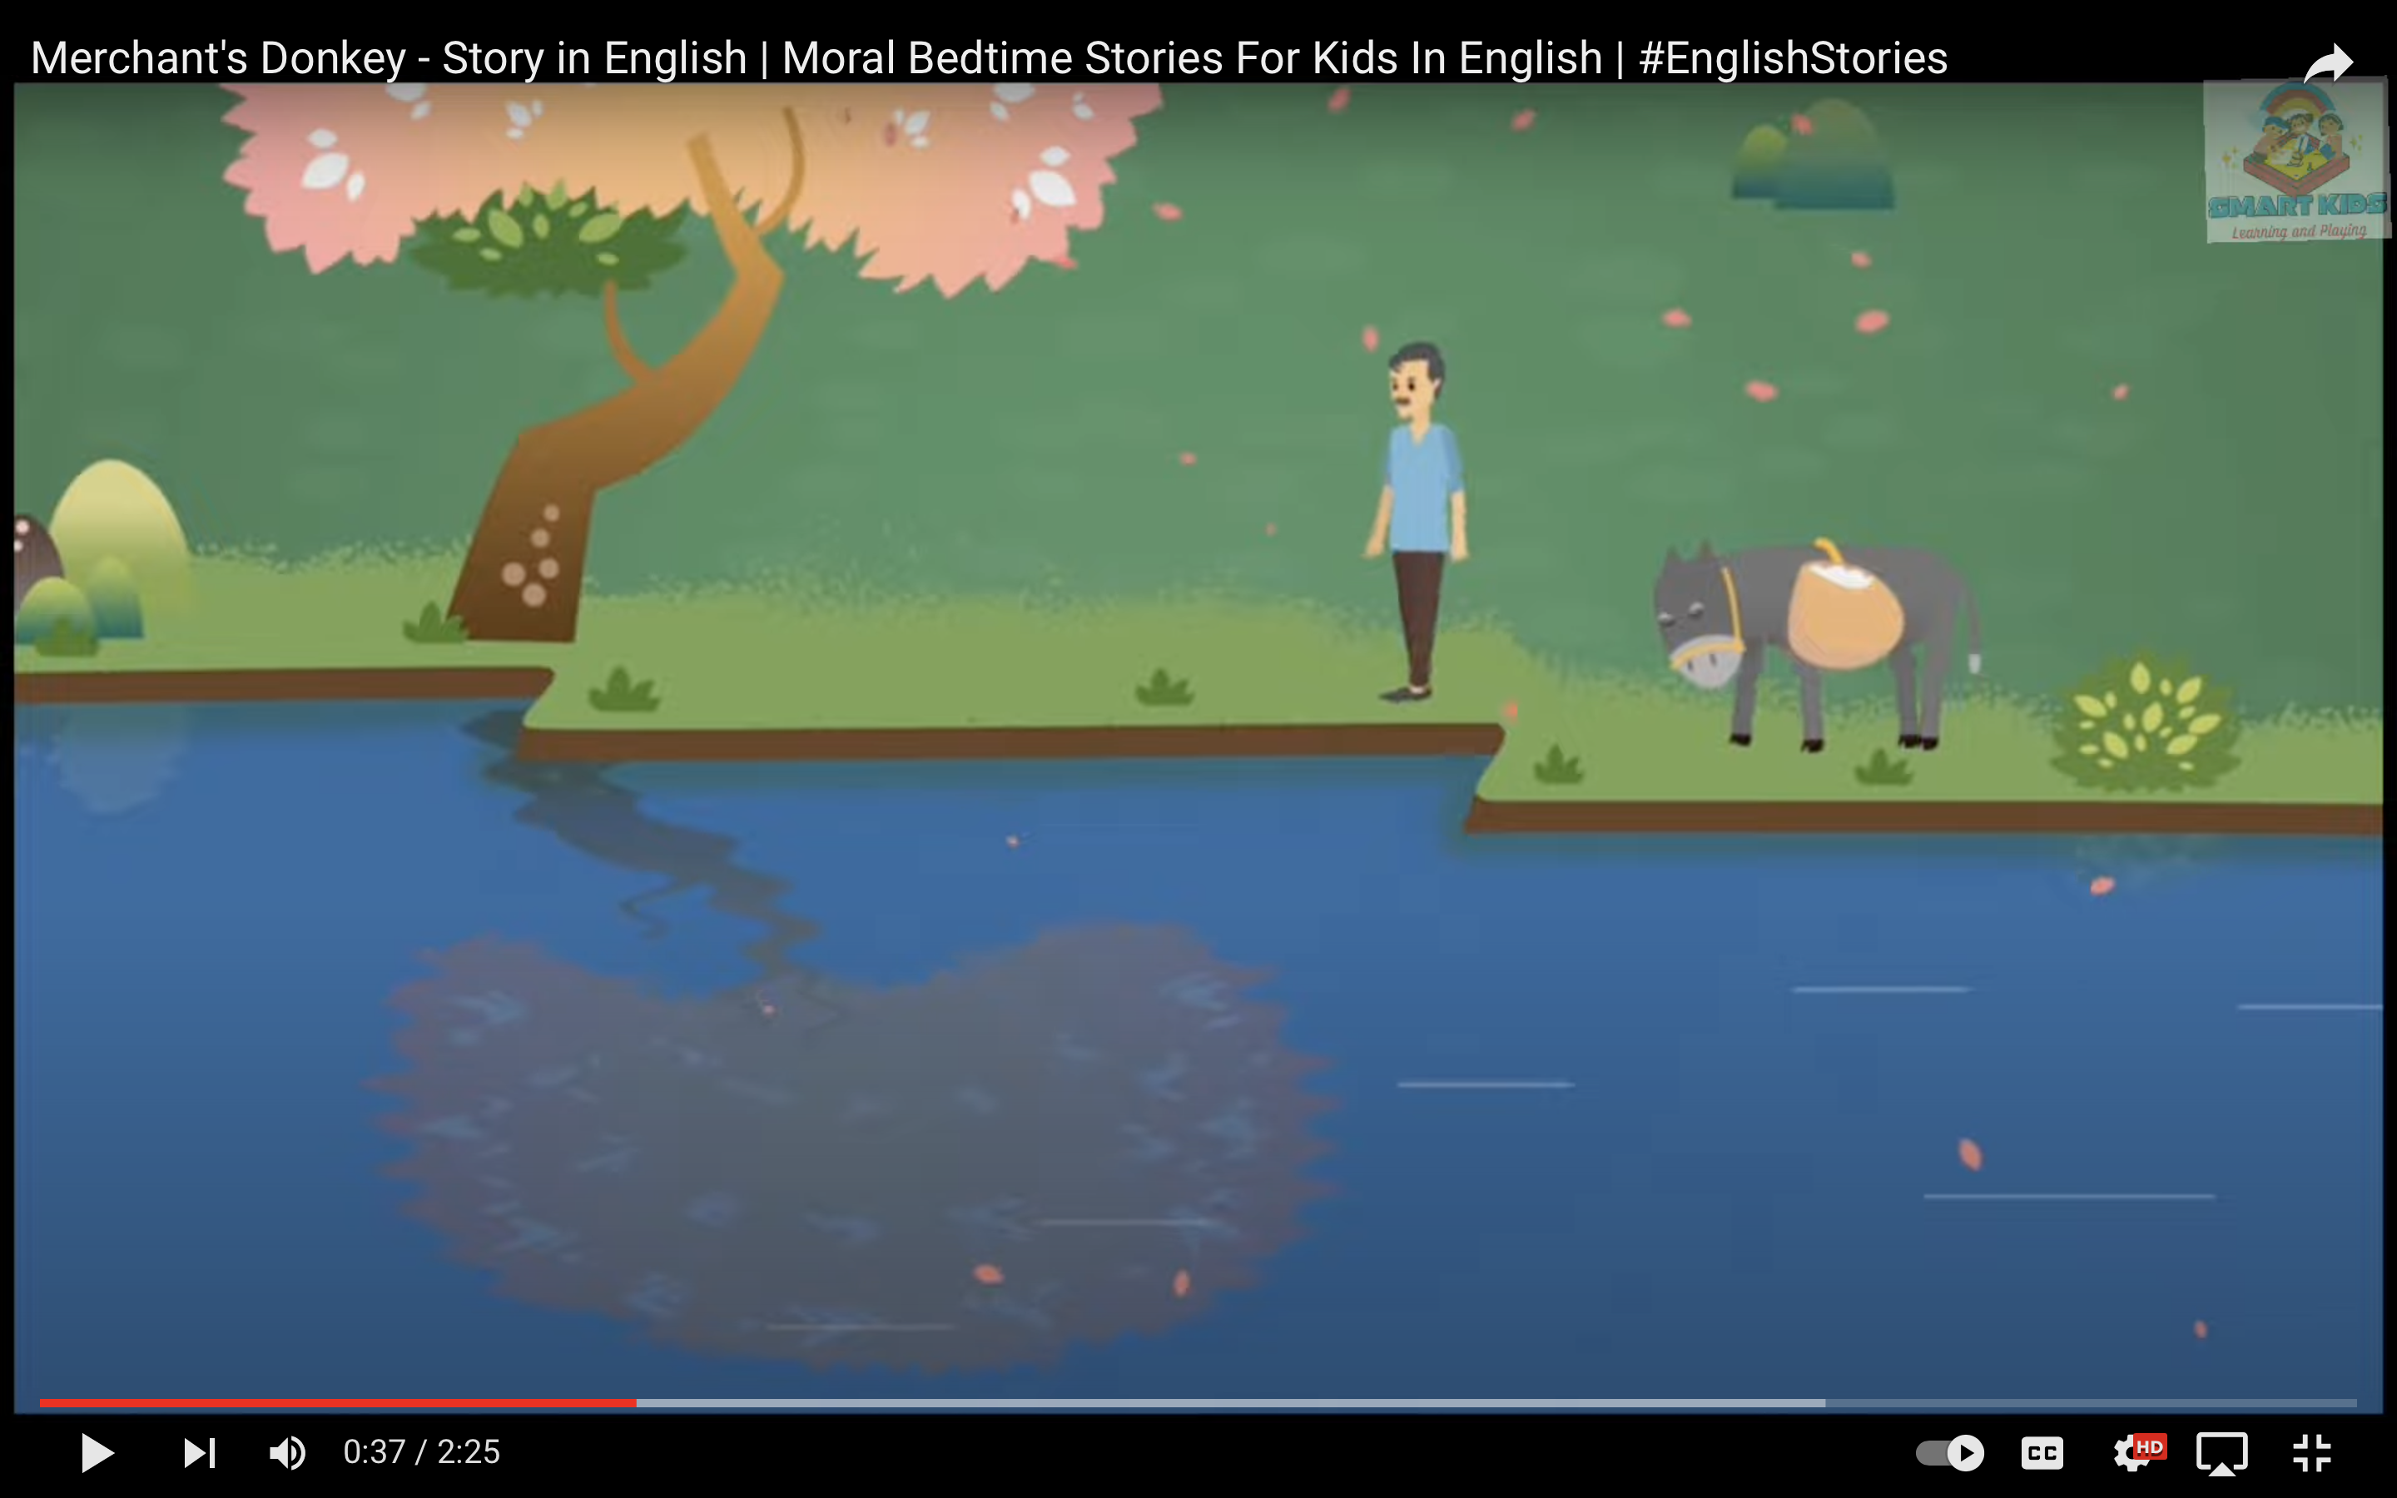
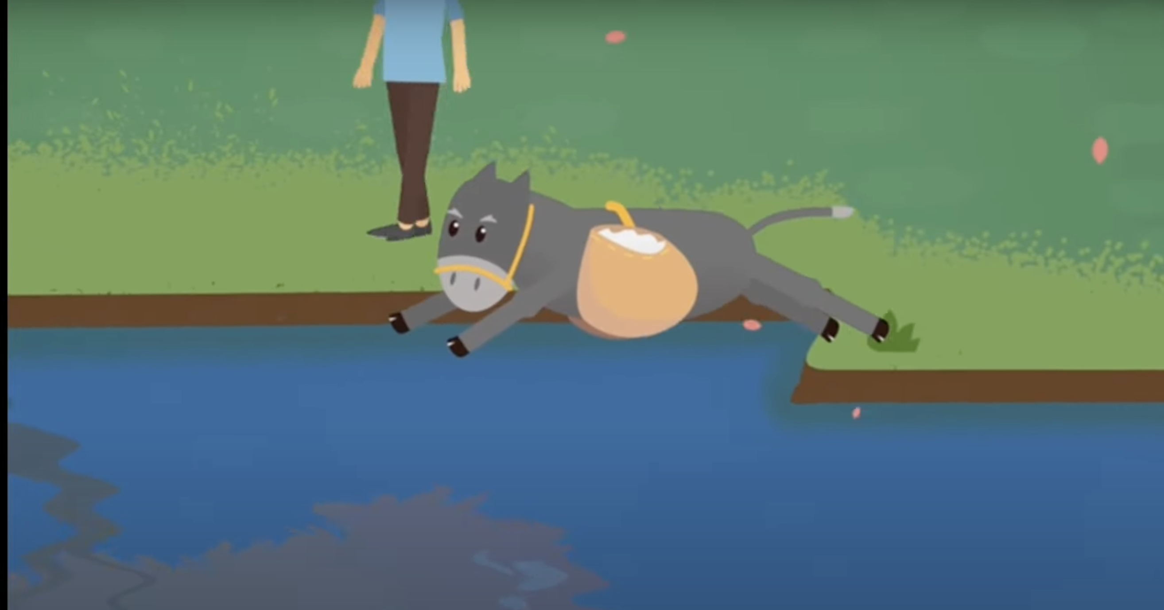
Foolish Dumdum
On their way, they both had to cross a stream. One day the donkey suddenly fell into the stream, and the salt bag fell into the water. The salt completely dissolved in that water, so the bag became very light to carry.
Notes:
Notes for Teacher - < Information for further reference or explanation >
Suggestions: <Ideas/ Images/ Animations / Others – To make better representation of the content >
Source of Multimedia used in this slide - <Please provide source URL where we find the image and the license agreement>
Image : https://youtu.be/G3LZNjeURC4?t=37
Image : https://youtu.be/G3LZNjeURC4?t=40

Slide 5
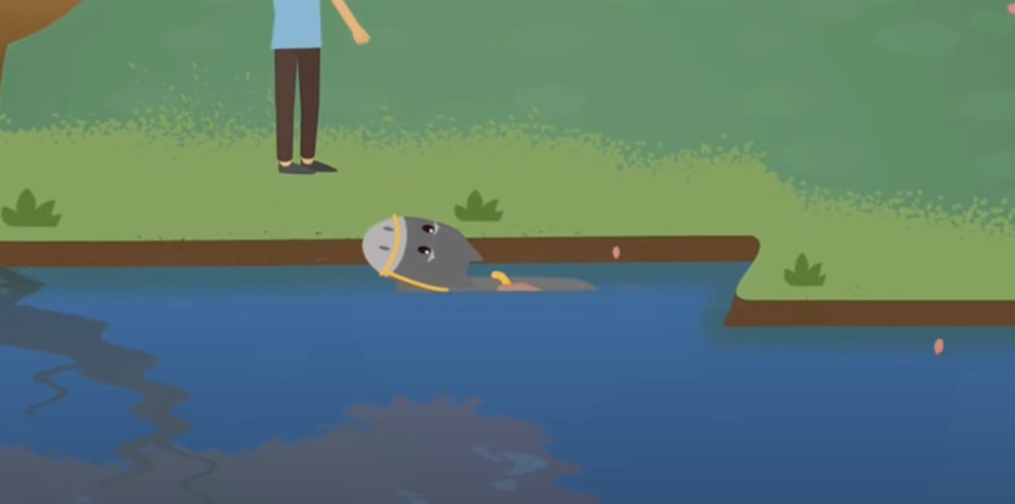
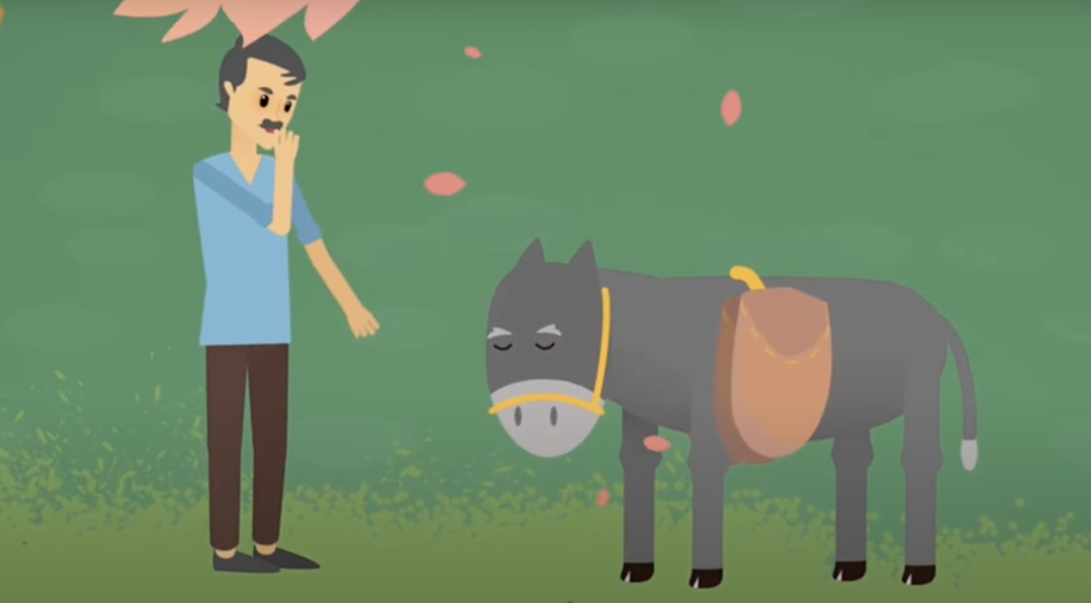
Foolish Dumdum
The donkey was very happy because he didn’t have to carry the salt bags which his master had been loading him with. Then the donkey started to play that same trick every day.
Notes:
Notes for Teacher - < Information for further reference or explanation >
Suggestions: <Ideas/ Images/ Animations / Others – To make better representation of the content >
Source of Multimedia used in this slide - <Please provide source URL where we find the image and the license agreement>
Image : https://youtu.be/G3LZNjeURC4?t=83
Image : https://youtu.be/G3LZNjeURC4?t=81

Slide 6
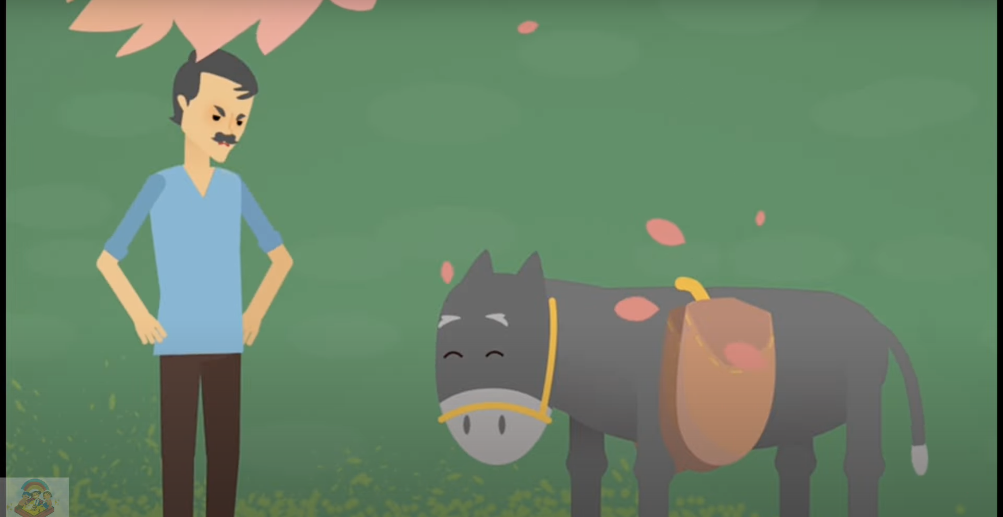
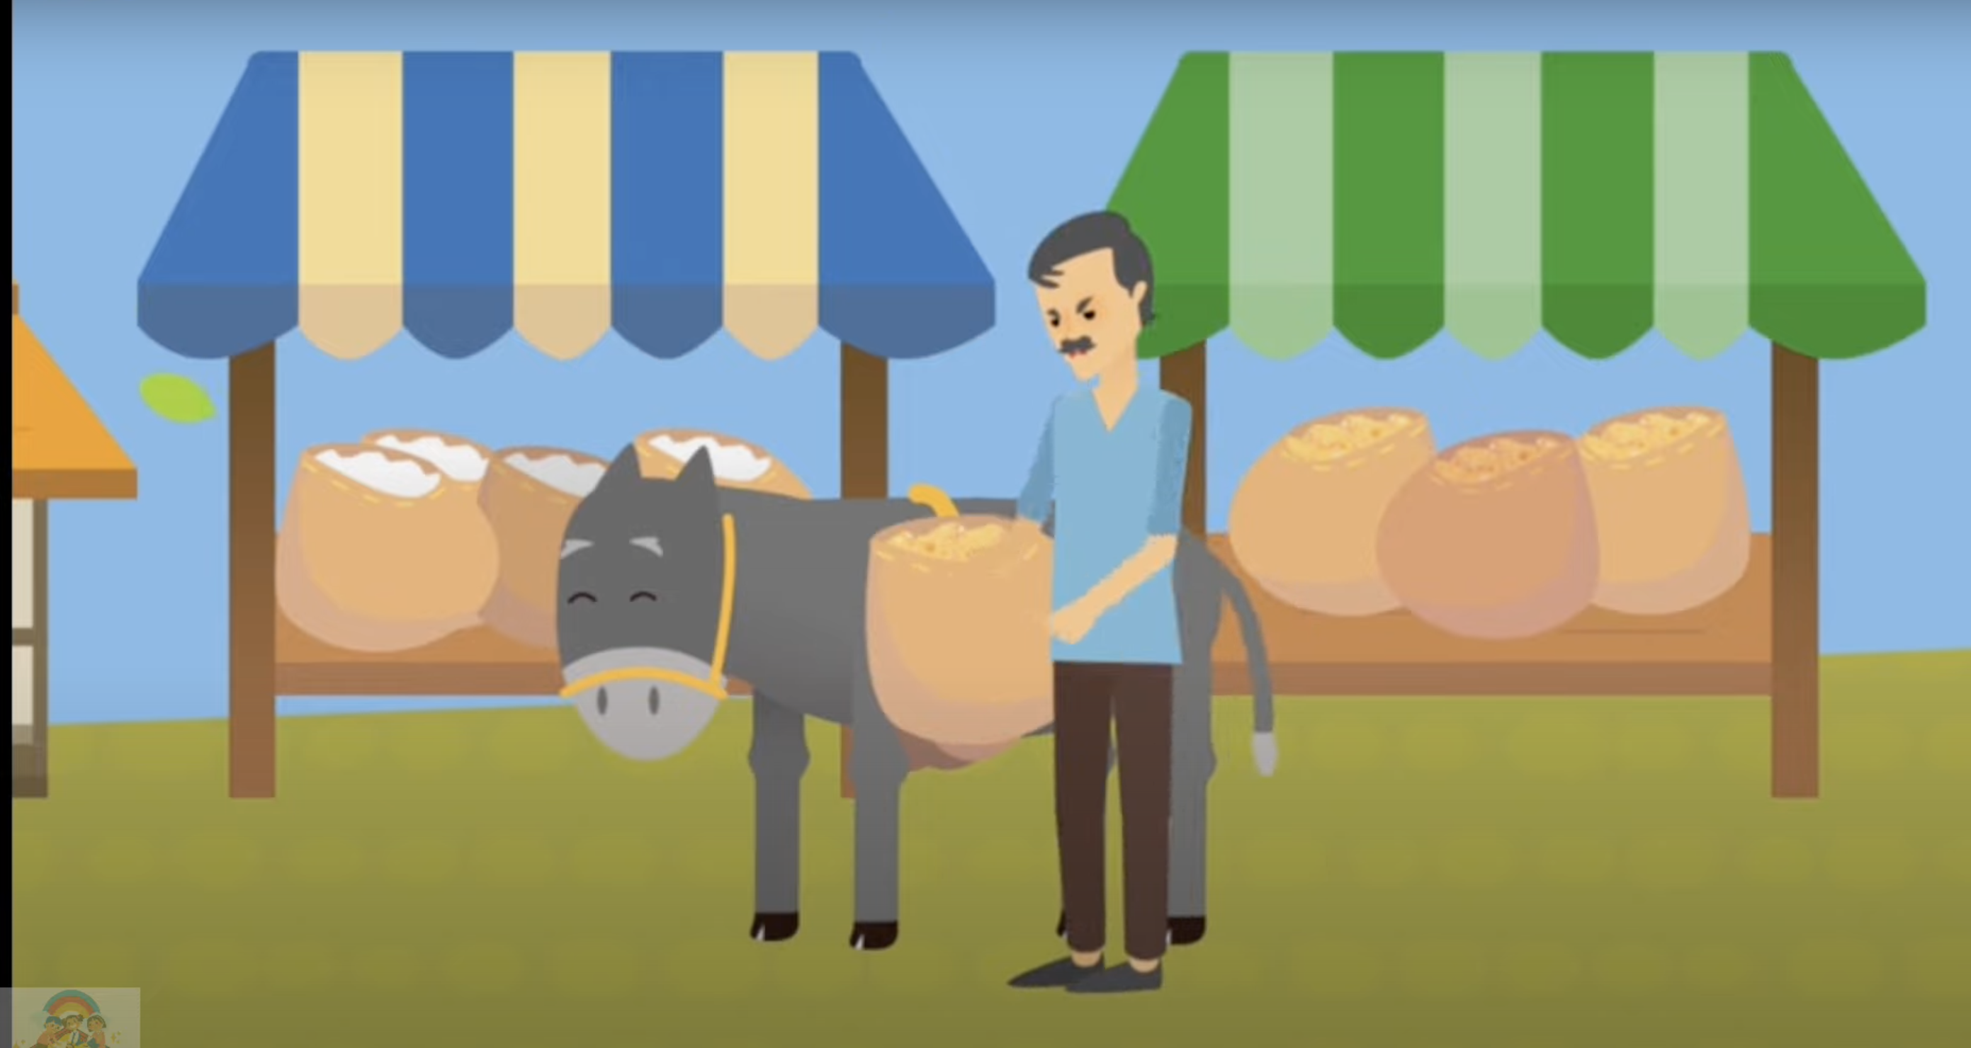
Foolish Dumdum
The salt merchant came to understand the trick and decided to teach a lesson to his Dumdum. The next day he loaded a cotton bag on the donkey. Again it played the same trick hoping that the cotton bag would still become lighter.
Notes:
Notes for Teacher - < Information for further reference or explanation >
Suggestions: <Ideas/ Images/ Animations / Others – To make better representation of the content >
Source of Multimedia used in this slide - <Please provide source URL where we find the image and the license agreement>
Image : https://youtu.be/G3LZNjeURC4?t=94
Image : https://youtu.be/G3LZNjeURC4?t=107

Slide 7
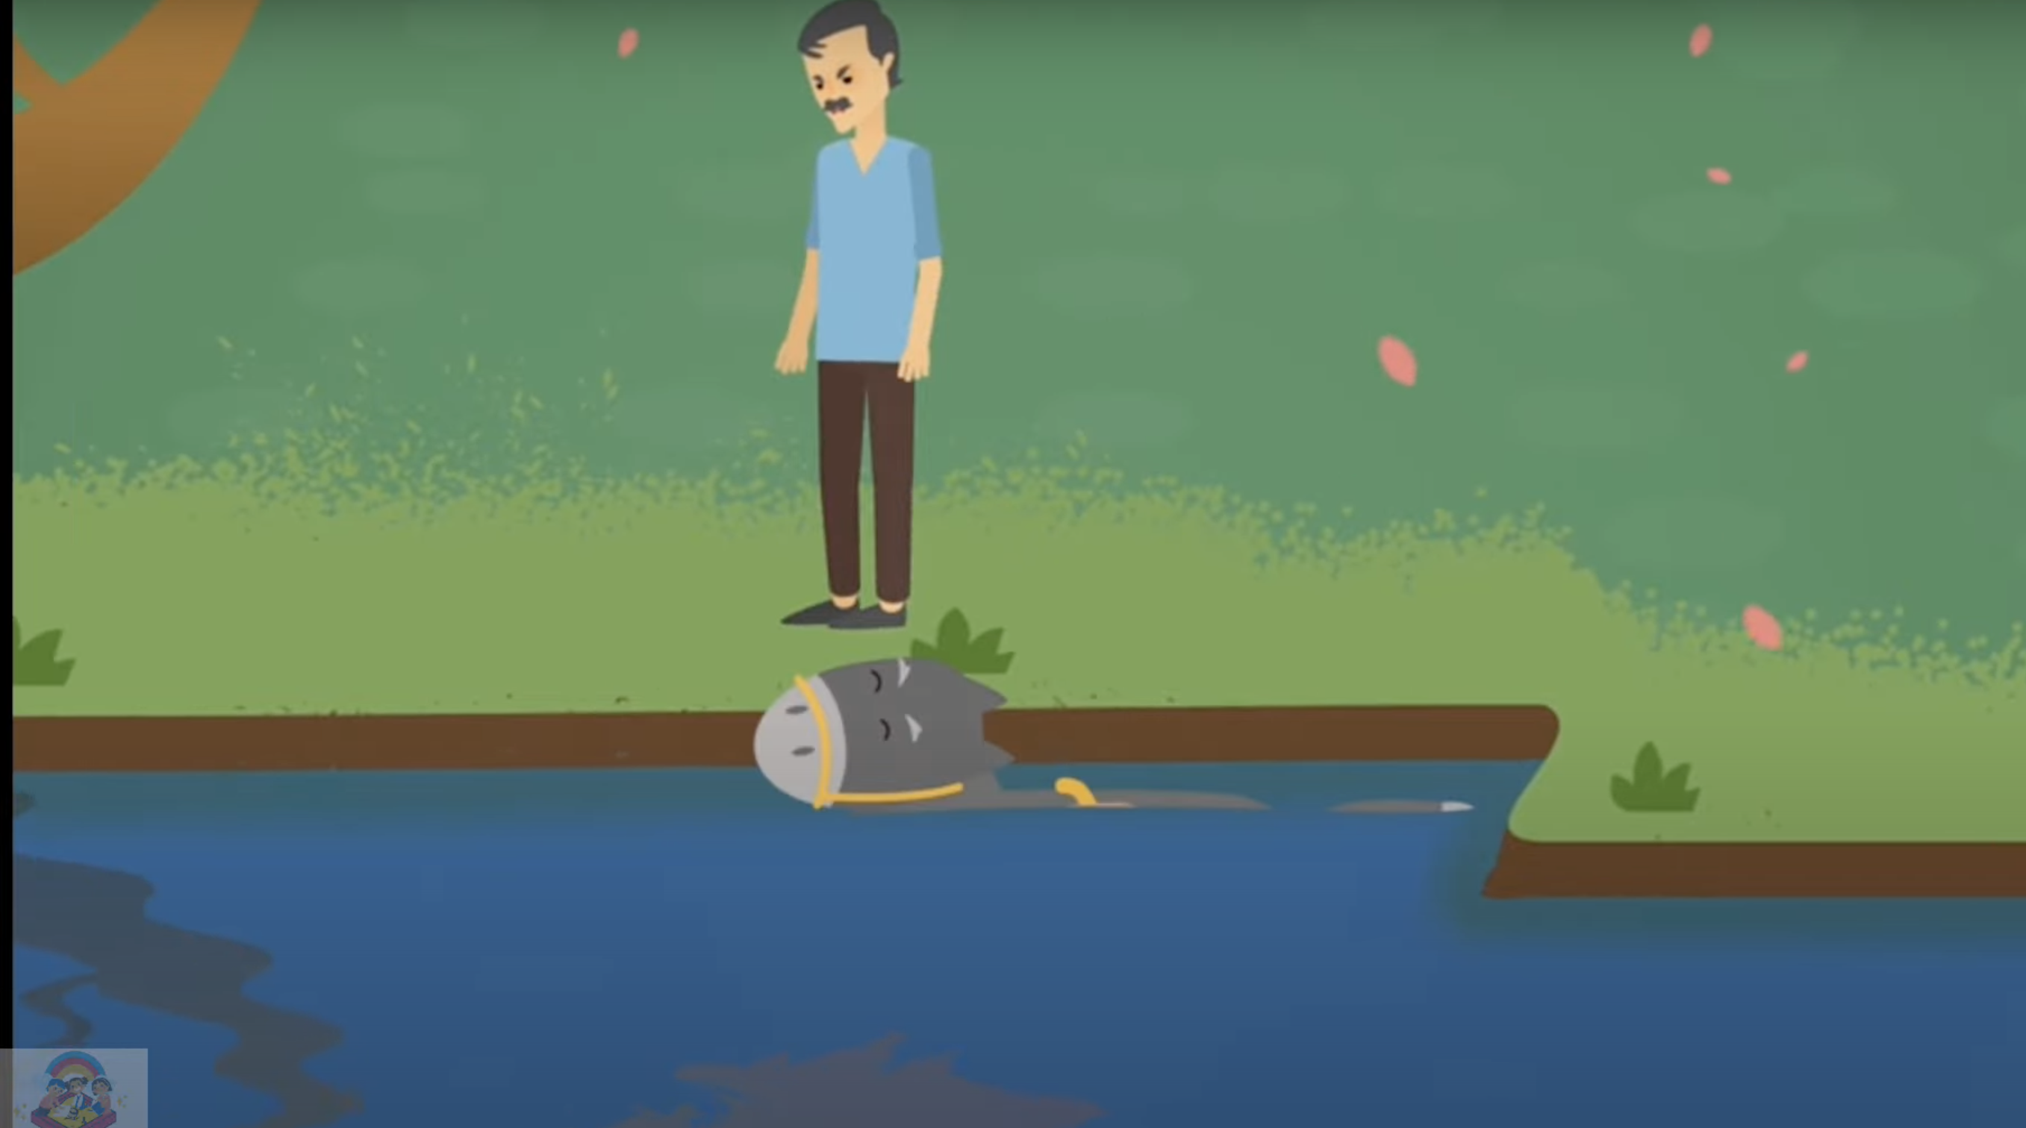
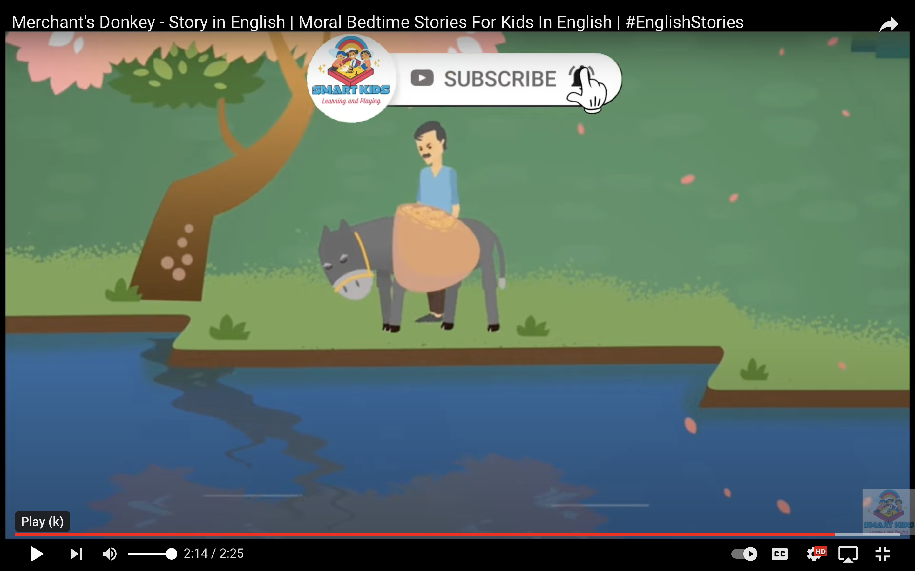
Foolish Dumdum
But the wet cotton became heavy, and the donkey suffered. It learnt a lesson and didn’t play the trick after that day, and the seller was happy.
Notes:
Notes for Teacher - < Information for further reference or explanation >
Suggestions: <Ideas/ Images/ Animations / Others – To make better representation of the content >
Source of Multimedia used in this slide - <Please provide source URL where we find the image and the license agreement>
Image : https://youtu.be/G3LZNjeURC4?t=119
Image : https://youtu.be/G3LZNjeURC4?t=134

Slide 8
Foolish Dumdum
Lesson Learnt
Never play tricks, be honest and should not run away from your duties and responsibilities.

Slide 9
Answers
He
Subject
His, Their
Possessive
That , These
Demonstrative
Which
Relative
Him, It
Object
They
Subject(3rd person)
Notes:
Notes for Teacher - < Information for further reference or explanation >
Suggestions: <Ideas/ Images/ Animations / Others – To make better representation of the content >
Source of Multimedia used in this slide - <Please provide source URL where we find the image and the license agreement>

Slide 10
Attribution / Citation
Slide # | Thumbnail | Source link | Author
2 |  | Image : https://youtu.be/G3LZNjeURC4?t=17 Image : https://youtu.be/G3LZNjeURC4?t=27 | Smart kids Learning & playing)
3 |  | Image : https://youtu.be/G3LZNjeURC4?t=37 Image : https://youtu.be/G3LZNjeURC4?t=40
4 |  | Image : https://youtu.be/G3LZNjeURC4?t=83 Image : https://youtu.be/G3LZNjeURC4?t=81
5 |  | Image : https://youtu.be/G3LZNjeURC4?t=94 Image : https://youtu.be/G3LZNjeURC4?t=107
6 |  | Image : https://youtu.be/G3LZNjeURC4?t=119 Image : https://youtu.be/G3LZNjeURC4?t=134
COPYRIGHT Cum DISCLAIMER NOTICE
Content owned by Sri Sathya Sai Central Trust, Prashanthi Nilayam, Puttaparthi, Sathya Sai District, Andhra Pradesh, India.
Strictly not for Commercial Use, excluding content that falls in Public Domain or common knowledge facts.
Content can be downloaded and used for personal, educational, informational and other non-commercial purposes, subject to attribution in the name of ‘Sri Sathya Sai Central Trust, Prashanthi Nilayam, Puttaparthi’ only. Any attempt to remove, alter, circumvent, or distort the data that is accessed is illegal and strictly prohibited.
Some of the content is owned by Third Parties and are used in compliance with their licensing conditions. Anyone infringing the Copyright of such Third Parties will be doing so at their own risks and costs.
Notes:
Notes for Teacher - < Information for further reference or explanation >
Suggestions: <Ideas/ Images/ Animations / Others – To make better representation of the content >
Source of Multimedia used in this slide - <Please provide source URL where we find the image and the license agreement>

