Slide 1
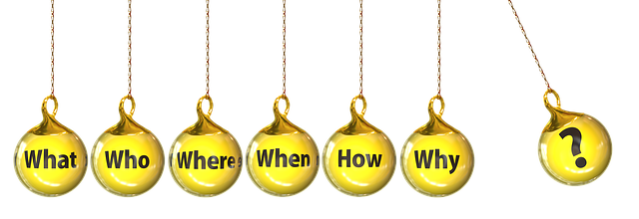
Knowing Relative Pronouns
Whom
Whose
Which
WHOM
WHO
WHICH
THAT
WHOSE
Notes:
Question mark- https://pixabay.com/cs/illustrations/otazn%c3%adk-ot%c3%a1zka-reakce-1020165/(Peggy und Marco Lachmann-Anke)
Question words- https://pixabay.com/illustrations/question-who-how-what-where-when-2415069/(Gerd Altmann)

Slide 2
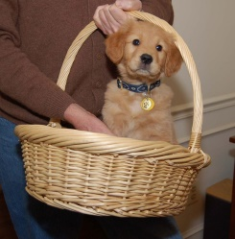
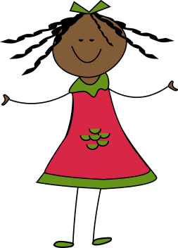
Introducing Relative Pronouns
Underline the Pronouns in
following sentences:
Answers
1. The dog in the basket is his.
His (possessive)
2. She is my sister.
She (personal), my (possessive)
3. That is his house.
That (demonstrative), his (possessive)
Notes:
Notes for Teacher –
a. This asset starts with IQ and seamlessly flows into the MS. The teacher could start the class by asking the students to frame a few sentences with the pronouns which they have already learnt in the class. She/he could then write down the sentences spoken by the students. She/he may then underline the Pronouns in those sentences and ask the students the kind of pronouns used. She/he can then recap the pronouns already learnt (he, she, it, we, my, her, his, we,his, hers, theirs, they, this, that, those, these etc.) and start the MS. The PPT may be used for clarity. Alternatively, the teacher may choose to prepare placards or reading cards with sentences as given in the TLM.
b. The teacher can ask the students the meaning and usage of WHOSE in the 5th sentence and what it stands for. Then the teacher introduces the students to Relative Pronouns.
The dog in Basket- https://pixabay.com/cs/photos/%c5%a1t%c4%9bn%c4%9b-pes-zlat%c3%bd-ko%c5%a1%c3%adk-mazl%c3%ad%c4%8dek-14685/(PublicDomainPictures)
Girl- https://pixabay.com/cs/vectors/d%c3%advka-%c5%a1%c5%a5astn%c3%bd-usm%c4%9bj-se-312518/ (Clker-Free-Vector-Images)

Slide 3
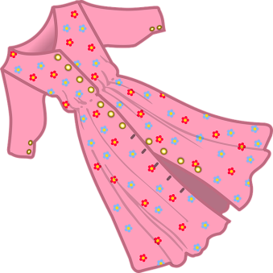
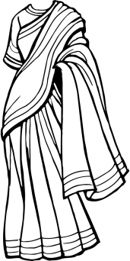
Introducing Relative Pronouns
Underline the Pronouns in
following sentences:
Answers
4. Those are my mother’s dresses.
Those (demonstrative), my(possessive)
5. Whose pen is this?
Whose (relative pronoun)
Notes:
Dresses- https://pixabay.com/cs/vectors/oble%c4%8den%c3%ad-rou%c5%a1ka-%c5%a1aty-%c5%beensk%c3%bd-od%c4%9bv-2027688/(OpenClipart-Vectors)
Dresses- https://pixabay.com/cs/vectors/tkanina-oble%c4%8den%c3%ad-%c5%a1aty-%c5%beensk%c3%bd-pan%c3%ad-1294908/(OpenClipart-Vectors)
pen- https://pixabay.com/cs/vectors/pero-vektor-ilustrace-design-1481138/(lucasfernandes)

Slide 4
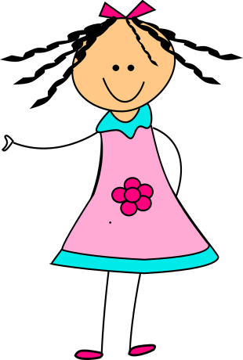
What is a Relative Pronoun?
Relative Pronoun is a word which is used to introduce a relative clause.
Relative pronouns are used to provide more information about the subject (Noun/Pronoun) it relates to.
where
when
Who
Whom
Whose
Which
When
Where
That
That
Examples of relative pronouns include
who
which
whom
whose
Notes:
Girl pointing …”That”- https://pixabay.com/cs/vectors/d%c3%advka-r%c5%af%c5%beov%c3%bd-ukazuj%c3%adc%c3%ad-roztomil%c3%bd-303667/ (Clker-Free-Vector-Images / 29538 images)
Boy asking(who, whom, whose, which, when, where)…- https://pixabay.com/cs/illustrations/ot%c3%a1zka-zmaten%c3%bd-chlapec-mu%c5%be-mu%c5%besk%c3%bd-5663412/ (HtcHnm / 228 images)

Slide 5
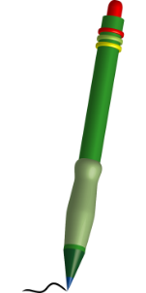
Relative Pronouns
It is used to refer to the PEOPLE
Ex-The boy who studies in my school is very kind.
WHO
It is used to refer to ANIMALS and OBJECTS.
Ex- Rahul has the cricket bat which his father has bought.
WHICH
It is used to refer to possession of PEOPLE or THINGS.
Ex- Whose pen is that?
WHOSE
Notes:
https://pixabay.com/vectors/boy-glasses-book-school-smile-310099/ By Clker-Free-Vector-Images

Slide 6
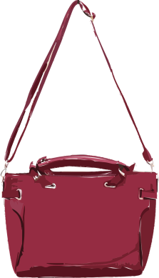
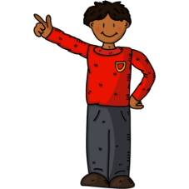
Relative Pronouns
It is used to refer to PEOPLE, ANIMALS and THINGS. It can replace WHO or WHICH
Ex- The pink bag which she is holding is mine.
THAT
It is used to refer to PEOPLE.
Ex- The boy whom I met is his brother.
WHOM
Notes:
Note the Teacher: The teacher may use the above sentences as and when required.
1. Shoes- https://pixabay.com/illustrations/blue-shoes-kids-footwear-fashion-927282/ (ArtsyBee)
2. doctor- https://pixabay.com/vectors/cartoon-checkup-clinic-comic-2027771/ (OpenClipart-Vectors)
3. uncle- https://pixabay.com/vectors/man-old-smile-wave-beckon-hair-160973/ (OpenClipart-Vectors)
4. bag- https://pixabay.com/vectors/shopping-bag-tote-bag-tote-sack-30543/ (Clker-Free-Vector-Images)
5. dictionary- https://pixabay.com/vectors/dictionary-book-english-school-155951/ (OpenClipart-Vectors)

Slide 7
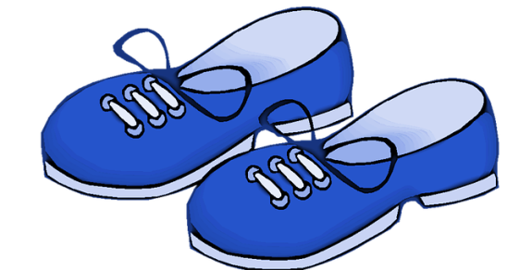
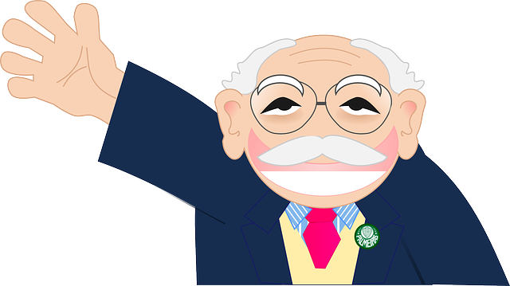
Relative Pronouns
Some more examples of sentences with Relative Pronouns:
1. I love the shoes that my mother bought me.
2. Latha, who is a doctor, has treated my brother.
3. This is my uncle, whose daughter is your classmate.
4. My mom asked me to clean the bag which was given by her.
Notes:
Note the Teacher: The teacher may use the above sentences as and when required.
1. Shoes- https://pixabay.com/illustrations/blue-shoes-kids-footwear-fashion-927282/ (ArtsyBee)
2. doctor- https://pixabay.com/vectors/cartoon-checkup-clinic-comic-2027771/ (OpenClipart-Vectors)
3. uncle- https://pixabay.com/vectors/man-old-smile-wave-beckon-hair-160973/ (OpenClipart-Vectors)
4. bag- https://pixabay.com/vectors/shopping-bag-tote-bag-tote-sack-30543/ (Clker-Free-Vector-Images)
5. dictionary- https://pixabay.com/vectors/dictionary-book-english-school-155951/ (OpenClipart-Vectors)

Slide 8
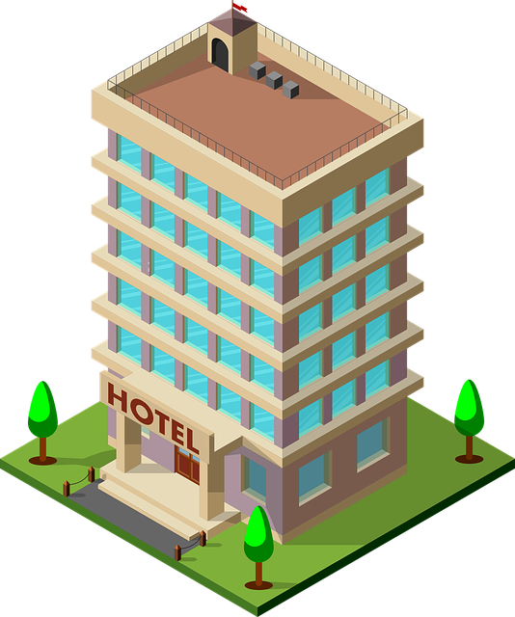
Relative Pronouns
Some more examples of sentences with Relative Pronouns:
5. Whose dictionary is that?
6. The hotel that we went to last week was good.
7. Whom did you go with, to visit your friend?
Notes:
dictionary- https://pixabay.com/vectors/dictionary-book-english-school-155951/ (OpenClipart-Vectors)
hotel- https://pixabay.com/vectors/hotel-3d-building-isonometriche-3584086/ (Jean Lambert Salvatori)
Friends- https://pixabay.com/vectors/kids-students-back-to-school-boy-160168/ (OpenClipart-Vectors)

Slide 9
Relative Pronouns
Some more examples of sentences with Relative Pronouns:
8. That pink frock which she is wearing was gifted to her by my mother.
9. Rahul was the boy whom you met last week in my house.
10. Sanaya is the girl who gave me this book.
Notes:
dictionary- https://pixabay.com/vectors/dictionary-book-english-school-155951/ (OpenClipart-Vectors)
hotel- https://pixabay.com/vectors/hotel-3d-building-isonometriche-3584086/ (Jean Lambert Salvatori)
Friends- https://pixabay.com/vectors/kids-students-back-to-school-boy-160168/ (OpenClipart-Vectors)

Slide 10
Attribution / Citation
Slide # | Thumbnail | Source link | Author
1. |  | 1. Question mark- https://pixabay.com/cs/illustrations/otazn%c3%adk-ot%c3%a1zka-reakce-1020165/ 2. Question words- https://pixabay.com/illustrations/question-who-how-what-where-when-2415069/ | 1. Peggy und Marco Lachmann-Anke 2. Gerd Altmann
2. |  | 1. The dog in Basket- https://pixabay.com/cs/photos/%c5%a1t%c4%9bn%c4%9b-pes-zlat%c3%bd-ko%c5%a1%c3%adk-mazl%c3%ad%c4%8dek-14685/ 2. Girl- https://pixabay.com/cs/vectors/d%c3%advka-%c5%a1%c5%a5astn%c3%bd-usm%c4%9bj-se-312518/ | PublicDomainPictures Clker-Free-Vector-Image
3. |  | 1. Dresses- https://pixabay.com/cs/vectors/opble%c4%8den%c3%ad-rou%c5%a1ka-%c5%a1aty-%c5%beensk%c3%bd-od%c4%9bv-2027688/(OenClipart-Vectors) 2. Dresses- https://pixabay.com/cs/vectors/tkanina-oble%c4%8den%c3%ad-%c5%a1aty-%c5%beensk%c3%bd-pan%c3%ad-1294908/OpenClipart-Vectors) 3. pen- https://pixabay.com/cs/vectors/pero-vektor-ilustrace-design-1481138/lucasfernandes) | OenClipart-Vectors OpenClipart-Vectors lucasfernandes
4. |  | 1. Girl pointing …”That”- https://pixabay.com/cs/vectors/d%c3%advka-r%c5%af%c5%beov%c3%bd-ukazuj%c3%adc%c3%ad-roztomil%c3%bd-303667/ 2. Boy - https://pixabay.com/cs/illustrations/ot%c3%a1zka-zmaten%c3%bd-chlapec-mu%c5%be-mu%c5%besk%c3%bd-5663412/ | Clker-Free-Vector-Images HtcHnm
5. |  | 1. Boy - https://pixabay.com/vectors/boy-glasses-book-school-smile-310099/ 2. Cricket Bat- https://pixabay.com/cs/vectors/netop%c3%bdr-kriket-d%c5%99evo-n%c3%a1%c5%99ad%c3%ad-25749/ 3. Pen - https://pixabay.com/cs/vectors/%c4%8dm%c3%a1ranice-pero-napsat-skica-zelen%c3%a1-23629/ | Clker-Free-Vector-Images Clker-Free-Vector-Images Clker-Free-Vector-Images
6. |  | 1. Pink Bag- https://pixabay.com/cs/vectors/kabelka-k%c5%af%c5%bee-luxus-r%c5%af%c5%beov%c3%bd-1300262/ 2. Boy- https://pixabay.com/cs/vectors/kabelka-k%c5%af%c5%bee-luxus-r%c5%af%c5%beov%c3%bd-1300262/ | OpenClipart-Vectors Katillustrationlondon
Notes:
Notes for Teacher - < Information for further reference or explanation >
Suggestions: <Ideas/ Images/ Animations / Others – To make better representation of the content >
Source of Multimedia used in this slide - <Please provide source URL where we find the image and the license agreement>

Slide 11
Attribution / Citation
Slide # | Thumbnail | Source link | Author
7. |  | 1. Shoes- https://pixabay.com/illustrations/blue-shoes-kids-footwear-fashion-927282/ (ArtsyBee) 2. doctor- https://pixabay.com/vectors/cartoon-checkup-clinic-comic-2027771/ (OpenClipart-Vectors) 3. uncle- https://pixabay.com/vectors/man-old-smile-wave-beckon-hair-160973/ (OpenClipart-Vectors) 4. bag- https://pixabay.com/vectors/shopping-bag-tote-bag-tote-sack-30543/ (Clker-Free-Vector-Images) 5. dictionary- https://pixabay.com/vectors/dictionary-book-english-school-155951/ (OpenClipart-Vectors) | ArtsyBee) OpenClipart-Vectors OpenClipart-Vectors Clker-Free-Vector-Images OpenClipart-Vectors
8. |  | 1. dictionary- https://pixabay.com/vectors/dictionary-book-english-school-155951/ (OpenClipart-Vectors) 2. hotel- https://pixabay.com/vectors/hotel-3d-building-isonometriche-3584086/ (Jean Lambert Salvatori) 3. Friends- https://pixabay.com/vectors/kids-students-back-to-school-boy-160168/ (OpenClipart-Vectors) | OpenClipart-Vectors Jean Lambert Salvatori OpenClipart-Vectors
9. |  | 1. Pink frock- https://pixabay.com/vectors/girl-dress-little-girl-happy-6989654/(Susan Cipriano) 2. Boy- https://pixabay.com/vectors/school-boy-student-showing-7571912/(BeezeeStock ) 3. Girl- https://pixabay.com/illustrations/school-girl-book-reading-education-4152931/(Katherine Ab) | Susan Cipriano BeezeeStock Katherine Ab
Notes:
Notes for Teacher - < Information for further reference or explanation >
Suggestions: <Ideas/ Images/ Animations / Others – To make better representation of the content >
Source of Multimedia used in this slide - <Please provide source URL where we find the image and the license agreement>

