Slide 1
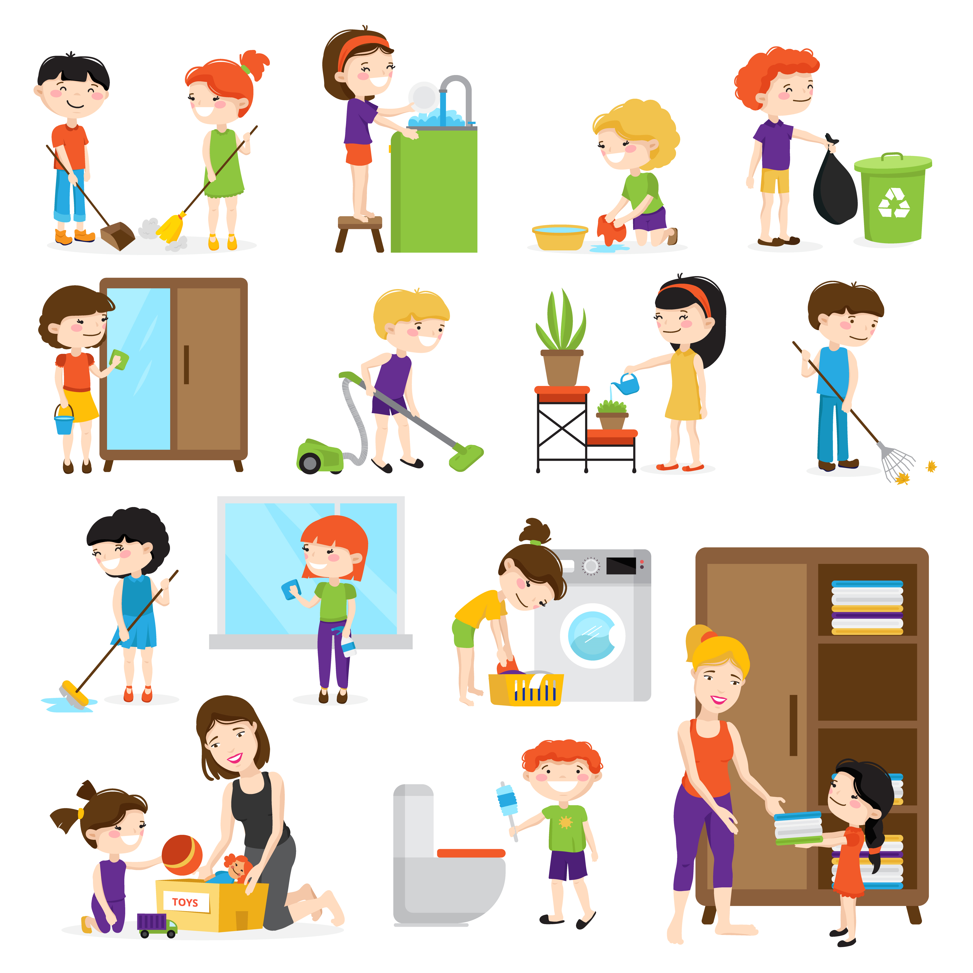
Good Behaviour is Strength
Notes:
Notes for Teacher - < Information for further reference or explanation >
Suggestions: <Ideas/ Images/ Animations / Others – To make better representation of the content >
Source of Multimedia used in this slide - <Please provide source URL where we find the image and the license agreement>
Household chores - https://www.freepik.com/free-vector/colorful-cartoon-set-with-kids-cleaning-rooms-helping-their-mums-
isolated-white-background-ve_4017370.htm (macrovector)
Dumbbells - https://www.freepik.com/free-vector/happy-male-standing-training-with-gray-dumbbell_4138623.htm (teravector)

Slide 2
Concept Value Connection
A demonstrative pronoun points out a specific person, place, thing, or idea.
Demonstrative pronouns are this, that, these, and those.
Notes:
Notes for Teacher - Behaviour is the way in which one speaks, acts or conducts oneself, it demonstrates who we are to others.
Suggestions: <Ideas/ Images/ Animations / Others – To make better representation of the content >
Source of Multimedia used in this slide - <Please provide source URL where we find the image and the license agreement>
Strength - https://www.freepik.com/free-photo/light-bulb-drawn-yellow-with-muscular-arms_973542.htm (dashu83)

Slide 3
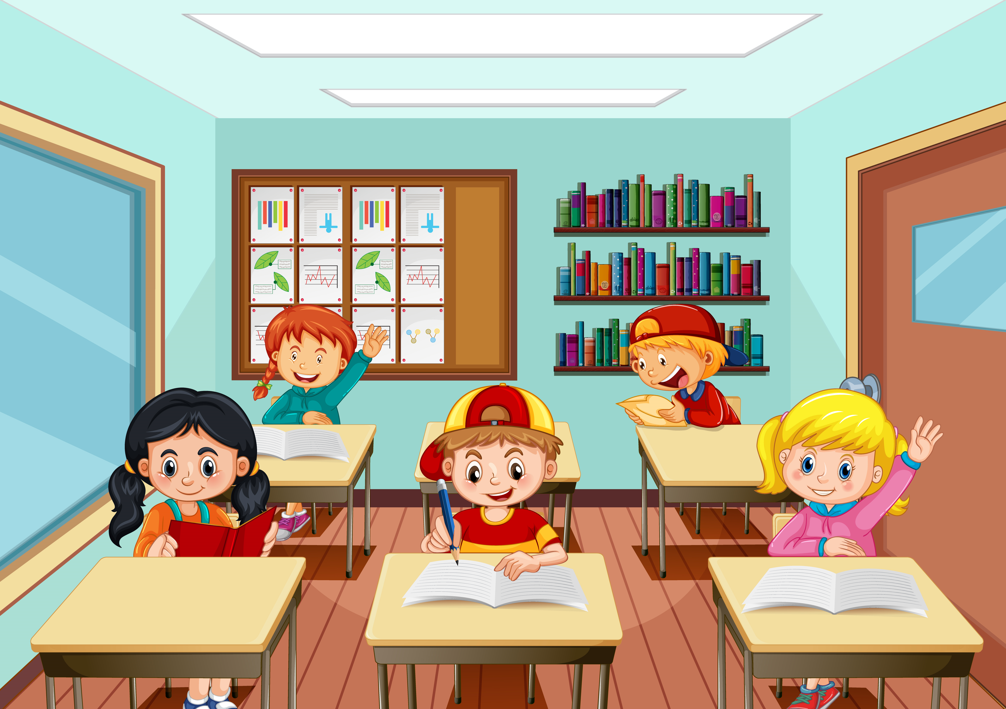
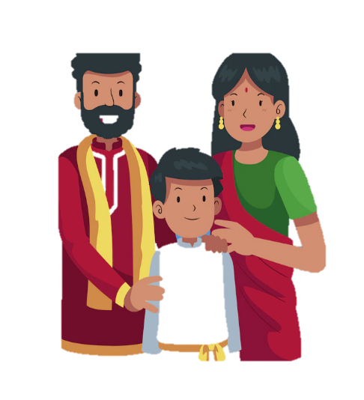
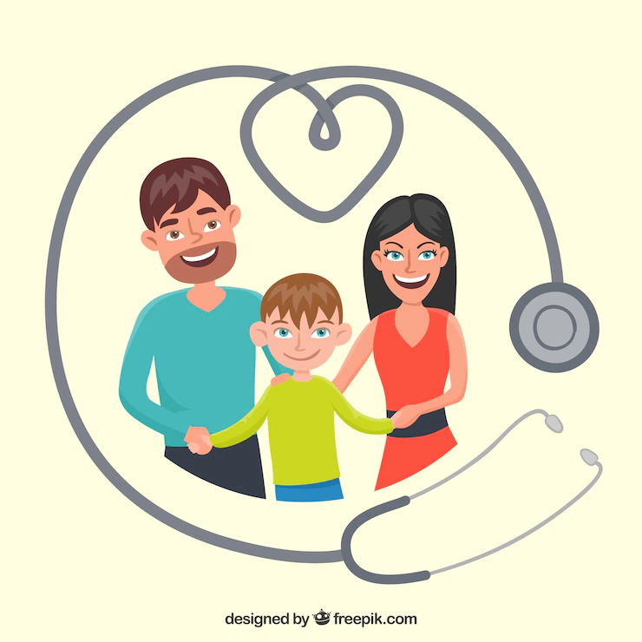
Good Behaviour is Strength
Rahul was in Grade 4 and was a well-behaved and fun-loving child.
His parents’ were doctors who did a lot of good by helping the poor.
So, he adjusted to their irregular timings. His parents in return showed their concern for him.
Their home therefore had a peaceful atmosphere.
Notes:
Notes for Teacher - < Information for further reference or explanation >
Behaviour is the way in which one speaks, acts or conducts oneself, especially it demonstrates us towards others.
It shows who we are to others.
Suggestions: <Ideas/ Images/ Animations / Others – To make better representation of the content >
Source of Multimedia used in this slide - <Please provide source URL where we find the image and the license agreement>
Classroom - https://www.freepik.com/free-vector/scene-with-many-kids-studying-classroom_18342596.htm (brgfx)
Doctor Family - https://www.freepik.com/free-vector/stethoscope-happy-family_1240266.htm (freepik)
Loving Family - https://www.freepik.com/free-vector/international-day-families_4145832.htm (freepik)
Family - https://www.freepik.com/free-vector/hand-drawn-indian-family-illustration_26520455.htm (freepik)

Slide 4
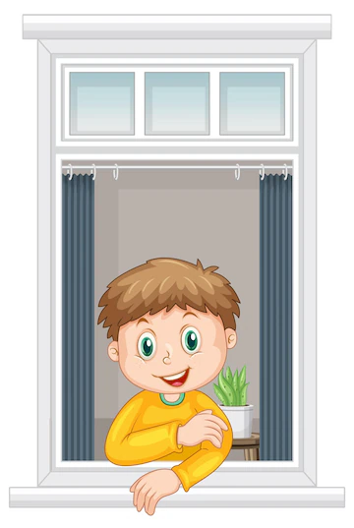
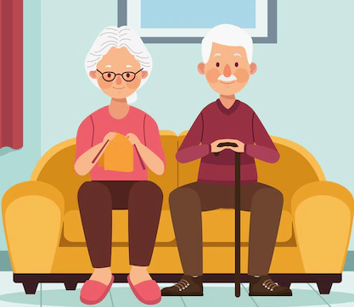
Good Behaviour is Strength
Once, Rahul was eagerly waiting for his parents when the doorbell rang. He saw an elderly couple from their neighbourhood at the door.
He welcomed them inside and said “My parents will be back in an hour. May I get you some water?”
Thanking him for his hospitality and etiquette the delighted couple spoke for some time and then took leave.
Notes:
Notes for Teacher - < Information for further reference or explanation >
Suggestions: <Ideas/ Images/ Animations / Others – To make better representation of the content >
Source of Multimedia used in this slide - <Please provide source URL where we find the image and the license agreement>
Boy near the window - https://www.freepik.com/free-vector/view-through-window-cartoon-character_24459752.htm (brgfx)
Elderly couple - https://www.freepik.com/free-vector/elderly-couple-seated-sofa_28807048.htm (gstudioimagen1)
Boy offering tea - https://www.freepik.com/free-vector/sticker-template-with-happy-boy-holding-cup-tea-isolated_17622268.htm (brgfx)

Slide 5
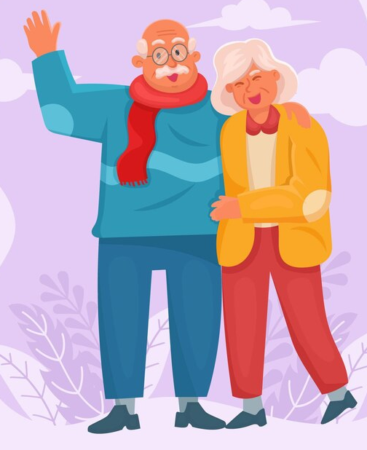
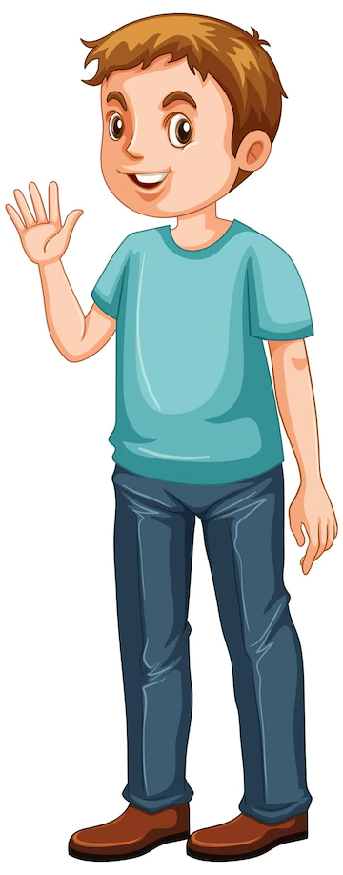
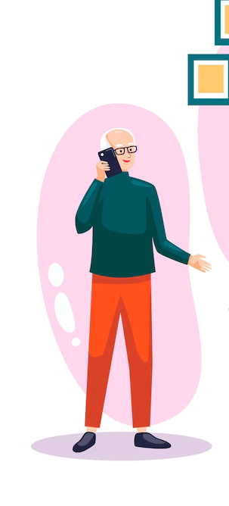
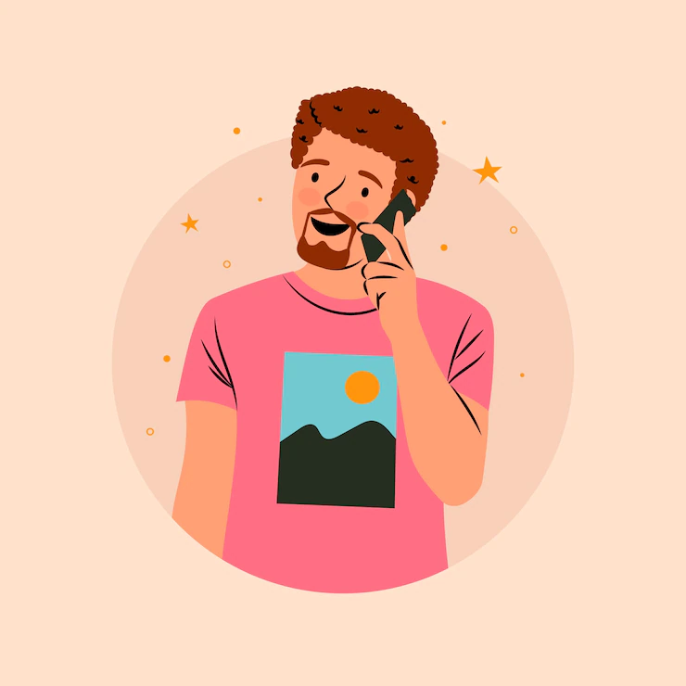
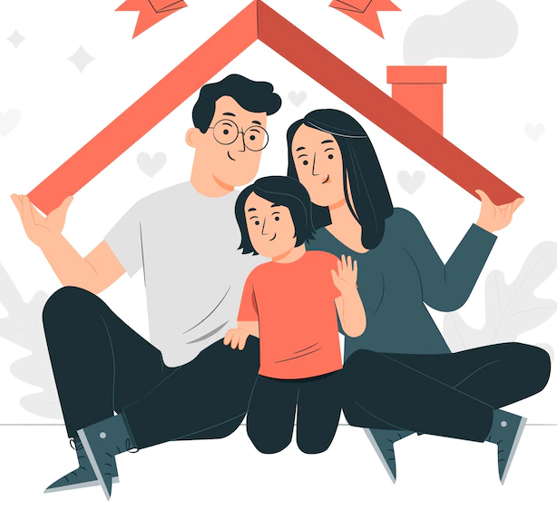
Good Behaviour is Strength
As you can see, Rahul’s good behaviour not only earned him praise, but it also made his parents proud of him and happy.
The couple were in a hurry to leave. Rahul apologised for his parent’s delay and assured them he would inform about their visit.
The elderly couple called Rahul’s father the next morning to appreciate Rahul’s impeccable behaviour. Rahul’s parents felt proud of their well-behaved son.
Notes:
Notes for Teacher - < Information for further reference or explanation >
Suggestions: <Ideas/ Images/ Animations / Others – To make better representation of the content >
Source of Multimedia used in this slide - <Please provide source URL where we find the image and the license agreement>
Boy - https://www.freepik.com/free-vector/man-wearing-blue-t-shirt-cartoon_27185842.htm (brgfx)
Grandparents - https://www.freepik.com/free-vector/flat-design-happy-grandparents-couple_8232111.htm (freepik)
Grandpa - https://www.freepik.com/free-vector/flat-hand-drawn-seniors-using-technology_12428217.htm (freepik)
Man on phone - https://www.freepik.com/free-vector/hand-drawn-person-talking-phone-illustration_34014179.htm (freepik)
Happy Family - https://www.freepik.com/free-vector/international-day-families-concept-illustration_12977789.htm (storyset)

Slide 6
Points to Ponder/Reflect
Everyone likes people who are courteous and use kind words.
Good behaviour helps you keep a good relationship with everyone.
It helps you to be positive and cheerful throughout the day.
It makes you and the people around you feel happy.
Students!
It is very important that we
behave well at all times, whether
it is at home, school or in society.
Notes:
Notes for Teacher - < Information for further reference or explanation >
Suggestions: <Ideas/ Images/ Animations / Others – To make better representation of the content >
Source of Multimedia used in this slide - <Please provide source URL where we find the image and the license agreement>
Man showing idea - https://www.freepik.com/free-vector/man-shows-gesture-great-idea_10541562.htm (sayarifahbrit)

Slide 7
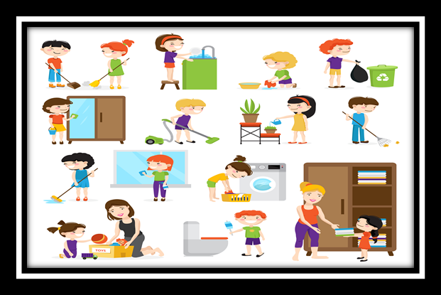
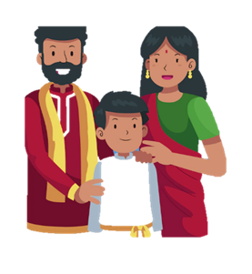
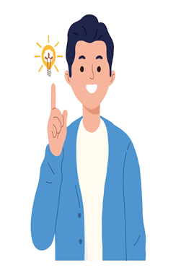
Attribution / Citation
Slide # | Thumbnail | Source link | Author
1 |  | Household chores - https://www.freepik.com/free-vector/colorful-cartoon-set-with-kids-cleaning-rooms-helping-their-mums-isolated-white-background-ve_4017370.htm Dumbbells - https://www.freepik.com/free-vector/happy-male-standing-training-with-gray-dumbbell_4138623.htm | (macrovector) (teravector)
2 |  | Strength - https://www.freepik.com/free-photo/light-bulb-drawn-yellow-with-muscular-arms_973542.htm | (dashu83)
3 |  | Classroom - https://www.freepik.com/free-vector/scene-with-many-kids-studying-classroom_18342596.htm Doctor Family - https://www.freepik.com/free-vector/stethoscope-happy-family_1240266.htm Loving Family – https://www.freepik.com/free-vector/international-day-families_4145832.htm Family - https://www.freepik.com/free-vector/hand-drawn-indian-family-illustration_26520455. | (brgfx) (freepik) (freepik) (freepik)
4 |  | Boy near the window - https://www.freepik.com/free-vector/view-through-window-cartoon-character_24459752.htm Elderly couple - https://www.freepik.com/free-vector/elderly-couple-seated-sofa_28807048.htm Boy offering tea - https://www.freepik.com/free-vector/sticker-template-with-happy-boy-holding-cup-tea isolated_17622268.htm | (brgfx) (gstudioimagen1) (brgfx)
5 |  | Boy - https://www.freepik.com/free-vector/man-wearing-blue-t-shirt-cartoon_27185842.htm Grandparents - https://www.freepik.com/free-vector/flat-design-happy-grandparents-couple_8232111.htm Grandpa - https://www.freepik.com/free-vector/flat-hand-drawn-seniors-using-technology_12428217.htm Man on phone - https://www.freepik.com/free-vector/hand-drawn-person-talking-phone-illustration_34014179.htm Happy Family - https://www.freepik.com/free-vector/international-day-families-concept-illustration_12977789.htm | (brgfx) (freepik) (freepik) (freepik) (storyset)
6 |  | Man showing idea - https://www.freepik.com/free-vector/man-shows-gesture-great-idea_10541562.htm | (sayarifahbrit)
COPYRIGHT Cum DISCLAIMER NOTICE
Content owned by Sri Sathya Sai Central Trust, Prashanthi Nilayam, Puttaparthi, Sathya Sai District, Andhra Pradesh, India.
Strictly not for Commercial Use, excluding content that falls in Public Domain or common knowledge facts.
Content can be downloaded and used for personal, educational, informational and other non-commercial purposes, subject to attribution in the name of ‘Sri Sathya Sai Central Trust, Prashanthi Nilayam, Puttaparthi’ only. Any attempt to remove, alter, circumvent, or distort the data that is accessed is illegal and strictly prohibited.
Some of the content is owned by Third Parties and are used in compliance with their licensing conditions. Anyone infringing the Copyright of such Third Parties will be doing so at their own risks and costs.
Notes:
Notes for Teacher - < Information for further reference or explanation >
Suggestions: <Ideas/ Images/ Animations / Others – To make better representation of the content >
Source of Multimedia used in this slide - <Please provide source URL where we find the image and the license agreement>

