Slide 1
We raise by lifting others
Notes:
Notes for Teacher - < Information for further reference or explanation >
Suggestions: <Ideas/ Images/ Animations / Others – To make better representation of the content >
Source of Multimedia used in this slide - <Please provide source URL where we find the image and the license agreement

Slide 2
Concept-Value Connection
Relative Clauses tell us more about people and things.
Similarly, we need to relate to others by putting ourselves in their place or situation and thereby understand and care about what they feel.

Slide 3
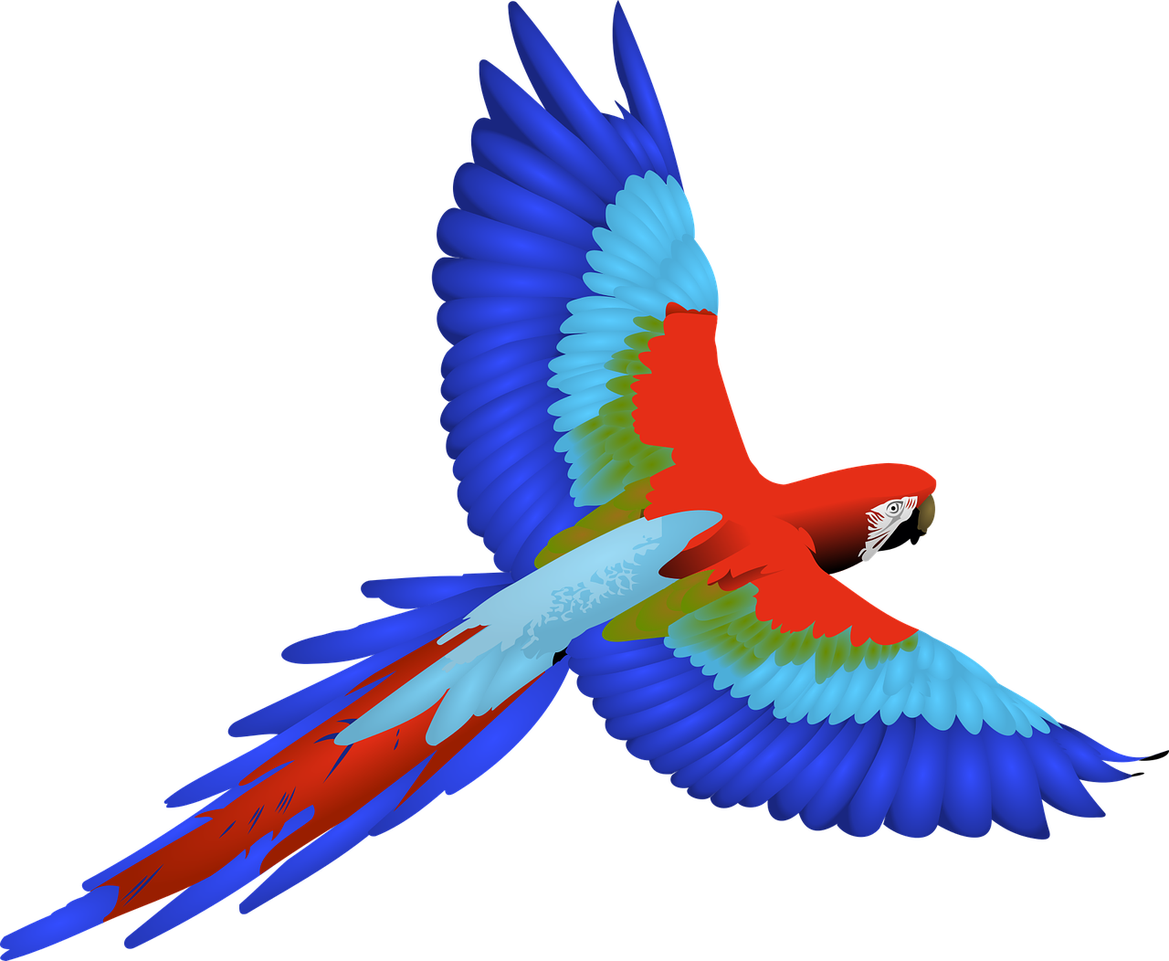
Happy Parrot
One day a little parrot was flying happily in the sky.
Notes:
Notes for Teacher - < Information for further reference or explanation >
Suggestions: <Ideas/ Images/ Animations / Others – To make better representation of the content >
Source of Multimedia used in this slide - <Please provide source URL where we find the image and the license agreement>
<Scenery>: <https://pixabay.com/vectors/landscape-twilight-light-night-1844229/>
<Parrot> - <https://pixabay.com/vectors/bird-feathers-flying-macaw-wings-2028367/>
<man throwing stone> - <https://pixabay.com/vectors/throwing-stone-cast-launching-man-154588/>
<neem tree> <https://pixabay.com/vectors/tree-trunk-leaves-branches-nature-576847/>
<coconut tree> - <https://www.freepik.com/free-vector/tropical-palm-tree-with-coconuts-symbol-isolated-vector-illustration_1158178.htm#query=Coconut%20tree&position=10&from_view=search&track=ais>

Slide 4
Attacked by a hunter
Suddenly a hunter hit her with a stone. One of her wing’s was injured and she was unable to fly.
Notes:
Notes for Teacher - < Information for further reference or explanation >
Suggestions: <Ideas/ Images/ Animations / Others – To make better representation of the content >
Source of Multimedia used in this slide - <Please provide source URL where we find the image and the license agreement>
<Parrot> - <https://pixabay.com/vectors/bird-feathers-flying-macaw-wings-2028367/>
<man throwing stone> - <https://pixabay.com/vectors/throwing-stone-cast-launching-man-154588/>
<neem tree> <https://pixabay.com/vectors/tree-trunk-leaves-branches-nature-576847/>
<coconut tree> - <https://www.freepik.com/free-vector/tropical-palm-tree-with-coconuts-symbol-isolated-vector-illustration_1158178.htm#query=Coconut%20tree&position=10&from_view=search&track=ais>

Slide 5
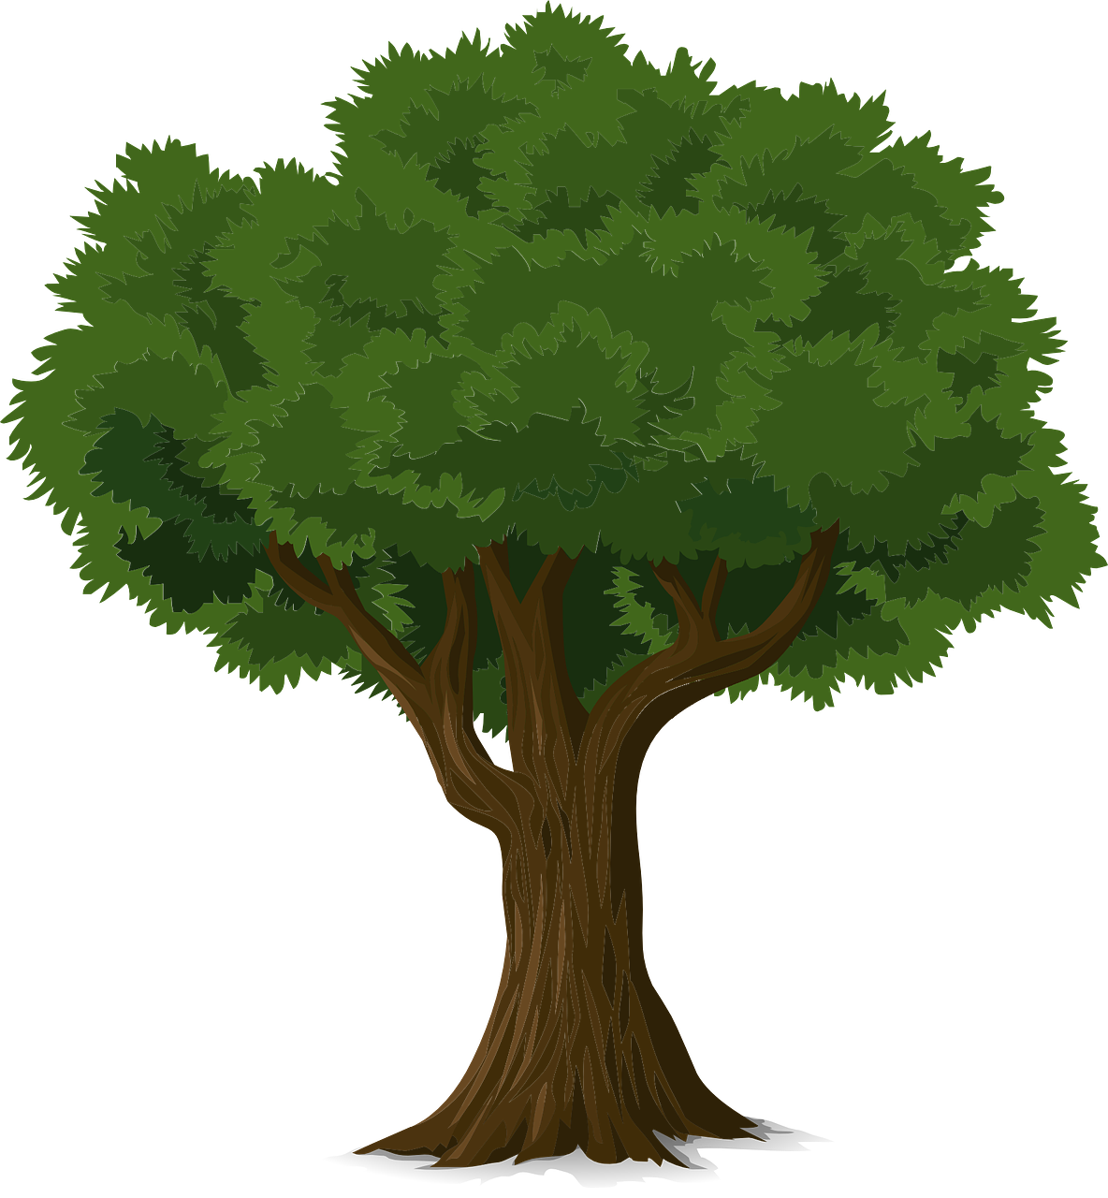
Looking for help
She saw a tree nearby and decided to stay there, but when she approached the tree, it didn’t allow her to stay in its branch.
Notes:
Notes for Teacher - < Information for further reference or explanation >
Suggestions: <Ideas/ Images/ Animations / Others – To make better representation of the content >
Source of Multimedia used in this slide - <Please provide source URL where we find the image and the license agreement>
<Parrot> - <https://pixabay.com/vectors/bird-feathers-flying-macaw-wings-2028367/>
<man throwing stone> - <https://pixabay.com/vectors/throwing-stone-cast-launching-man-154588/>
<neem tree> <https://pixabay.com/vectors/tree-trunk-leaves-branches-nature-576847/>
<coconut tree> - <https://www.freepik.com/free-vector/tropical-palm-tree-with-coconuts-symbol-isolated-vector-illustration_1158178.htm#query=Coconut%20tree&position=10&from_view=search&track=ais>

Slide 6
Looking for help
She, then with great difficulty flew to the next tree, a coconut tree and he also refused to help her.
Notes:
Notes for Teacher - < Information for further reference or explanation >
Suggestions: <Ideas/ Images/ Animations / Others – To make better representation of the content >
Source of Multimedia used in this slide - <Please provide source URL where we find the image and the license agreement>
<Parrot> - <https://pixabay.com/vectors/bird-feathers-flying-macaw-wings-2028367/>
<man throwing stone> - <https://pixabay.com/vectors/throwing-stone-cast-launching-man-154588/>
<neem tree> <https://pixabay.com/vectors/tree-trunk-leaves-branches-nature-576847/>
<coconut tree> - <https://www.freepik.com/free-vector/tropical-palm-tree-with-coconuts-symbol-isolated-vector-illustration_1158178.htm#query=Coconut%20tree&position=10&from_view=search&track=ais>

Slide 7
Kind Banyan Tree
“Don’t worry dear little bird, I have plenty of space in my branches and you can comfortably stay here”
The poor bird was heartbroken and was crying and then suddenly she heard a voice. It was a Banyan tree. He told her,
Notes:
Notes for Teacher - < Information for further reference or explanation >
Suggestions: <Ideas/ Images/ Animations / Others – To make better representation of the content >
Source of Multimedia used in this slide - <Please provide source URL where we find the image and the license agreement>
<banyan tree> - <https://www.freepik.com/free-vector/cute-banyan-tree-cartoon-illustration_7038210.htm#query=Banyan%20tree&position=0&from_view=search&track=ais>
<Parrot> - <https://pixabay.com/vectors/bird-feathers-flying-macaw-wings-2028367/>

Slide 8
Angel’s Voice
“I am very happy to see your act of empathy and kindness. I want to reward you for it, you will be strongest of all the trees and will live a very long life and will provide shelter for many birds.”
The parrot felt relieved and happy to stay in the branches of the Banyan tree. Just then they heard an angel's voice from the sky,
Notes:
Notes for Teacher - < Information for further reference or explanation >
Suggestions: <Ideas/ Images/ Animations / Others – To make better representation of the content >
Source of Multimedia used in this slide - <Please provide source URL where we find the image and the license agreement>
<banyan tree> - <https://www.freepik.com/free-vector/cute-banyan-tree-cartoon-illustration_7038210.htm#query=Banyan%20tree&position=0&from_view=search&track=ais>
<Parrot> - <https://pixabay.com/vectors/bird-feathers-flying-macaw-wings-2028367/>
<goddess> - <https://pixabay.com/vectors/religion-india-wallpaper-goddess-42416/>

Slide 9
Points to Ponder
Being empathetic towards everyone and everything is crucial for us as it:
Allows us to see the world from their perspective.
Fosters positive relationships with everyone.
Makes us and those around us feel good.
Helps us develop into the best versions of ourselves.

Slide 10
Attribution / Citation
Slide # | Thumbnail | Source link | Author
3 |  | Scenery: https://pixabay.com/vectors/landscape-twilight-light-night-1844229/ | Wild0ne
4 |  | Man throwing stone - https://pixabay.com/vectors/throwing-stone-cast-launching-man-154588/ | OpenClipart-Vectors
3,4,5,6,7,8 |  | Parrot - https://pixabay.com/vectors/bird-feathers-flying-macaw-wings-2028367/ | Gustavorezende
5 |  | neem tree - https://pixabay.com/vectors/tree-trunk-leaves-branches-nature-576847/ | OpenClipart-Vectors
6 |  | coconut tree - https://www.freepik.com/free-vector/tropical-palm-tree-with-coconuts-symbol-isolated-vector-illustration_1158178.htm | macrovecto
7,8 |  | https://www.freepik.com/free-vector/cute-banyan-tree-cartoon-illustration_7038210.htm | User2104819
8 |  | https://pixabay.com/vectors/religion-india-wallpaper-goddess-42416/ | Clker-free-vctor-images
COPYRIGHT Cum DISCLAIMER NOTICE
Content owned by Sri Sathya Sai Central Trust, Prashanthi Nilayam, Puttaparthi, Sathya Sai District, Andhra Pradesh, India.
Strictly not for Commercial Use, excluding content that falls in Public Domain or common knowledge facts.
Content can be downloaded and used for personal, educational, informational and other non-commercial purposes, subject to attribution in the name of ‘Sri Sathya Sai Central Trust, Prashanthi Nilayam, Puttaparthi’ only. Any attempt to remove, alter, circumvent, or distort the data that is accessed is illegal and strictly prohibited.
Some of the content is owned by Third Parties and are used in compliance with their licensing conditions. Anyone infringing the Copyright of such Third Parties will be doing so at their own risks and costs.
Notes:
Notes for Teacher - < Information for further reference or explanation >
Suggestions: <Ideas/ Images/ Animations / Others – To make better representation of the content >
Source of Multimedia used in this slide - <Please provide source URL where we find the image and the license agreement>

