Slide 1
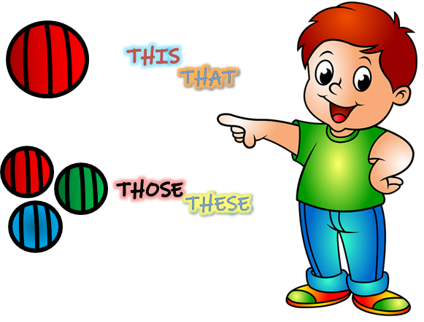
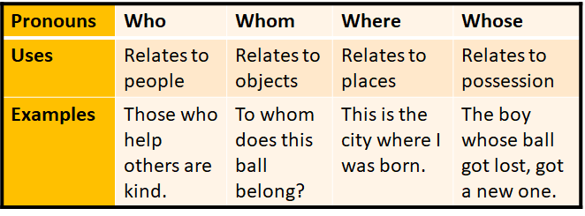
Demonstrative and Relative Pronouns
Notes:
Notes for Teacher –
<The teacher could use the following exercise as-
● Giving a printout of the same to all the students to work on, independently.
● Eliciting answers individually, using the ppt. >
Suggestions: <Ideas/ Images/ Animations / Others – To make better representation of the content >
Source of Multimedia used in this slide -
<Pointing Boy- https://pixabay.com/illustrations/child-boy-little-boy-pointing-5507695/ >

Slide 2
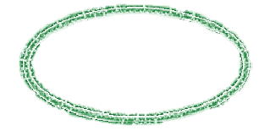
Exercise 1
Instructions: Circle the Pronouns given in brackets.
1. That book belongs to me. (Demonstrative)
That
book
belongs
to
me
Show Solution
Options-
2. To whom did you give the ball? (Relative)
Options-
To
whom
did
you
give
the
ball
Notes:
Notes for Teacher - < Information for further reference or explanation >
Suggestions: <Ideas/ Images/ Animations / Others – To make better representation of the content >
Source of Multimedia used in this slide - <Please provide source URL where we find the image and the license agreement>

Slide 3
Exercise 1
3. Those red flowers are mine. (Demonstrative)
Options-
Those
red
flowers
are
mine
Show Solution
4. John is the boy who got me flowers. (Relative)
Options-
John
is
the
boy
who
got
me
flowers
Notes:
Notes for Teacher - < Information for further reference or explanation >
Suggestions: <Ideas/ Images/ Animations / Others – To make better representation of the content >
Source of Multimedia used in this slide - <Please provide source URL where we find the image and the license agreement>

Slide 4
Exercise 1
5. This is my garden. (Demonstrative)
Show Solution
Options-
This
is
my
garden
Notes:
Notes for Teacher - < Information for further reference or explanation >
Suggestions: <Ideas/ Images/ Animations / Others – To make better representation of the content >
Source of Multimedia used in this slide - <Please provide source URL where we find the image and the license agreement>

Slide 5
Exercise 2
Instructions: Fill in the blanks with Demonstrative and Relative Pronouns.
Who
1. ……….. accompanied you to the school?
This
2. ………… boy accompanied me to the school.
which
3. I didn't see the kite ………… was flying up in the sky.
Notes:
Notes for Teacher - < Information for further reference or explanation >
Suggestions: <Ideas/ Images/ Animations / Others – To make better representation of the content >
Source of Multimedia used in this slide -
<Light Bulb- https://pixabay.com/illustrations/bulb-idea-bright-lamp-light-3118633/ >

Slide 6
Exercise 2
those
which
4. Please give me ………… books …………… are on the table.
who
this
5. Can you tell me ………… gave you ……….. ball?
Notes:
Notes for Teacher - < Information for further reference or explanation >
Suggestions: <Ideas/ Images/ Animations / Others – To make better representation of the content >
Source of Multimedia used in this slide - <Please provide source URL where we find the image and the license agreement>

Slide 7
Exercise 3
Instructions: Make sentences with the jumbled words and identify the Pronouns.
1. play/don't/those/with/stones.
Don’t play with those stones.
2. are/meeting/whom/you/today?
Whom are you meeting today?
3. pen/is/this/your?
Is this your pen?
Notes:
Notes for Teacher - < Information for further reference or explanation >
Suggestions: <Ideas/ Images/ Animations / Others – To make better representation of the content >
Source of Multimedia used in this slide - <Please provide source URL where we find the image and the license agreement>

Slide 8
Exercise 4
Instructions: Make sentences with any two pronouns given below:
— This is my book.
— Those are purple flowers.
— Whose chalks are on the table?
This
Those
Whose
Notes:
Notes for Teacher - < Information for further reference or explanation >
Suggestions: <Ideas/ Images/ Animations / Others – To make better representation of the content >
Source of Multimedia used in this slide - <Please provide source URL where we find the image and the license agreement>

Slide 9
Exercise 4
That
Who
— The bag that my father gave me is very nice.
— Ravi is the boy who helped me to cross the road.
Notes:
Notes for Teacher - < Information for further reference or explanation >
Suggestions: <Ideas/ Images/ Animations / Others – To make better representation of the content >
Source of Multimedia used in this slide - <Please provide source URL where we find the image and the license agreement>

Slide 10
Attribution / Citation
Slide # | Thumbnail | Source link | Author
1 |  | https://pixabay.com/illustrations/child-boy-little-boy-pointing-5507695/ | Felixmh
2 |  | Self-Made
5 |  | https://pixabay.com/illustrations/bulb-idea-bright-lamp-light-3118633/ | dapple-designers
COPYRIGHT Cum DISCLAIMER NOTICE
Content owned by Sri Sathya Sai Central Trust, Prashanthi Nilayam, Puttaparthi, Sathya Sai District, Andhra Pradesh, India.
Strictly not for Commercial Use, excluding content that falls in Public Domain or common knowledge facts.
Content can be downloaded and used for personal, educational, informational and other non-commercial purposes, subject to attribution in the name of ‘Sri Sathya Sai Central Trust, Prashanthi Nilayam, Puttaparthi’ only. Any attempt to remove, alter, circumvent, or distort the data that is accessed is illegal and strictly prohibited.
Some of the content is owned by Third Parties and are used in compliance with their licensing conditions. Anyone infringing the Copyright of such Third Parties will be doing so at their own risks and costs.
Notes:
Notes for Teacher - < Information for further reference or explanation >
Suggestions: <Ideas/ Images/ Animations / Others – To make better representation of the content >
Source of Multimedia used in this slide - <Please provide source URL where we find the image and the license agreement>

