Slide 1
Quotation Marks
Notes:
Notes for Teacher – N/A
Suggestions: N/A
Source of Multimedia used in this slide - N/A

Slide 2
Do you know punctuation marks
. ! ‘ _ : ; ()
I am at the beginning of a sentence, and I am used for names and places. _______.
I am a capital letter
I am used for making a list and am used for taking a pause._______.
I am a comma
I am an apostrophe
I am used to indicate possession or contraction of a missing letter. ______.
I am an exclamation mark
I am a mark at the end of a sentence that indicates strong feelings or high volume.__
I am a mark at the end of a sentence. ______.
I am a full stop
Notes:
Notes for Teacher – The teacher may begin the class with Inquisitive Questions (IQ)as a revision exercise to stimulate their thinking process, and then proceed to the Main Script.
A description of punctuation marks may be provided, and the teacher may ask the students to identify them and fill in the blanks with the correct punctuation mark alongside the blank.
For Example
I am used to asking questions. What am I?
I am a question mark___? ____
Suggestions: N/A
Source of Multimedia used in this slide –
Boy: https://freesvg.org/perplexed-male-vector-image

Slide 3
Inverted Commas - Definition
Used at the beginning and end of a quote to separate it from the rest of the writing.
They are known by two other names: quotation marks or inverted commas.
Like a pair of hands that hold only the words which are being spoken.
Notes:
Notes for Teacher – The teacher may begin the class with Inquisitive Questions (IQ)as a revision exercise to stimulate their thinking process, and then proceed to the Main Script.
A description of punctuation marks may be provided, and the teacher may ask the students to identify them and fill in the blanks with the correct punctuation mark alongside the blank.
For Example
I am used to asking questions. What am I?
I am a question mark___? ____
Suggestions: N/A
Source of Multimedia used in this slide - N/A

Slide 4
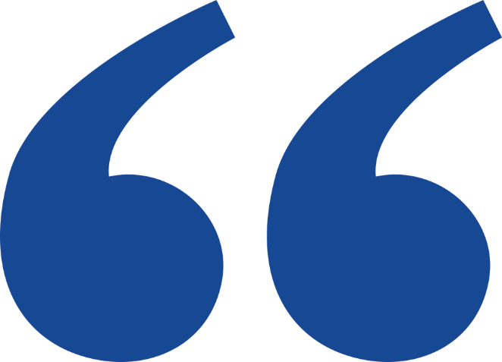
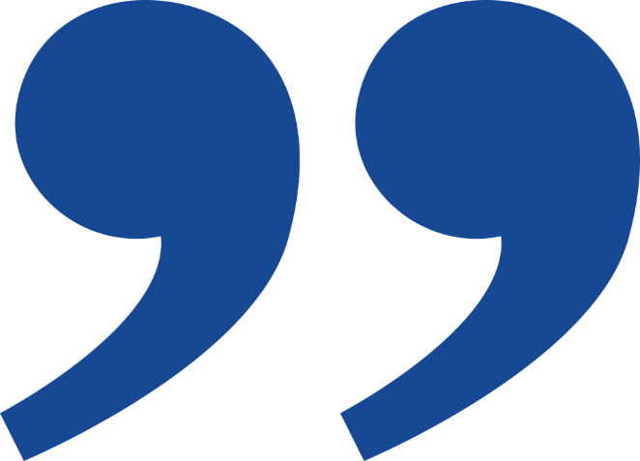
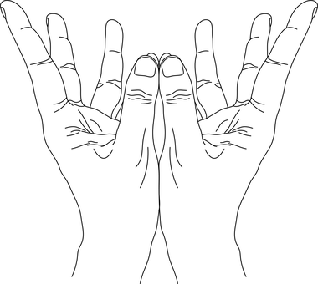
Quotation Marks
The opening inverted commas look like the number 66 and closed ones look like the number 99
01
“Like a pair of hands that hold only the words which are being spoken”.
Notes:
Notes for Teacher – It might be interesting for students to know that while speaking we can also make use of quotation marks by raising two fingers of both hands on either side of the face and saying “quote” in the beginning of the quoted words and “unquote” at the end of the quoted words.
Teacher could show this in class to give students a visual.
Suggestions: N/A
Source of Multimedia used in this slide -
Mudra: https://pixabay.com/vectors/jwalini-mudra-sacred-hand-posture-7241275/-By AmritenduMukhopadhya
https://www.freepik.com/free-vector/sticker-template-with-boy-reading-book-cartoon-character-isolated_18245782.htm#page=3&query=boy%20reading&position=3&from_view=search&track=ais-Attribute to brgfx

Slide 5
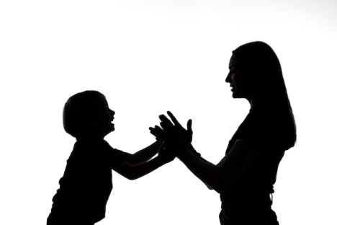
Using the Quotation Marks
Rules for using the Quotation Marks
Rule 1:
Use quotation marks to separate a direct quote (word-for-word) from the rest of the sentence.
I replied, "I will join you!"
"I will go to the green grocer to buy some fruits and vegetables," she said.
Mahesh told his mother,
"I love spending time with you!"
Notes:
Notes for Teacher – N/A
Suggestions: N/A
Source of Multimedia used in this slide - N/A

Slide 6
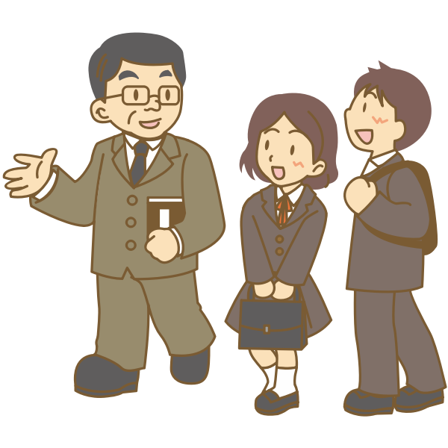
Rules for using the Quotation Marks
Rule 2:
Use a comma to introduce a quote after words like said, asked, or exclaimed. Quotation marks follow a comma unless they are at the beginning of a sentence.
She said,
Daddy asked,
Mrs. Khanna exclaimed,
"I finished my yoga class."
"It's time for a quiz!"
"Did you complete your assignment?"
Notes:
Notes for Teacher – N/A
Suggestions: N/A
Source of Multimedia used in this slide - N/A

Slide 7
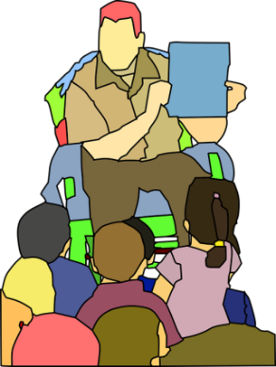
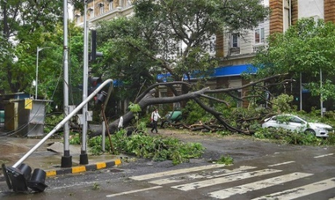
Rules for using the Quotation Marks
Rule 3:
Always keep any punctuation that is part of the quote inside the quotation marks.
“The story starts in a cold, dark, scary forest," said the storyteller.
Quotation Mark
"Look out! It's a cyclone!" shouted Deepa.
Sanjay asked, "Do you know the way to the city? I'm lost."
Notes:
Notes for Teacher – N/A
Suggestions: N/A
Source of Multimedia used in this slide - N/A

Slide 8
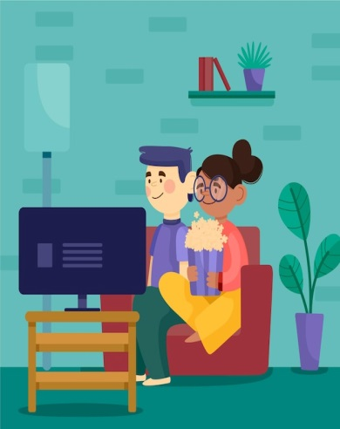
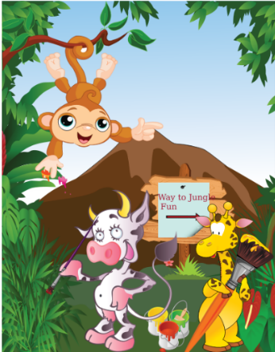
Rules for using the Quotation Marks
Rule 4:
Use inverted commas when writing the titles of books, films, magazines, plays, songs, poems, article titles, and chapters. Remember, either inverted commas or italics are customary for these titles.
I watched “Finding Nemo”
with my sister
1
My favourite book is “Panchatantra Tales”
2
“The Jungle Book” is both a book and a film.
3
Notes:
Notes for Teacher – N/A
Suggestions: N/A
Source of Multimedia used in this slide - N/A

Slide 9
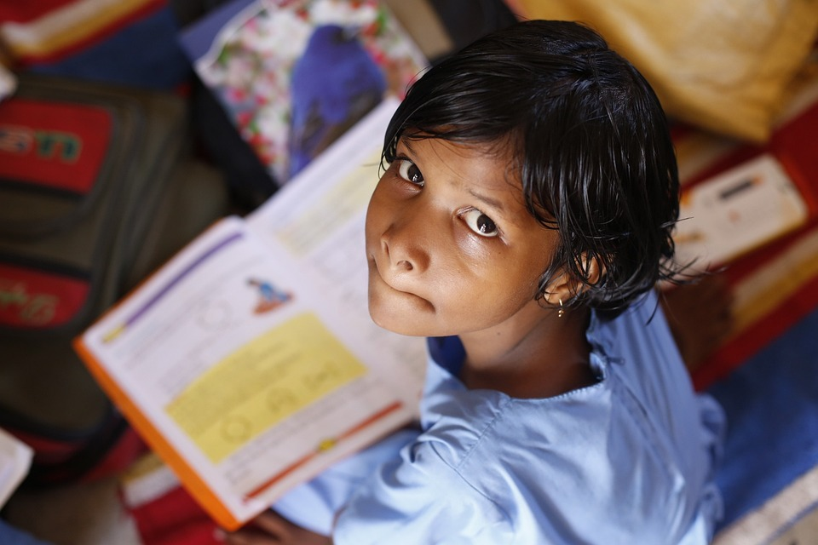
Rules for using the Quotation Marks
Rule 5:
Single quotation marks, or single inverted commas, are used when we use quotation marks within quotation marks
He asked, "Would you like to read 'Where the Wild Things Are'?"
Notes:
Notes for Teacher – N/A
Suggestions: N/A
Source of Multimedia used in this slide - N/A

Slide 10
Attribution / Citation
Slide # | Thumbnail | Source link | Author
4 |  | Mudra: https://pixabay.com/vectors/jwalini-mudra-sacred-hand-posture-7241275/ Close quote: https://pixabay.com/vectors/quotation-mark-quotation-quote-7228450/ Open quote: https://pixabay.com/vectors/quotation-mark-quotation-quote-7228448/ | AmritenduMukhopadhya davidglindberg davidglindberg
5 |  | Supermarket: https://pixabay.com/photos/grocery-shopping-supermarket-1232944/ https://www.freepik.com/free-icon/walking_14074251.htm Family: https://www.freepik.com/free-photo/classic-portrait-silhouette-mom-child_31978300.htm | Stevepb Flaticon freepik
6 |  | Quiz time: https://pixabay.com/vectors/quiz-time-quiz-time-answer-sign-2453148/ Yoga: https://publicdomainvectors.org/en/free-clipart/Yoga-pose-image/52234.html Teacher: https://freesvg.org/1549325432 | Josethestoryteller OpenClipart OpenClipart
7 |  | Story telling: https://pixabay.com/vectors/storytelling-storybook-school-294375/ Cyclone: https://pixahive.com/photo/fallen-tree-on-road-due-to-heavy-rain/ Road Map: https://www.freepik.com/free-vector/flat-road-map-with-several-landmarks_962968.htm | Clker-Free-Vector-Images Ronie freepik
8 |  | Watching: https://www.freepik.com/free-vector/people-watching-film-home_8401020.htm Book: https://pixabay.com/photos/book-to-read-literature-read-study-4480899 Jungle Book: https://freesvg.org/jungle-book-cartoon | Freepik Engin_Akyurt OpenClipart
9 |  | Student: https://pixabay.com/photos/children-infant-girl-school-306607/ | akshayapatra

