Slide 1
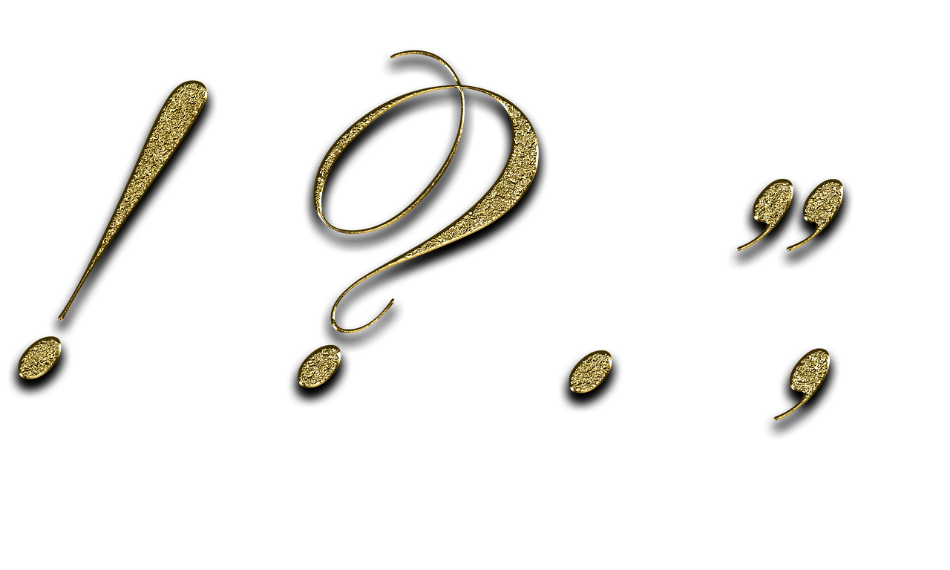
Punctuation Posters
Notes:
Notes for Teacher - < Information for further reference or explanation >
Suggestions: <Ideas/ Images/ Animations / Others – To make better representation of the content >
Source of Multimedia used in this slide - <Please provide source URL where we find the image and the license agreement>
<punctuation> <https://pixabay.com/illustrations/punctuation-marks-gold-point-3038383/>

Slide 2
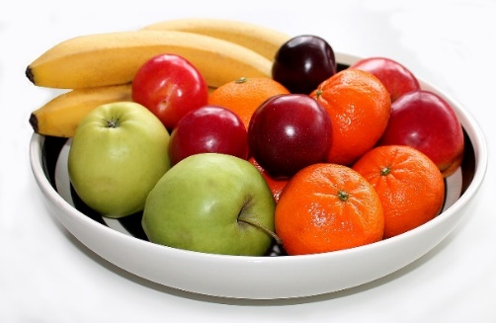
Punctuation Poster
Full stop/Period
Question mark
I like to be the first to complete my work.
I like to find out about anyone and everything
I am used at the end of a sentence.
They utter me with a higher pitch.
Stop, take a long pause while reading.
I mark the end of a sentence.
Example-
I love to eat fruits.
Example-
How old are you?
Notes:
Notes for Teacher - < Information for further reference or explanation >
Suggestions: <Ideas/ Images/ Animations / Others – To make better representation of the content >
Source of Multimedia used in this slide - <Please provide source URL where we find the image and the license agreement>
<Bowl of fruits> <https://pixabay.com/photos/fruit-cheers-fruit-bowl-fruits-657491/>
<thinking> <https://pixabay.com/photos/question-mark-symbol-icon-character-2309040/>
<fullstop> <SSSVV>
<question mark> <SSSVV>

Slide 3
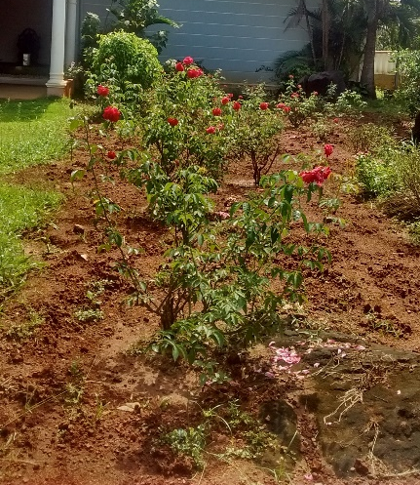
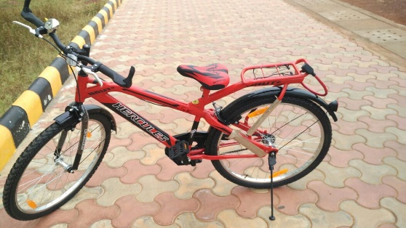
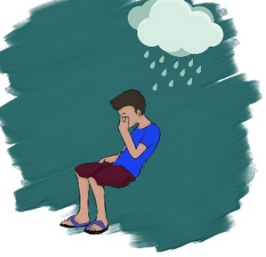
Punctuation Poster
Poster
Exclamation mark
Apostrophe
I am spoken with a higher pitch and volume.
I am used to express emotions-joy, sorrow, surprise
I am used for two reasons – to be possessive and to shorten things.
I am loud and excitable. I make myself heard.
Examples-
Don’t disturb me. (do not=don’t- contraction)
This is my brother’s motorbike. (brother’s bike- means the bike belonging to my brother- possession)
Examples-
What a beautiful garden!
Alas! We lost the match.
Notes:
Notes for Teacher - < Information for further reference or explanation >
Suggestions: <Ideas/ Images/ Animations / Others – To make better representation of the content >
Source of Multimedia used in this slide - <Please provide source URL where we find the image and the license agreement>
<garden> <SSSVV - rose garden, work in garden rose-garden-work-in-garden-5841 pink rose garden>
<sad> <https://pixabay.com/illustrations/sad-boy-child-feeling-mood-7778857/>
<cycle> <SSSVV- Cycle, non polluting vehicle, pollution, transport, road transport, vehicle, environment>
<donot disturb> <https://pixabay.com/vectors/do-not-disturb-door-sign-sign-wall-4772157/>
<exclamation mark> <SSSVV>
<apostrophe> <SSSVV>

Slide 4
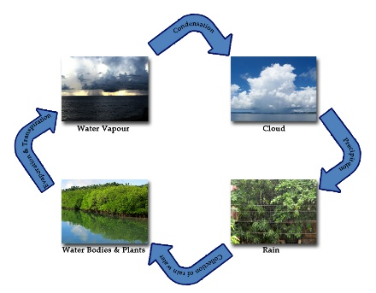
Punctuation Poster
Commas
Inverted commas/quotation marks
I help you to stop and take a breath while you speak.
I am always telling people what others have said.
I denote short pauses while writing/reading.
I am also used to separate 3 or more items.
Examples
My sister said, “I need to complete my homework.”
We call this phenomenon “water cycle.”
I recited the poem, ‘Daffodils’ by William Wordsworth.
I am used to enclose the exact words of the speaker.
I am also used around titles of books, poems, and so on.
Examples
I bought apples, cherries, guavas, and mangoes from the fruit market.
Vijay goes to bed early, but he is always late for work.
Notes:
Notes for Teacher - < Information for further reference or explanation >
Suggestions: <Ideas/ Images/ Animations / Others – To make better representation of the content >
Source of Multimedia used in this slide - <Please provide source URL where we find the image and the license agreement>
<Bowl of fruits> <https://pixabay.com/photos/fruit-cheers-fruit-bowl-fruits-657491/>
<Sleeping boy> <SSSVV - hand sketch, drawing, we need you tiger, boy, sleeping, caring, father, >
<water cycle> <SSSVV - Watercycle, rain, cloud, evaporation, condensation, precipitation>
<commas> <SSSVV>
<inverted commas/quotation marks> <SSSVV>

Slide 5
Attribution / Citation
Slide # | Thumbnail | Source link | Author
1 |  | https://pixabay.com/illustrations/punctuation-marks-gold-point-3038383/ | Darkmoon_Art
2 |  | <Bowl of fruits> https://pixabay.com/photos/fruit-cheers-fruit-bowl-fruits-657491/ <thinking> <https://pixabay.com/photos/question-mark-symbol-icon-character-2309040/> | Erbs55 Peggy_Marco
3 |  | <sad> https://pixabay.com/illustrations/sad-boy-child-feeling-mood-7778857/ <do not disturb> <https://pixabay.com/vectors/do-not-disturb-door-sign-sign-wall-4772157/> | Tilixia Prettysleepy
4 |  | <Bowl of fruits> <https://pixabay.com/photos/fruit-cheers-fruit-bowl-fruits-657491/> | Erbs55
Notes:
Notes for Teacher - < Information for further reference or explanation >
Suggestions: <Ideas/ Images/ Animations / Others – To make better representation of the content >
Source of Multimedia used in this slide - <Please provide source URL where we find the image and the license agreement>

