Slide 1
Excellence Draws Attention
Notes:
Notes for Teacher - < Information for further reference or explanation >
Suggestions: <Ideas/ Images/ Animations / Others – To make better representation of the content >
Source of Multimedia used in this slide - <Please provide source URL where we find the image and the license agreement>
ATTENTION - attention-303861_960_720.png (805×720) (pixabay.com)

Slide 2
Concept - Value Connection
Inverted commas or Quotation marks are used to highlight
a direct speech, a direct quote or titles of books and
it draws the attention of the reader.
Main Point
Any work we do in our daily lives is highlighted when we do it in the best way possible and it draws the attention of others.
Main Point
Notes:
Notes for Teacher - < Information for further reference or explanation >
Suggestions: <Ideas/ Images/ Animations / Others – To make better representation of the content >
Source of Multimedia used in this slide - <Please provide source URL where we find the image and the license agreement>

Slide 3
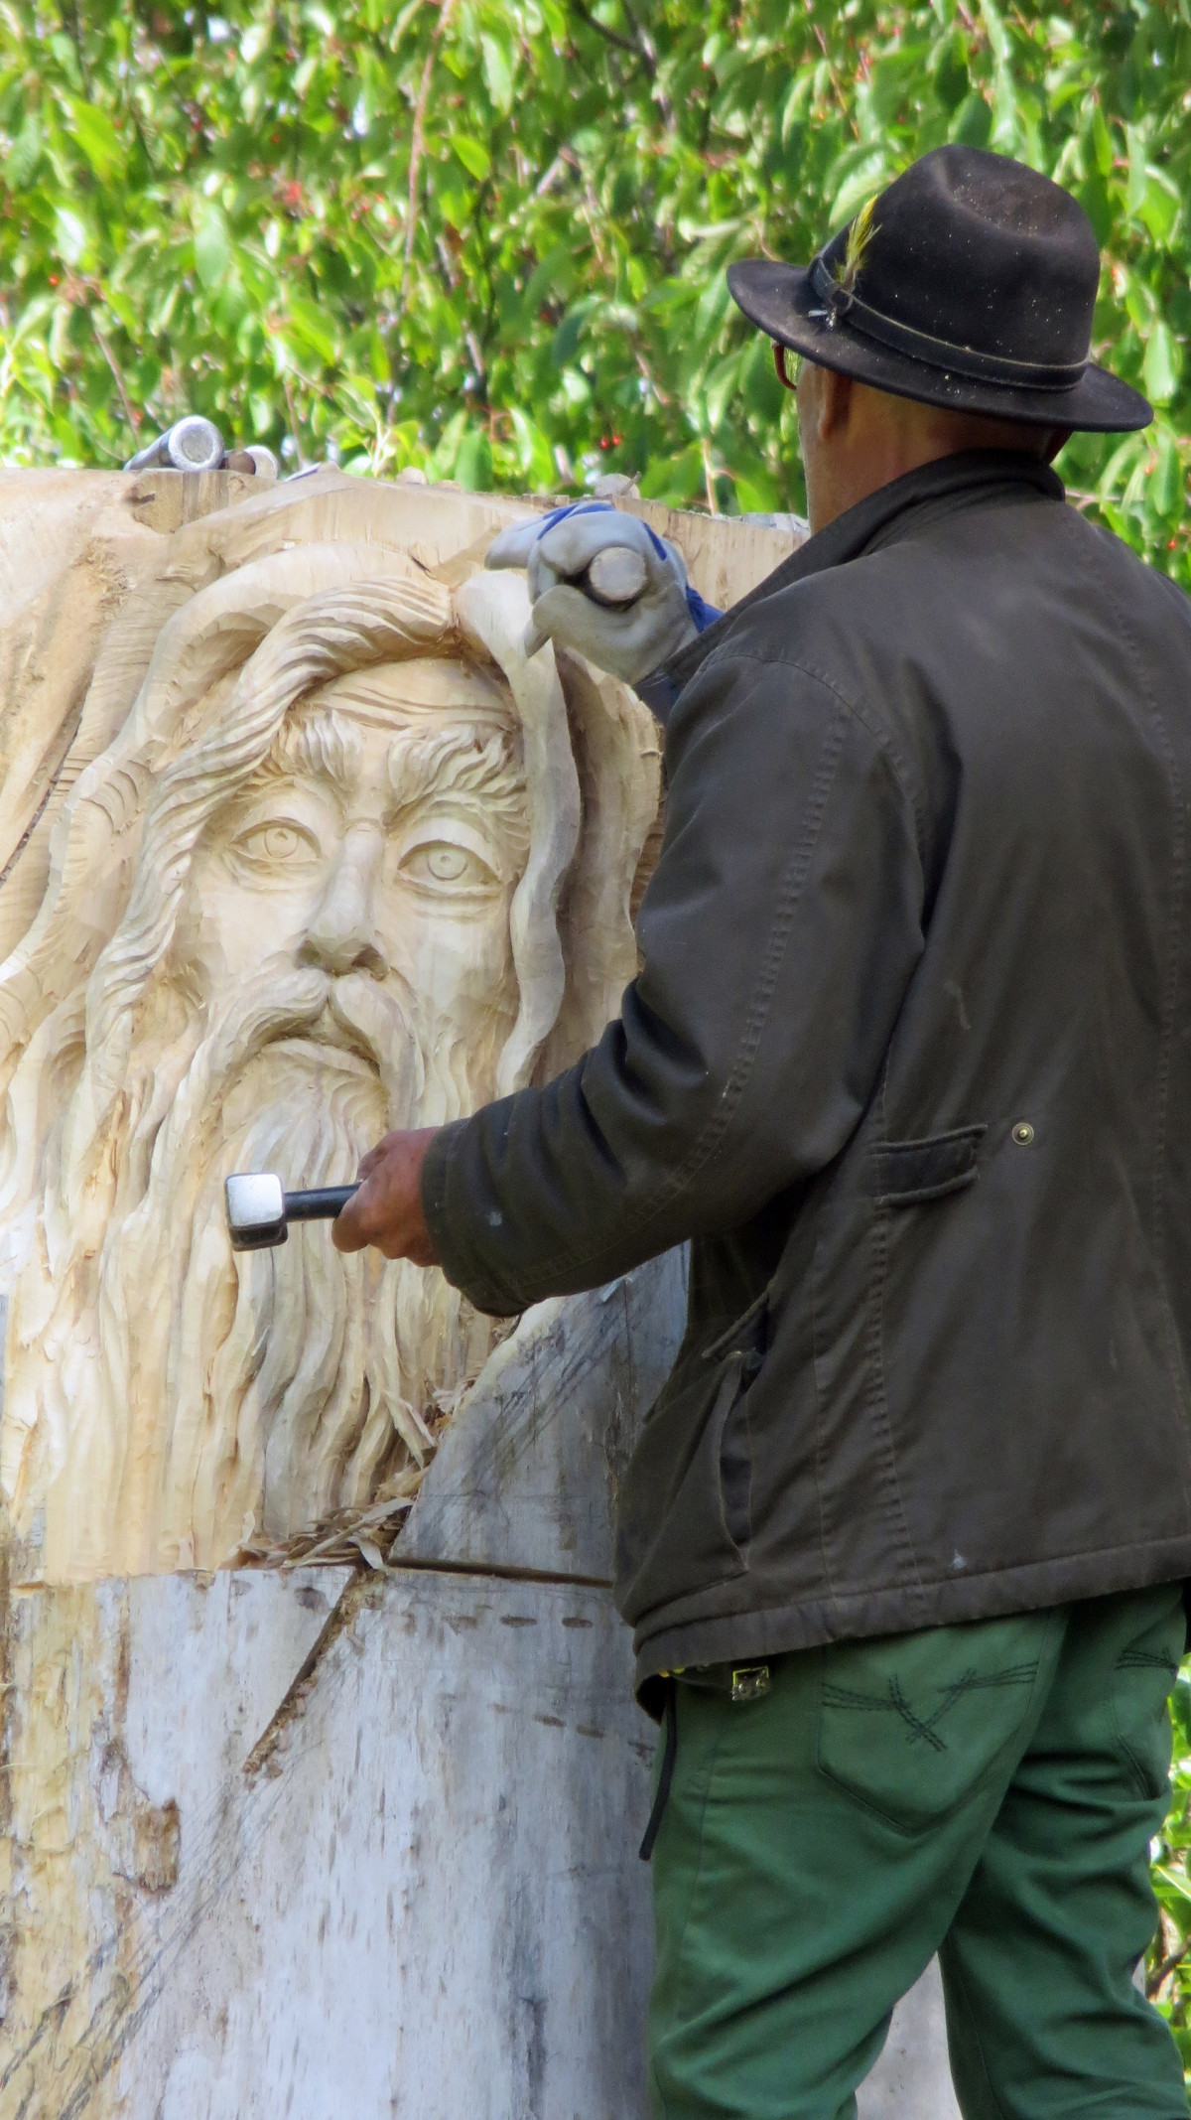
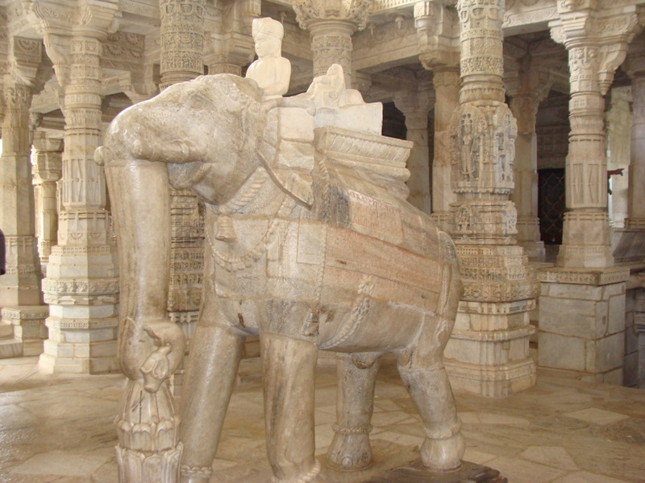
Story Time
“ Why are you making two statues of the same type? “
“Isn’t one enough?”
“Yes”
“Only one is needed but the first one I carved got damaged at the last stage and hence I am making another one.”
Notes:
Notes for Teacher - < Information for further reference or explanation >
A traveller was once passing by a village. He noticed a temple under construction and a sculptor carving a beautiful idol of the Lord. The focus, dedication, and the skill of the sculptor in carving the idol captured the attention of the traveller and he went up to him. There he saw another idol lying next to the sculptor and it looked exactly similar to what the sculptor was making.
Suggestions: <Ideas/ Images/ Animations / Others – To make better representation of the content >
Source of Multimedia used in this slide - <Please provide source URL where we find the image and the license agreement>
Traveller - SVG > person suit line smile - Free SVG Image & Icon. | SVG Silh by SVGSiLH
Idol – SSSVV Gallery - Sculpt

Slide 4
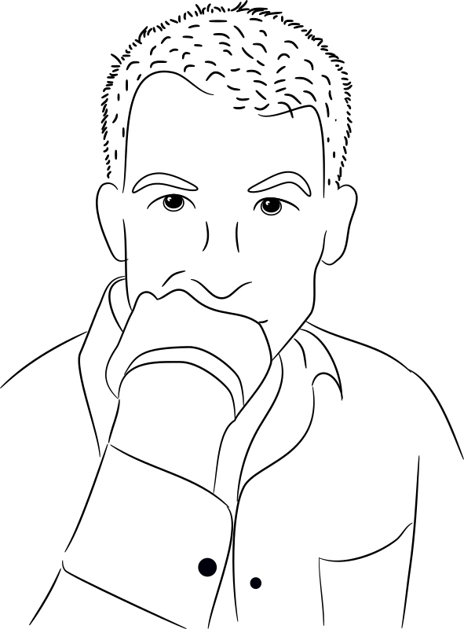
Story continues….
I could not find any damage in the idol.
“Well”
“I am unable to find any damage in this idol.
Where is the damage?”
Notes:
Notes for Teacher - < Information for further reference or explanation >
Suggestions: <Ideas/ Images/ Animations / Others – To make better representation of the content >
Source of Multimedia used in this slide - <Please provide source URL where we find the image and the license agreement>
Thnking man = Thinking – Openclipart by https://openclipart.org/artist/dear_theophilus

Slide 5
Story continues…
“There is a small scratch on the nose of the idol.”
“No one can even spot it unless you tell.
By the way, where is it going to be installed?”
Notes:
Notes for Teacher - < Information for further reference or explanation >
Suggestions: <Ideas/ Images/ Animations / Others – To make better representation of the content >
Source of Multimedia used in this slide - <Please provide source URL where we find the image and the license agreement>
Sculptor Free images : grass, plant, tools, monument, statue, craft, wood work, face, sculpture, art, artists, sculptor, woodcarving, stone carving, gouge, chainsaw carving 1686x3000 - - 558216 –
Ssculpt - SSSVV Gallery sculpt
Free images - PxHereTravellor - Businessman Attacher - Free vector images on Pixabay by OpenClipart-Vectors

Slide 6
Story continues…
It would be installed on the top of a fifteen feet top pillar.
In that case, no one will know.
Why do you exert yourself?
Notes:
Notes for Teacher - < Information for further reference or explanation >
Suggestions: <Ideas/ Images/ Animations / Others – To make better representation of the content >
Source of Multimedia used in this slide - <Please provide source URL where we find the image and the license agreement>
Sculptor - Free images : grass, plant, tools, monument, statue, craft, wood work, face, sculpture, art, artists, sculptor, woodcarving, stone carving, gouge, chainsaw carving 1686x3000 - - 558216 - Free images – PxHere
Sculpt – SSSVV Gallery
Travellor - Businessman Attacher - Free vector images on Pixabay by OpenClipart-Vectors

Slide 7
Story continues…
.
“Others may not know, but I know, and the Lord knows it.
Whatever work I have done till now,
I have always put in my best efforts. It gives me joy.
That is why every idol I make comes out best and it has also earned me a good name among the people in the village.
I will continue to give my best, not for people to notice but for my own satisfaction”.
Notes:
Notes for Teacher - < Information for further reference or explanation >
Suggestions: <Ideas/ Images/ Animations / Others – To make better representation of the content >
Source of Multimedia used in this slide - <Please provide source URL where we find the image and the license agreement>
Sculptor - Free images : grass, plant, tools, monument, statue, craft, wood work, face, sculpture, art, artists, sculptor, woodcarving, stone carving, gouge, chainsaw carving 1686x3000 - - 558216 - Free images - PxHere
Sculpt – SSSVV Gallery

Slide 8
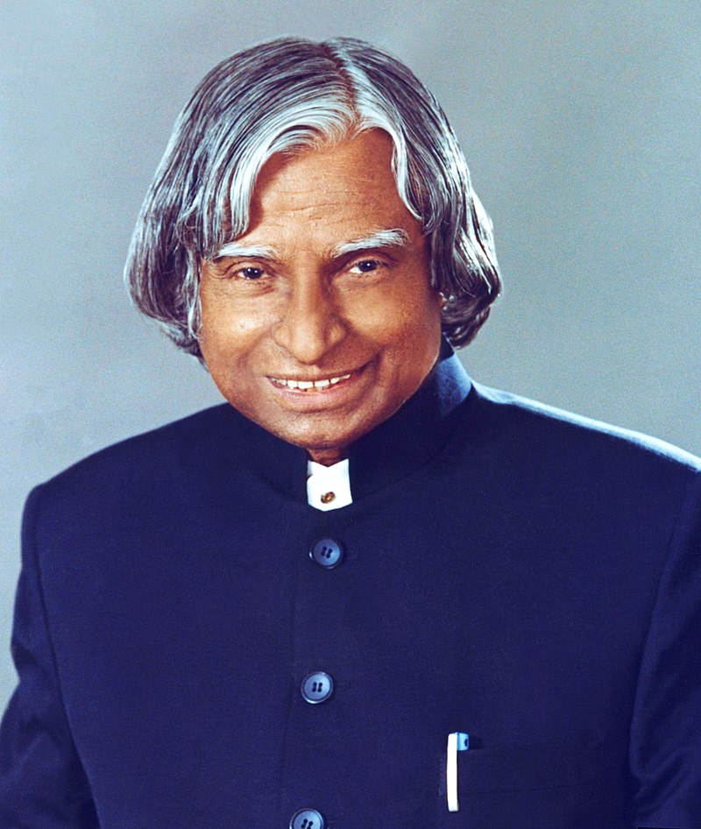
Quote ……
“We become what we repeatedly do. Excellence is a continuous process, not an accident”.
.
Notes:
Notes for Teacher - < Information for further reference or explanation >
Suggestions: <Ideas/ Images/ Animations / Others – To make better representation of the content >
Source of Multimedia used in this slide - <Please provide source URL where we find the image and the license agreement>
Dr A.P.J Abdul Kalam - A. P. J. Abdul Kalam - File:A. P. J. Abdul Kalam.jpg - Wikimedia Commons

Slide 9
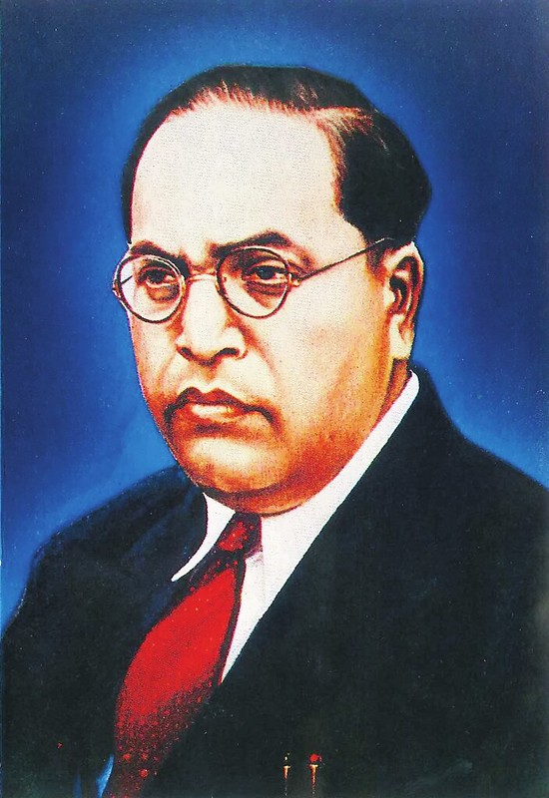
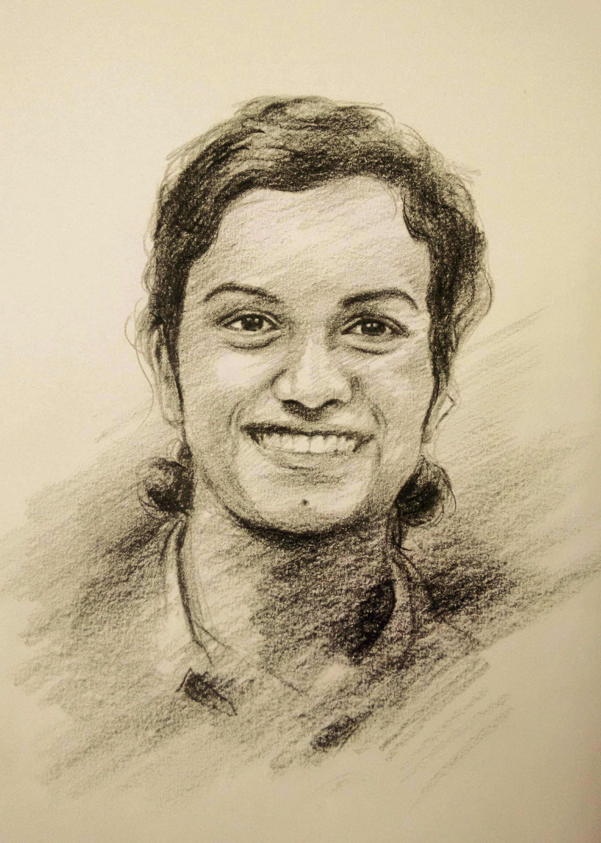
Discussion points
“We are Indians, firstly and lastly.” Dr. B.R. Ambedkar, the
Father of Indian Constitution.
“You win some and lose some. It’s all part of the game.”
P.V. Sindhu Badminton Player
“Don’t believe in luck. Believe in hard work.” Dr. A.P.J. Abdul Kalam, 11th President of India.
Notes:
Notes for Teacher - < Information for further reference or explanation >
Suggestions: <Ideas/ Images/ Animations / Others – To make better representation of the content >
Source of Multimedia used in this slide - <Please provide source URL where we find the image and the license agreement>
Ambedkar: https://www.flickr.com/photos/publicresourceorg/27786786461 by Public.Resource.Org
P.V. Sindhu - SSSVV Gallery
Dr A.P.J. Abdul Kalam - https://en.wikipedia.org/wiki/A._P._J._Abdul_Kalam#/media/File:A._P._J._Abdul_Kalam.jpg

Slide 10
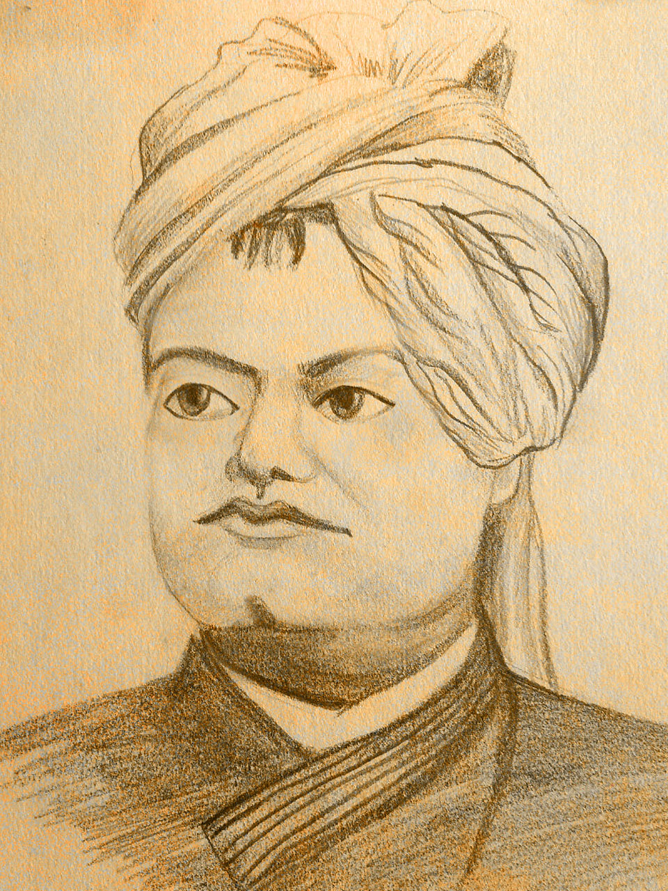
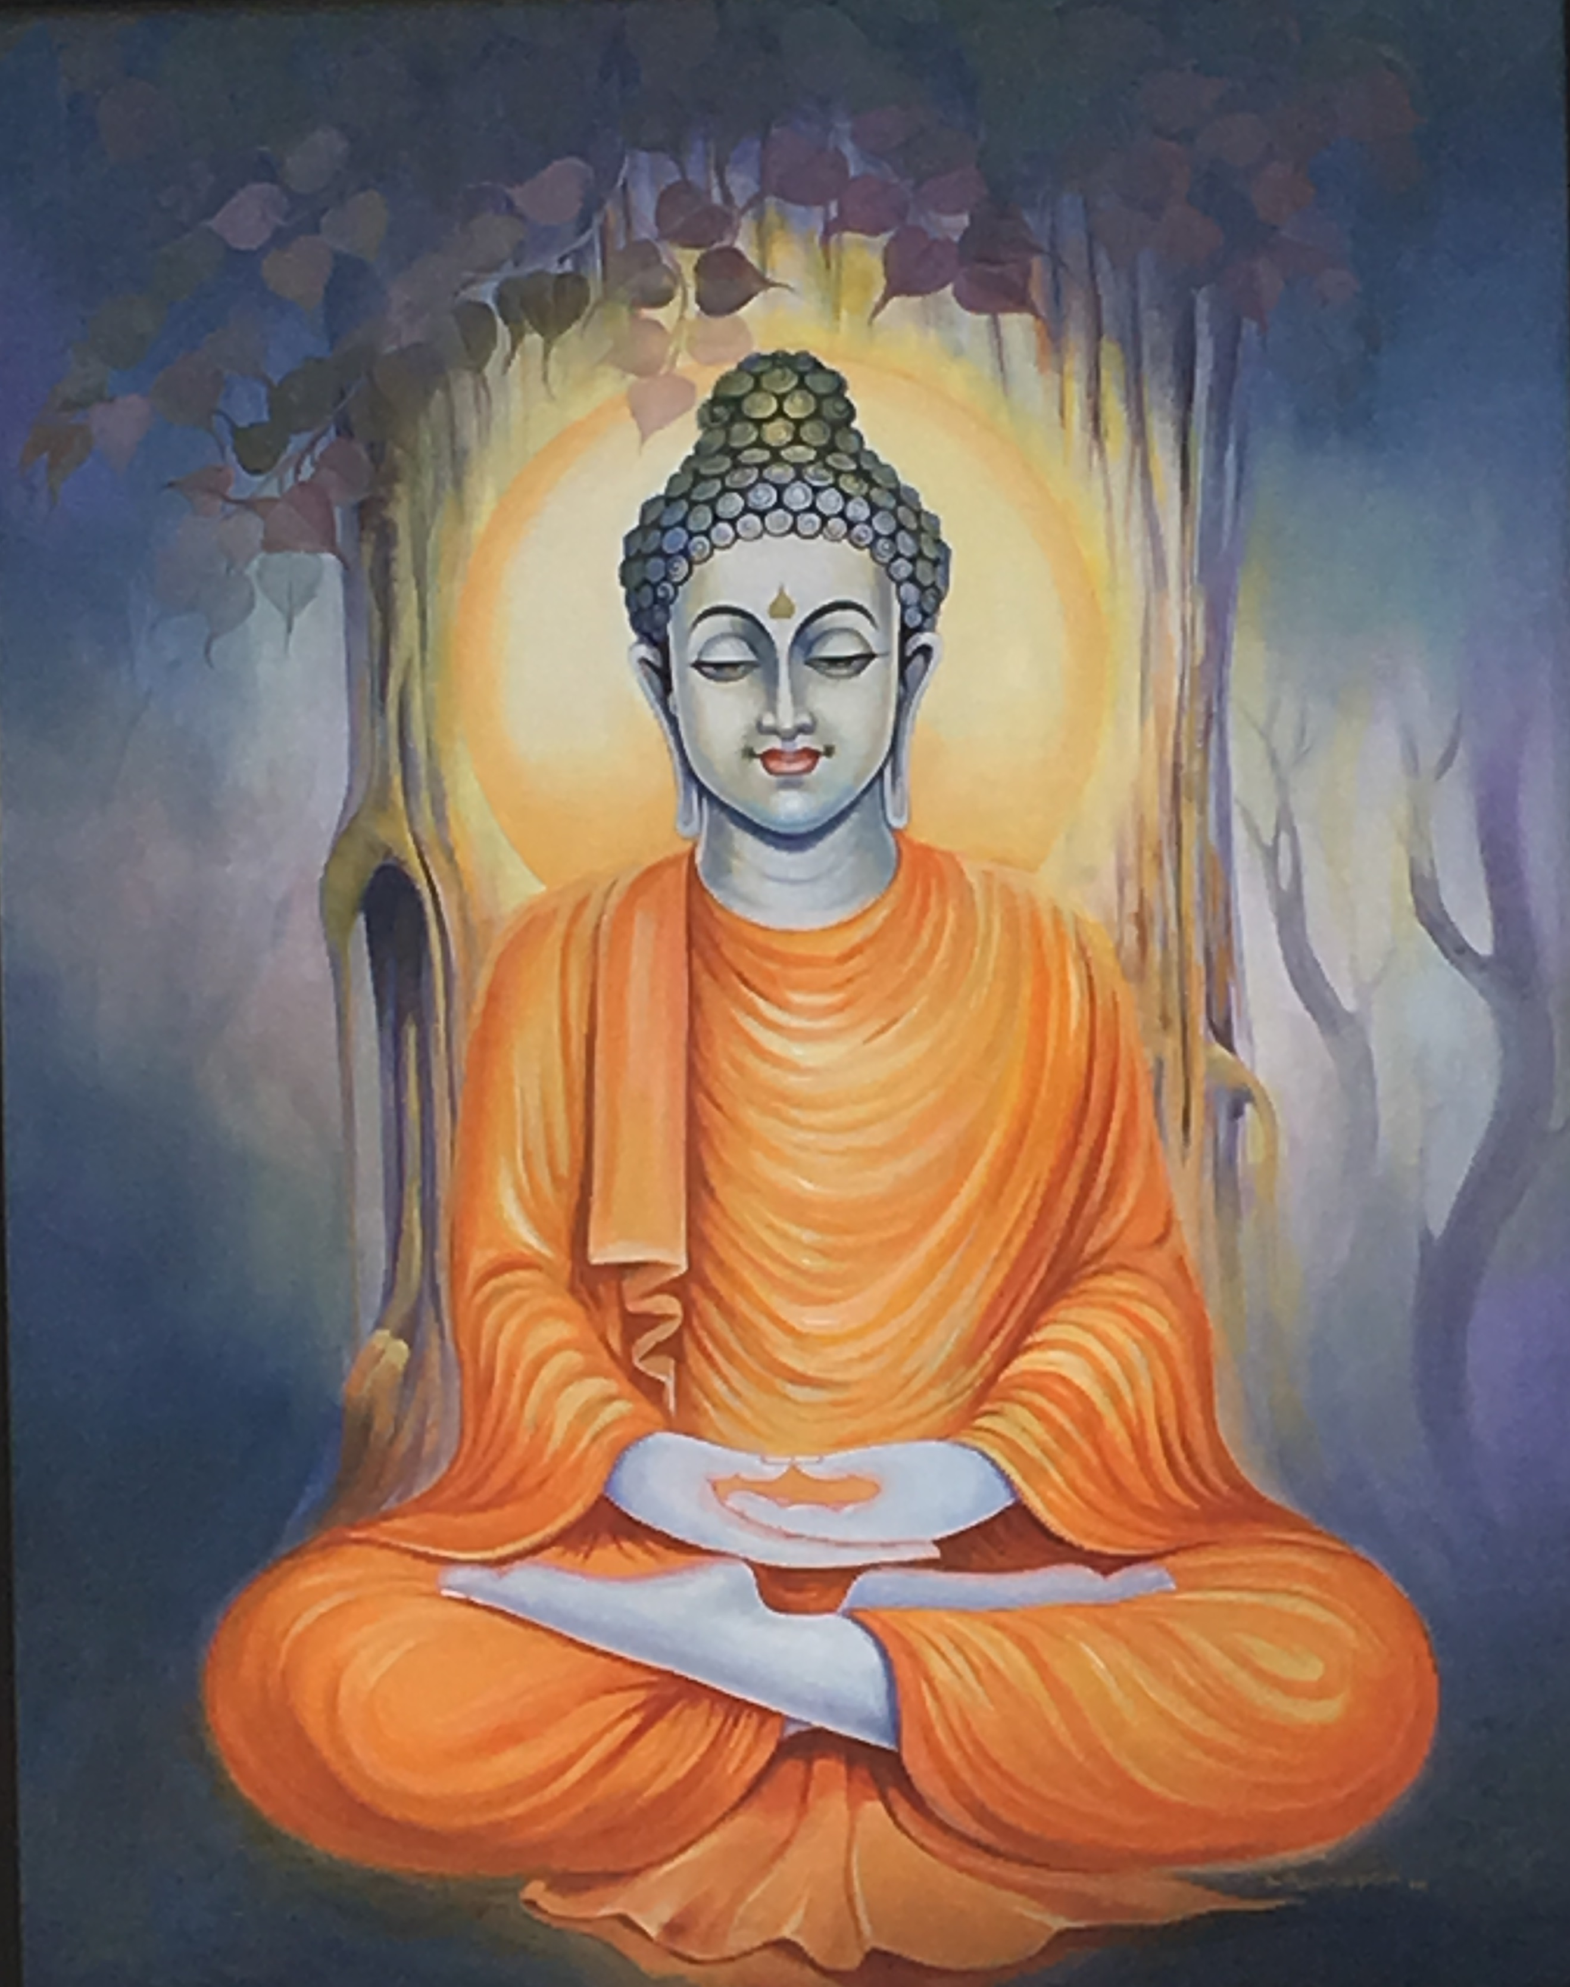
Discussion points
“I fear not the man who has practiced 10,000 kicks once, but I fear the man who has practiced one kick 10,000 times.”
Bruce Lee (Martial Artist)
“Arise, awake, and stop not until the goal is reached.” Swami Vivekananda.
(Great Indian philosopher)
“If you light a lamp for somebody, it will also brighten your path.”
Lord Gautam Buddha
Notes:
Notes for Teacher - < Information for further reference or explanation >
Suggestions: <Ideas/ Images/ Animations / Others – To make better representation of the content >
Source of Multimedia used in this slide - <Please provide source URL where we find the image and the license agreement>
Swami Vivekananda – SSSVV Gallery
Lord Gautama Buddha – SSSVV Gallery
Martial Arts: https://pixabay.com/vectors/martial-art-judo-taekwondo-fight-311021/

Slide 11
Points to Ponder/reflect
It is doing ordinary things extraordinarily well.
We should keep doing our best whether someone appreciates it or not.
1
1
3
3
5
5
2
2
4
4
Excellence is not being the best but doing one’s best.
It is a habit that we must cultivate with repeated practice.
When we do ordinary things extraordinarily well, we command the attention of the world.

Slide 12
Attribution / Citation
Slide # | Thumbnail | Source link | Author
1 |  | https://pixabay.com/vectors/attention-warning-sign-danger-303861/ | Clker-Free-Vector-Images
3,5,6,7 |  | Idols: SSSVV Gallery Sculptor: https://pxhere.com/en/photo/558216 Traveller: https://pixabay.com/fr/vectors/homme-d-affaires-homme-attacher-147092/ | PxHere OpenClipart-Vectors
4 |  | Thinking man: https://openclipart.org/detail/189626/thinking-by-dear_theophilus-189626 | Open Clipat thinking
8 |  | https://en.wikipedia.org/wiki/A._P._J._Abdul_Kalam#/media/File:A._P._J._Abdul_Kalam.jpg | GoDL India
9 |  | Ambedkar: https://www.flickr.com/photos/publicresourceorg/27786786461 by Dr A.P.J. Abdul Kalam – https://en.wikipedia.org/wiki/A._P._J._Abdul_Kalam#/media/File:A._P._J._Abdul_Kalam.jpg P.V. Sindhu - SSSVV Gallery | Public.Resource.Org GoDL India
10 |  | Lord Goutama Buddha – SSSVV Gallery Swami Vivekananda – SSSVV Gallery Kung Fu: https://pixabay.com/vectors/martial-art-judo-taekwondo-fight-311021/ | Clker-Free-Vector-Images
Notes:
Notes for Teacher - < Information for further reference or explanation >
Suggestions: <Ideas/ Images/ Animations / Others – To make better representation of the content >
Source of Multimedia used in this slide - <Please provide source URL where we find the image and the license agreement>

