Slide 1
Half a Bucket
Notes:
Notes for Teacher - < Information for further reference or explanation >
Suggestions: <Ideas/ Images/ Animations / Others – To make better representation of the content >
Source of Multimedia used in this slide - <Please provide source URL where we find the image and the license agreement>
Bucket - SSSVV Gallery
Running Tap Water: Clipart problem Robinet Hahn - Free vector images on Pixabay
Water - Water Splash Spume - Free photo on Pixabay

Slide 2
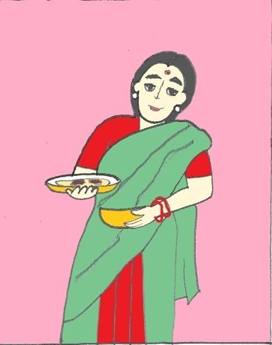
Discussion between Owner and Servant
“But I don’t know how to, Madam”,”
“Suppandi, use the new washing powder to wash the clothes,”
“Just read the instructions printed on the packet and follow them carefully.”
Notes:
Notes for Teacher - < Information for further reference or explanation >
Suggestions: <Ideas/ Images/ Animations / Others – To make better representation of the content >
Source of Multimedia used in this slide - <Please provide source URL where we find the image and the license agreement>
Woman – SSSVV GAllery
Detergent - Pink Dishwasher Kitchen - Free vector graphic on Pixabay
Man - Boy Young - Free vector graphic on Pixabay by harshal07
House = House | Free Stock Photo | Illustration of a house | # 16119 (freestockphotos.biz)

Slide 3
“What’s happening……….???”
“What’s this noise?? Let me go and see.”
“Suppandi, what are you doing?.”
Notes:
Notes for Teacher - < Information for further reference or explanation >
Suggestions: <Ideas/ Images/ Animations / Others – To make better representation of the content >
Plastic broken sound - https://pixabay.com/de/sound-effects/search/plastic/ Bathroom - laundry room | Shot on Canon Rebel 2000 on Canon EF 50mm/f1.… | Flickr
Source of Multimedia used in this slide - <Please provide source URL where we find the image and the license agreement>
Soap water - https://www.flickr.com/photos/30478819@N08/51038109086
Broken bucket - Free Images : beach, sea, coast, sand, plastic, shore, water, abandoned, blue, material, body of water, bucket, feather, dregs, forgotten, forgotten. 4724x3264 - - 1084163 - Free stock photos - PxHere
Woman – SSSVV gallery
Man - Boy Young - Free vector graphic on Pixabay by harshal07

Slide 4
Shocking moments !!!...........
“The instructions on the packet of the detergent say that the detergent must be dissolved in half a bucket of water……. So, I am cutting this bucket into half.”
“Oh! My God”!!
Notes:
Notes for Teacher - < Information for further reference or explanation >
Suggestions: <Ideas/ Images/ Animations / Others – To make better representation of the content >
Source of Multimedia used in this slide - <Please provide source URL where we find the image and the license agreement>
Woman - https://creazilla.com/nodes/38811-woman-is-falling-down-clipart
Man - Boy Young - Free vector graphic on Pixabay by harshal07
Audio - Sound Effect from <a href="https://pixabay.com/?utm_source=link-attribution&amp;utm_medium=referral&amp;utm_campaign=music&amp;utm_content=96194">Pixabay</a>

Slide 5
Attribution / Citation
Slide # | Thumbnail | Source link | Author
1 |  | Running tap – https://pixabay.com/vectors/clipart-issue-faucet-hahn-tap-1295270/ | OpenClipart-Vectors
2,3,4 |  | Woman – SSSVV Galery Man - https://pixabay.com/vectors/boy-young-man-1456758/ Detergent - https://pixabay.com/vectors/pink-dishwasher-kitchen-cleaning-304502/ House = SSSVV Gallery | Harshal07 Clker-Free-Vector-Images
3, 4 | Audio | broken sound - https://pixabay.com/de/sound-effects/search/plastic/ Broken bucket -https://pxhere.com/en/photo/1084163 Shocked lady – SSSVV gallery | Jacklimcss pxhere
4 |  | Shocked lady – SSSVV gallery
Notes:
Notes for Teacher - < Information for further reference or explanation >
Suggestions: <Ideas/ Images/ Animations / Others – To make better representation of the content >
Source of Multimedia used in this slide - <Please provide source URL where we find the image and the license agreement>

