Slide 1
The Key to Happiness
Notes:
Notes for Teacher - The teacher may use the ppt provided or write the sentences on the board and allow the students to complete the exercise. Once completed, the students should be allowed to reflect on the sentences made, to appreciate the values it reinforces. The students will be able to infer that the value of understanding one another will give happiness and joy when applied in their daily lives.
Suggestions: Not applicable
Source of Multimedia used in this slide - Not applicable

Slide 2
Introduction
Subjects and verbs must agree with one another in number (singular or plural).
So, we too should be understanding with others and work together for our own happiness and joy.
Notes:
Notes for Teacher – Not applicable
Suggestions: Not applicable
Source of Multimedia used in this slide - Not applicable

Slide 3
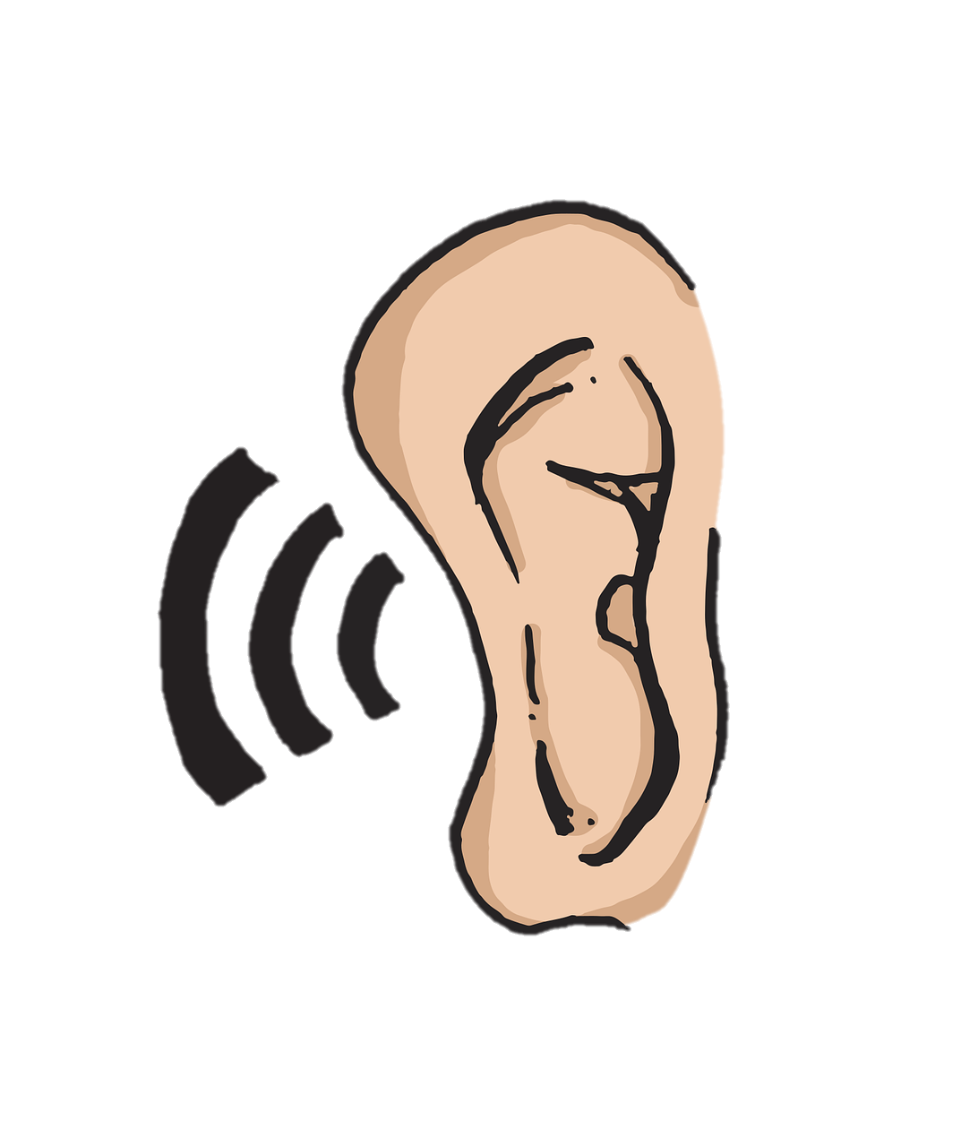
Choose the right answer
Mary always to others before she speaks.
(listen / listens)
listens
Click for answer
We need to be good listeners to understand others’ views and ideas.
Notes:
Notes for Teacher – Not applicable
Suggestions: Not applicable
Source of Multimedia used in this slide - https://pixabay.com/vectors/ear-sound-listen-5204373/
Hand – PPT icon

Slide 4
Choose the right answer
Ram and Shyam their money to help the needy.
(save / saves)
save
Click for answer
We should always support and help those who are in need.
Notes:
Notes for Teacher – Not applicable
Suggestions: Not applicable
Source of Multimedia used in this slide - https://pixabay.com/illustrations/rupees-giving-giving-money-donating-4698727/
Hand – PPT icon

Slide 5
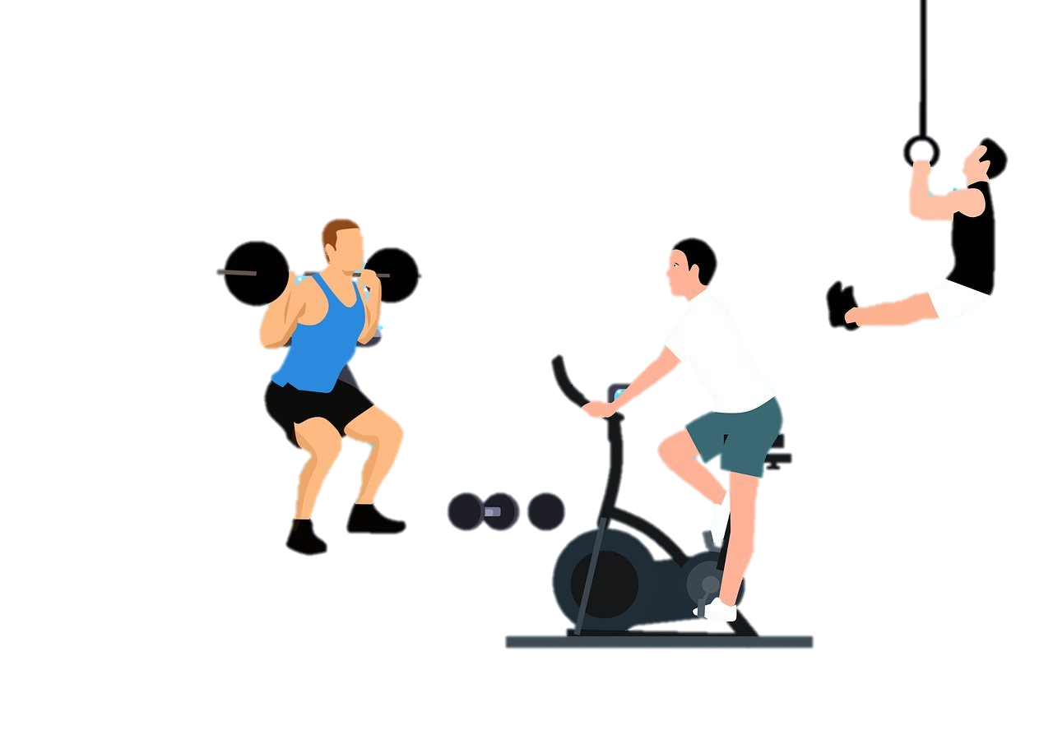
Choose the right answer
Teacher her students to exercise regularly.
(encourage / encourages)
encourages
Click for answer
Always encourage others to get the best out of them.
Notes:
Notes for Teacher – Not applicable
Suggestions: Not applicable
Source of Multimedia used in this slide - https://pixabay.com/illustrations/gym-exercise-fitness-health-7397553/
Hand – PPT icon

Slide 6
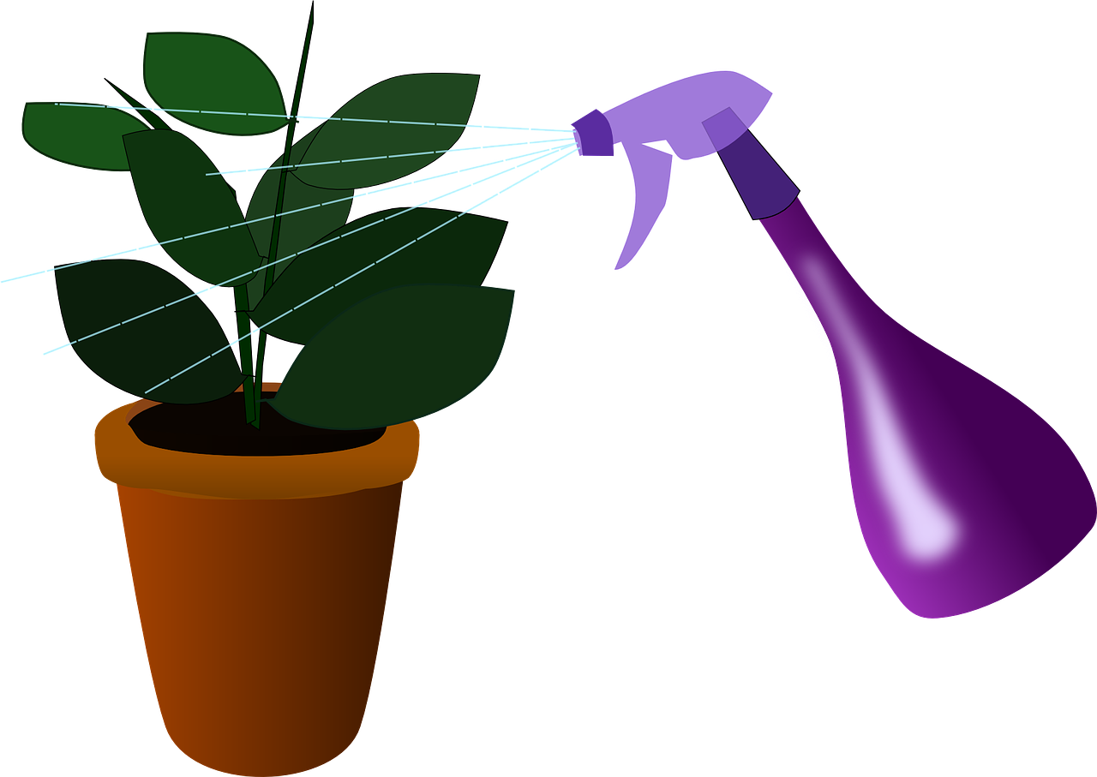
Choose the right answer
loves
John to grow, care for and water the plants around him.
(love / loves)
Click for answer
Caring for everything around us is a very good quality.
Notes:
Notes for Teacher – Not applicable Suggestions: Not applicable
Source of Multimedia used in this slide - https://pixabay.com/vectors/houseplant-plant-watering-155455/
Hand – PPT icon

Slide 7
Choose the right answer
The players in the team each other’s opinion.
(respect / respects)
respect
Click for answer
To respect others' opinions shows our understanding and respect for them.
Notes:
Notes for Teacher – Not applicable Suggestions: Not applicable
Source of Multimedia used in this slide - https://pixabay.com/illustrations/handshake-regard-cooperate-connect-2009183/
Hand – PPT icon

Slide 8
Attribution / Citation
Slide # | Thumbnail | Source link | Author
3 |  | https://pixabay.com/vectors/ear-sound-listen-5204373/ | MoteOo
4 |  | https://pixabay.com/illustrations/rupees-giving-giving-money-donating-4698727/ | shatadip7
5 |  | https://pixabay.com/illustrations/gym-exercise-fitness-health-7397553/ | mohamed_hassan
6 |  | https://pixabay.com/vectors/houseplant-plant-watering-155455/ | OpenClipart-Vectors
7 |  | https://pixabay.com/illustrations/handshake-regard-cooperate-connect-2009183/ | johnhain
COPYRIGHT Cum DISCLAIMER NOTICE
Content owned by Sri Sathya Sai Central Trust, Prashanthi Nilayam, Puttaparthi, Sathya Sai District, Andhra Pradesh, India.
Strictly not for Commercial Use, excluding content that falls in Public Domain or common knowledge facts.
Content can be downloaded and used for personal, educational, informational and other non-commercial purposes, subject to attribution in the name of ‘Sri Sathya Sai Central Trust, Prashanthi Nilayam, Puttaparthi’ only. Any attempt to remove, alter, circumvent, or distort the data that is accessed is illegal and strictly prohibited.
Some of the content is owned by Third Parties and are used in compliance with their licensing conditions. Anyone infringing the Copyright of such Third Parties will be doing so at their own risks and costs.
Notes:
Notes for Teacher - Not applicable
Suggestions: Not applicable
Source of Multimedia used in this slide - Not applicable

