Slide 1
We Can
Notes:
Notes for Teacher - < Information for further reference or explanation >
Suggestions: <Ideas/ Images/ Animations / Others – To make better representation of the content >
Source of Multimedia used in this slide - <Please provide source URL where we find the image and the license agreement>
Kids : https://www.freepik.com/free-vector/sample-text-template-with-kids-reading-books_1503217.htm#query=happy%20child%20learning&position=22&from_view=search&track=ais (brgfx)

Slide 2
Make ten sentences using the table given below
1 | Rahul and Sathya | is | school today.
2 | Birds | are | our teeth twice a day.
3 | The owls | has | waiting for the bus.
4 | Bina | have | awake at night.
5 | We | stay | playing in the garden.
6 | The policemen | were | controlling the traffic.
7 | My grandparents | brush | dancing on stage.
8 | His father | go | chirping on the tree.
9 | The children | goes | healthy habits.
10 | They | was | with us.
Notes:
Notes for Teacher - : The teacher may use the pdf provided and take copies of the same and distribute it to the students or may also write the conjugation table on the blackboard.
Suggestions: <Ideas/ Images/ Animations / Others – To make better representation of the content >
Source of Multimedia used in this slide - <Please provide source URL where we find the image and the license agreement>

Slide 3
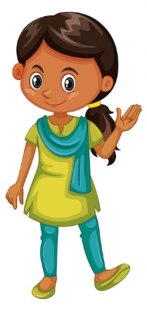
Sample Sentences
Click here for some sample sentences
4. Bina is dancing on stage.
3. The owls are awake at night.
2. Birds are chirping on the tree.
1. Rahul and Sathya are playing in the garden.
Notes:
Notes for Teacher - : < Information for further reference or explanation >
Suggestions: <Ideas/ Images/ Animations / Others – To make better representation of the content >
Source of Multimedia used in this slide - <Please provide source URL where we find the image and the license agreement>
Girl : https://www.freepik.com/free-vector/cute-happy-smiling-child-isolated-white_5934381.htm#query=indian%20kids&position=10&from_view=search&track=ais : (brgfx)
Kids : https://www.maxpixel.net/Stick-People-Childrens-Playground-Slide-Swing-5067156 (maxpixel)
Birds : https://www.freepik.com/free-vector/hand-drawing-tropical-birds-background_900334.htm#query=birds%20on%20tree&position=9&from_view=keyword&track=ais (freepik)
Owl : https://www.freepik.com/free-vector/elf-owl-standing-branch-cartoon-style-isolated-white-background_16254154.htm#query=owl&position=5&from_view=keyword&track=sph (brgfx)
Dancing : https://www.freepik.com/free-vector/indian-woman-dancing_1036080.htm#query=indian%20classical%20dance&position=0&from_view=keyword&track=ais (ddraw)
Arrow : ppt icon

Slide 4
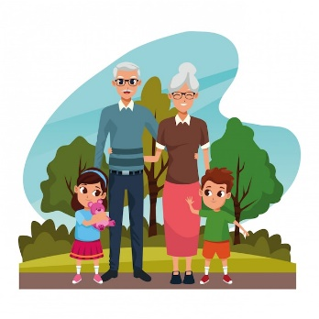
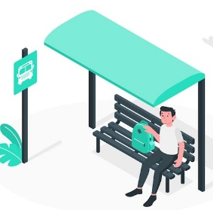
Sample Sentences
Click here for some sample sentences
5. We brush our teeth twice a day.
6. The policemen are controlling the traffic.
7. My grandparents stay with us.
8. His father is waiting for the bus.
Notes:
Notes for Teacher - : < Information for further reference or explanation >
Suggestions: <Ideas/ Images/ Animations / Others – To make better representation of the content >
Source of Multimedia used in this slide - <Please provide source URL where we find the image and the license agreement>
Boy : https://www.freepik.com/free-vector/sticker-design-with-boy-brushing-his-tooth-cartoon-character_16460093.htm#page=2&query=brushing%20teeth&position=6&from_view=search&track=ais (brgfx)
Traffic : https://www.freepik.com/free-vector/police-officer-regulating-traffic-set-policeman-stopping-standing-with-camera-device-showing-stop-sign-giving-signal-drive-safe-driving-vector-illustration-man-uniform-white-background_23591792.htm#query=police%20traffic%20stop&position=34&from_view=search&track=ais (studio4rt)
Kids : https://www.freepik.com/free-vector/grandparents-with-grandsons-park_4889850.htm#query=grandparents%20with%20kids&position=48&from_view=search&track=ais (jemastock)
Father : https://www.freepik.com/free-vector/bus-stop-concept-illustration_5357401.htm#page=2&query=public%20transport%20stop&position=2&from_view=search&track=ais (storyset)

Slide 5
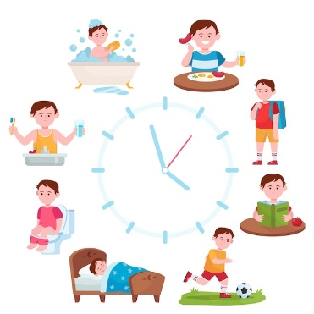
Sample Sentences
Click here for some sample sentences
9. The children have healthy habits.
10. They have school today.
Notes:
Notes for Teacher - : < Information for further reference or explanation >
Suggestions: <Ideas/ Images/ Animations / Others – To make better representation of the content >
Source of Multimedia used in this slide - <Please provide source URL where we find the image and the license agreement>
Habits : https://www.freepik.com/free-vector/child-daily-routine-clocks_9174425.htm#query=healthy%20habits%20kids&position=2&from_view=search&track=ais (pch.vector)
School : https://pixabay.com/illustrations/children-school-children-boy-girl-965506/ (hrohmann)
Dog : https://pixabay.com/vectors/puppy-dog-leashed-dog-leash-pet-32025/ (Clker-Free-Vector-Images)

Slide 6
Attribution / Citation
Slide # | Thumbnail | Source link | Author
1 |  | Kids : https://www.freepik.com/free-vector/sample-text-template-with-kids-reading-books_1503217.htm | brgfx
3, 4, 5 |  | Girl : https://www.freepik.com/free-vector/cute-happy-smiling-child-isolated-white_5934381.htm Kids : https://www.maxpixel.net/Stick-People-Childrens-Playground-Slide-Swing-5067156 (maxpixel) Birds : https://www.freepik.com/free-vector/hand-drawing-tropical-birds-background_900334.htm Owl : https://www.freepik.com/free-vector/elf-owl-standing-branch-cartoon-style-isolated-white-background_16254154.htm Dancing : https://www.freepik.com/free-vector/indian-woman-dancing_1036080.htm | brgfx maxipixel freepik Brgfx Ddraw
4 |  | Boy : https://www.freepik.com/free-vector/sticker-design-with-boy-brushing-his-tooth-cartoon-character_16460093.htm Traffic : https://www.freepik.com/free-vector/police-officer-regulating-traffic-set-policeman-stopping-standing-with-camera-device-showing-stop-sign-giving-signal-drive-safe-driving-vector-illustration-man-uniform-white-background_23591792.htm Kids : https://www.freepik.com/free-vector/grandparents-with-grandsons-park_4889850.htm Father : https://www.freepik.com/free-vector/bus-stop-concept-illustration_5357401.htm | brgfx studio4rt jemastock storyset
5 |  | Habits : https://www.freepik.com/free-vector/child-daily-routine-clocks_9174425.htm School : https://pixabay.com/illustrations/children-school-children-boy-girl-965506/ (hrohmann) | Pch,vector Hrohmann
Notes:
Notes for Teacher - < Information for further reference or explanation >
Suggestions: <Ideas/ Images/ Animations / Others – To make better representation of the content >
Source of Multimedia used in this slide - <Please provide source URL where we find the image and the license agreement>

