Slide 1
Remember Me?
Notes:
Notes for Teacher – N/A
Suggestions: N/A
Source of Multimedia used in this slide - <Please provide source URL where we find the image and the license agreement>
Remember icon -PPT

Slide 2
Can you identify the TENSES?
My mother cooks new dishes for me.
Simple Present Tense
Answer
My parents went for the film yesterday.
Simple Past Tense
Answer
My father is going to the office.
Present Continuous Tense
Answer
Notes:
Notes for Teacher – N/A
Suggestions: N/A
Source of Multimedia used in this slide -
Hand: PPT Icon

Slide 3
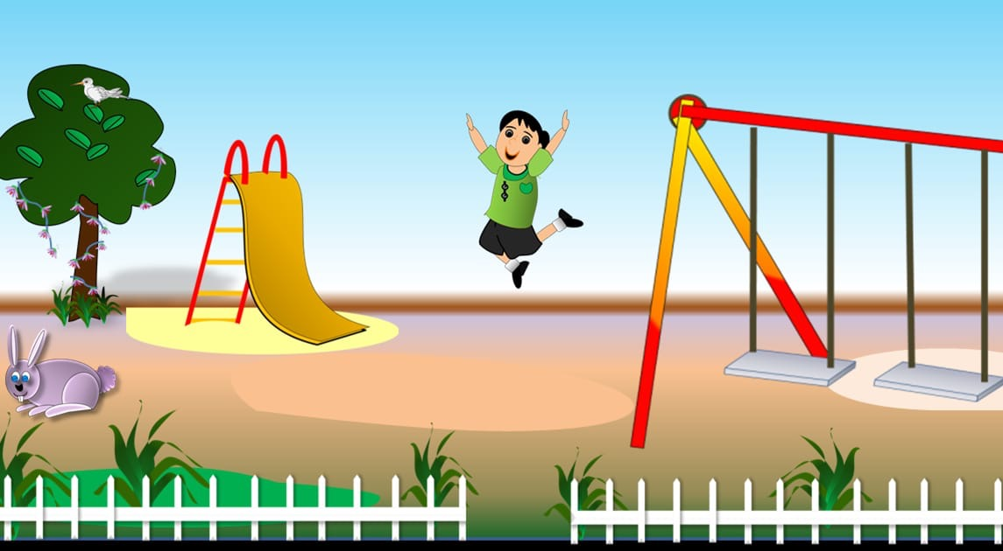
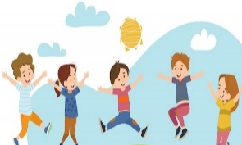
Can you identify the TENSES?
Simple Present Tense
Click for the Tense
All my friends jump with me in the park.
I never jump in my bed.
Notes:
Notes for Teacher – The teacher could now show the pictures wherein the time of action is mentioned and pick students (encouraging the shy students who generally don’t speak up along with the smart ones) and ask them to identify the tense to be used in the given situations (Yesterday - past tense, everyday - present tense, always - present tense, last week - past tense, a few days ago - past tense, etc.) and make complete sentences orally.
Suggestions: N/A
Source of Multimedia used in this slide -
Girl jumping : https://www.freepik.com/free-vector/two-girls-having-pillow-fight_4567210.htm (Attribution:brgfx)
Garden : SSSVV Image Gallery: Search Keyword “jump”
Children jumping: https://www.freepik.com/free-vector/happy-children-jumping-summer-meadow_8609202.htm (Attribution: pch-vector)
Hand: PPT Icon

Slide 4
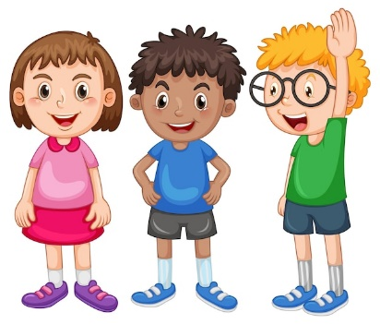
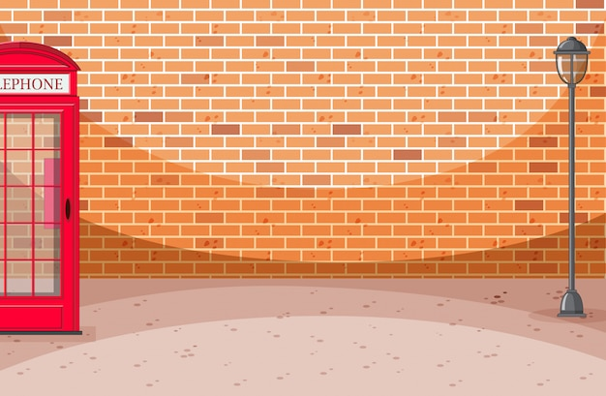
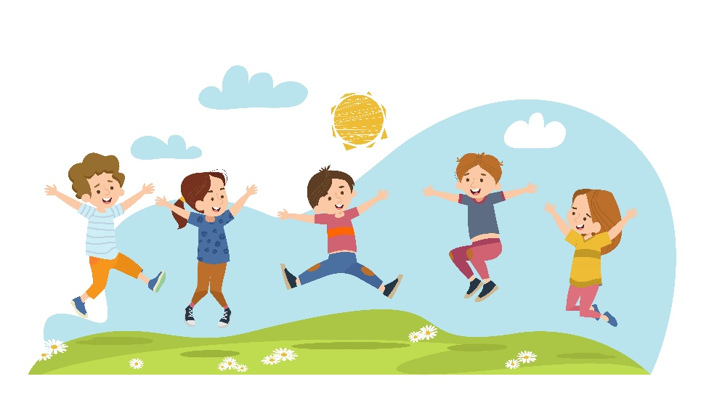
Can you identify the TENSES?
Simple Past Tense
Click for the Tense
We jumped with our friends yesterday.
She jumped with me in the field yesterday.
Notes:
Notes for Teacher – The teacher could now show the pictures wherein the time of action is mentioned and pick students (encouraging the shy students who generally don’t speak up along with the smart ones) and ask them to identify the tense to be used in the given situations (Yesterday - past tense, everyday - present tense, always - present tense, last week - past tense, a few days ago - past tense, etc.) and make complete sentences orally.
Suggestions: N/A
Source of Multimedia used in this slide -
Kids: https://www.freepik.com/free-vector/three-happy-kids-standing_26213026.htm (Attribution:brgfx)
Wall: https://www.freepik.com/free-vector/brick-wall-street-scene-with-telephon-box_9741605.htm (Attribution:brgfx)
Girls jumping : https://www.freepik.com/free-vector/happy-children-jumping-summer-meadow_8609202.htm (Attribution: @pch.vector)
Hand: PPT Icon

Slide 5
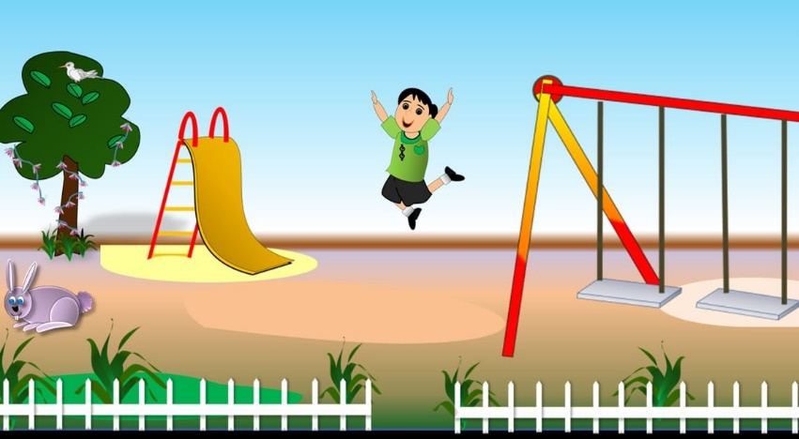
Can you identify the TENSES?
Present Continuous Tense
Click for Tense
She is always jumping with her brother.
I am jumping in the garden.
Notes:
Notes for Teacher – The teacher could now show the pictures wherein the time of action is mentioned and pick students (encouraging the shy students who generally don’t speak up along with the smart ones) and ask them to identify the tense to be used in the given situations (Yesterday - past tense, everyday - present tense, always - present tense, last week - past tense, a few days ago - past tense, etc.) and make complete sentences orally.
Suggestions: N/A
Source of Multimedia used in this slide -
Kids: https://www.freepik.com/free-vector/three-happy-kids-standing_26213026.htm (Attribution:brgfx)
Boy Jump: SSSVV Image Gallery: Search Keyword “jump”
Hand: PPT Icon

Slide 6
Can you identify the TENSES?
Past Continuous Tense
Click for Tense
She was jumping with her friends.
He was jumping with the monkey.
Notes:
Notes for Teacher – The teacher could now show the pictures wherein the time of action is mentioned and pick students (encouraging the shy students who generally don’t speak up along with the smart ones) and ask them to identify the tense to be used in the given situations (Yesterday - past tense, everyday - present tense, always - present tense, last week - past tense, a few days ago - past tense, etc.) and make complete sentences orally.
Suggestions: N/A
Source of Multimedia used in this slide -
Girls jumping : https://www.freepik.com/free-vector/two-girls-having-pillow-fight_4567210.htm (Attribution:brgfx)
Boy : https://www.freepik.com/free-vector/set-happy-multiethnic-preschool-boys-standing-different-action_29006602.htm (Attribution: jcomp)
Monkey : https://www.freepik.com/free-vector/monkey-hanging-tree-branch-cartoon-character-sticker_20770388.htm (Attribution:brgfx)
Hand: PPT Icon

Slide 7
MM Index
Slide # | Thumbnail | Source link and Attribution
3 |  | Girl jumping : https://www.freepik.com/free-vector/two-girls-having-pillow-fight_4567210.htm (Attribution:brgfx)
3, 4, 6 |  | Children jumping: https://www.freepik.com/free-vector/happy-children-jumping-summer-meadow_8609202.htm (Attribution: pch-vector)
4, 5 |  | Kids: https://www.freepik.com/free-vector/three-happy-kids-standing_26213026.htm (Attribution:brgfx)
4 |  | Wall: https://www.freepik.com/free-vector/brick-wall-street-scene-with-telephon-box_9741605.htm (Attribution:brgfx)
6 |  | Boy : https://www.freepik.com/free-vector/set-happy-multiethnic-preschool-boys-standing-different-action_29006602.htm (Attribution: jcomp) Monkey : https://www.freepik.com/free-vector/monkey-hanging-tree-branch-cartoon-character-sticker_20770388.htm (Attribution:brgfx)
Notes:
Notes for Teacher - < Information for further reference or explanation >
Suggestions: <Ideas/ Images/ Animations / Others – To make better representation of the content >
Source of Multimedia used in this slide - <Please provide source URL where we find the image and the license agreement>

