Slide 1
Know the ING-Tenses
Notes:
Notes for Teacher – N/A
Suggestions: N/A
Source of Multimedia used in this slide - N/A

Slide 2
Past Continuous Tense
Actions in the past which were ongoing.
Subject
helping verb
Verb + ing
I/She/He/They/It/We
was/were
reading/playing/singing
Notes:
Notes for Teacher - < The teacher could begin the class with a detailed explanation of the verb form used in the Past Continuous Tense with the required rules. A set of six sentences will be given to the students and they will be asked to identify the verbs and tenses used. She/he could go into the details about the use of auxiliary verbs (referred to as ‘helping verbs’ here) to enable the students to understand the changes occurring with the number of the subject. The pictorial description given in the GO and the PPT could enable easy understanding of the topic. The teacher can prepare a flow chart and use it in the class and can use black board to add value to the explanation.>
Suggestions: N/A
Source of Multimedia used in this slide - N/A

Slide 3
Past Continuous Tense
For example: I was walking yesterday.
Actions in the past which were ongoing.
Subject
Subject | helping verb | Verb + ing
I/She/he/they/it/we | was/were | reading/playing/singing
Notes:
Notes for Teacher - < The teacher could begin the class with a detailed explanation of the verb form used in the Past Continuous Tense with the required rules. A set of six sentences will be given to the students and they will be asked to identify the verbs and tenses used. She/he could go into the details about the use of auxiliary verbs (referred to as ‘helping verbs’ here) to enable the students to understand the changes occurring with the number of the subject. The pictorial description given in the GO and the PPT could enable easy understanding of the topic. The teacher can prepare a flow chart and use it in the class and can use black board to add value to the explanation.>
Suggestions: N/A
Source of Multimedia used in this slide - N/A

Slide 4
Past Continuous Tense
Subject | Helping Verbs | Verb + ing
I | was | reading playing singing
She | was
He | was
It | was
They | were | reading/singing/playing
We | were | singing / reading /playing
Notes:
Notes for Teacher – N/A
Suggestions: N/A
Source of Multimedia used in this slide - N/A

Slide 5
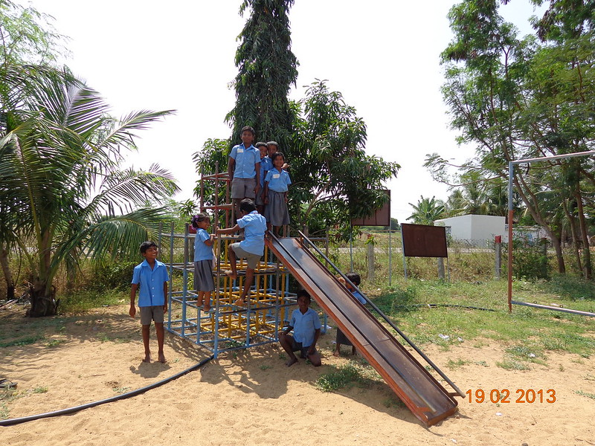
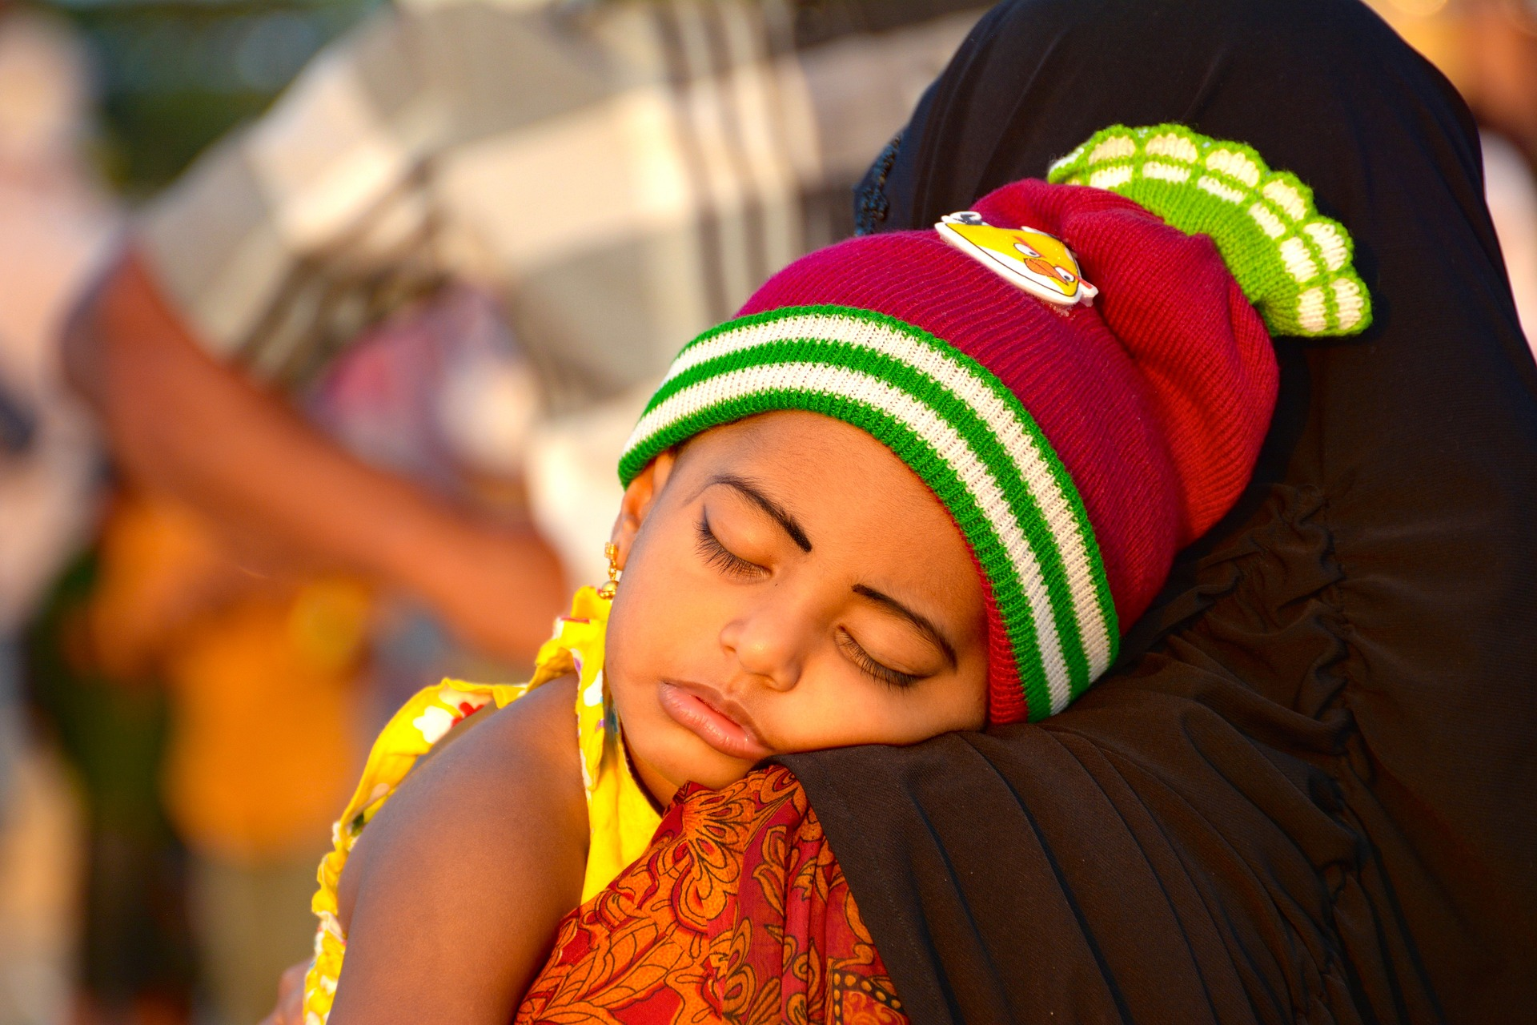
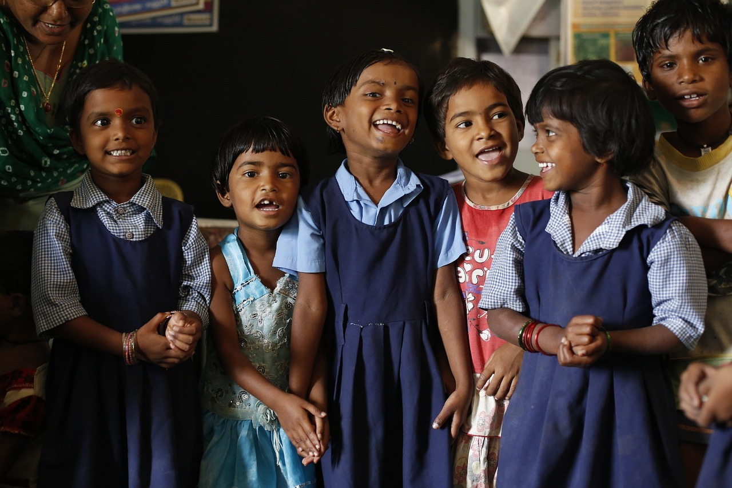
Basic rules for changing spellings
Rule : 1 Verbs to which only ‘ing’ is added
Paint
Painting
Colour
Colouring
Play
ing
Playing
Sleep
Sleeping
Laugh
Laughing
Jump
Jumping
Notes:
Notes for Teacher – N/A
Suggestions: N/A
Source of Multimedia used in this slide -
Playing: https://www.flickr.com/photos/92053708@N03/8644431472 By Global Partnership for Education – GPE
Laugh: https://pixabay.com/photos/children-india-education-classroom-876543/
Read: https://pixabay.com/photos/children-infant-girl-school-306607/
Sleep: https://pixabay.com/photos/sleep-sleeping-child-india-sunset-4984130/

Slide 6
Basic rules for changing spellings
Rule 2: For one syllable words which end with ‘consonant’-‘vowel’-‘consonant’
Double the last consonant
Add ‘ing’
Run
Sit
Run
ing
Sit
ing
n
t
Running
sitting
Notes:
Notes for Teacher – N/A
Suggestions: N/A
Source of Multimedia used in this slide - N/A

Slide 7
Basic rules for changing spellings
Rule 2: For one syllable words which end with ‘consonant’-‘vowel’-‘consonant’
Double the last consonant
Add ‘ing’
Run | +n + ing | Running
Mop | +p + ing | Mopping
Hop | +p + ing | Hopping
Stop | +p + ing | Stopping
Sit | +t + ing | Sitting
Clap | +p + ing | Clapping
Notes:
Notes for Teacher – N/A
Suggestions: N/A
Source of Multimedia used in this slide - N/A

Slide 8
Basic rules for changing spellings
Rule 3: For verbs that end with the vowel ‘e’
Drop ‘e’
Add ‘ing’
Smile
Write
Bake
Smil (e)
+
ing
Writ (e)
+
ing
Bak (e)
+
ing
Smiling
Writing
Baking
Notes:
Notes for Teacher – N/A
Suggestions: N/A
Source of Multimedia used in this slide - N/A

Slide 9
Basic rules for changing spellings
Rule 3: For verbs that end with the vowel ‘e’
Drop ‘e’
Add ‘ing’
Write | -e + ing | Writing
Smile | -e + ing | Smiling
Bake | -e + ing | Baking
Bathe | -e + ing | Bathing
Love | -e + ing | Loving
Like | -e + ing | Liking
Notes:
Notes for Teacher – N/A
Suggestions: N/A
Source of Multimedia used in this slide - N/A

Slide 10
Basic rules for changing spellings
Rule 4: For verbs that end in ‘ie’
Drop the ‘ie’
Add ‘ying’
T
i
e
+
y
i
n
g
+
y
i
n
g
L
i
e
Notes:
Notes for Teacher – Animation for the example works on several clicks
Suggestions: N/A
Source of Multimedia used in this slide - N/A

Slide 11
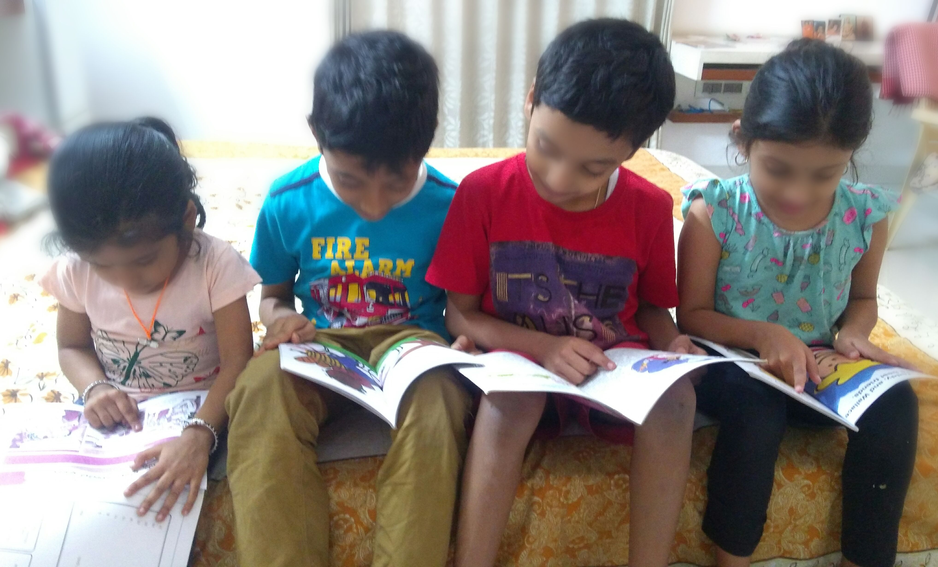
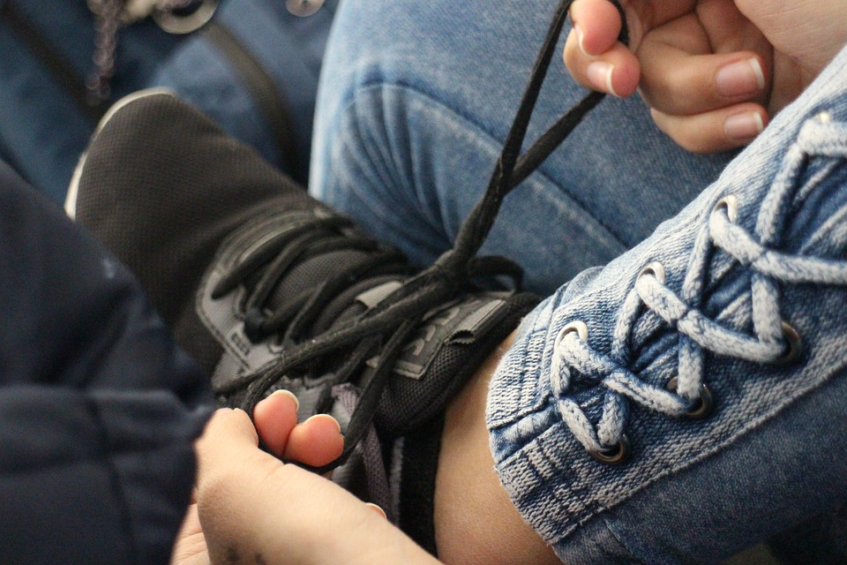
Basic rules for changing spellings
Read
Reading
Run
Running
Rule 1: Add ‘ing’
Rule 2: Double last consonant Add ‘ing’
Smile
Smiling
Tie
Tying
Rule 3: Drop ‘e’, Add ‘ing
Rule 4: Drop ‘ie’, Add ‘ying’
Notes:
Notes for Teacher – The teacher could conclude with a casual conversation in the class using Past Continuous Tense, (with proper verb forms in full sentences) as reinforcement.
Suggestions: N/A
Source of Multimedia used in this slide -
Reading – SSSVV Image Gallery: Search Keyword “story book”
Running: https://pixabay.com/photos/running-woman-race-athlete-sport-4782722/ Attribution Fotorech
Smiling: https://pixabay.com/photos/children-boy-girl-young-innocent-82272/
Tying: https://pixabay.com/photos/shoelace-tying-fingers-foot-shoe-6210942/

Slide 12
MM index
Slide # | Thumbnail | Source link and Attribution
4 |  | Playing: https://www.flickr.com/photos/92053708@N03/8644431472 By Global Partnership for Education – GPE Laugh: https://pixabay.com/photos/children-india-education-classroom-876543/ Read: https://pixabay.com/photos/children-infant-girl-school-306607/ Sleep: https://pixabay.com/photos/sleep-sleeping-child-india-sunset-4984130/
10 |  | Reading : Reading – SSSVV Image Gallery: Search Keyword “story book” Running: https://pixabay.com/photos/running-woman-race-athlete-sport-4782722/ Attribution Fotorech Smiling: https://pixabay.com/photos/children-boy-girl-young-innocent-82272/ Tying: https://pixabay.com/photos/shoelace-tying-fingers-foot-shoe-6210942/
Notes:
Notes for Teacher – N/A
Suggestions: N/A
Source of Multimedia used in this slide - N/A

