Slide 1
An Anecdote For Tense
Notes:
Notes for Teacher - < Information for further reference or explanation >
Suggestions: <Ideas/ Images/ Animations / Others – To make better representation of the content >
Source of Multimedia used in this slide - <Please provide source URL where we find the image and the license agreement>

Slide 2
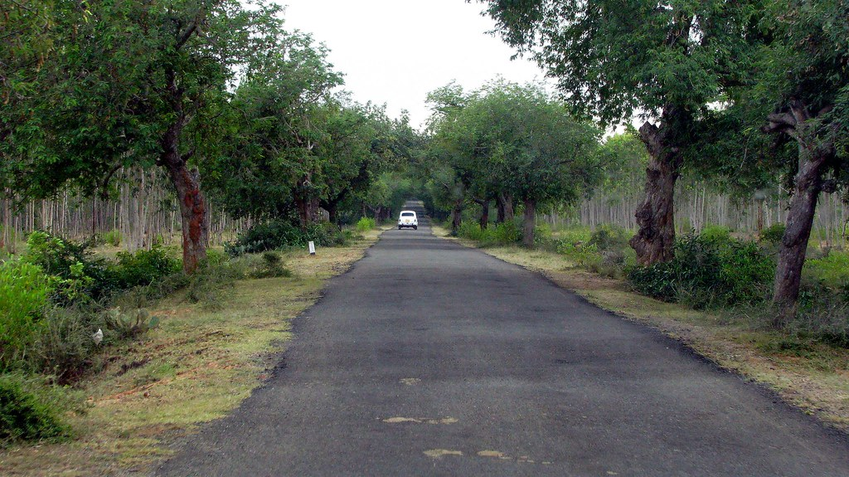
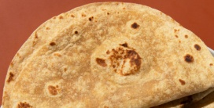
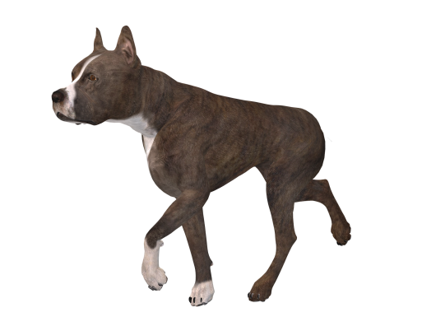
A Piece of Bread
Notes:
Notes for Teacher – There is audio added to the PPT, ensure that the speakers are connected
The teacher may begin the class with sharing an anecdote with the students to learn Grammar. She/he could interestingly differentiate between the present continuous and past continuous to bring clarity for the students with regard to the use of tenses in daily life. To set the mood the teacher could ask them to share any such incident and will help them to narrate in appropriate tense.
Suggestions: <Ideas/ Images/ Animations / Others – To make better representation of the content >
Source of Multimedia used in this slide -

Slide 3
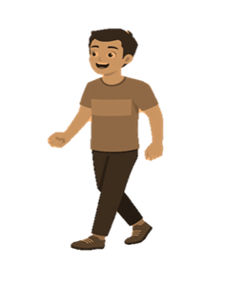
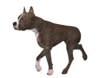
MM Index
Slide # | Thumbnail | Source link and Attribution
2 |  | Scene: https://www.flickr.com/photos/rampix/3273584782 By Ramanathan Kathiresan Black Dog: https://pixabay.com/vectors/dog-silhouette-animal-domestic-dog-1185460/ Brown Dog: https://pixabay.com/illustrations/dog-fighting-dog-dear-loyal-to-2085060/ Bread: https://www.freepik.com/free-vector/toasted-bread-slice-cartoon-sticker_17620458.htm By brgfx Roti: https://www.freepik.com/free-photo/indian-tasty-roti-composition_17662705.htm By freepik Rahul: https://www.freepik.com/free-vector/back-school-schoolboy-with-book-backpack-elementary-school-pupil-going-lesson_16495301.htm by nizovatina Man Walking: https://pixabay.com/vectors/man-walk-young-isolated-white-7184711/ Man with bag: https://pixabay.com/vectors/walking-alone-person-walk-bag-7617043/
Notes:
Notes for Teacher - < Information for further reference or explanation >
Suggestions: <Ideas/ Images/ Animations / Others – To make better representation of the content >
Source of Multimedia used in this slide - <Please provide source URL where we find the image and the license agreement>

